Slide 1
Applied Electronics And Instrumentation Engineering TECHNO INTERNATIONAL NEW TOWN New Town, Megacity, Rajarhat, Kolkata-700156 July 7 , 2020
Mind Wave Controlled Robot

Slide 2
Group Members:
Trisha Pal (Roll No. 18705516006)
Sourish Bhattacharya (Roll No. 18705516013)
Sayantan Das (Roll No. 18705516017)
Rohan Roy Chowdhury (Roll No. 18705516022)
Mrinmoy Pal (Roll No. 18705516032)
Chandrama Maulik (Roll No. 18705516045)
Under the supervision of
Prof. Nantu Das
Prof. Soumyajit Datta

Slide 3
INTRODUCTION
The communication between neurons within our brain is responsible for all our thoughts, emotions and behaviors. Brainwaves are produced by synchronized electrical pulses from masses of neurons communicating with each other.
Brainwaves are detected using sensors placed on the scalp. Our brainwaves change according to what we’re doing and feeling. When slower brainwaves are dominant we can feel tired, slow, sluggish, or dreamy.

Slide 4
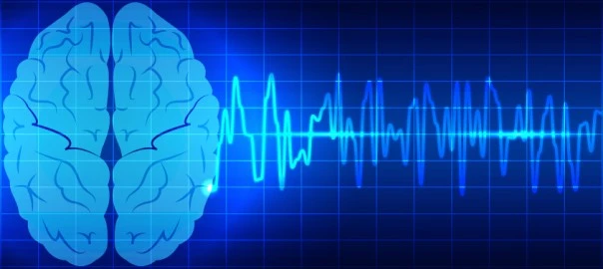
The higher frequencies are dominant when we feel wired, or hyper-alert. Brainwave speed is measured in Hertz (cycles per second) and they are divided into bands delineating slow, moderate, and fast waves.

Slide 5
MOTIVATION
Many wearable devices can track heart rate, steps etc but a new class of wearables aims work by detecting the brain's electrical activity, or brain waves, using electroencephalography (EEG).
Brainwaves are tiny electrical impulses released when a neuron fires in the brain.
The neural signals are input into a chip, and interpreted using required algorithms.
The measured electrical signals and calculated interpretations are then output as digital messages to the computer.

Slide 6
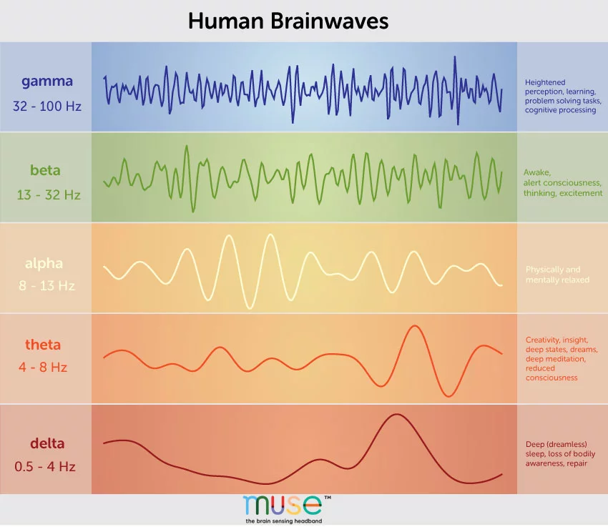
Gamma 32-100 Hz
Beta 13-32 Hz
Alpha 8-13 Hz
Theta 4-8 Hz
Delta 0.5-4 Hz
Perception, learning, problem solving task, cognitive processing.
Awake, alert consciousness, thinking, excitement
Physically and mentally relaxed
Creativity, insight, deep meditation, reduced consciousness
Deep sleep, loss of bodily awareness

Slide 7
METHODOLOGY
There are basically two Steps of this project one is connecting the mind wave to a software that can analyses the signal that comes from the Mindwave kit.
For this purpose we use a software called OpenVibe to analyze the raw signal because the raw signal is unusable by any microcontroller. OpenVibe is a software platform dedicated to designing, testing and using brain-computer interfaces.
The package includes a Designer tool to create and run custom applications, along with several pre-configured and demo programs which are ready for use.

Slide 8
So here are the methods to connect and test run the OpenVibe with the Neurosky mindwave module:
STEP 1:
The OpenVibe Acquisition Server is opened. After setup, the neurosky headset is configured.
STEP 2:
The driver is selected as ‘ Neurosky Mindset (Mindset Dev Kit 2.1+)’. The device is configured using ‘Driver Properties’.

Slide 9
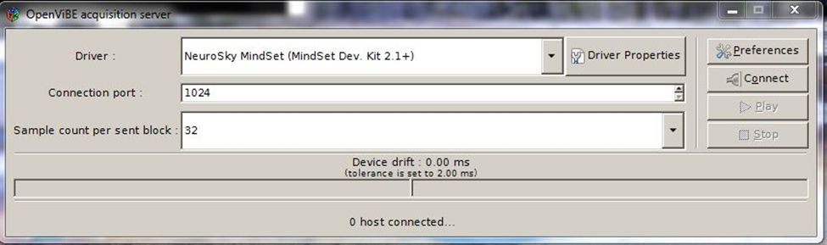
Step 2 continued…
The default connection port is advised. The sample count sent per block is set to 512. The ‘Connect’ button is pressed followed by ‘Play’ button. The Acquisition server then starts receiving data from the device and send it to the connected hosts.

Slide 10
STEP 3 :
After configuring the port and device, the OpenVibe Designer is opened. The signal acquired is then displayed.
The box algorithm named ‘Acquisition Client’ is dragged and dropped to the workspace.
To configure, the ‘Acquisition Client’ is double clicked. This process is applicable to almost all the boxes. There should be no discrepancy in the connection port value.

Slide 11
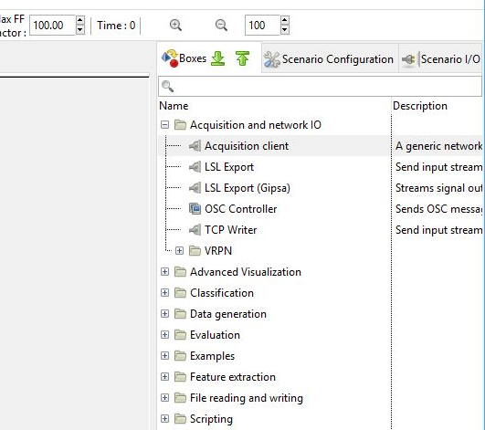
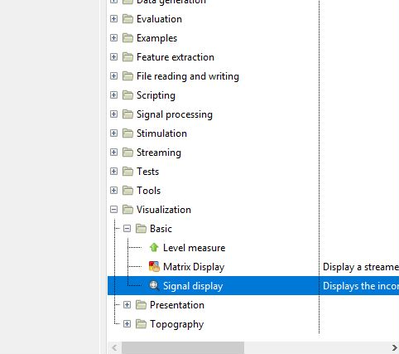
In order to get a simple visualization of EEG, we go to Visualization >> Basic Signal Display, and connect it to the ‘Acquisition Client’ box that we have already added.

Slide 12
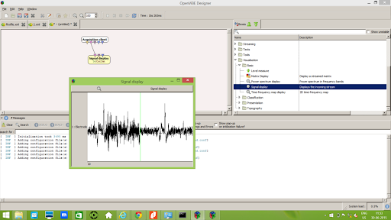
As soon as we press Play button, the Signal Display Box opens as below.

Slide 13
Second stage that is connecting a microcontroller to the OpenVibe.
This stage is done using the TCP/IP protocol.
Some important information about that TCP/IP in OpenVibe are stated bellow:
Data and stimulations can be sent using the TCP/IP protocol, The TCP/IP approach is efficient for large amounts of data. The corresponding box is called the TCP Writer.
In Acquisition Server, the Generic Telnet Reader driver can receive signal data over TCP/IP. The telnet driver can be configured to accept the TCP Writer box stream format.

Slide 14

INPUT :
The supported input stream types are StreamedMatrix, Signal and Stimulations. The stream type of the input can be changed by the user.
Type identifier : Streamed matrix (0x544a003e, 0x6dcba5f6)

Slide 15
PORT:
Port denotes the TCP port that will accept the client connections. Default is 5678.
Type identifier : Integer (0x007deef9, 0x2f3e95c6)
Default value : [ 5678 ]
OUTPUT FORMAT:
If the input is Stimulations, this setting can change the format the stimulations are sent in to the TCP socket. The choices are raw uint64, hex string, or a descriptive string. For other inputs, this setting is ignored.
Type identifier : Raw output (0x77d3e238, 0xb954ec48)

Slide 16
Process Flow:
Signal from MindWave Module
Openvibe Acquisition Client
Raw signal Analyzed by various filters
TCP/IP Box
TCP/IP configured to send data to server
Arduino collects data by TCP/IP client protocol
Converted the data to an readable data for the motor driver
Motor driver acts as the data comes in
Wheel Spins accordingly

Slide 17
LIMITATIONS
Although this communication works but there are two major limitations we have faced in this project.
As the Neurosky has to Bluetooth mode we have to implement other protocol that are complicated to implement.
The Neurosky mind wave only has one EEG sensor. So, we can only work with one signal. If there are multiple sensors then we can work with stronger signal pulses and many types to waves to control many nodes.

Slide 18
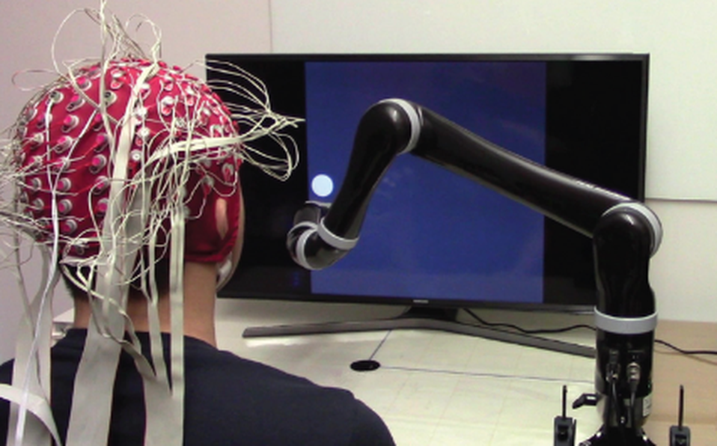
RELATED WORK
First-ever successful mind-controlled robotic arm without brain implants was done on June 19, 2019 from College of Engineering, Carnegie Mellon University. Researchers have developed the first-ever successful mind-controlled robotic arm exhibiting the ability to continuously track and follow a computer cursor.

Slide 19
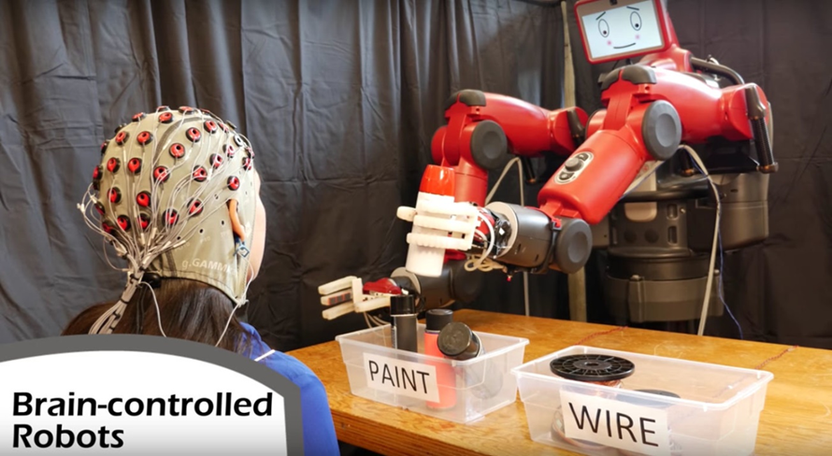
The MIT Computer Science and Artificial Intelligence Laboratory (CSAIL) program has come up with some amazing advances in robotics recently, from origami robots that transform themselves to artificial intelligence that can sense people through walls. Its newest project allows you to control a robot just by Watching it and correct mistakes with a simple hand gesture.

Slide 20
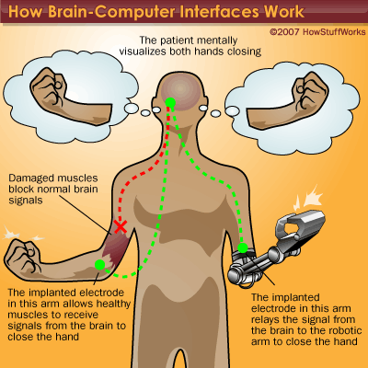
There are many more applications of the Brain Computer Interface(BCI), Like the replacement of body parts which are damaged by an accident. This will help patient to feel the artificial part as a part of the body because the are controlled by the brain of the patient.

Slide 21
CONCLUSION
This project about the brain controlled robot using the BCI protocol is the very first step to develop a fully brain controlled robot in future. Here are some prospects of this project –
On the basis of this project a robot can be developed that will controlled by an operator’s brain but working on different area where human can’t work.
Using the several brain waves created we can control my node instruments.
A brain controlled car can be made that can help those people who lost their body parts to drive a car. This is possible by measuring the brainwaves for attention and the movement of the eye ball of that person.
These are some potential applications by moving forward with our work in this project.

Slide 22
REFERENCES
The References of this project, from where information are gathered are these following links:
http://openvibe.inria.fr/
http://support.neurosky.com/discussions
https://forum.arduino.cc/
http://openvibe.inria.fr/openvibe/wp-content/uploads/2016/06/open-vibe_workshopSlidesCamille.pdf
https://evothings.com/doc/examples/arduino-led-onoff-tcp.html
https://www.ncbi.nlm.nih.gov/pmc/articles/PMC3497935/

Slide 23
THANK YOU.

