Slide 1

Driver Drowsiness Detection using CNN
Presented By
Mr. Swapnil Mahajan
TE (Computer Engineering)
Roll No. : TA65
Under the guidance of
Prof. Supriya Kamble
Department of Computer Engineering
Hope Foundations’
International Institute of Information Technology, Hinjawadi, Pune-411057
A.Y. 2023-24

Slide 2
Contents
•Introduction
•Motivation
•Literature Survey
•Summary/findings of Literature Survey
•Objectives
•Architecture of System
•Conclusion
•References

Slide 3
Topic:
Driver Drowsiness Detection using CNN

Slide 4
Introduction
Drowsiness and Road Safety
Driver drowsiness is a leading cause of road accidents globally.
Fatigue impairs reaction time, awareness, and decision-making.
Difficult to detect using traditional methods like steering pattern or lane tracking.
Need for Intelligent Detection
Conventional techniques are often inaccurate or require expensive external sensors.
There is a need for a non-intrusive, cost-effective, real-time solution.
Role of Computer Vision & Deep Learning
Computer vision enables real-time facial analysis using just a webcam.
Convolutional Neural Networks (CNNs) excel at detecting visual patterns like closed eyes and yawning.

Slide 5
Overview of the Proposed System
Uses Haar cascade classifiers for face and eye detection.
Frames are preprocessed and passed through a trained CNN.
The CNN predicts whether eyes are open or closed, or if yawning is occurring.
Real-Time Monitoring and Alert Mechanism
Tracks eye closure duration over consecutive frames.
If drowsiness is detected (e.g., eyes closed for more than 10 frames), an alarm is triggered.
Designed to function in real-time using basic hardware (webcam + computer).
Goals of the Project
Enhance driver safety through early drowsiness detection.
Demonstrate the effectiveness of deep learning for real-world safety applications.

Slide 6
Motivation
+ High Rate of Road Accidents Due to Fatigue
Drowsy driving is a major contributor to road accidents, especially on highways and long routes.
According to WHO and traffic safety reports, fatigue-related crashes often result in severe injuries or fatalities.
Need for Non-Invasive Detection Methods
Traditional detection systems rely on sensors or driver input, which can be intrusive or impractical.
There's a growing need for a camera-based, real-time solution that doesn’t disturb the driver.
Rise in AI and Deep Learning Capabilities
Advances in computer vision and CNNs allow for accurate detection of subtle visual cues like eye closure, blinking rate, and yawning.
The reliability of these techniques motivates their use in life-critical systems.

Slide 7
Literature Survey
Sr no | Name of paper | Journal published and year | Author | Summary
1. | Driver Drowsiness Detection Model Using Convolutional Neural Networks Techniques for Android Application | International Conference on Communication, Computing and Virtualization | Rateb Jabbar, Mohammed Shinoy, Mohamed Kharbeche, Khalifa Al-Khalifa, Moez Krichen, Kamel Barkaoui | Approach: The authors propose a CNN-based drowsiness detection framework tailored for Android devices. It uses facial landmark extraction (via Dlib) to analyze eye movement and facial orientation, classifying drowsiness in real-time using images from the NTHU-DDD dataset. Innovation: Prioritizing computational efficiency, the model maintains a memory size of just 75 KB while achieving over 83% accuracy across multiple conditions (day/night, with/without glasses). The work bridges deep learning with mobile computing for accessible and scalable deployment.
2. | Driver Drowsiness Detection System Using CNN | International Journal of Science, Engineering and Technology (IJSET), Vol. 10, Issue 2, 2022 | Soumya Agarwal, Dr. M.N. Nachappa | Approach: A CNN model is trained on a dataset of 30,000 images to detect driver fatigue through eye state analysis using webcam input. The system uses a multi-layer CNN architecture, with convolutional and pooling layers feeding into fully connected layers, classifying eye openness in real-time. Innovation: With an accuracy of 96–98%, the model provides timely audio alerts for closed-eye duration exceeding thresholds. It is designed for deployment on low-resource devices and emphasizes scalable safety applications for commercial vehicles and public transportation systems.

Slide 8
3. | Facial Region of Interest Based Driver Drowsiness Detection Using CNN Models | Applied Sciences (MDPI), 2023 | Wilson Florez, Miguel A. Rodriguez, Jeysson H. Pedraza, Juan C. Fernandez, Carlos E. Montenegr | Approach: A comparative analysis of CNN architectures (InceptionV3, VGG16, ResNet50V2) is presented for eye-state classification using the NITYMED dataset, with MediaPipe utilized to precisely extract eye regions. The model detects drowsiness by analyzing blink duration and frequency in dynamic, real-world scenarios. Innovation: The research introduces a novel ROI correction method to maintain eye tracking accuracy during head movement. ResNet50V2 outperforms other architectures, achieving 99.71% accuracy, and visualization via Grad-CAM supports explainable AI in safety-critical applications.
4. | Driver Drowsiness Detection System Using CNN | International Journal of Research and Analytical Reviews (IJRAR), Vol. 8, Issue 3, July 2021 | Sushmita Prasad, Nihal Shaikh, Trushita Jadhav, Robin Sen, Pushkar Sath | Approach: The authors developed a real-time driver drowsiness detection system using Convolutional Neural Networks (CNNs) to analyze eye closure over time. By processing video frames through OpenCV and TensorFlow, the system detects prolonged eye closure and triggers an alarm, effectively translating temporal visual features into fatigue cues. Innovation: They integrated boosting with weak classifiers (decision stumps) to iteratively enhance model accuracy, addressing common issues in traditional systems such as sensitivity to illumination changes. The model’s lightweight design makes it suitable for deployment on Android and embedded systems.

Slide 9
5. | Drowsiness Detection in Real-Time via Convolutional Neural Networks and Transfer Learning | Journal of Engineering and Applied Science, 2024 (Vol. 71:122) | Dina Salem and Mohamed Waleed | Approach: This study applies transfer learning with pre-trained CNN architectures (e.g., InceptionV3) to detect drowsiness by classifying eye states (open, closed, yawning) using datasets like YAWDD and MRL. The model processes diverse visual cues from facial images and achieves high generalization through fine-tuning on domain-specific datasets. Innovation: The system achieves up to 99.86% accuracy in multi-class classification and includes a mobile application with a real-time alert system. Techniques like Grad-CAM are used to visualize feature attention, improving interpretability and model trustworthiness.

Slide 10
Summary / finding of literature Survey
CNNs as the Core Technique All papers employ CNNs for accurate eye state and yawning detection due to their effectiveness in image classification. Some use transfer learning to enhance performance.
Real-Time Eye & Facial Monitoring Drowsiness detection relies on prolonged eye closure (typically >300ms), blinking patterns, and yawning to trigger alerts—enabling timely microsleep prevention.
Diverse & Realistic Datasets Datasets like NTHU-DDD, YAWDD, CEW, and MRL Eye ensure robustness in real-world conditions (e.g., low light, head tilts), improving generalization.
Lightweight & Mobile-Friendly Models Several models are optimized for Android and embedded systems, promoting accessibility beyond luxury vehicles to fleets and public transport.
High Accuracy & Deployment Success Models report accuracies from 83% to 99%, with many implemented as real-time apps, bridging research with practical road safety applications.

Slide 11
Objectives
Develop a Real-Time Drowsiness Detection System Design and implement a computer vision-based system that continuously monitors a driver’s facial features to identify signs of fatigue or sleep.
Utilize Convolutional Neural Networks (CNNs) for Accurate Classification Leverage the power of CNNs to classify eye states (open/closed) and yawning with high precision using training data and live webcam input.
Enhance Road Safety by Early Detection Trigger alerts when signs of drowsiness are detected for a certain period ( eyes closed for 10+ frames), preventing accidents due to microsleeps

Slide 12
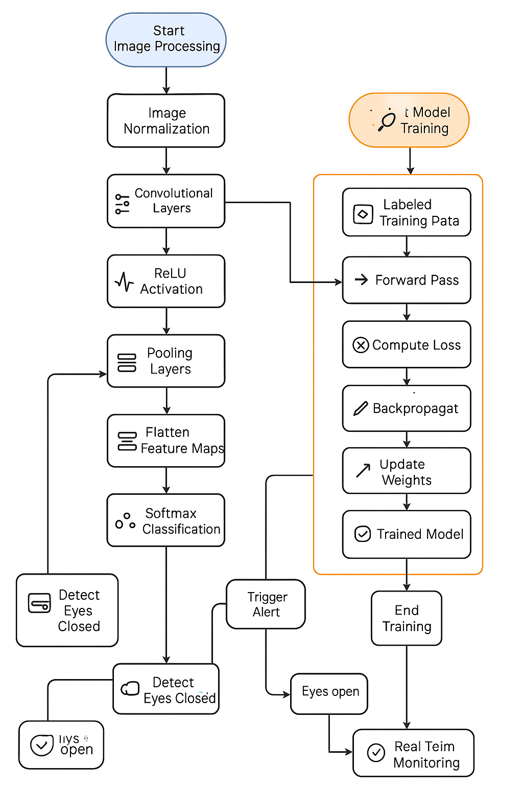
Architecture of System

Slide 13
Image Processing Phase
Start Image Processing: The system begins by capturing video frames (typically through a webcam).
Image Normalization: Captured frames are preprocessed—resized (e.g., 145x145), converted to grayscale, and pixel values are normalized to improve CNN performance.
Convolutional Layers: These layers extract local patterns such as edges, eye contours, and facial landmarks from the input image.
ReLU Activation: A nonlinear activation function that introduces non-linearity into the model, helping to learn complex patterns.
Pooling Layers: Used for spatial reduction of feature maps (e.g., max pooling), reducing computation while retaining important features.
Flatten Feature Maps: Converts the pooled features into a 1D vector to feed into dense layers.
Softmax Classification: Final output layer gives probabilities of each class (e.g., eyes open, eyes closed, yawning).
Model Training Block
Start Model Training: Initiates the CNN training phase using labeled datasets.
Labeled Training Data: Images with annotated eye states (open/closed) are used for supervised training.
Forward Pass: Input data passes through the CNN model and outputs predictions.
Compute Loss: The difference between the predicted and actual values is calculated using a loss function (e.g., cross-entropy).

Slide 14
Backpropagation: Gradients are computed and passed backward to update the weights.
Update Weights: CNN parameters are adjusted to minimize the loss.
Trained Model: After multiple epochs, a trained model is produced.
End Training: Marks the completion of model training, ready for real-time deployment.
3. Real-Time Monitoring Phase
Prediction Output: New frames are classified using the trained CNN.
Detect Eyes Closed: Logic checks if eyes are classified as "closed."
Count Consecutive Frames: If eyes remain closed for >10 frames, the system assumes drowsiness.
Trigger Alert: A visual/auditory alert is activated to wake the driver.
Eyes Open Path: If eyes open before the threshold, monitoring continues.
End Real-Time Monitoring: System ends session or continues based on user or external input.

Slide 15
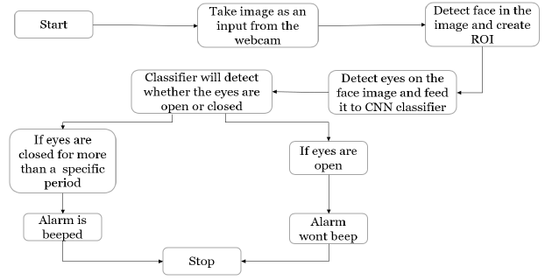
Real time Monitoring

Slide 16
Technical Workflow:
Captures live video using OpenCV.
Applies Haar cascade detection for face and eye tracking in every frame.
Crops eye regions and resizes them.
Feeds frames into the trained CNN model.
Based on model output, triggers alerts after:
10+ frames of eyes closed.
Yawning detected multiple times in short intervals.
Output Mechanism
Visual Alert: “Drowsiness Detected!” text on screen.
Auditory Alert: Buzzer or alert sound using playsound() or pygame.
Advantages:
Lightweight for edge devices.
Works in varying lighting conditions due to augmented training.
Scalable for commercial vehicle fleets, public transport, and personal cars.

Slide 17
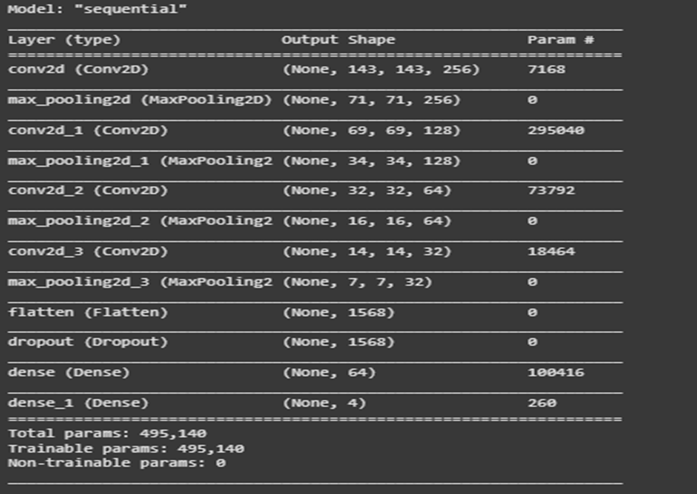
Implementation : CNN model

Slide 18
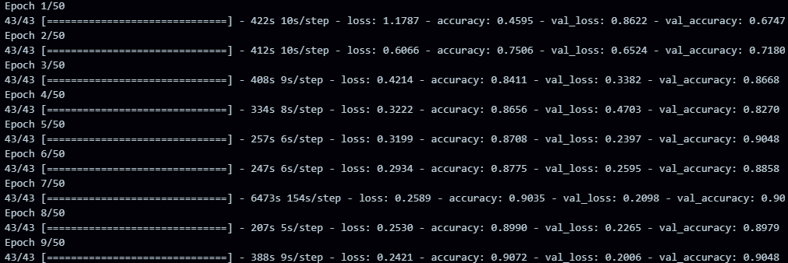
Training

Slide 19
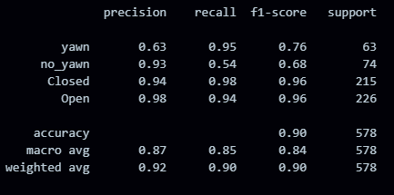
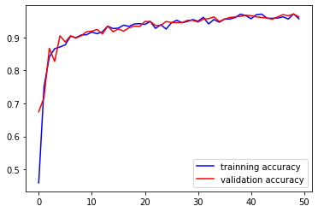
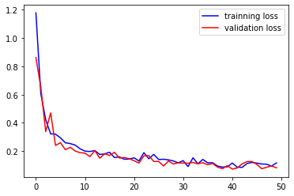
Results

Slide 20
Conclusion
Driver drowsiness detection using computer vision and deep learning techniques is an essential contribution to intelligent transportation systems and road safety. The project developed a real-time detection system that leverages convolutional neural networks (CNNs) to classify four distinct states—open eyes, closed eyes, yawning, and no yawning—based on facial features, specifically eye and mouth movements. The system was trained on a carefully preprocessed dataset, and a model was built that integrates Haar cascade classifiers for face and eye detection with a custom CNN for classification.
The achieved validation accuracy (~96%) highlights the model’s ability to generalize on unseen data, demonstrating its suitability for practical scenarios. The system also successfully integrates alarm-based feedback to alert drowsy drivers, combining both software intelligence and user safety response. This hybrid design, involving classical image processing (for face/eye localization) and deep learning (for behavior classification), proved to be effective and modular.
However, despite its success, the model has certain limitations rooted in real-world unpredictability, including changes in lighting, facial occlusions, and subtle behavioral variations. The CNN, although effective, still relies on supervised training, which requires a robust and diverse dataset. Overall, the project not only showcases the technical feasibility of real-time drowsiness detection but also opens up opportunities for enhancement through multi-modal input and adaptive learning systems.

Slide 21
References
Rateb Jabbar et al., “Driver Drowsiness Detection Model Using CNN Techniques for Android Application” – 2021. Describes a lightweight CNN model implemented on Android to monitor driver fatigue through eye state detection.
Soumya Agarwal, Dr. M.N. Nachappa, “Driver Drowsiness Detection System Using CNN” – IJSET, Vol. 10, Issue 2, 2022. Proposes a CNN-based system to classify driver alertness using image inputs with real-time application focus.
Wilson Florez et al., “Facial Region of Interest Based Driver Drowsiness Detection Using CNN Models” – Applied Sciences (MDPI), 2023. Utilizes a region-of-interest approach with CNNs to isolate facial features critical for fatigue detection.
Md. Iqbal Hasan et al., “Real-Time Driver Drowsiness Detection Using Facial Features and Deep Learning” – IEEE Access, Vol. 9, 2021. Combines Haar cascades for detection and deep CNN for classification, tested in real-world driving environments.
Abdul Wahid et al., “Deep Learning-Based Drowsiness Detection Using Eye Aspect Ratio and CNN” – Procedia Computer Science, Vol. 189, 2021. Integrates classical eye aspect ratio (EAR) techniques with CNN classification for better performance.
M. Pourya Rikhtegar et al., “Drowsy Driver Detection Based on Yawning Analysis Using CNN” – 2020, IEEE International Conference on Image Processing. Focuses on yawning behavior using facial landmarks and CNN-based classification models.
Aashima et al., “Driver Drowsiness Detection System Using Image Processing and CNN” – International Journal of Engineering Research & Technology (IJERT), Vol. 9, Issue 7, 2020. Explores the preprocessing pipeline along with CNN-based classification of eye states.
Pawel Woznowski et al., “Real-Time Eye State Detection for Driver Drowsiness Monitoring Using Deep Convolutional Neural Networks” – Sensors (MDPI), Vol. 22, 2022. Employs advanced CNN architectures and pre-trained models for eye state detection in varied lighting conditions.
K. Bhandari, A. Sharma, “Eye Blink Detection Using CNN for Drowsiness Detection” – International Journal of Computer Applications, Vol. 182, No. 46, 2019. Focused solely on blink frequency and eye closure using CNNs for early drowsiness symptoms.
T. Sanjeev, A. Arora, “Real-Time Driver Drowsiness Detection System Using Deep Learning Techniques” – 2022, International Journal of Computer Sciences and Engineering. Presents an end-to-end deep learning pipeline from video input to drowsiness alerts, emphasizing system latency and accuracy.

