Slide 1

Pandemic Analytics using Machine Learning with Python
MAJOR PROJECT PRESENTATION
Prepared By :
Snigdha
H12044

Slide 2
Problem Statement :
The World Health Organization has hired you for working on the dataset of COVID 19. Aggregate data & within two days, present your point of view to the joint committee on strategic planning to fight against COVID 19 on :
Present State Analytics - India
Correlation Heatmap for Various Parameters
Build a Model for Predicting the Confirmed & Recovered on Any Dates Past 15th July
Build a Classifier for Severity Gauging

Slide 3
Present State Analytics for the Top 5 States of India namely Rajasthan, Delhi, Maharashtra, Gujarat, Uttar Pradesh.

Slide 4
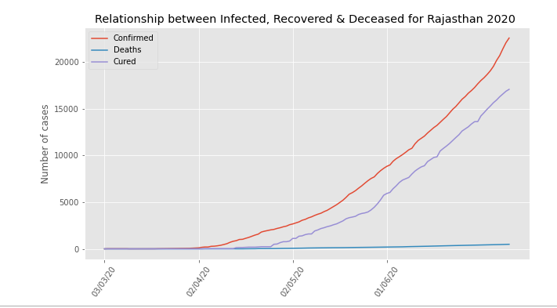
State Rajasthan’s Analysis

Slide 5
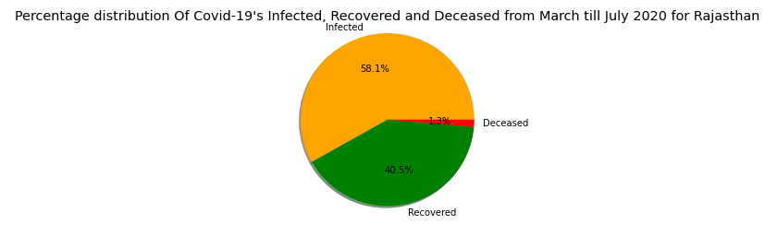

Slide 6
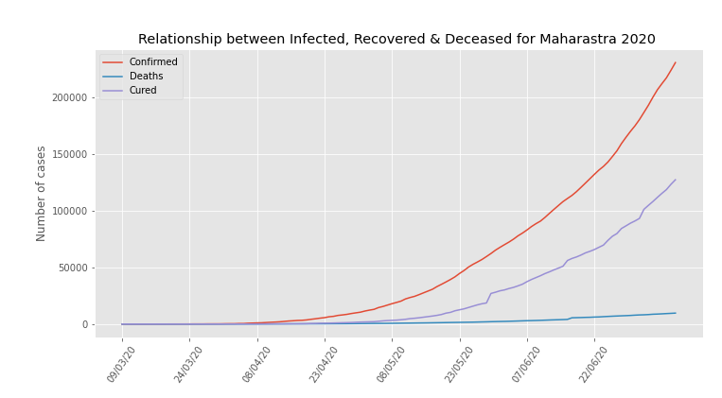
State Maharashtra’s Analysis

Slide 7
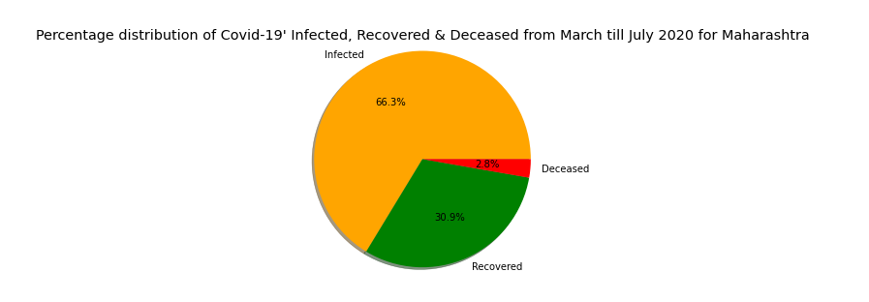

Slide 8
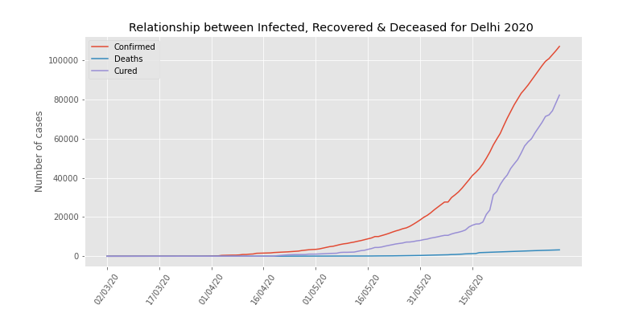
Delhi’s Analysis

Slide 9
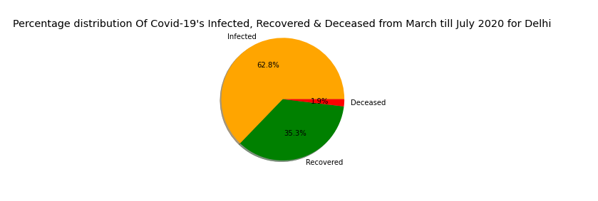

Slide 10
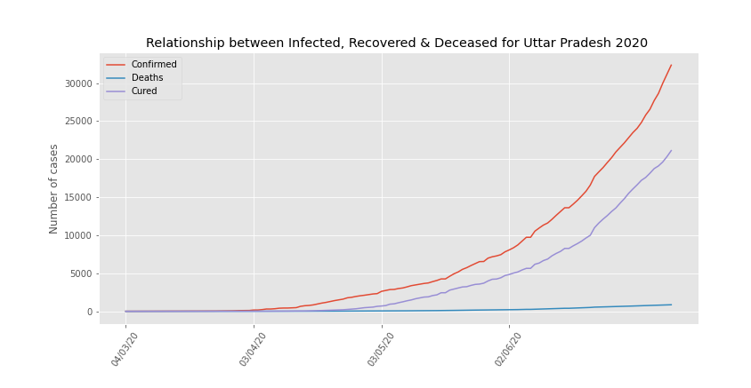
State Uttar Pradesh’s Analysis

Slide 11
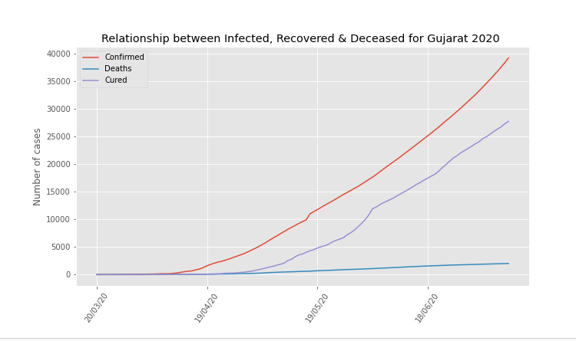
State Gujarat’s Analysis

Slide 12
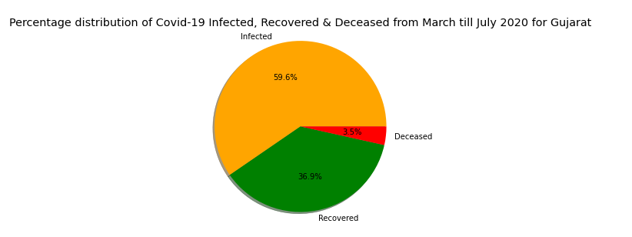

Slide 13
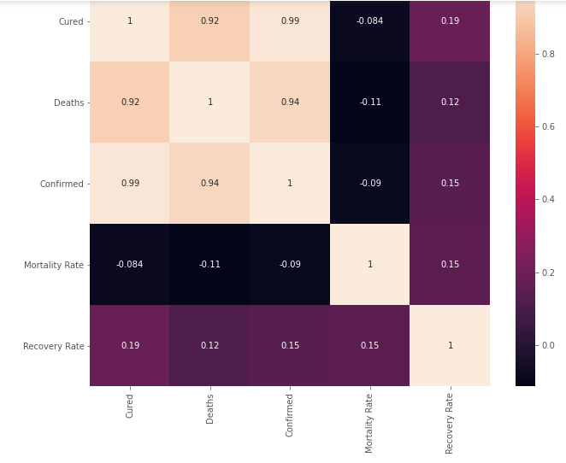
B. Correlation Heatmap for Various Parameters

Slide 14
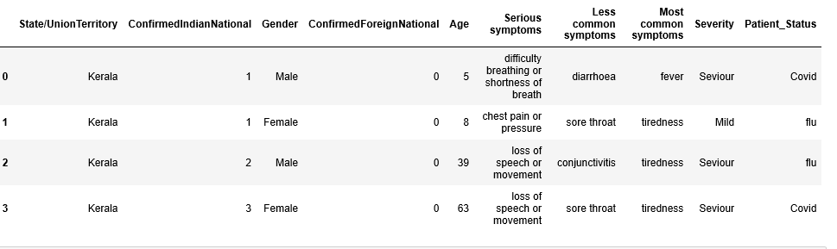
D. Building a Classifier for Severity Gauging

Slide 15
Conclusion & Finishing Notes :
Through predictive analytics, aggregating and correlating the information, trends and useful insights are derived. Pertaining to the COVID 19 pandemic, a thorough and rudimentary analysis has led to the discovery and refinement of instrumental parameters, which can be used for reflection, analysis and for devising practical solutions which would be cost effective and precision oriented.

