Slide 1

Pandemic Analytics using Machine Learning with Python
MINOR PROJECT
PRESENTATION
Prepared by :
Snigdha
H12044

Slide 2
Problem Statement :
The Chief Minister of the state is wanting to have a detailed overview of COVID 19 in the state for the month of June 2020 to plan the strategy for safeguarding the people of the state.

Slide 3
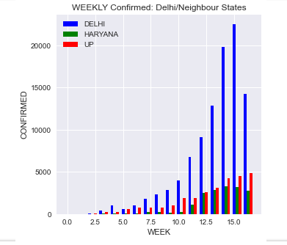
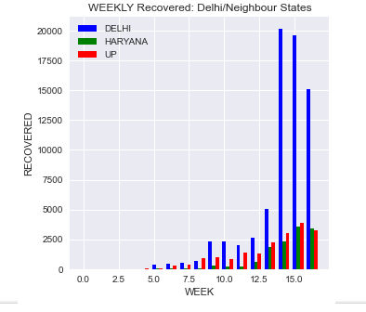
Data Analyzed and showcased according to the Confirmed, Recovered and Deceased cases for Delhi with respect to the neighboring states for a given week.

Slide 4
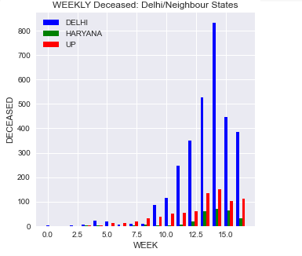
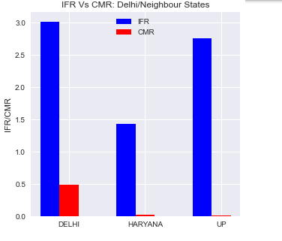
Comparative Analysis for Infection Fatality Rate ( IFR ) v/s Crude Mortality Rate ( CMR ) for Delhi/Neighboring States.

Slide 5
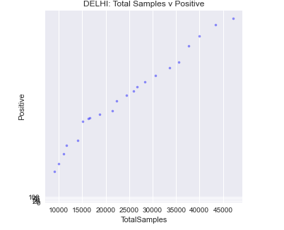
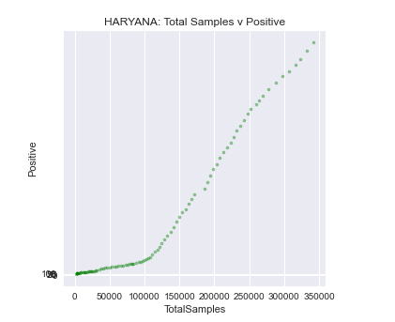
Seaborn Data Visualization for Total Samples v/s Positive for Delhi, Haryana, and Uttar Pradesh.

Slide 6
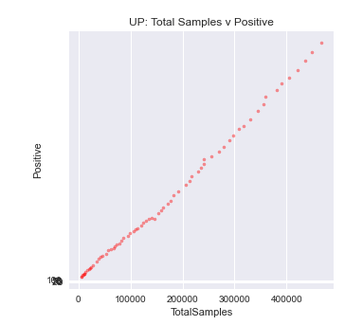
For Delhi, the information can be summarised as :
1522493.0 : Cured
81802.0 : Deaths
2710367.0 : Confirmed
16787941.0 : Population
3.018115 : CMR
0.487266 : IFR
Drawing Conclusions :
For a metropolitan city, Delhi has confirmed cases of COVID 19 which outnumber the cured cases. The number of ‘deceased’ cases is less than the cured cases, but not by a great margin. Social distancing, safety & sanitizing along with regular tests and observing Govt. lockdowns can cause a marginal decline in the infected cases.

