Slide 1
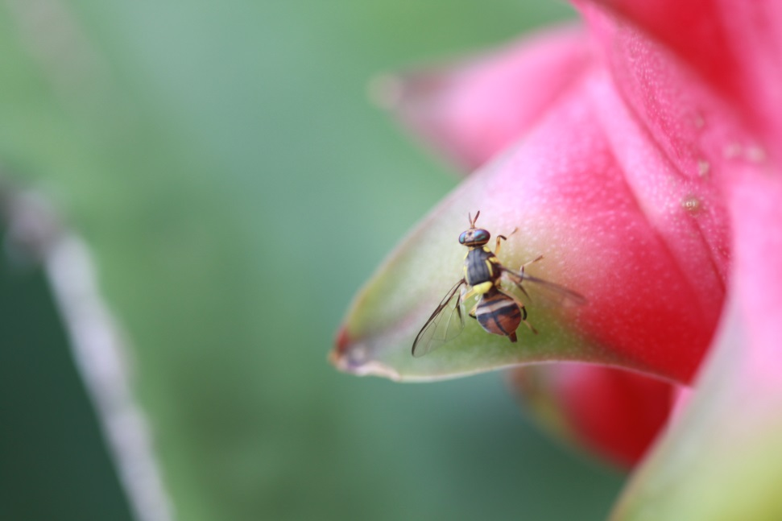
Title on A0 Paper Size (1189 x 841 mm); Use Portrait for Layout A.B. Author(s) Main Affiliation(s) and Contact Email (A.B. Author@.................)
Insert in upper left the Logo(s) of major institutions involved; in the upper right the Poster Number in 80 point font size
INTRODUCTION
The top of the poster should display, in lettering of 60 point font size, the following information:
Title of the Paper, Name(s) of the Author(s), Affiliation(s), Poster Number
48 point font size is recommended for headings.
The poster should be a visual presentation of your submitted abstract. Please keep in mind that information on a poster should attract attention. It should therefore be limited to the most important information only; leaving details and explanations for face to face dialogue.
Figure X: Guava fruit fly
METHODS
Posters should meet the following criteria:
All posters should be in portrait format and size: A0 (1189 mm high and 841 mm wide).
Single spaced 32 font size is recommended. The text should be concise and easy to read.
The message that your poster contains should be clear and understandable without the requirement of oral explanation. If relevant, methods should be presented simply and concisely.
Don’t forget the power of graphics. The proportion of text and graphics should be about 60%-40%.
Use colours sparingly, with effect:
o Use colours for emphasis, differentiation, and interest—not just to impress.
o Avoid large expanses of bright garish colours—they will detract from your print and pictorial content.
o Choose background and foreground colours that are contrasting and complement each other—for example, black or dark blue on light grey or white (it’s better to keep the background the light colour).
RESULTS
The top of the poster should display, in 60 point font size, the following information: TITLE OF PRESENTATION, NAMES OF AUTHORS, AFFILIATIONS.
The poster should be easily readable at a distance of two metres. Use UPPER and lower case for general content, as all-capital text is difficult to read. Avoid using mixtures of type/font styles. Left justify text, as it is easier on the eyes of the reader.
All display material should be prepared in advance. It is not possible to print posters on-site. Pins for mounting posters are available on-site.
Identify the single, fundamental concept you want to communicate! Ask yourself what is the research question that generates your presentation. Write out “answers” to that question, so that you find a concise statement (aim for 10-15 words) that “captures” your central idea.
The important point here is that a poster should condense your central idea so that your audience can grasp its overall message at the outset at a glance, and then be able to follow the poster’s text and graphics to understand the idea more fully. (Having a well-focused concise poster proposition will also help you find concise ways of stating your three or four points of explanation of the proposition.
Table Y: Implementation of 2016 Subprogramme Outputs
 | PROJECTS / Outputs
 | A | B | C | Total
2.1.4.1. | 50 | 5 | 0 | 55
2.1.4.2. | 36 | 5 | 2 | 43
2.1.4.3. | 28 | 7 | 1 | 36
Subprogr. | 114 | 17 | 3 | 134
CONCLUSIONS
After the title, the two most important sections are the Introduction and the Conclusions (48 point font size in capital letters). On the basis of these two sections, a reader will decide whether to consider the poster details and perhaps talk to the presenter. These panels need to be very simple, concise and visually attractive.
The viewers of your poster will not necessarily work in your specific field—but they may well be interested in your topic. So avoid jargon and acronyms specific to your field of research; or, at worst, explain terms.
An advantage to you in expressing your research ideas in words that are accessible to a wide (educated) audience is that doing so is a powerful way of understanding them.

