Slide 1
Major Triads
Ian Sniffen

Slide 2
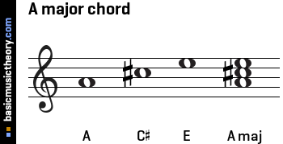

Slide 3
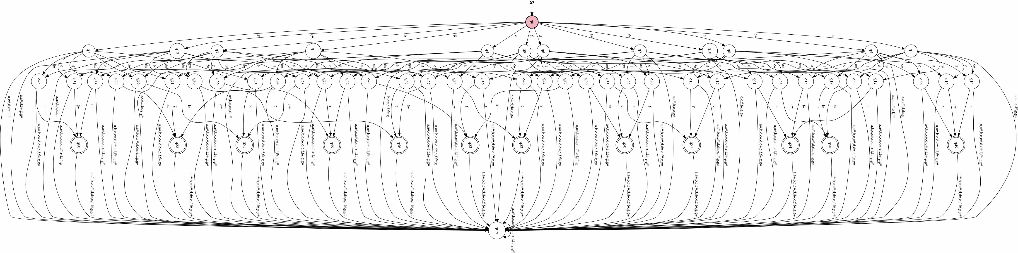
An Unreadable DFA

Slide 4
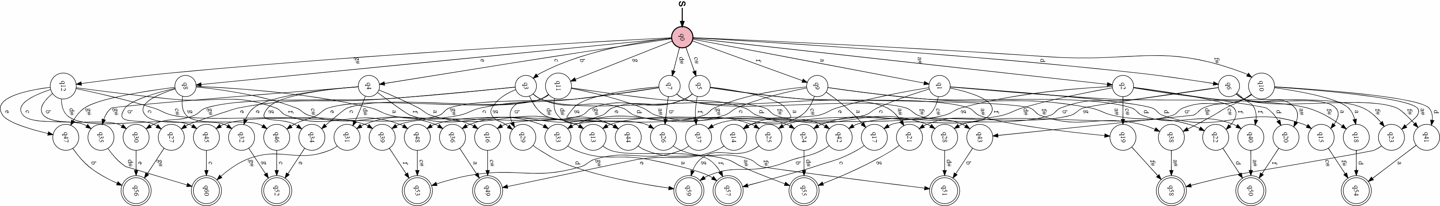
An Unreadable DFA (without the error state)

