Slide 1
SheHacks_Team-019

Slide 2
PROBLEM IDENTIFICATION
Every year when the counselling process of JoSSA starts students find it a troublesome task to properly make their counselling list.
Making a good list requires a lot of good research
Many students end up getting colleges that are not optimally the best suited to them because of negligence in this research or simply because they did not have enough information to do that.

Slide 3
SOLUTION
You must be wondering that many college predictors that can give you a counselling list generated on the basis of rank are already present to do that.
But do they consider all the factors?
Our idea basically maps the whole thought process that an applicant would go through considering factors like closeness of the institute from the applicants home, branch preferences of the applicant and other factors.
We basically help frame the mind of the applicant according to his needs and not just his rank only

Slide 4
BASIC FEATURES
Login and signup of students and admin.
A customized list will be provided based on factors like whether the student prefers to stay close to home (region wise categorization or same city of college), branch preference, JEE/NEET rank, category, gender etc.
Admin and user dashboard with all the basic details.
Admin can add/delete any new college/branch from the list.
A small contact us form for the students to contact the admin.
Link to NIRF and other kinds of ranking of colleges.
Responsive Design

Slide 5
QUESTIONS FOR THE APPLICANT
Q1)Do you strictly prefer institutes from your own region?
Q2) Do you strictly prefer institutes from your own state?
Q3) If the college is one of the IIT’s this is more important than branch preference. True or False
Q4) If the college is one of the NIT’s this is more important than branch preference. True or False
Q5) If the college is one of the IIIT’s this is more important than branch preference. True or False
Q6) Preferred duration of course-4,5 or both
Q7) Get branch preference
Q8) Get region preference
Q9) Get preference from these 6-NIRF,placement,campus,branch,region,how old is the college

Slide 6
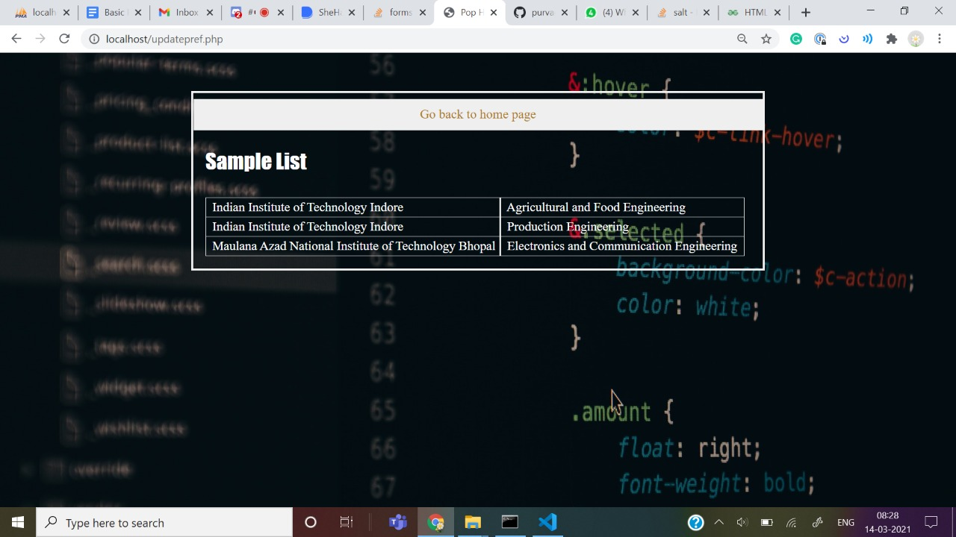

Slide 7
