Slide 1
Design and Implementation of a Database Management System for Smart Parking Lot Allocation and Billing System
REVIEW 1
P
Problem identification, ER design and initial relational schema
Notes:
Introduce the project: a relational database for smart parking allocation and billing. Today's review covers the problem, ER design and the initial schema.

Slide 2



The problem: manual tickets cause chaos
Slot conflicts
Revenue leakage
No reliable records
Two vehicles are sent to the same slot, or a bike takes a truck bay, because nobody sees live availability.
Lost or reused paper tickets and unrecorded exits mean some stays are never billed.
Reservations, passes and payments sit in different notebooks, so reports on occupancy and peak hours are guesswork.
Our answer: one central database that allocates slots live, records every entry and exit, and bills by tariff.
Notes:
Explain the real-world pain points before moving to the solution.

Slide 3
Scope and objectives
In scope
Objectives
Multi-level facilities with floors, zones and slots
Customers, vehicles and vehicle types
Reservations, entry/exit and slot allocation
Passes, tariffs, bills and payments
Reports: occupancy, peak hours, violations, revenue
Remove slot conflicts with live allocation
Stop revenue leakage with tariff-based billing
Design a normalized schema up to 3NF
Enforce business rules with database constraints
Deliver a small Java or Python front end

Slide 4



Who uses the system
Customer
Gate operator
Administrator
Searches free slots
Makes and cancels reservations
Buys and renews passes
Pays the bill
Records vehicle entry and exit
Allocates a slot
Checks reservation or pass
Collects payment
Manages facilities, floors, zones, slots
Sets tariffs
Views occupancy and revenue reports
Reviews violations

Slide 5






Functional requirements
Slot search
Reservation
Gate entry / exit
Find free slots by facility, floor, zone and vehicle type
Book a slot for a time window; unused bookings expire
Record entry and exit times and allocate a matching slot
Duration billing
Pass management
Payment and reports
Bill automatically from stay length and tariff
Issue, validate and renew passes
Take payments; report occupancy, peak hours, violations, revenue

Slide 6
Business rules the database must enforce
1
One active vehicle per slot
A slot cannot hold two vehicles that have not exited.
2
Slot and vehicle type match
A bike cannot be allotted a truck bay, and the reverse.
3
Exit only after entry
Exit time must be later than entry time.
4
Reservation expiry
A reservation past its expiry time cannot be used.
5
Tariff-based charges
Bill amount comes from duration and the tariff rate.

Slide 7
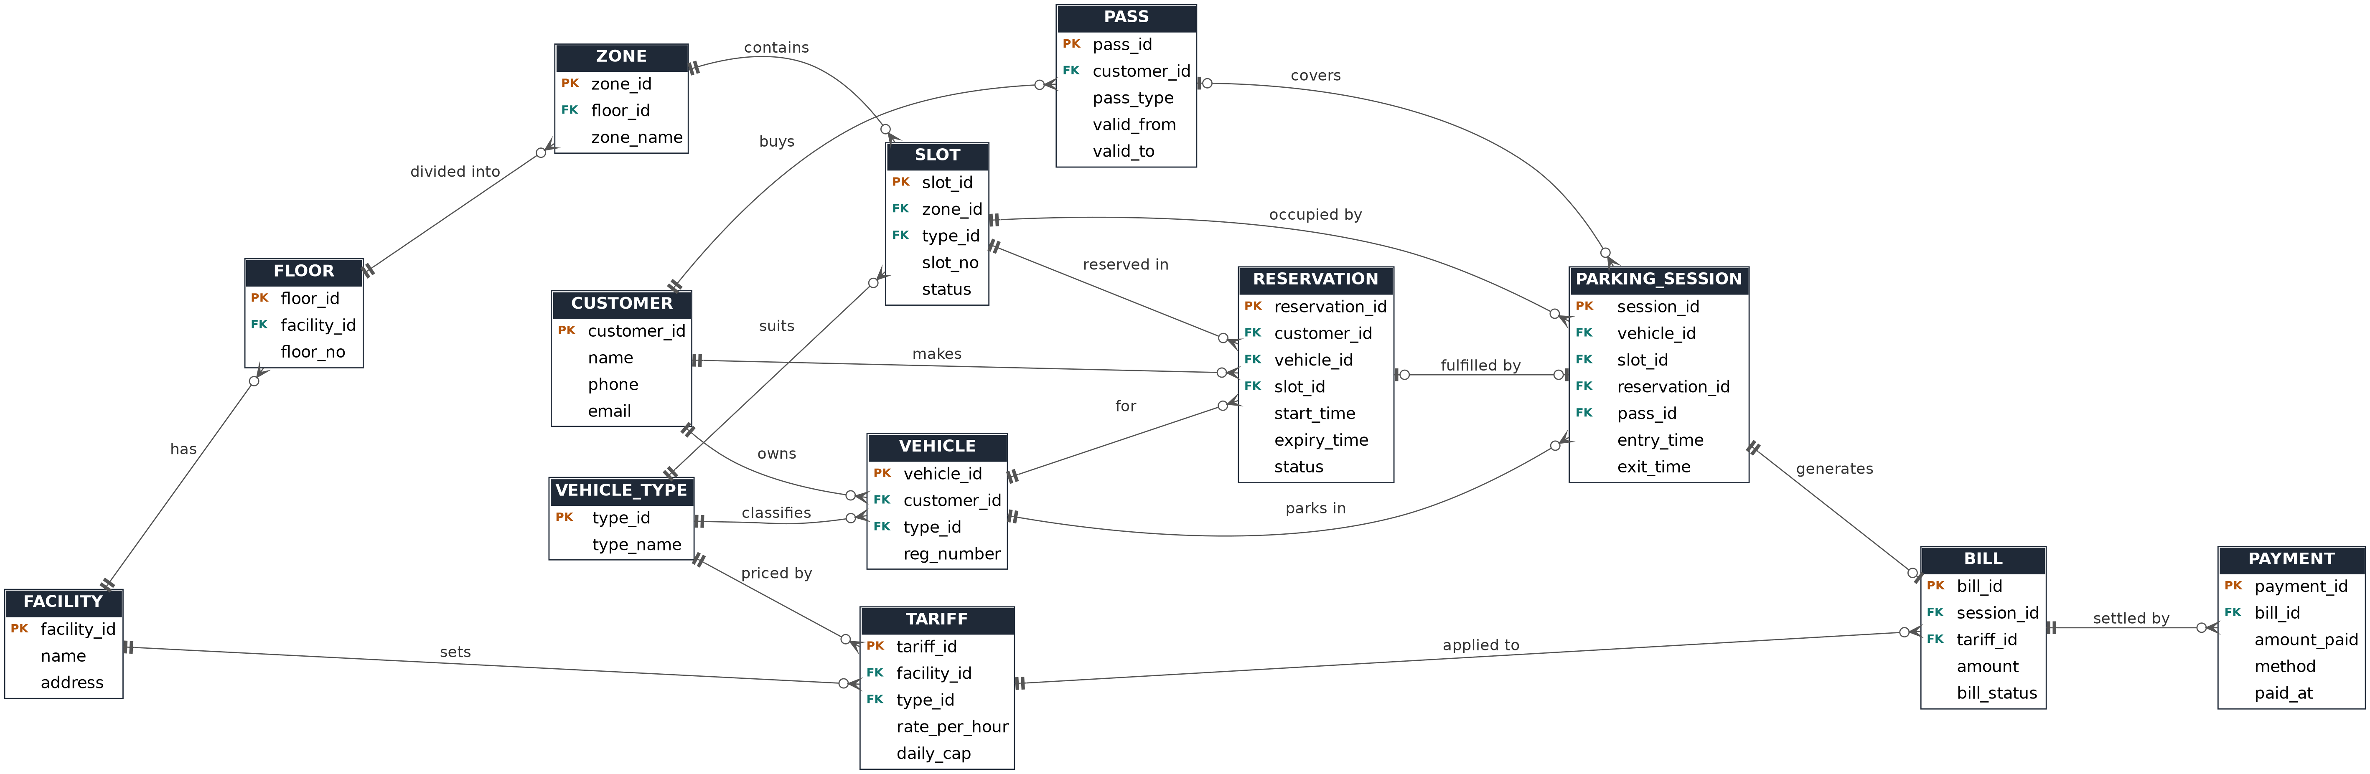
ER diagram: 13 entities
Crow's foot notation: three prongs = many, bar = exactly one, circle = optional. PK = primary key, FK = foreign key.
Notes:
Overview of the full ER diagram. The next two slides zoom into each half.

Slide 8
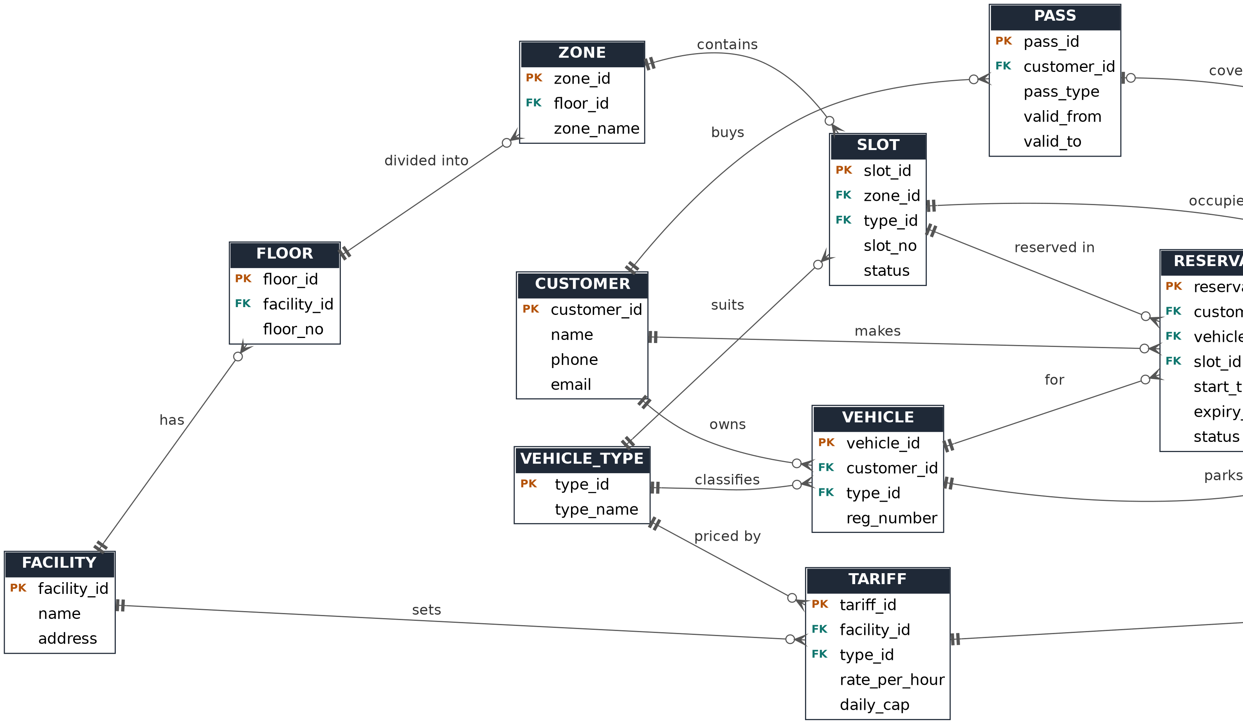
ER detail 1: structure, people and pricing

Slide 9
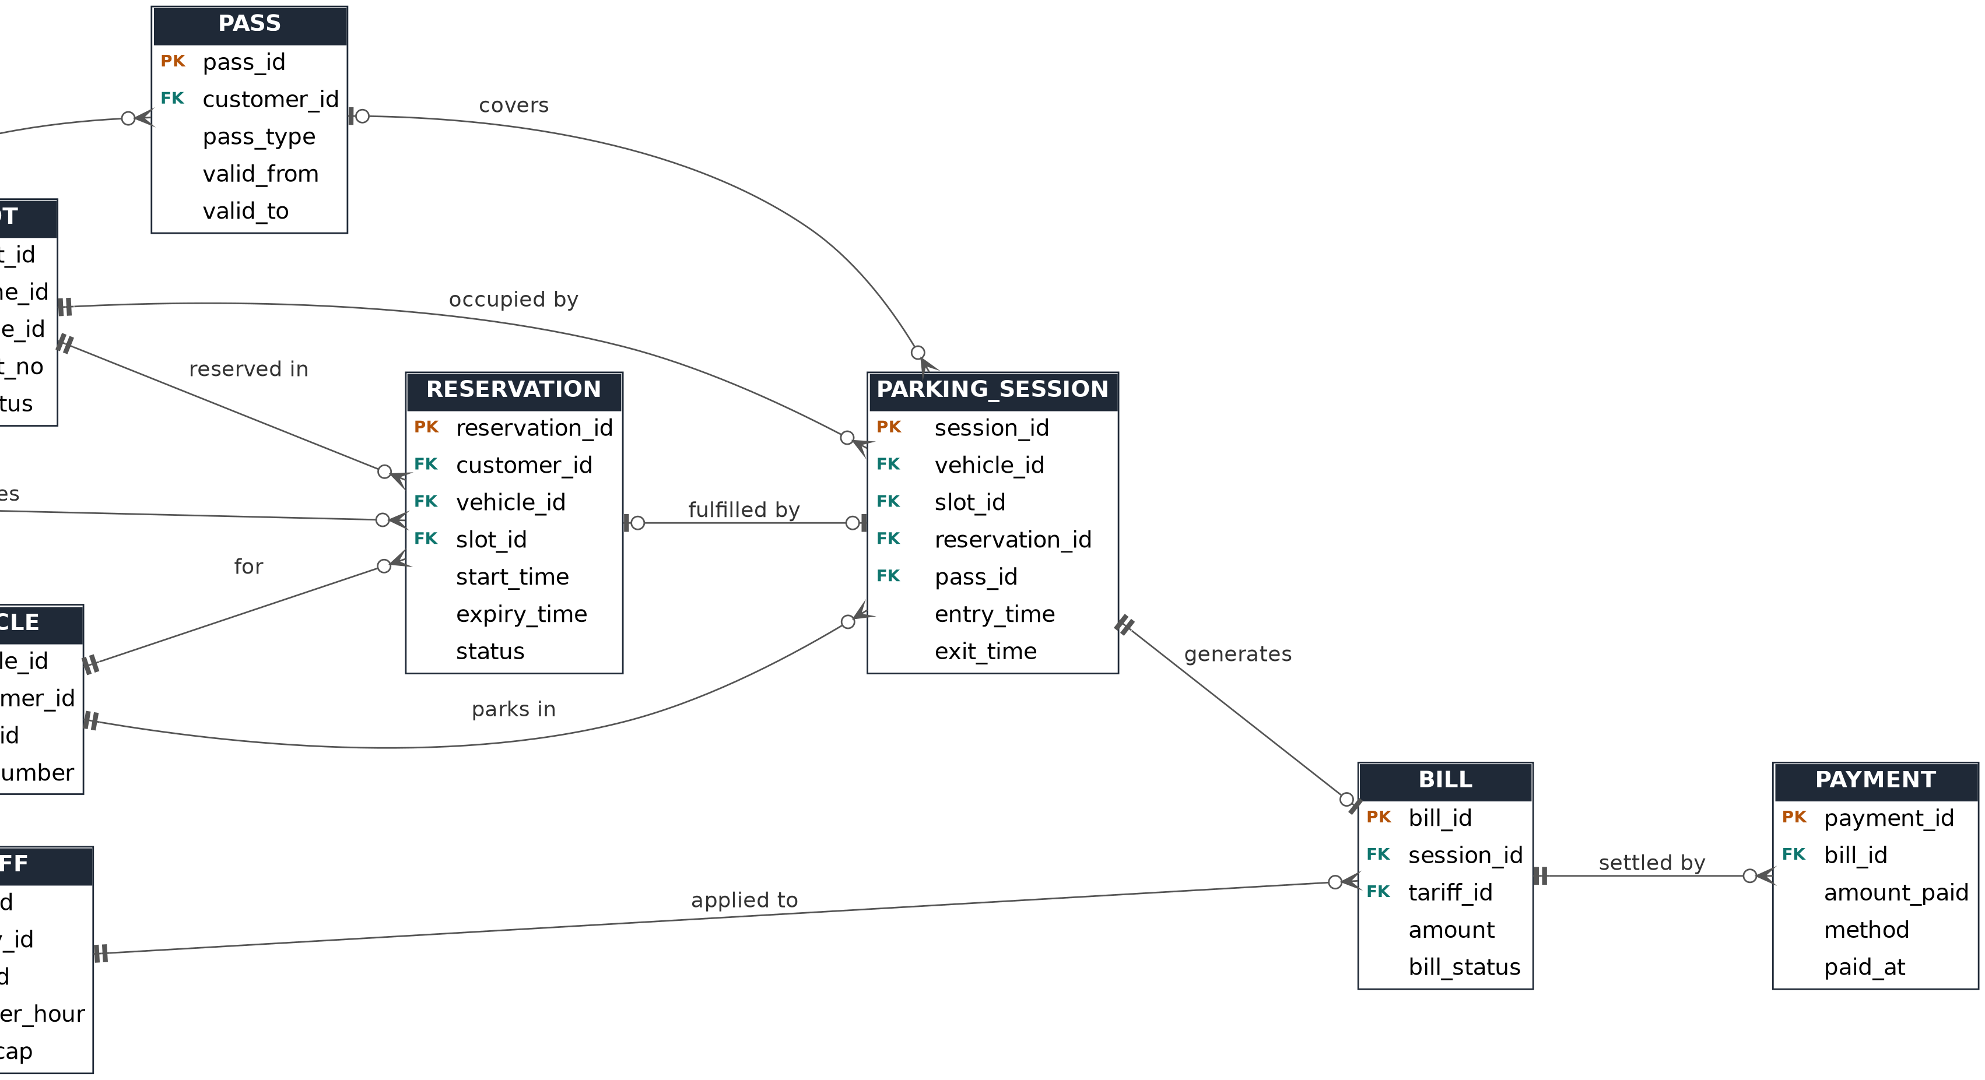
ER detail 2: reservations, sessions and billing

Slide 10
Key relationships and cardinalities
Relationship | Cardinality | Meaning
Facility - Floor - Zone - Slot | 1 : N at each step | A facility has floors, floors have zones, zones have slots
Vehicle type - Slot | 1 : N | Each slot is built for one vehicle type
Customer - Vehicle | 1 : N | A customer can own several vehicles
Customer, Vehicle, Slot - Reservation | 1 : N each | A reservation links who, which vehicle and which slot
Vehicle, Slot - Parking session | 1 : N each | Every stay records one vehicle in one slot
Reservation, Pass - Parking session | 1 : 0..1 / 1 : N | A session may come from a reservation or a pass
Parking session - Bill - Payment | 1 : 0..1, 1 : N | One bill per session, paid in one or more payments
Facility, Vehicle type - Tariff | 1 : N each | Rates depend on facility and vehicle type

Slide 11
Initial schema 1: facility and master data
Table | Primary key | Foreign keys | Other key columns
FACILITY | facility_id | none | name, address
FLOOR | floor_id | facility_id | floor_no
ZONE | zone_id | floor_id | zone_name
VEHICLE_TYPE | type_id | none | type_name
SLOT | slot_id | zone_id, type_id | slot_no, status
CUSTOMER | customer_id | none | name, phone, email
TARIFF | tariff_id | facility_id, type_id | rate_per_hour, daily_cap

Slide 12
Initial schema 2: transactions and billing
Table | Primary key | Foreign keys | Other key columns
VEHICLE | vehicle_id | customer_id, type_id | reg_number (unique)
RESERVATION | reservation_id | customer_id, vehicle_id, slot_id | start_time, expiry_time, status
PASS | pass_id | customer_id | pass_type, valid_from, valid_to
PARKING_SESSION | session_id | vehicle_id, slot_id, reservation_id, pass_id | entry_time, exit_time
BILL | bill_id | session_id, tariff_id | amount, bill_status
PAYMENT | payment_id | bill_id | amount_paid, method, paid_at
Reservation and pass links in PARKING_SESSION are optional, so walk-in visitors work without either.

Slide 13



Tools and plan for Reviews 2 and 3
Proposed tools
Review 2 | Week 11
MySQL or PostgreSQL
Normalize to 3NF with functional dependencies and data dictionary; DDL with constraints; sample data; queries and views; prototype demo.
Python or Java front end
Indexes on frequently searched columns
Review 3 | Week 16
Front-end application; CRUD, search, validation, reports and error handling; final demo, report and viva.

