Slide 1
Design and Implementation of a Database Management System for Smart Parking Lot Allocation and Billing System
REVIEW 2
P
Normalized design, DDL with integrity rules, sample data, reports and prototype

Slide 2


Where we stand after Review 1
Review 1 (done)
Problem, scope, users, requirements, ER diagram with 13 entities, initial schema
Review 2 (this review)
3NF design, DDL with rules, sample data, reports, working prototype
Review 3 (next)
Front-end application, CRUD, validation, final demo, report and viva
Database: MySQL 8.0. Everything is tested on a live database and will be submitted on GitHub.

Slide 3
Normalization: from one flat record to 13 tables
1
2
3
4
UNF
1NF
2NF
3NF
One wide row holds owner, slot, floor, facility, rate, bill and a list of payments
Payments with several values in one cell become one row each
Partial dependencies removed: session, bill and payment split apart
Transitive dependencies removed: customer, vehicle, slot-zone-floor-facility, tariff, reservation, pass
3NF test: every non-key attribute depends on the key, the whole key, and nothing but the key.

Slide 4
What normalization changed in the ER design
Before (Review 1)
After (Review 2)
RESERVATION
reservation_id (PK)
customer_id (FK)
vehicle_id (FK)
slot_id, start_time, expiry_time, status
RESERVATION
reservation_id (PK)
vehicle_id (FK)
slot_id, start_time, expiry_time, status
Why: reservation_id determines vehicle_id, and vehicle_id determines customer_id. That is a transitive dependency, so customer_id was removed and is reached through VEHICLE.

Slide 5
Functional dependencies
Table | Dependency on the primary key
facility | facility_id -> name, address
floor | floor_id -> facility_id, floor_no
zone | zone_id -> floor_id, zone_name
vehicle_type | type_id -> type_name
slot | slot_id -> zone_id, type_id, slot_no, status
tariff | tariff_id -> facility_id, type_id, effective_from, rate_per_hour, daily_cap
customer | customer_id -> name, phone, email
vehicle | vehicle_id -> customer_id, type_id, reg_number
reservation | reservation_id -> vehicle_id, slot_id, start_time, expiry_time, status
pass | pass_id -> customer_id, pass_type, valid_from, valid_to, fee
parking_session | session_id -> vehicle_id, slot_id, reservation_id, pass_id, entry_time, exit_time
bill | bill_id -> session_id, tariff_id, amount, bill_status, generated_at
payment | payment_id -> bill_id, amount_paid, method, paid_at

Slide 6
3NF result and controlled redundancy
bill.amount
bill.bill_status
slot.status
Snapshot of the charge, because tariffs change later
Fast search for unpaid bills
Instant free-slot search; MAINTENANCE cannot be derived
Kept correct by: Computed by the bill trigger from the tariff
Kept correct by: Recalculated by the payment trigger
Kept correct by: Updated by the entry and exit triggers
Verdict: all 13 tables are in 3NF. These three stored values are deliberate, documented and impossible to enter wrongly by hand.

Slide 7
Data dictionary 1: facility and master data
Table | Columns (PK, FK, UNIQUE) | Constraints and indexes
facility | facility_id PK, name UNIQUE, address | No foreign keys
floor | floor_id PK, facility_id FK, floor_no (CHECK -5..50) | UNIQUE (facility, floor_no)
zone | zone_id PK, floor_id FK, zone_name | UNIQUE (floor, zone_name)
vehicle_type | type_id PK, type_name UNIQUE | Bike, Car, Truck
slot | slot_id PK, zone_id FK, type_id FK, slot_no, status ENUM | UNIQUE (zone, slot_no); index (status, type)
tariff | tariff_id PK, facility_id FK, type_id FK, effective_from, rate_per_hour, daily_cap | CHECK rate > 0, cap >= rate
customer | customer_id PK, name, phone UNIQUE, email UNIQUE | CHECK phone 10 digits, email format
Full column-by-column dictionary with types, NULL rules and defaults: docs/normalization_and_data_dictionary.md in the repository.

Slide 8
Data dictionary 2: customers, sessions and billing
Table | Columns (PK, FK, UNIQUE) | Constraints and indexes
vehicle | vehicle_id PK, customer_id FK, type_id FK, reg_number UNIQUE | CHECK registration format
reservation | reservation_id PK, vehicle_id FK, slot_id FK, start_time, expiry_time, status ENUM | CHECK expiry > start
pass | pass_id PK, customer_id FK, pass_type ENUM, valid_from, valid_to, fee | CHECK valid_to >= valid_from
parking_session | session_id PK, vehicle_id FK, slot_id FK, reservation_id FK (UNIQUE), pass_id FK, entry_time, exit_time | CHECK exit > entry; 2 generated UNIQUE columns
bill | bill_id PK, session_id FK (UNIQUE), tariff_id FK, amount, bill_status ENUM, generated_at | One bill per session; CHECK amount >= 0
payment | payment_id PK, bill_id FK, amount_paid, method ENUM, paid_at | CHECK amount_paid > 0

Slide 9
DDL scripts at a glance
13
8
2
5
tables
triggers
functions
stored procedures
Keys
13 primary keys, 18 foreign keys (UPDATE CASCADE, DELETE RESTRICT)
UNIQUE
reg_number, phone, email, facility name, one bill per session, one slot number per zone
CHECK
phone, email and registration formats, positive rates and payments, valid date ranges
DEFAULT / NOT NULL
status columns default to safe values; every required field is NOT NULL
Indexes
status and type for free-slot search, entry time for reports, slot and time windows for overlap checks

Slide 10
Business rules enforced inside the database
Rule | Enforced by
One active vehicle per slot | Overlap trigger + UNIQUE generated column
Slot and vehicle type match | Entry and reservation triggers
Exit after entry | CHECK constraint + update trigger
Reservation expiry | Entry trigger + sp_expire_reservations()
Tariff-based charges | fn_bill_amount() run by bill trigger
One active vehicle per slot
active_slot_id INT UNSIGNED
GENERATED ALWAYS AS
(IF(exit_time IS NULL,
slot_id, NULL)) STORED,
CONSTRAINT
uq_one_active_vehicle_per_slot
UNIQUE (active_slot_id)
The column is NULL once the vehicle exits, so only open stays compete for a slot.

Slide 11
Transaction awareness: exit and bill succeed together
sp_vehicle_exit (simplified)
All or nothing
DECLARE EXIT HANDLER FOR SQLEXCEPTION
BEGIN ROLLBACK; RESIGNAL; END;
START TRANSACTION;
UPDATE parking_session
SET exit_time = ...;
SET v_tariff = fn_pick_tariff(...);
-- no tariff? raise an error
INSERT INTO bill ...;
COMMIT;
If the bill cannot be created, the exit time is undone. A vehicle is never left exited but unbilled.
Single statements
One INSERT and the triggers it fires succeed or fail as one unit (billing, payments, entries).
Tested
A vehicle type with no tariff is billed in a test: the session stays open and no bill exists.

Slide 12
Proof: rules reject bad data
Test | Attempt | Database response (real output)
T1 | Second vehicle into an occupied slot | slot already holds a vehicle in that period
T3 | Car parked in a bike slot | slot type does not match vehicle type
T4 | Exit time before entry time | CHECK chk_exit_after_entry violated
T5 | Use an expired reservation | reservation expired, not active, or does not match vehicle/slot
T7 | Overlapping reservation on one slot | slot already reserved for an overlapping period
T8 | Walk-in into a reserved slot | slot is reserved by another customer at this time
T10 | Use an expired pass | pass is invalid, expired, or belongs to another customer
T13 | Pay more than the bill | payment exceeds the outstanding bill amount
T15 | Malformed registration number | CHECK chk_vehicle_reg violated
20 of 20 invalid statements were rejected (script: 05_constraint_tests.sql).

Slide 13
Sample data loaded through the triggers
2
facilities
55
slots
12
customers
15
vehicles
7
reservations
4
passes
61
parking sessions
56
bills
48
payments
Realistic Indian registration numbers and phone numbers, 2 facilities, 3 vehicle types, a week of history, 5 vehicles inside now, partial payments and violations on purpose.

Slide 14
Joins and subqueries
Q1 Who is parked now (5-table join)
Q4 Bills above the average for the vehicle type
SELECT v.reg_number, vt.type_name,
l.facility, l.slot_no,
TIMESTAMPDIFF(MINUTE,
ps.entry_time, NOW()) AS mins
FROM parking_session ps
JOIN vehicle v ON v.vehicle_id=ps.vehicle_id
JOIN vehicle_type vt ON vt.type_id=v.type_id
JOIN v_slot_location l
ON l.slot_id=ps.slot_id
WHERE ps.exit_time IS NULL;
SELECT b.bill_id, v.reg_number, b.amount
FROM bill b
JOIN parking_session ps
ON ps.session_id=b.session_id
JOIN vehicle v
ON v.vehicle_id=ps.vehicle_id
WHERE b.amount >
(SELECT AVG(b2.amount)
FROM bill b2 JOIN parking_session p2
ON p2.session_id=b2.session_id
JOIN vehicle v2
ON v2.vehicle_id=p2.vehicle_id
WHERE v2.type_id=v.type_id);
AP29TT7070 Truck T01 1800 min
TS11TR2468 Truck T01 300 min
TS09ZX5050 Bike B01 180 min
Result: bill 38 (Rs 250), bill 47 (Rs 210), bill 10 (Rs 200) ...

Slide 15
Reports: peak hours and revenue
Peaks fall at 10:00 and in the 08:00-09:00 and 18:00 windows. Rs 4,650 billed so far, about 81% collected.

Slide 16
Reports: violations, pass usage and free slots
12
Unpaid over 24 h
2
Overstay past reservation
1
Pass expired during stay
1
Stay over 24 h
Pass usage
Free slots now
Holder | Type | State | Visits | Hours
Ravi Kumar | MONTHLY | ACTIVE | 4 | 35.7
Priya Nair | MONTHLY | ACTIVE | 3 | 26.5
Arjun Verma | MONTHLY | EXPIRED | 2 | 21.0
Kavya Rao | ANNUAL | ACTIVE | 0 | 0.0
Facility | Type | Free
Lakeview Mall | Bike | 6
Lakeview Mall | Car | 22
Lakeview Mall | Truck | 2
Tech Park | Bike | 4
Tech Park | Car | 11
Tech Park | Truck | 2

Slide 17
Prototype demo: one visit from gate to payment
1 Entry
2 Slot status
3 Exit and bill
sp_vehicle_entry: car MH12AB3030 gets slot C01 in basement zone B1-CAR. Free car slots: 22 to 21.
Slot turns OCCUPIED by trigger; the slot is blocked for any other vehicle.
sp_vehicle_exit after 200 min: rounded up to 4 h at Rs 30/h, bill Rs 120.00, UNPAID.
4 Part payment
5 Final payment
6 Tamper test
Rs 50 by UPI: status becomes PARTIAL.
Rs 70 in cash: status becomes PAID; overpaying is rejected.
Bill inserted with Rs 1.00 typed in: the trigger stored Rs 30.00 (3 h x Rs 10).
Script: 06_prototype_demo.sql. The same procedure calls will be used by the Review 3 front end.

Slide 18
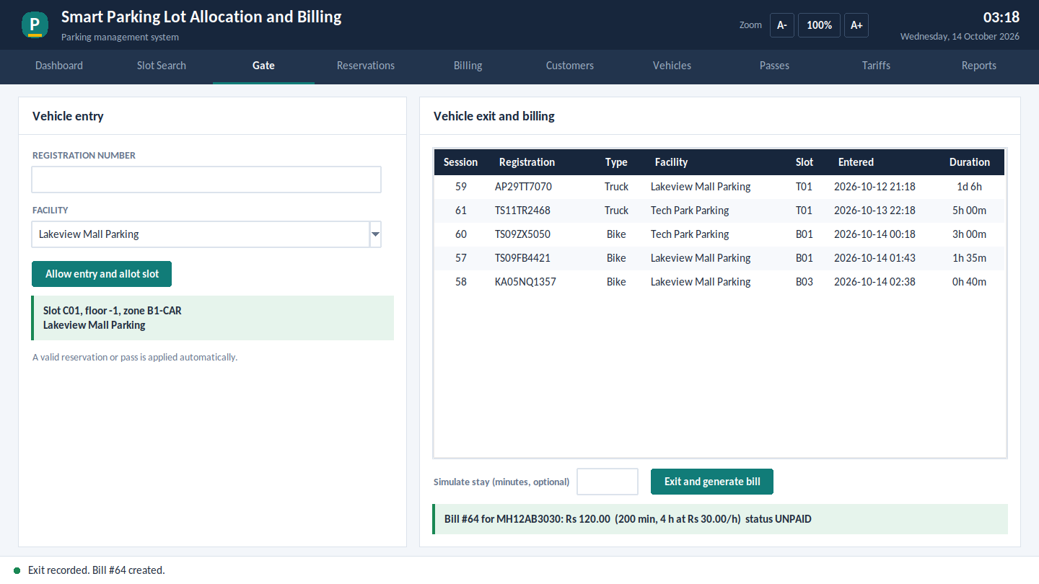
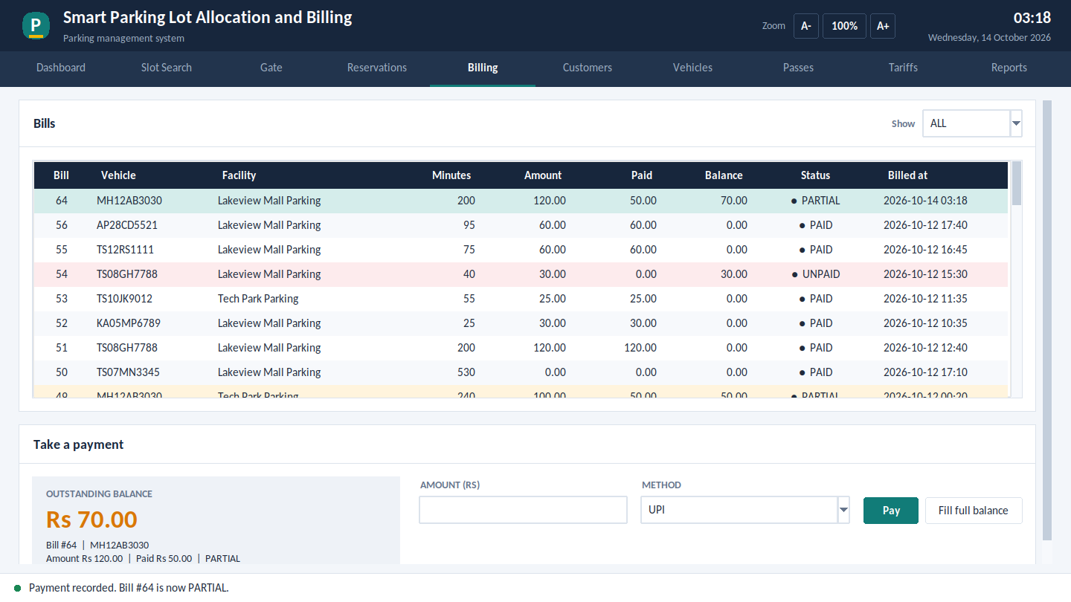
Python front end connected to the same database
Gate exit: sp_vehicle_exit creates the bill, Rs 120.00 for 200 minutes.
Billing: sp_make_payment records Rs 50, status becomes PARTIAL.
The application only calls the stored procedures and views shown in this review. All business rules stay inside MySQL.

Slide 19
Implementation progress and plan for Review 3
Completed
Review 3 plan
3NF design, FDs and data dictionary
Final Python (Tkinter) application, 10 screens
Search, reservation, gate, billing, passes, tariffs
Reports with charts and CSV export
Validation, friendly errors, zoomable screen
23 automated tests, report, GitHub repository
DDL, triggers, procedures, transactions
Sample data, 17 queries, 9 views
20 database rule tests passed
Python app connected and tested

