Slide 1
Design and Implementation of a Database Management System for Smart Parking Lot Allocation and Billing System
REVIEW 3
P
Python application on MySQL: CRUD, search, validation, reports and error handling

Slide 2
From design to a working system
WEEK 7
WEEK 11
WEEK 16
Review 1
Review 2
Review 3
Problem, requirements, ER diagram, initial schema
3NF design, DDL with rules, sample data, reports
Python application, full demo, tests, report
Outcome: 13 tables, 8 triggers, 5 procedures, a 10-page Python application with zoom, 23 automated tests, all on MySQL 8.

Slide 3
Architecture: three layers
Screen
10 pages in one design system: navy header, teal actions, themed tables, zoom 80% to 200%
gui.py, widgets.py, theme.py
Logic
Checks input, runs operations, turns database errors into plain sentences
services.py, validators.py, errors.py
Database
13 tables, CHECK and UNIQUE rules, triggers, functions, procedures, views
MySQL 8.0
Every query uses placeholders, so user input never becomes part of the SQL text (no SQL injection).

Slide 4
A consistent design system
Navy
Teal
Workspace
Yellow
Success
Warning
Error
Header, table headings
Main actions, selected tab
Page background
Small highlights
Paid, active
Partial, maintenance
Unpaid, delete
theme.py
Colours, fonts, spacing, zoom scale, table and input styles in one file
widgets.py
Buttons, panels, tables, cards, navigation, chart
gui.py
Page layouts and button actions; business logic unchanged

Slide 5
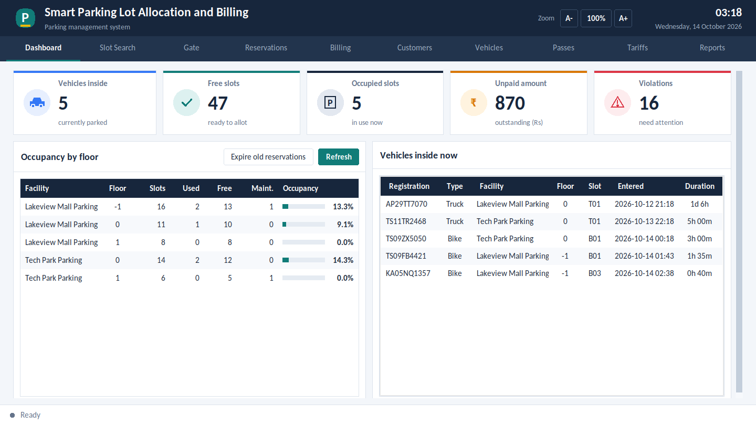
Dashboard
Five summary cards: vehicles inside, free and occupied slots, unpaid amount and violations.
Occupancy by floor with progress bars, and the vehicles inside now with their duration.
The same layout adapts when the window is small or the zoom is large.

Slide 6
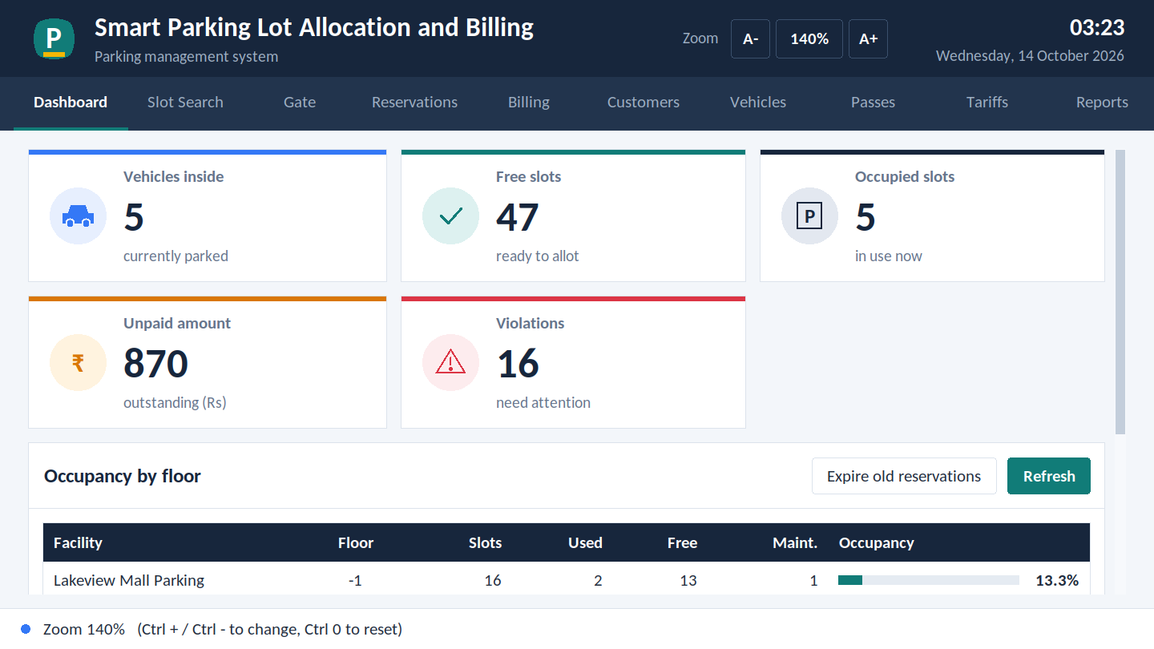
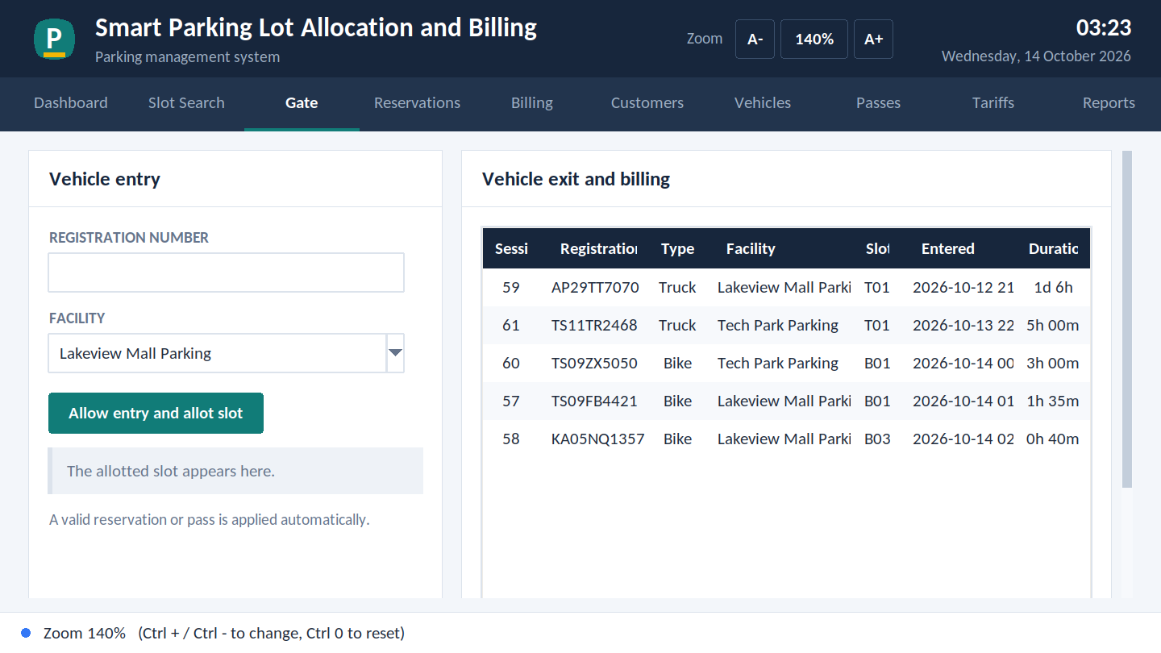
Clear text and zoom from 80% to 200%
Both screens at 150% zoom
Sharp on any screen
Three ways to zoom
Remembered
High-DPI mode is switched on, so text is not blurred by Windows scaling
A+ / A- buttons, Ctrl + and Ctrl -, or Ctrl with the mouse wheel; Ctrl 0 resets
The chosen zoom is saved and used next time

Slide 7
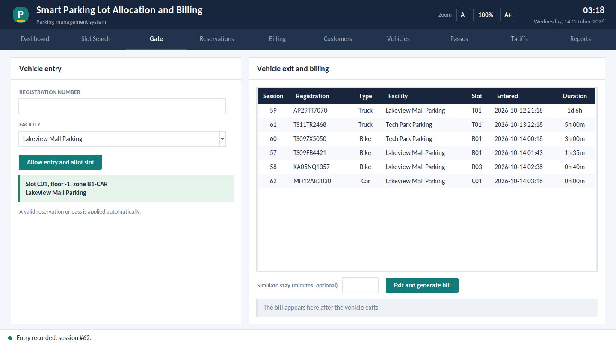
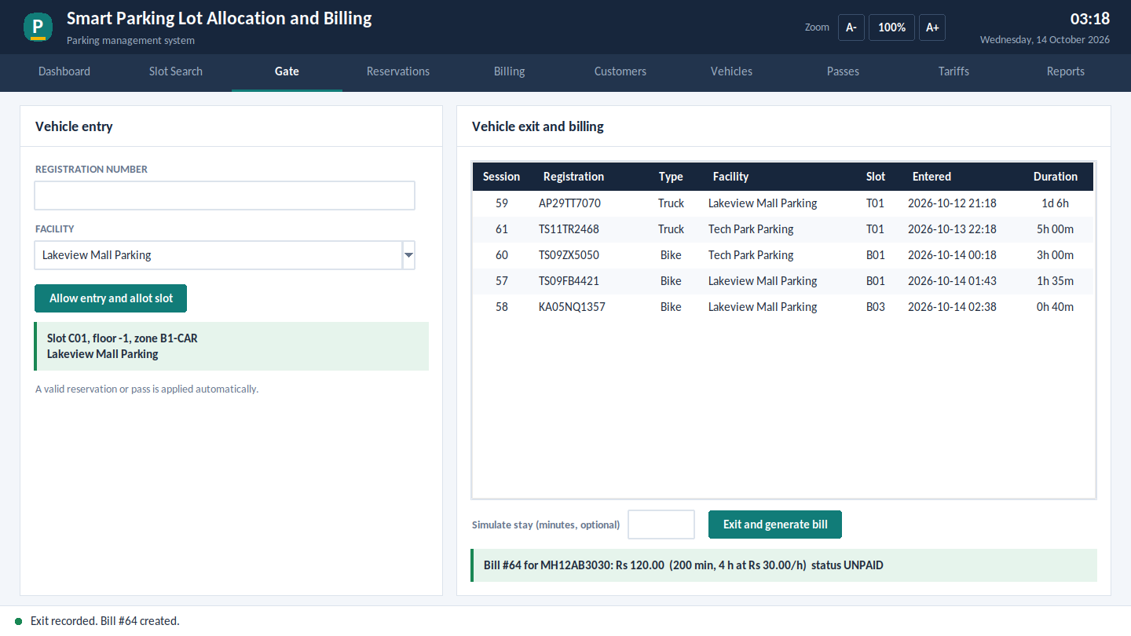
Gate entry and automatic slot allocation
Entry: car MH12AB3030 is given slot C01 on basement floor -1. The system chose a free slot of the right type.
Exit: after a 200 minute stay the bill is Rs 120.00 (4 hours at Rs 30 per hour).

Slide 8
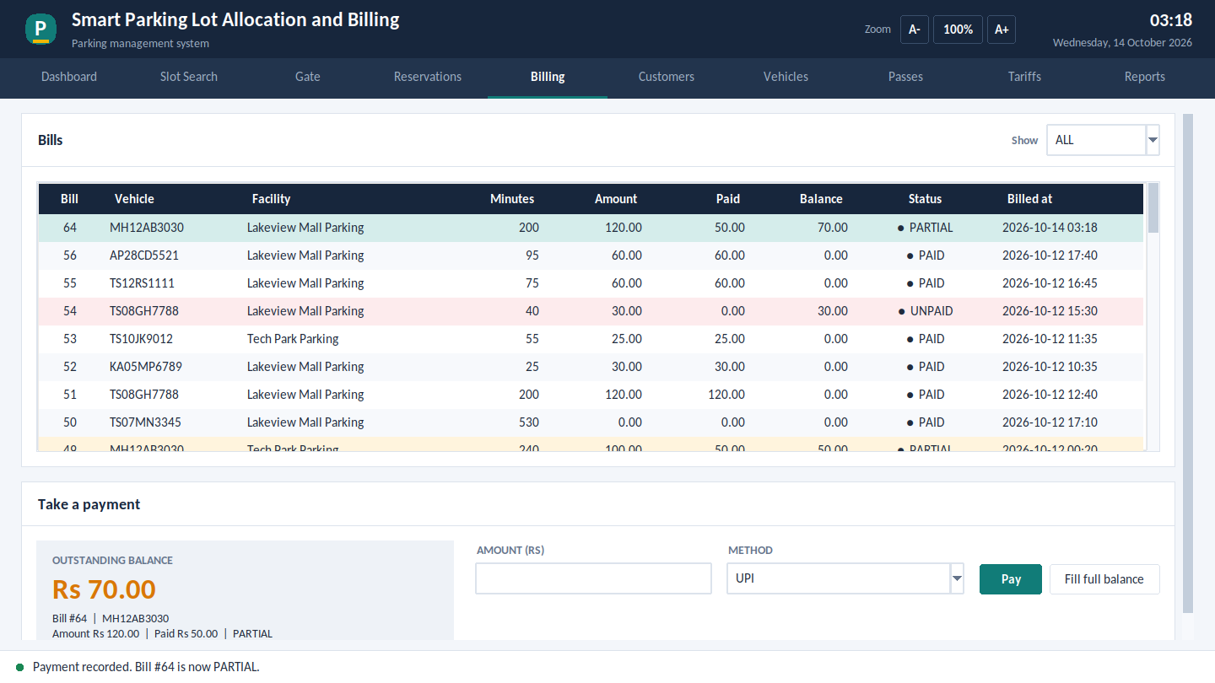
Duration billing and payment
Round up
Time is charged in whole hours, minimum one hour
Daily cap
Each full 24 hours costs the cap; the rest is hours x rate, up to the cap
Pass holder
Valid pass means Rs 0 for the stay
Part payments
Status moves UNPAID, PARTIAL, PAID; overpaying is refused
Bill 64 after paying Rs 50 of Rs 120: status PARTIAL, balance Rs 70.

Slide 9
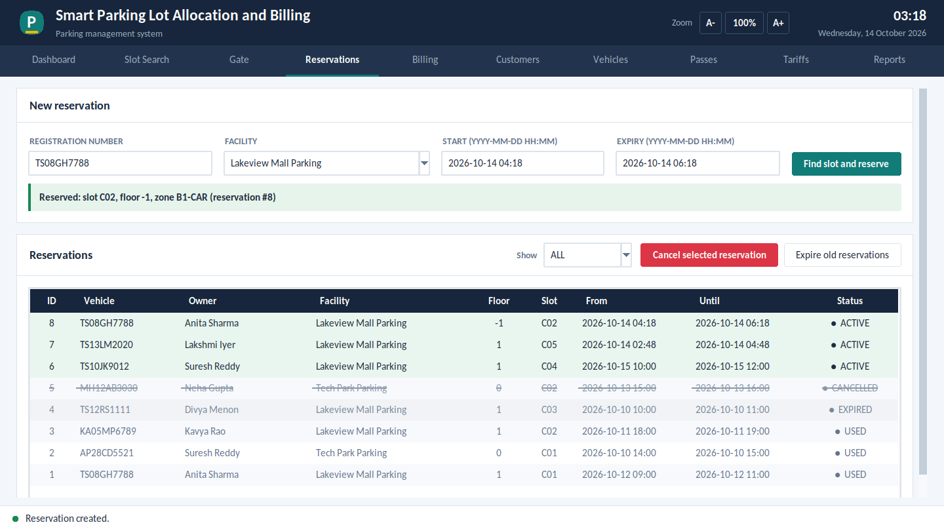
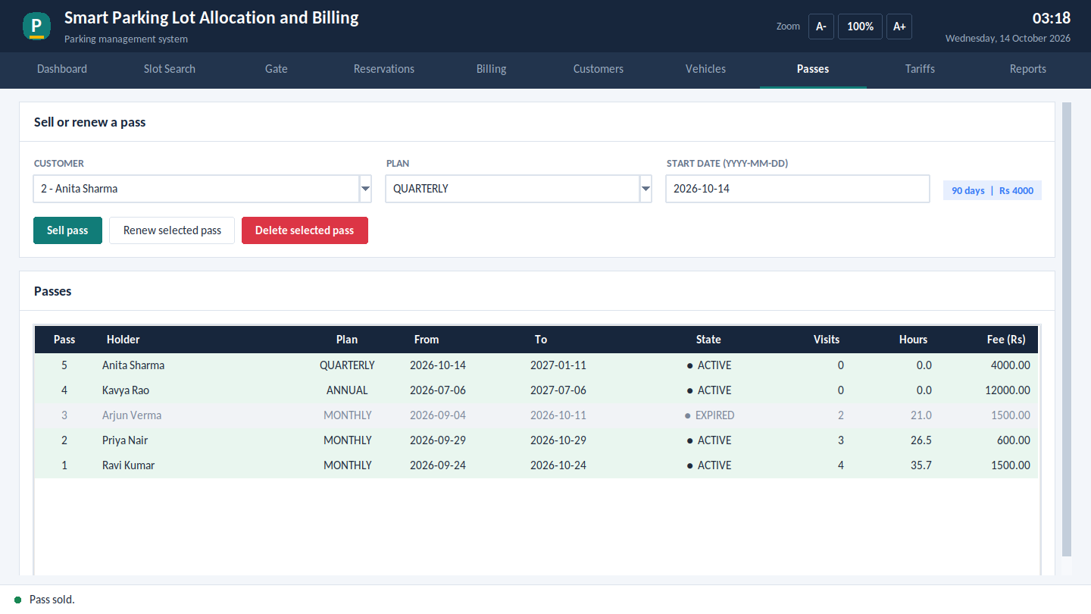
Reservations and passes
Reservation: enter vehicle and time window. The system finds a free slot of the right type; unused bookings expire; a booking can be cancelled.
Passes: sell monthly, quarterly or annual passes, renew after expiry, delete if never used. A valid pass is applied at the gate automatically.

Slide 10
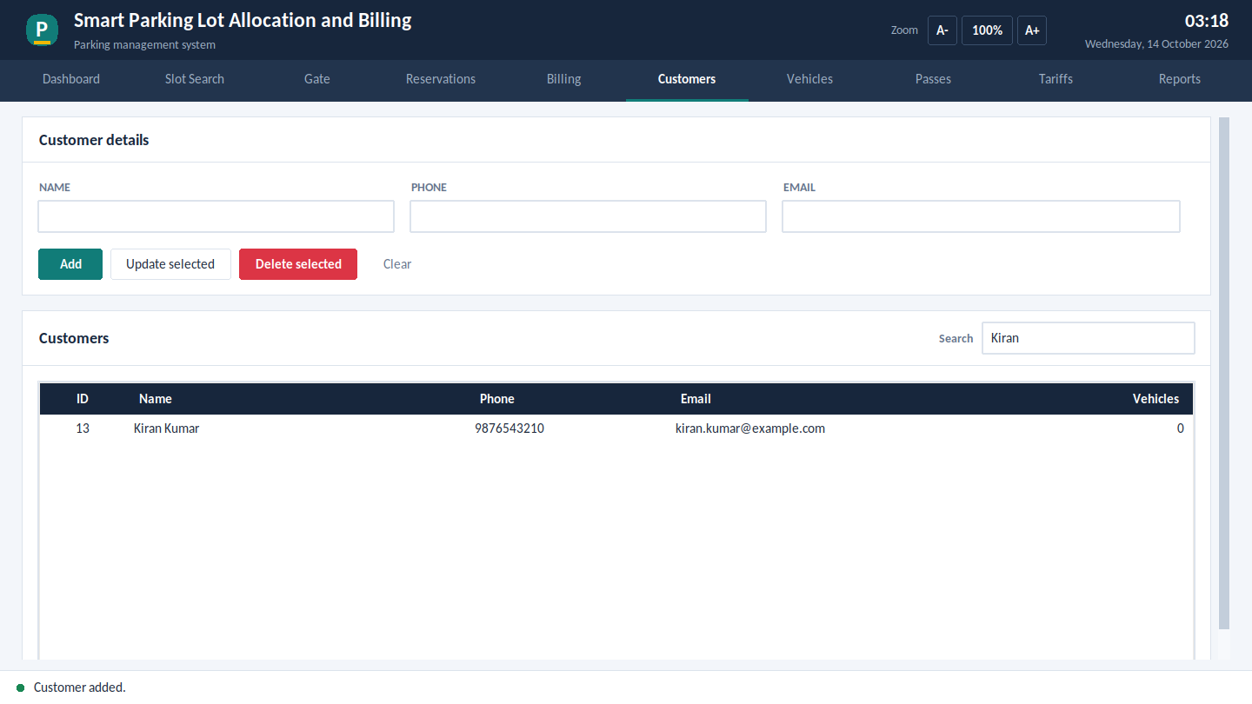
CRUD operations and search
Record | Create | Read / search | Update | Delete
Customer | yes | name, phone, email | yes | yes
Vehicle | yes | registration, owner | yes | yes
Reservation | yes | by status | cancel | cancel
Pass | yes | list and usage | renew | yes
Tariff | yes | list | yes | -
Slot | - | free / closed | open / close | -

Slide 11
Input validation in two layers
Field | Python checks before saving
Registration number | TS09EA1234 format, spaces and hyphens removed, upper case
Phone | 10 digits starting 6 to 9, +91 accepted
Email | Must contain @ and a domain
Name | 2 to 80 letters
Amount | Number above 0, at most 100000
Date and time | YYYY-MM-DD HH:MM; no past start, at most 24 h
Payment method | CASH, CARD, UPI or WALLET
Why two layers?
Python gives a quick, friendly message. MySQL repeats the key checks with CHECK, UNIQUE and triggers, so bad data cannot get in from any other tool either.

Slide 12
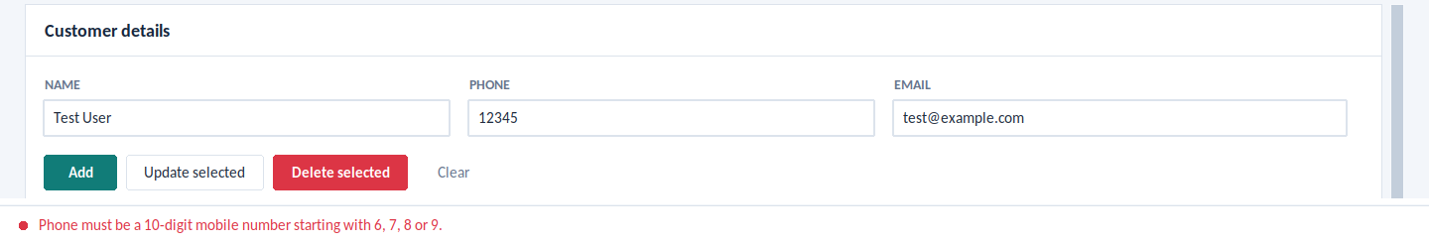

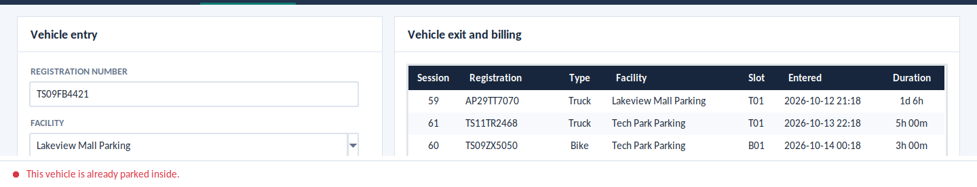
Error handling: clear messages, no crashes
Invalid phone number: nothing is saved
Customer still in use: delete refused
Vehicle already inside: entry refused
Every MySQL error (duplicate, CHECK, foreign key, rule trigger, lost connection) becomes one plain sentence in red. Unexpected problems are caught too, so the window never closes by itself.

Slide 13
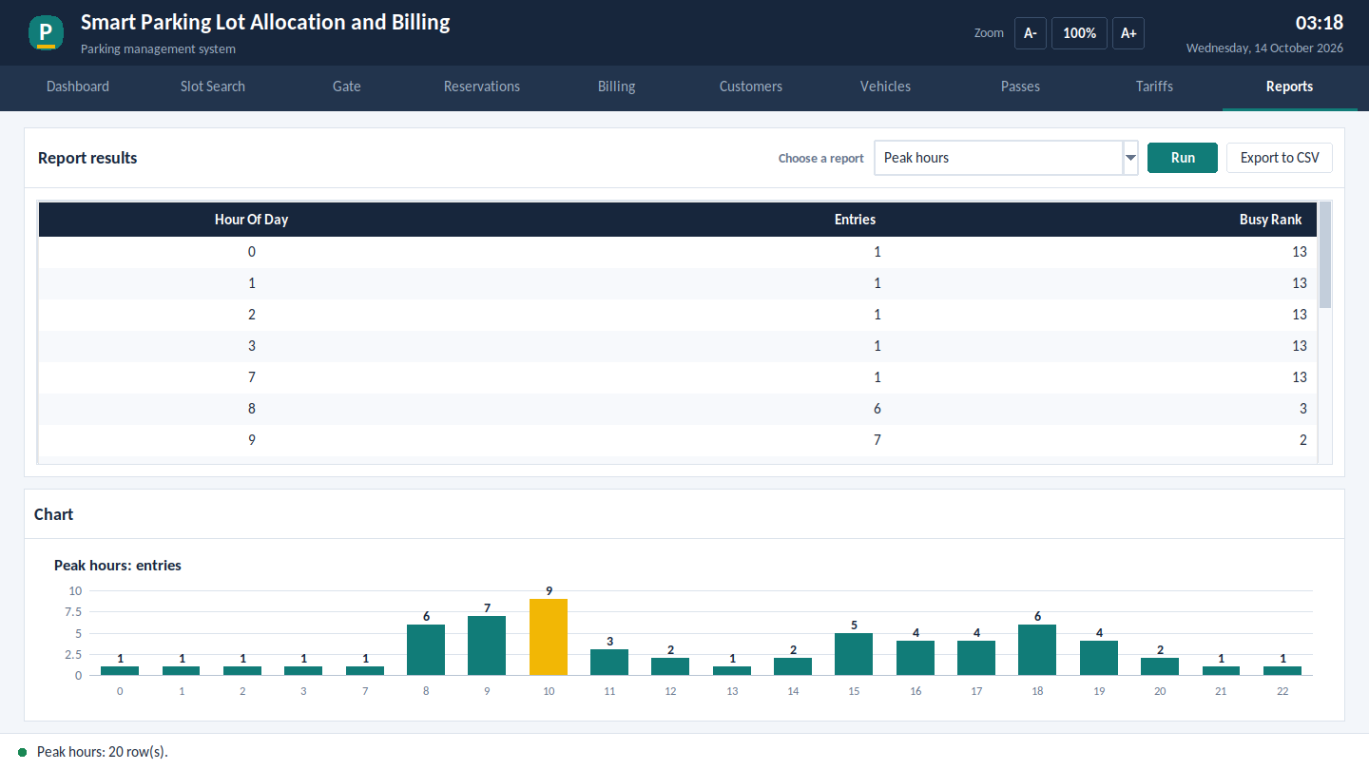
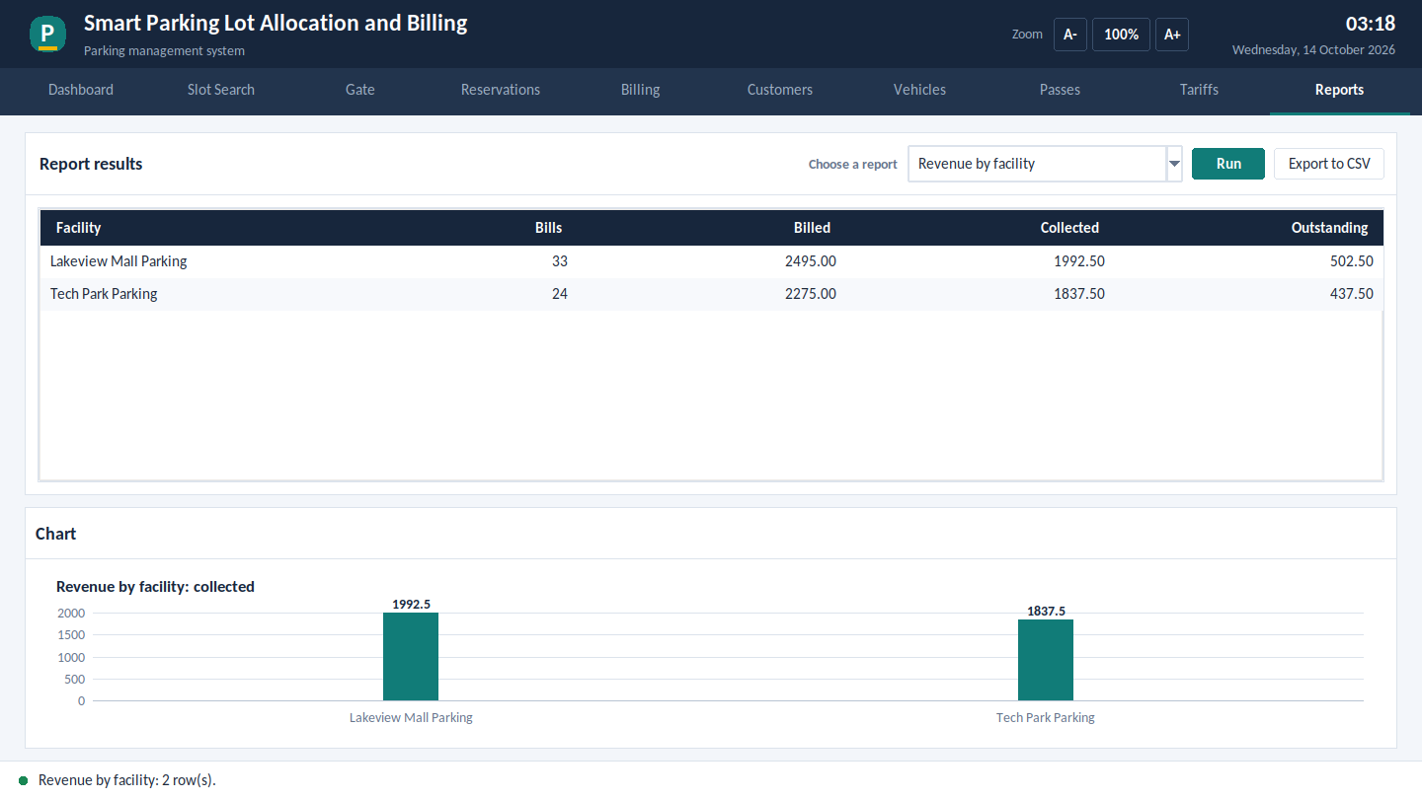
Reports and charts
Ten reports: occupancy, free slots, peak hours, longest stays, pass usage, violations, revenue by day, facility and method, unpaid bills.
Each report is a query on a database view. Charts are drawn for peak hours, occupancy and revenue; any report can be exported to CSV.

Slide 14
Transactions and data integrity
sp_vehicle_exit (simplified)
Exit and bill together
DECLARE EXIT HANDLER FOR SQLEXCEPTION
BEGIN ROLLBACK; RESIGNAL; END;
START TRANSACTION;
UPDATE parking_session
SET exit_time = ...;
SET v_tariff = fn_pick_tariff(...);
-- no tariff? raise an error
INSERT INTO bill ...;
COMMIT;
If the bill cannot be created, the exit time is undone. A vehicle is never left exited but unbilled.
Proved by a test
A vehicle type with no tariff is billed: the session stays open and no bill exists.
Single statements
An INSERT and the triggers it fires succeed or fail as one unit.

Slide 15
Systematic testing
23
automated tests
20
database rule tests
58
screen workflow checks
What the 23 automated tests cover
A bug the tests found
Billing: hourly rounding, one-hour minimum, daily cap, pass holders pay Rs 0
Gate: correct slot type, double entry refused, reservation used automatically
Payments: part payment, overpayment refused, status changes
CRUD with duplicates, invalid input and in-use records refused
All 10 reports, tariffs, passes, slot maintenance, transaction rollback; 58 screen checks at 100%, 150% and 200% zoom
The allocator could pick a slot still blocked by a stay with a later exit time. It now skips such slots. The fix is in sp_allocate_slot.

Slide 16

Summary and future work
Delivered
Future work
Normalized 13-table MySQL database
Number plate reading at the gate
Online and QR payments
Web or mobile front end
Logins and roles per user type
Dynamic pricing for peak hours
Business rules inside the database
Python app: 10 pages, zoom 80% to 200%
Sharp text, validation, friendly errors, reports
Tests, screenshots, documents, GitHub repository

