Slide 1
CATEGORY REVIEW: CHIPS
Retail Analytics

Slide 2
Notes:
To view Privacy video explaining how important data privacy is to Quantium, please click here: https://www.youtube.com/watch?v=Zq1QDAkoRzU
or here Q:\Company Reference\Brand & Design\Brand videos\Q Privacy.mp4
At Quantium, we believe that data is the behavioural footprint of humanity and that it has to be treated with the utmost care and responsibility.
Histories, attitudes, indeed lives are stored within it in ways that aren’t always apparent – and that’s what makes its potential so powerful.
To work with it responsibly, sensitively, we set ourselves the highest data privacy protection and governance standards.
We have spent 17 years perfecting privacy-by-design and secure-by-design principles. Central to this is not holding any personally identifiable information about people –
we neither receive it, and put the necessary protections in place to be unable to decipher it.
Every aspect of handling data is safeguarded: from its de-identification, to its encryption – data security is paramount and of the highest grade.
We pride ourselves on gaining the trust of iconic organisations around the world through years of securely working with their data,
and in turn the trust that builds with their stakeholders.

Slide 3
Executive summary
01
IDENTIFY CUSTOMER PURCHASING BEHAVIOR
AND PROVIDE COMMERCIAL RECOMMENDATIONS
Sales increase during December just before Christmas and then go down due to holidays
Sales are the highest on Fridays and Sundays
Most customers are older singles/ couples
Customers prefer to buy mainstream products
Total sales is driven majorly by two chips products: Smiths and Doritos
Preferred packet size for chips is 175g
02
ANALYSE IMPACT OF TRIAL STORES ON CUSTOMER SALES
Trial store 77’s marketing technique during the trial period did not work
Trial store 86 showed better results that store 77 in terms of increase in total sales, number of customers and number of transactions
Trial store 88 recorded maximum increase in total sales, number of customers and number of transactions. It carried out best implementation of the trial.

Slide 4
01
Customer Behaviour

Slide 5
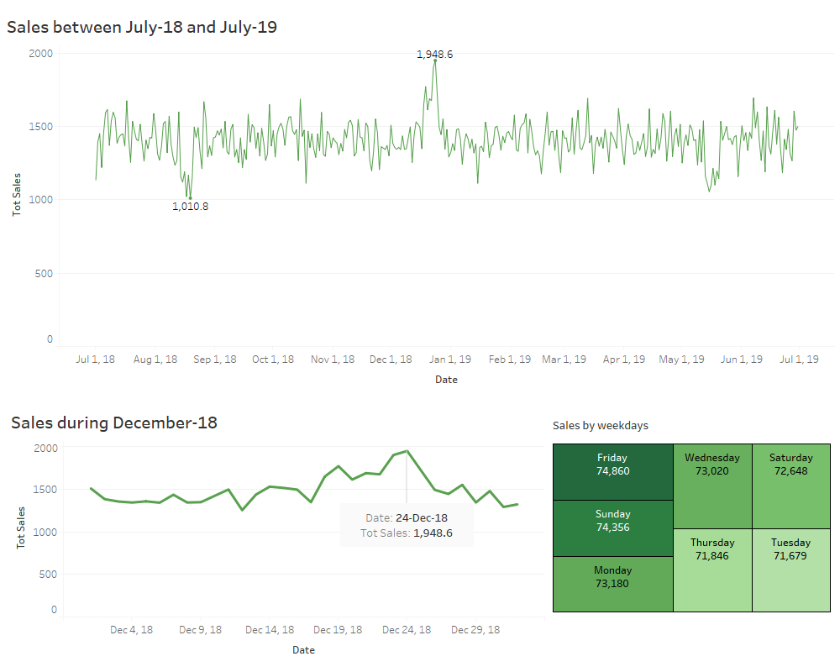
Sales increase during December just before Christmas and then go down due to holidays
Sales are the highest on Fridays and Sundays

Slide 6
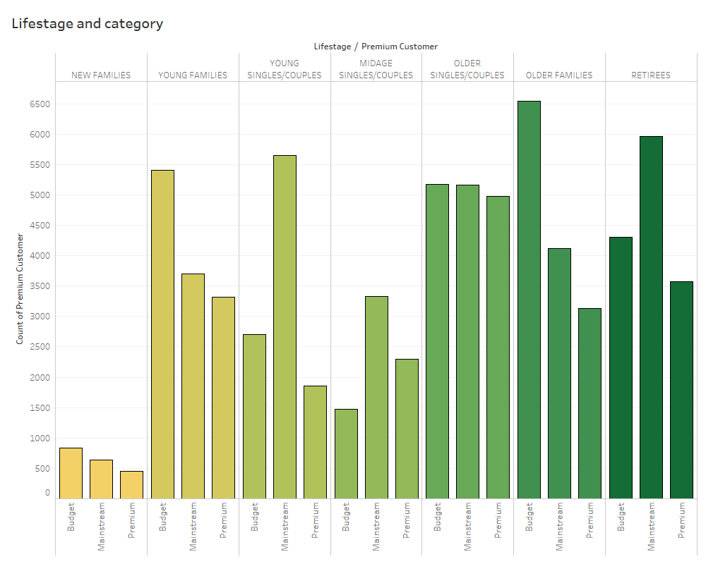
Families prefer to buy budget rated products
Singles/couples and retirees prefer to buy mainstream rated products

Slide 7
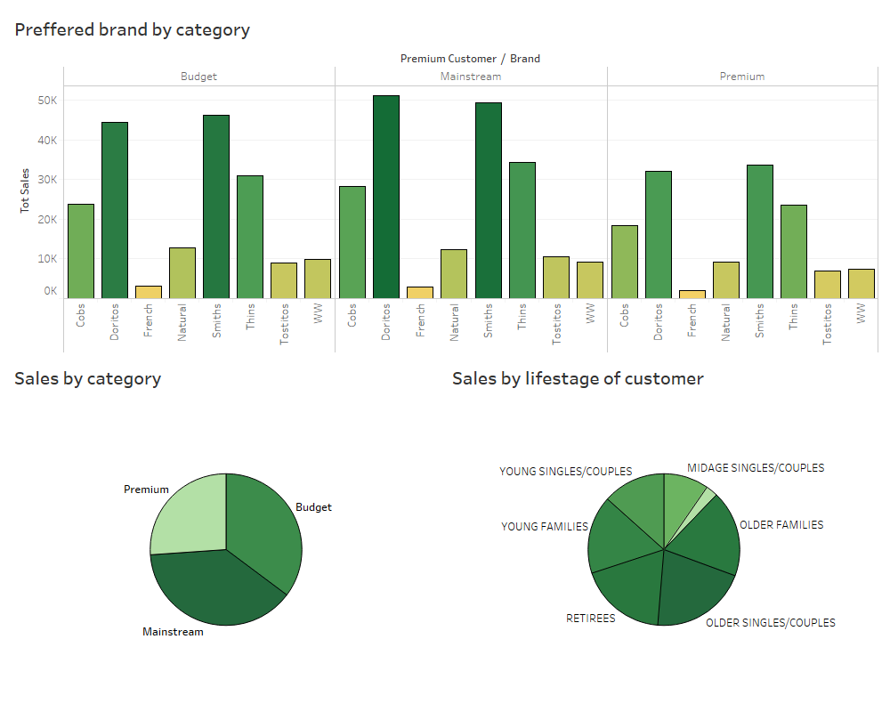
Preferred
Smiths & Doritos are the most sold brands
Customers prefer to buy mainstream products
Most customers are older singles/ couples

Slide 8
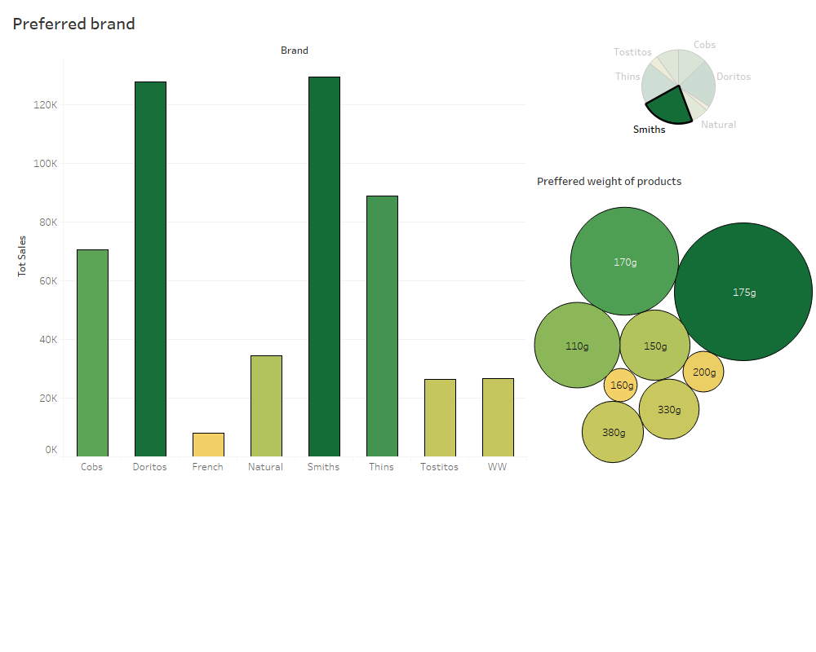
Total sales is driven majorly by two chips products: Smiths and Doritos

Slide 9
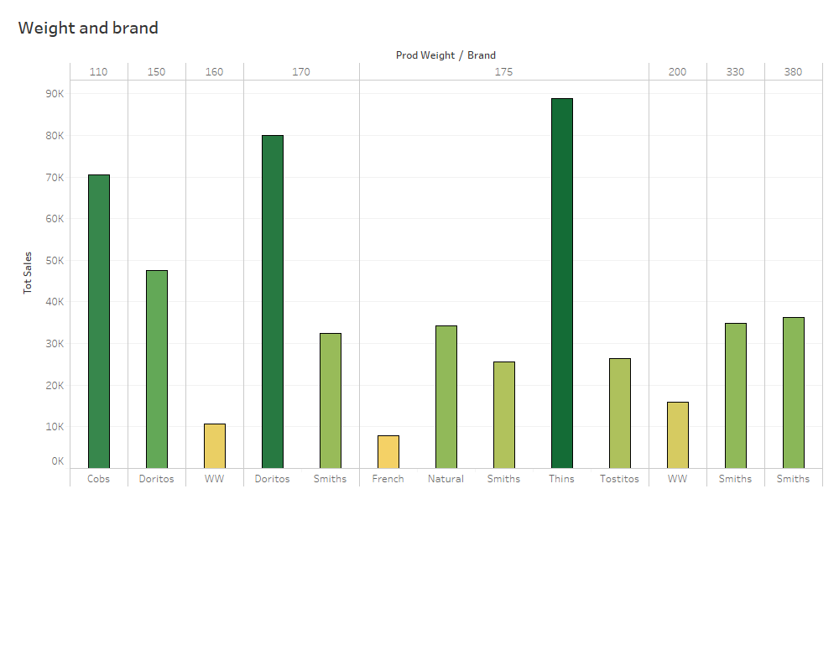
Preferred
Preferred brand for 110g : Cobs
Preferred brand for 150g : Doritos
Preferred brand for 160g : WW
Preferred brand for 170g : Doritos
Preferred brand for 175g : Thins
Preferred brand for 200g : WW
Preferred brand for above 200g : Smiths
Preferred packet size for chips is 175g

Slide 10
02
Trial store performance

Slide 11
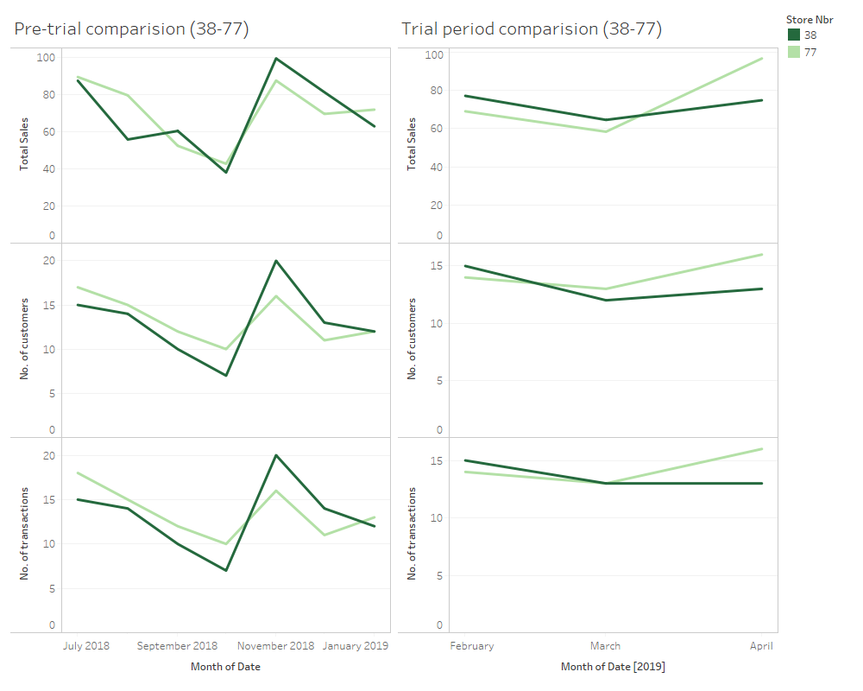
Trial store 77 showed moderate improvement in terms of total sales, number of customers and number of transactions
Trial store 77’s marketing technique during the trial period did not work

Slide 12
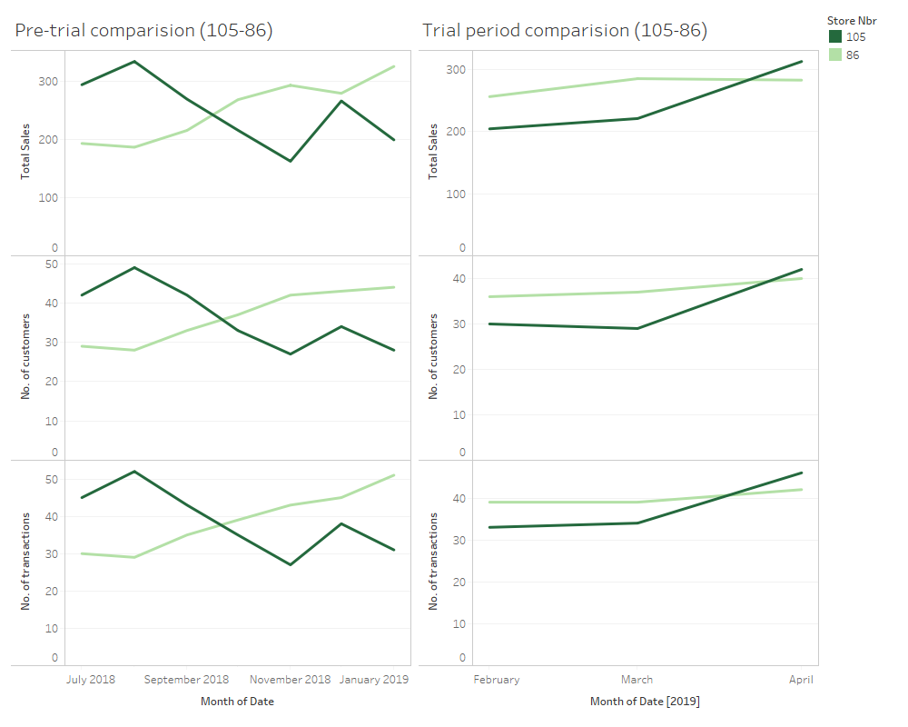
Trial store 86 showed better results that store 77 in terms of increase in total sales, number of customers and number of transactions

Slide 13
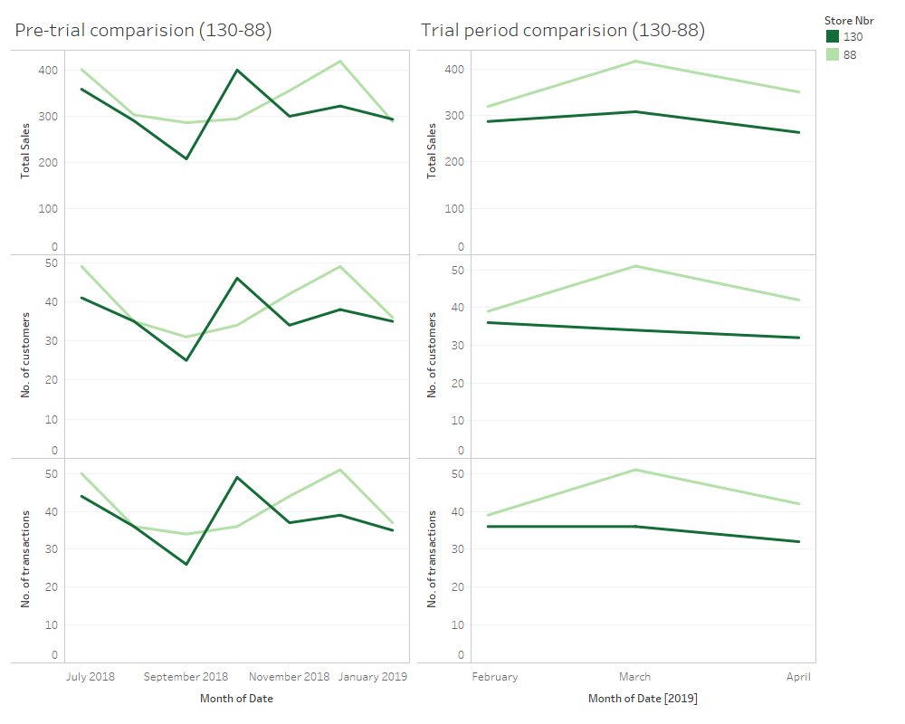
Trial store 88 recorded maximum increase in total sales, number of customers and number of transactions
Trial store 88 carried out the best implementation of trial and it must be followed in other stores as well

