Slide 1
APACHE2
Web Server Hosting
Installing, Configuring & Verifying Apache2 on Kali Linux

Slide 2
Assignment Overview
01
Install Apache2
sudo apt install apache2
02
Check Service Status
sudo systemctl status apache2
03
Start the Service
sudo systemctl start apache2
04
Host Files
/var/www/html/ — projects1, sample1.html, share9.txt
05
Verify Hosting
by IP address and by localhost

Slide 3
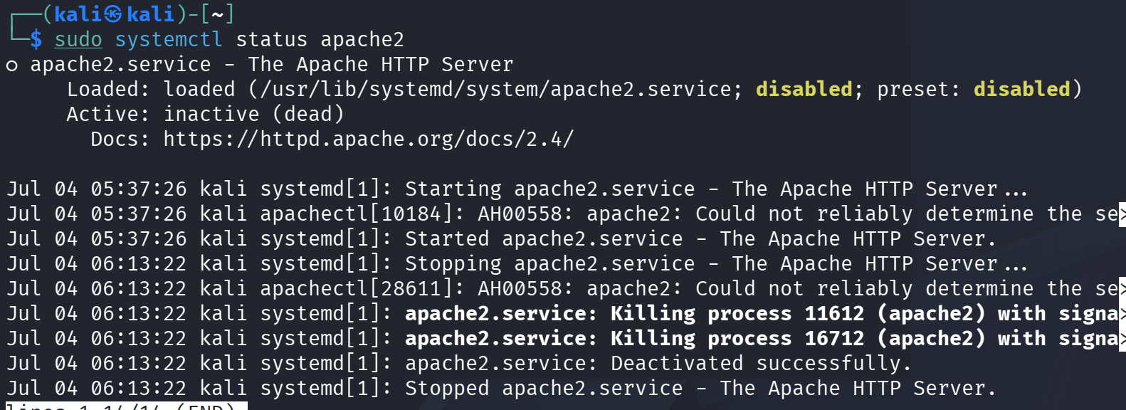
1
Install Apache2 & Check Status
Install command:
sudo apt install apache2
Check status command:
sudo systemctl status apache2
Result: Inactive
If the service is inactive, the status output will show “Active: inactive (dead)” as in the screenshot.
systemctl status apache2 — inactive

Slide 4
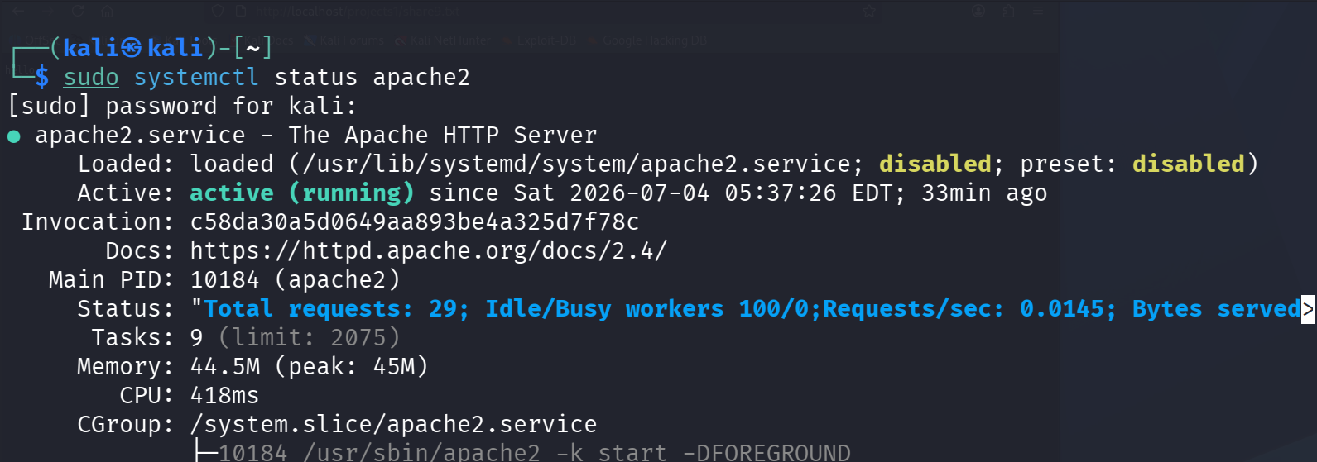
2
Start the Apache2 Service
Start command:
sudo systemctl start apache2
Result: Active (running)
Re-checking status confirms the service is active and running, with the process and memory details listed.
systemctl status apache2 — active (running)

Slide 5
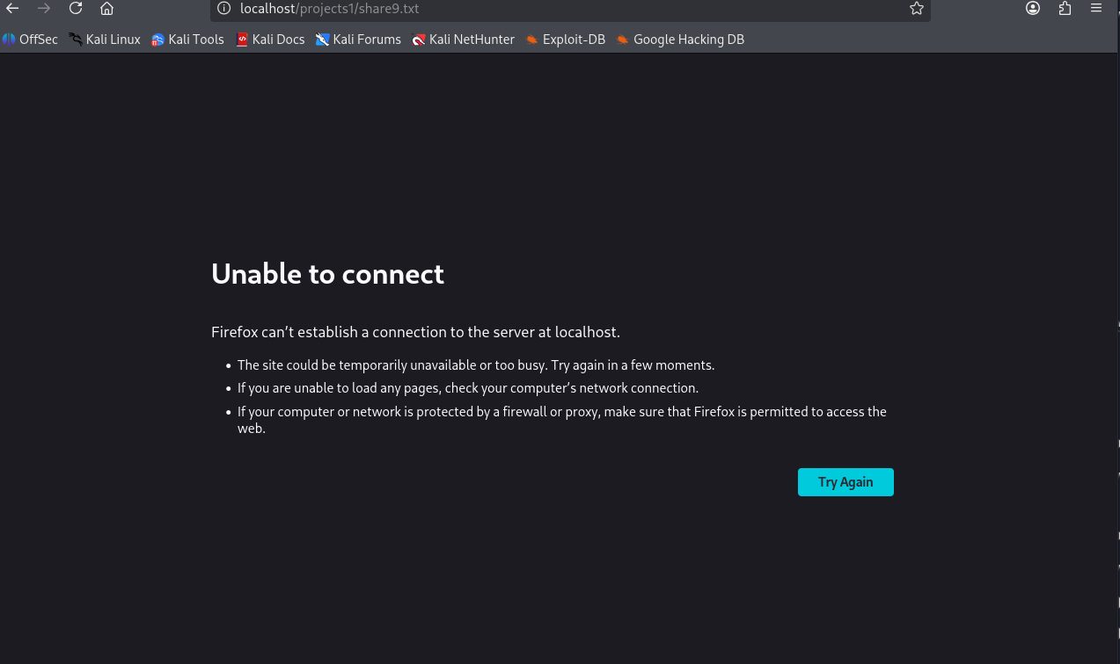
3
Accessing the Server — Error Case
If the server is not active, attempting to reach it in the browser throws a connection error, as shown below.
Firefox — Unable to connect (localhost)

Slide 6
4
Hosting Files
Web root
/var/www/html/
Project folder
Created projects1 under /var/www/html/
Access URL
http://localhost/projects1
Test file 1
sample1.html — created inside projects1
Test file 2
share9.txt — empty file created, then populated using cat >> and closed with Ctrl+D

Slide 7
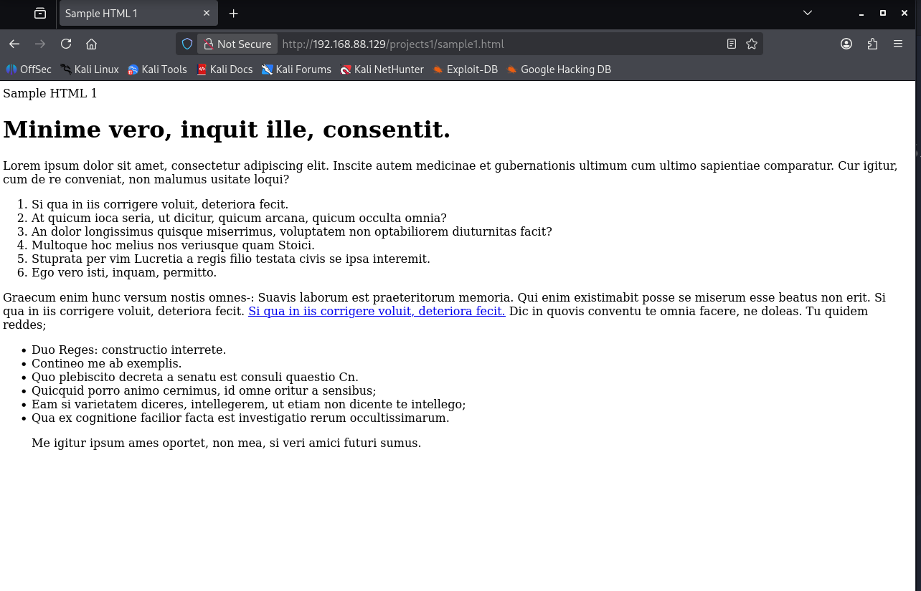
5
Verification — Method 1: By IP Address
Accessing the hosted sample1.html page using the server's IP address confirms Apache2 is serving content correctly.
http://192.168.88.129/projects1/sample1.html
sample1.html rendered via IP address

Slide 8
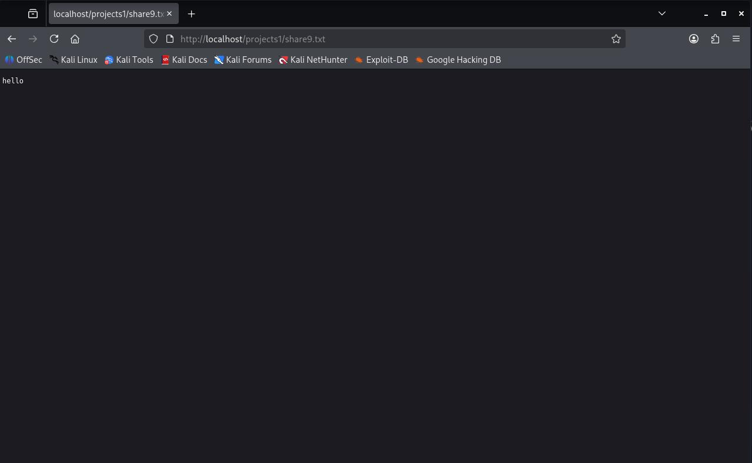
5
Verification — Method 2: By localhost
Accessing share9.txt through localhost confirms the created file is being served from the projects1 directory.
http://localhost/projects1/share9.txt
share9.txt served via localhost

Slide 9
Summary
Apache2 installed with: sudo apt install apache2
Service status checked with: sudo systemctl status apache2
Inactive service started with: sudo systemctl start apache2
Files hosted from /var/www/html/projects1 (sample1.html, share9.txt)
Hosting verified two ways: by IP address and by localhost

