Slide 1
RECON
Reconnaissance Methodology
Subdomain • URL • Content Discovery • Port Scanning • IP Collection
Target: hackthebox.com

Slide 2
Assignment Overview
01
Subdomain Discovery
subfinder, chaos, assetfinder, amass
02
URL Discovery
katana, gau, waybackurl
03
Content Discovery
directory / content enumeration
04
Port Scanning
nmap — top 1000 common ports
05
IP Collection
resolving & recording target IPs

Slide 3
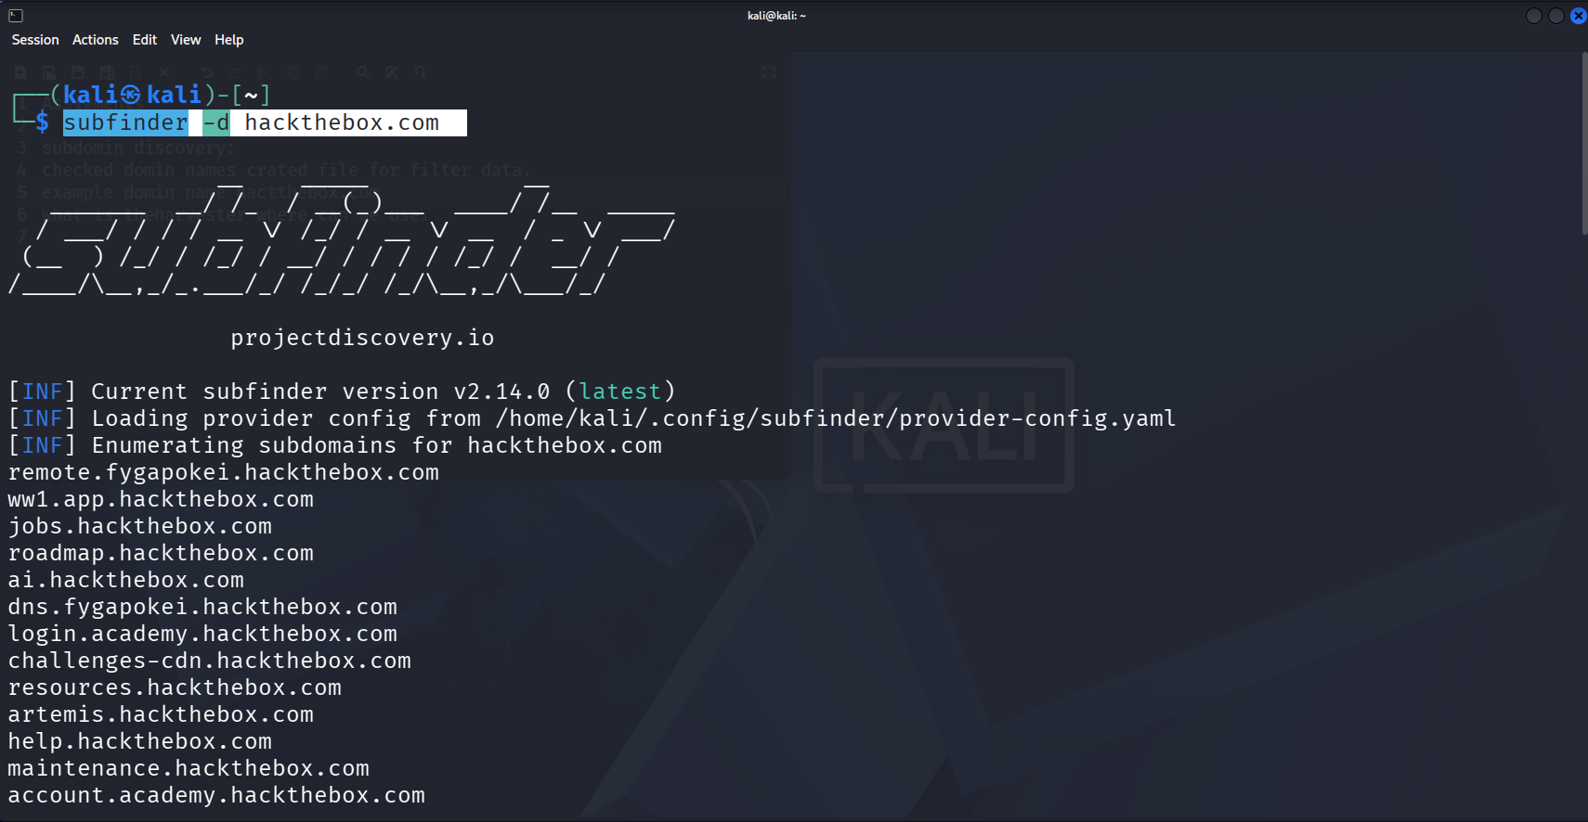
1
Subdomain Discovery — Tools Used
subfinder
✓
Used successfully to enumerate subdomains
chaos
✕
Not able to find subdomains
assetfinder
✓
Used successfully to enumerate subdomains
subfinder -d hackthebox.com
amass
✕
Not able to find subdomains

Slide 4
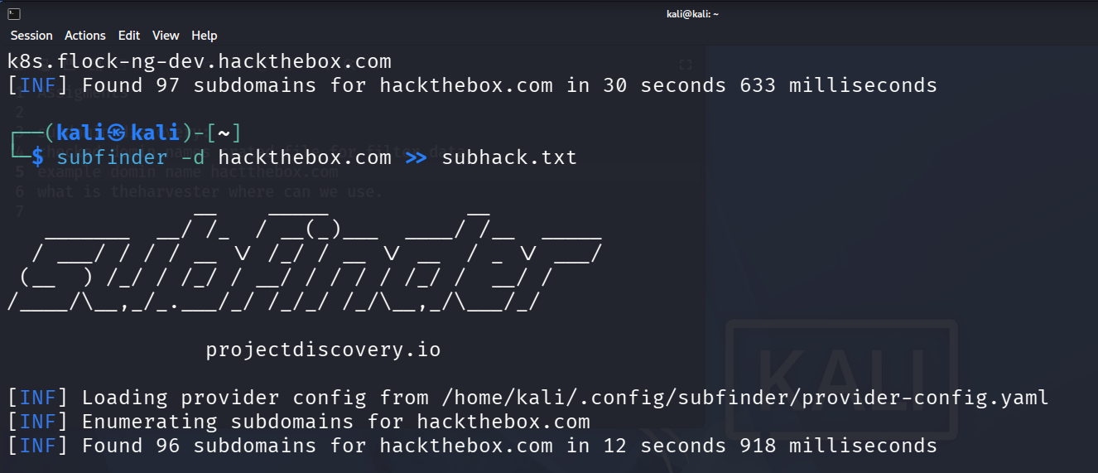
1
Subdomain Discovery — Saving Output
Command executed:
subfinder -d hackthebox.com >> subhack.txt
Output file created:
subhack.txt
All discovered subdomains for hackthebox.com were appended into this file for later filtering and analysis.
Command output & file creation

Slide 5
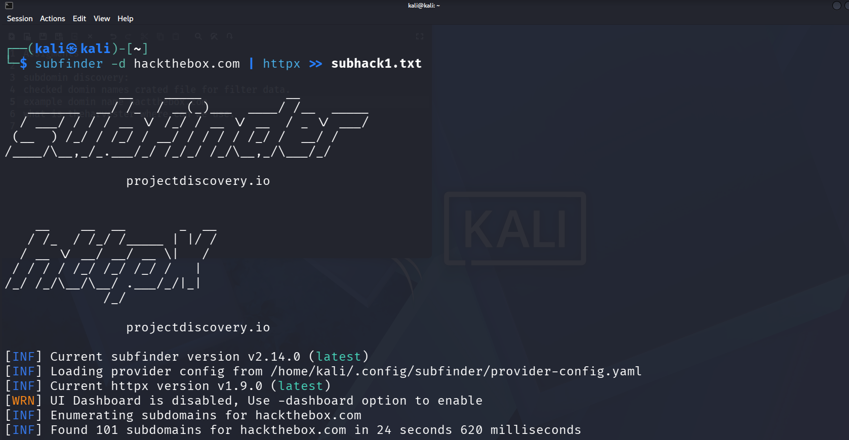
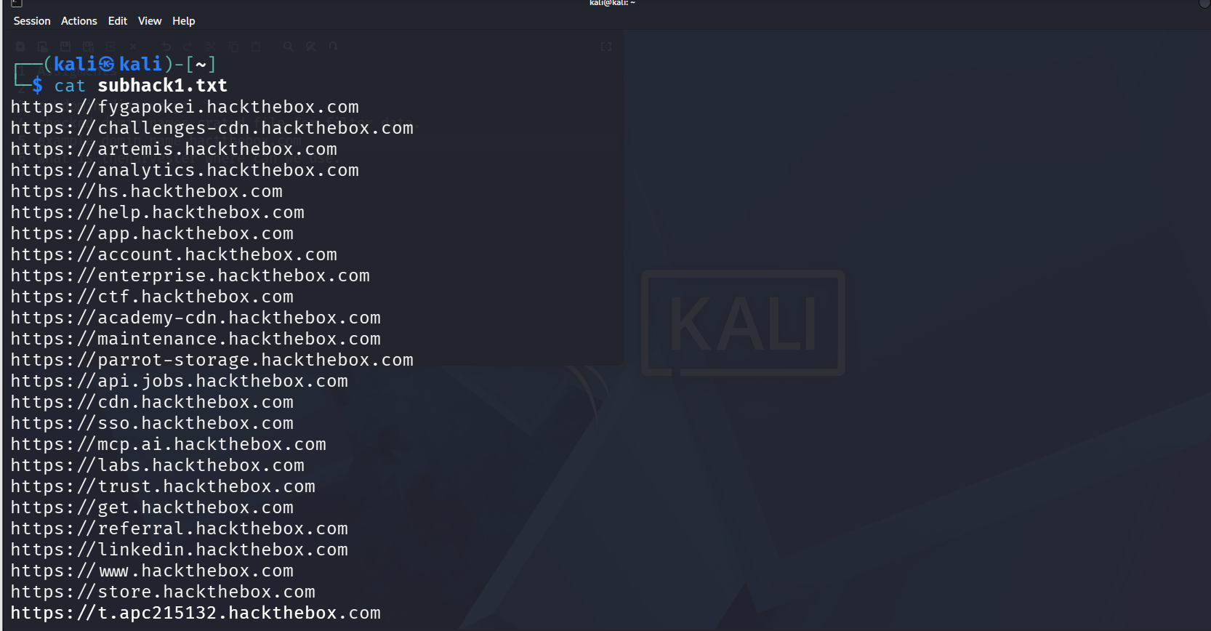
1
Subdomain Discovery — Filtering Results
Subdomains saved in subhack.txt were filtered to remove noise and duplicates before further analysis.
Filtering command
Filtered subdomain data

Slide 6
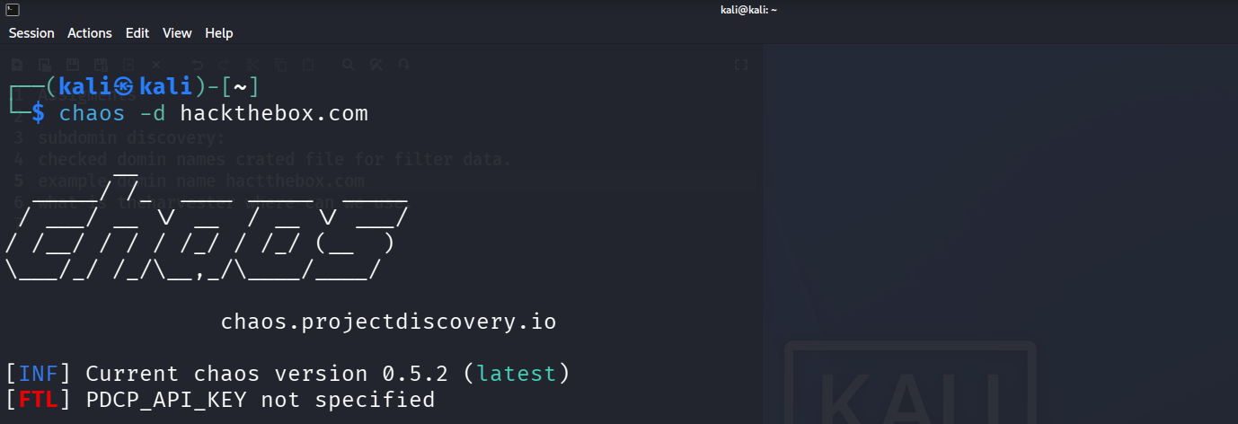
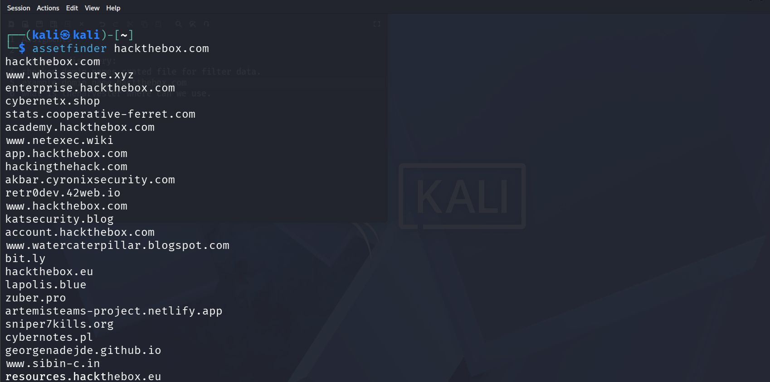
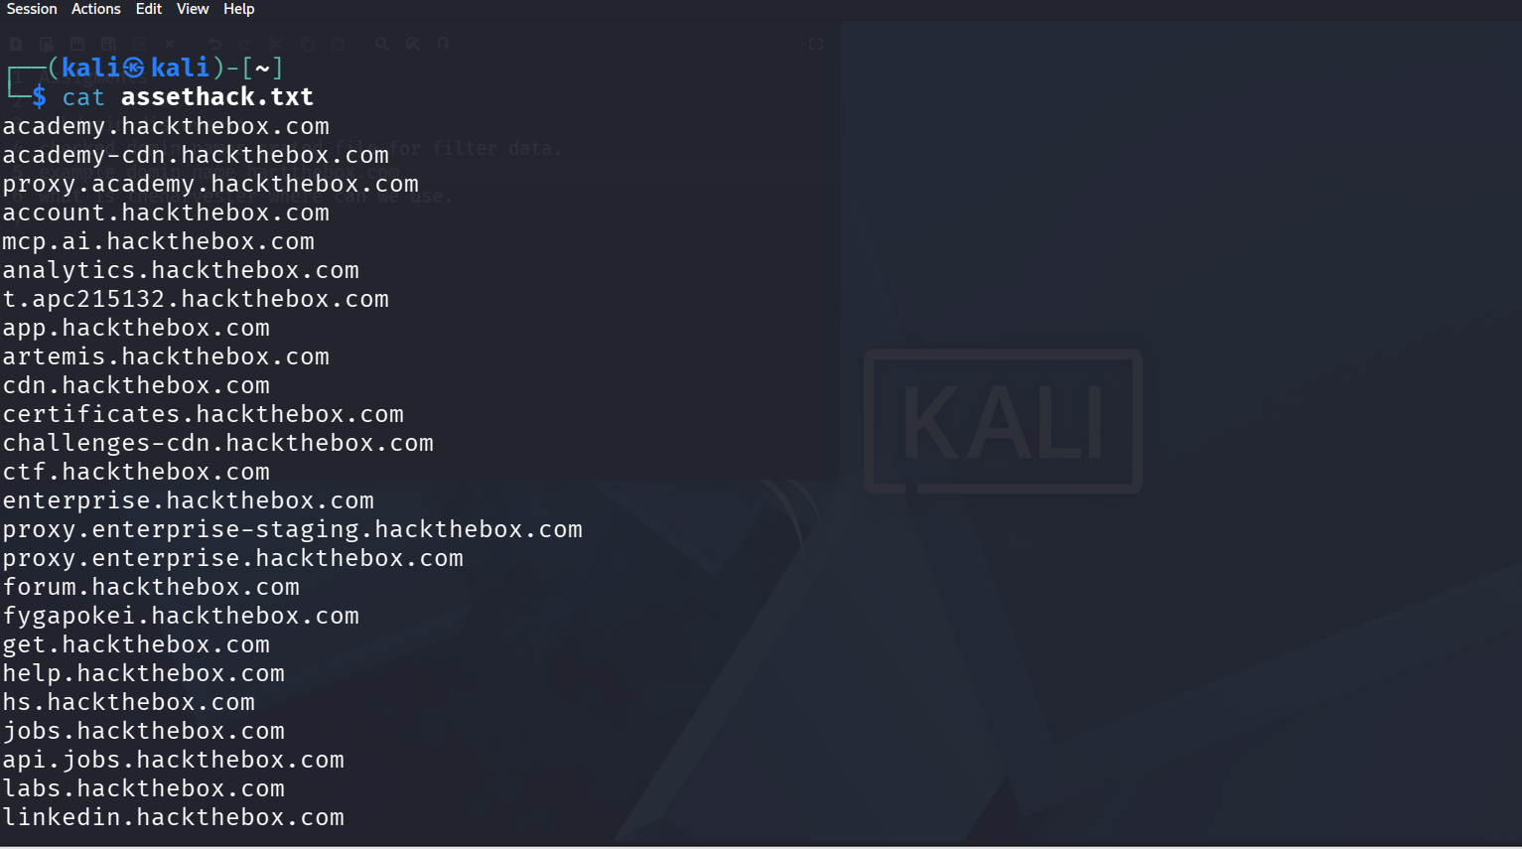
1
Subdomain Discovery — Chaos & Assetfinder
chaos — no subdomains found
assetfinder tool run
assetfinder — file created

Slide 7
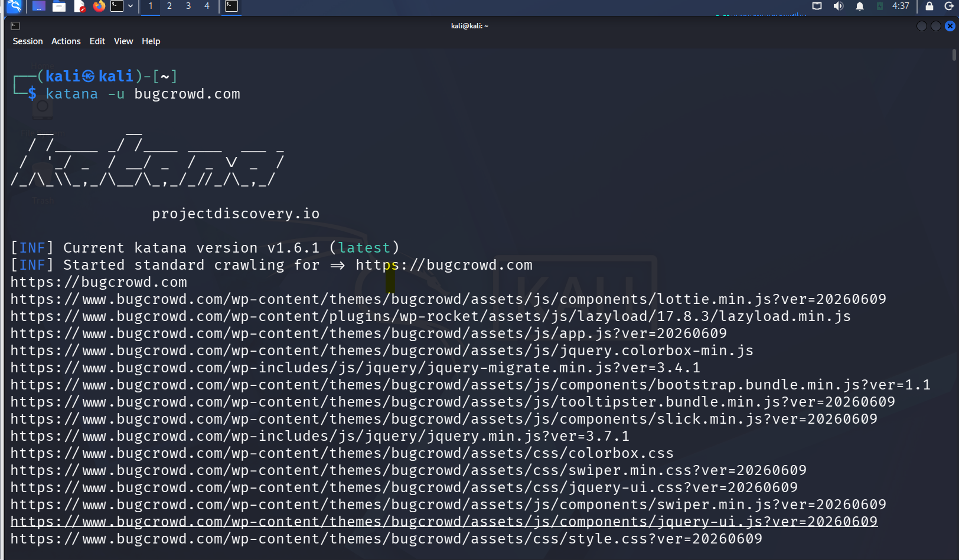
2
URL Discovery — Tools Used
›
Katana
›
Gau
›
Waybackurl
Katana crawl output

Slide 8
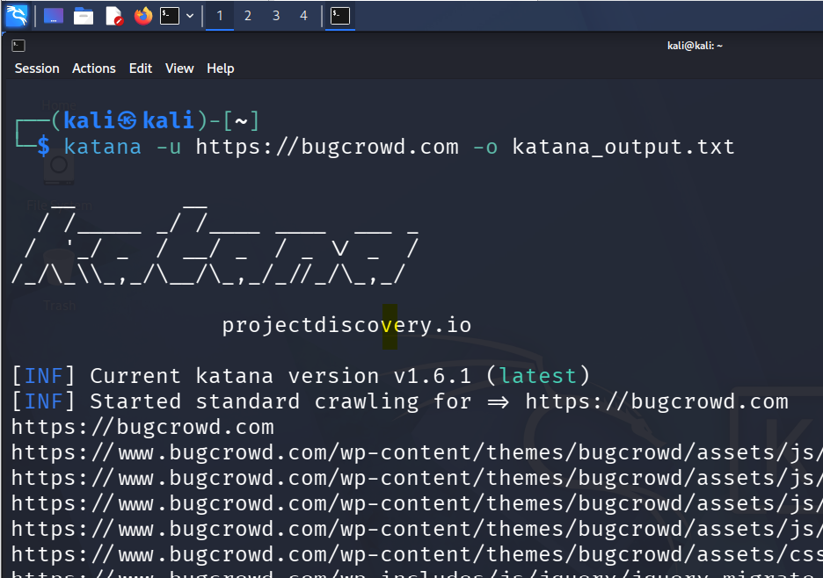
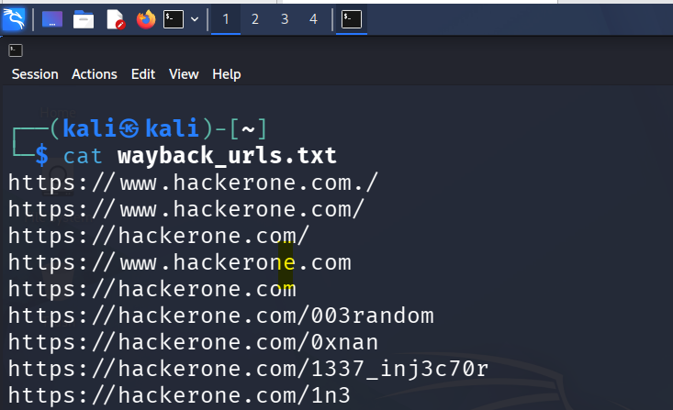
2
URL Discovery — Saving Data & Waybackurl
waybackurl results
Saved data in file

Slide 9
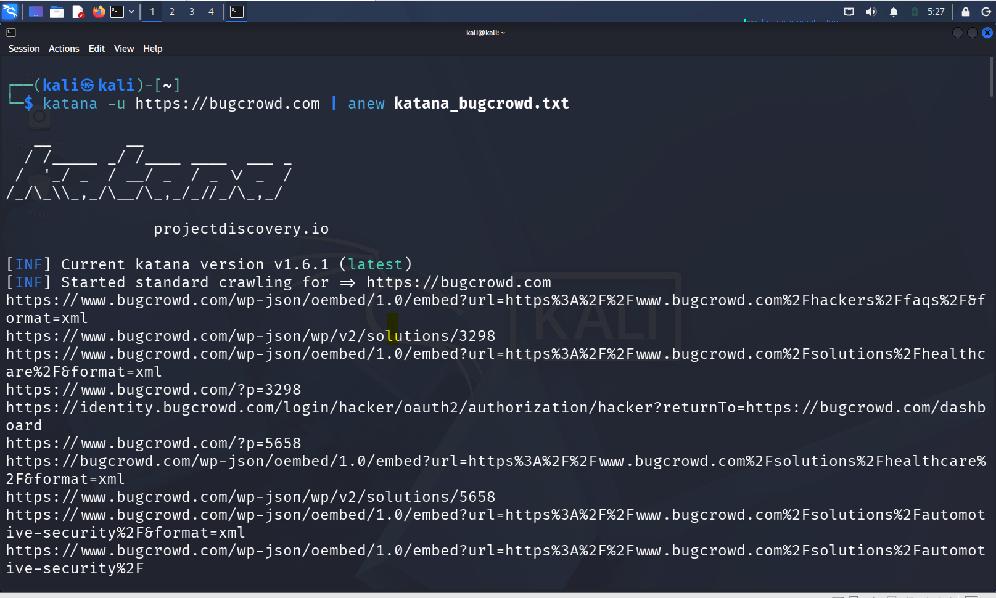
2
URL Discovery — Consolidated Scan Output
URLs gathered were scanned and consolidated into a new output file for the next phase of testing.
New file from scanned URLs

Slide 10
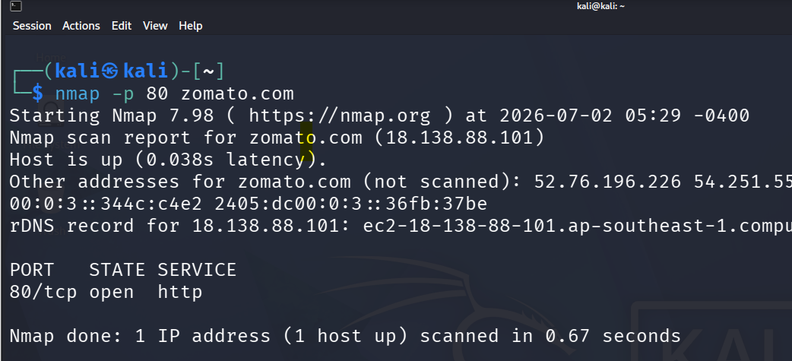
3
Content Discovery & Port Scanning
Content Discovery
Planned phase for enumerating accessible content/directories on the target. No further detail was recorded in the source notes.
Port Scanning
Tool: nmap
Scope: top 1000 common ports
nmap scan — top 1000 ports

Slide 11
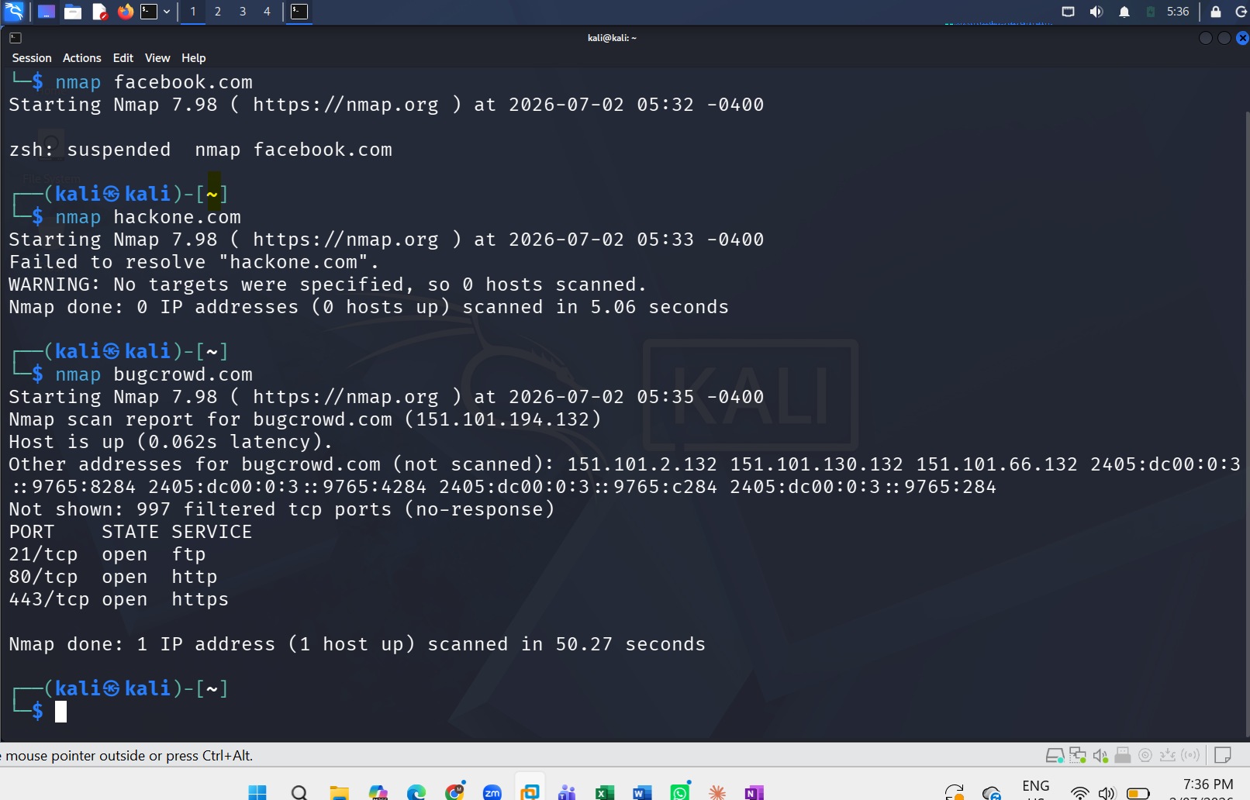
4
Port Scanning — Results
nmap scan results

Slide 12
Summary
Subdomain discovery: subfinder & assetfinder succeeded; chaos & amass found no subdomains
URL discovery: katana, gau, and waybackurl used to collect target URLs
Content discovery: planned but not detailed in source notes
Port scanning: nmap scan across the top 1000 common ports
IP collection: listed as a planned phase in the assignment scope

