Slide 1



EXATHON 2026
DataTrust Ops
TRACK 4: THE WORK BEHIND THE WORK
Autonomous Data Reliability & Observability Platform
"Eliminating silent data decay before it poisons downstream business intelligence."

Slide 2
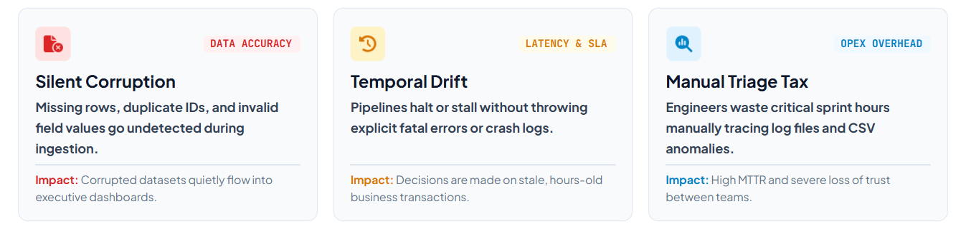


02
PROBLEM STATEMENT
!
The Core Problem: Traditional APM tools observe server uptime—not data integrity. Organizations lack unified, proactive data observability.

Slide 3
03
PROPOSED SOLUTION
Key innovations
Expected impact
  Unified monitoring of pipelines, quality, freshness and incidents
  Independent data freshness evaluation
  Circuit-breakers stop high scores hiding severe problems
  Column-level validation with explainable incidents
  Earlier detection of data-quality issues
  Less manual inspection effort
  Better visibility into pipeline operations
  Greater confidence in business data
  More informed incident prioritisation
Notes:
8

Slide 4
04
ARCHITECTURE & STACK
User
→
React Frontend
→
Node.js & Express Backend
→
Validation & Scoring Services
→
MongoDB
Frontend
React.js
Vite
Tailwind CSS
Recharts
Backend
Node.js
Express.js
REST APIs
Database
MongoDB
Mongoose
Data processing
Papa Parse
JavaScript validation and scoring
Notes:
4

Slide 5
05
KEY MODULES
1
Operations Dashboard
Reliability scores, freshness, incidents and pipeline health
2
Pipeline Monitoring
Four simulated pipelines with status, logs and run controls
3
CSV Quality Scanner
Finds missing values, duplicates, invalid and empty data
4
Reliability Scoring
Weighted quality: completeness, uniqueness and validity
5
Freshness Monitoring
Checks data age against timestamp and SLA policies
6
Incident Management
Creates and tracks incidents for significant quality issues
7
AI Incident Assistant
Deterministic explanations and recommended next steps
Notes:
5

Slide 6
06
IMPLEMENTED COMPONENTS
React-based responsive dashboard
Node.js and Express REST API backend
1
2
MongoDB database connectivity
CSV upload and automated validation
3
4
Data reliability scoring and operational circuit-breakers
Pipeline execution simulation
5
6
Incident creation and status management
Deterministic AI incident explanations
7
8
Notes:
7

Slide 7
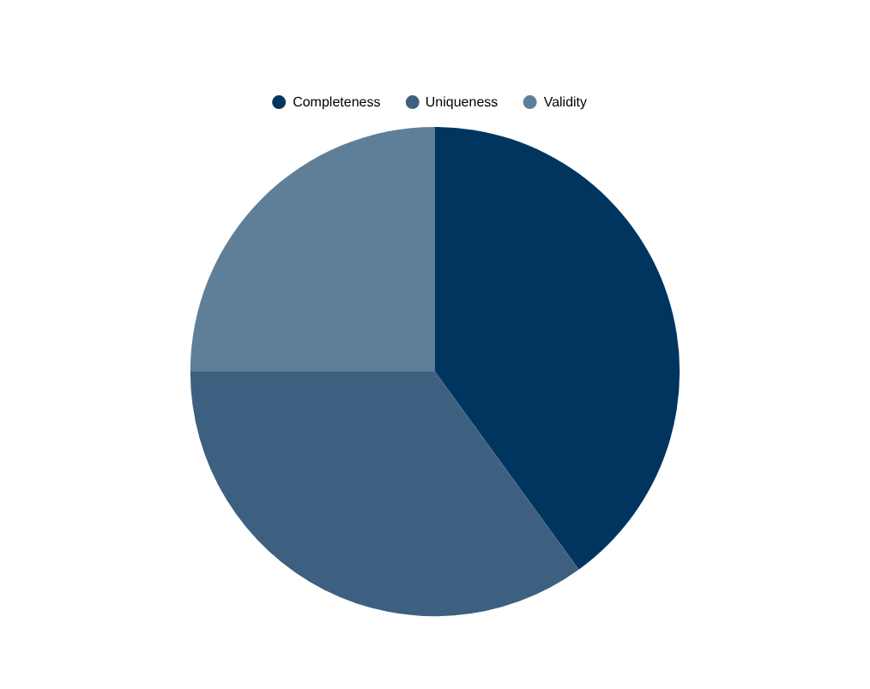
07
RELIABILITY SCORING
Weighted quality
Each dataset is scored on completeness (40%), uniqueness (35%) and validity (25%).
Operational circuit-breakers
Severe issues cap the grade, so a high weighted score cannot hide them.
Example: orders_missing_values.csv scores 94.7% but is graded C after circuit-breakers.
Notes:
6

Slide 8
08
INNOVATION & IMPACT
Key innovations
Expected impact
  Unified monitoring of pipelines, quality, freshness and incidents
  Independent data freshness evaluation
  Circuit-breakers stop high scores hiding severe problems
  Column-level validation with explainable incidents
  Earlier detection of data-quality issues
  Less manual inspection effort
  Better visibility into pipeline operations
  Greater confidence in business data
  More informed incident prioritisation
Notes:
8

Slide 9
09
CONCLUSION & FUTURE SCOPE
DataTrust Ops transforms data reliability from reactive troubleshooting into proactive monitoring. By combining pipeline observability, automated quality validation, freshness assessment and incident management, it helps organisations maintain greater confidence in their data.
Future scope
Enterprise ETL platform integration
LLM-powered root-cause analysis
Real-time monitoring and alerts
Predictive anomaly detection
Cloud deployment and role-based access
Notes:
9

Slide 10
10
THANK YOU

