Slide 1
Seeing the Harvest
Before It Happens
Drone-Based Bloom Intelligence for Almond Yield Forecasting
A statistical validation report, tested against 167 real, weighed tree-harvests
KEDMA PLOT A · ISRAEL

Slide 2
Yield Forecasts Today Are
Guesswork Dressed Up as Data
The model growers rely on today, predicted_Yield, is built mostly from canopy and growth measurements, a clustering model's output, not a real weighing of the harvest.
29%
It can reconstruct itself almost perfectly, 94 to 96 percent, when tested against its own ingredients. Tested against what actually came off the trees across 167 tree-harvests (2022-2023), that accuracy collapses to 29 percent.
of the real, weighed harvest's variation explained by the existing model (r=0.54, p<0.001, n=167)
Kedma Plot A · Almond Yield Forecasting
2

Slide 3
A Drone Flight in February.
A Forecast You Can Trust in July.
1
Fly the orchard at bloom
A UAV pass in February extracts each tree's Enhanced Bloom Index (EBI) from 4-band imagery, per tree, not per block.
2
Add cultivar identity
Bloom intensity predicts yield in opposite directions by cultivar: UEF r=+0.29, cultivar 53 r=-0.26 (interaction F=11.58, p=0.0009). The model treats them differently, not as one average tree.
3
Add winter chill and canopy growth
Chill Portions (Dynamic Model) and spring canopy growth round out what the drone alone can't see.
4
Validate against the real harvest
Every number in this deck is checked against trees the model never saw during training, not just how well it fits its own data.
Kedma Plot A · Almond Yield Forecasting
3

Slide 4
The Full Comparison, Not Just the Highlights
Pooled across both cultivars, 167 tree-harvests, 2022-2023, Kedma Plot A
Comparison | r | R² | p-value | n
Existing model vs. real harvest | 0.541 | 29.3% | < 0.001 | 167
Our model vs. real harvest (fit to its own training data) | 0.727 | 52.9% | < 0.001 | 167
Our model vs. real harvest (cross-validated, the honest number) | n/a | 45.6% | n/a | 167
Our model vs. existing model (agreement only, not accuracy) | 0.745 | 55.6% | < 0.001 | 167
Why two R² numbers for our model? 53% is how well it fits the same data it was built on, always a bit optimistic. 46% is the stricter test: fit on some trees, checked on others it never saw. We report 46% throughout this deck because it is the number that predicts how the model performs on a new tree.
Kedma Plot A · Almond Yield Forecasting
4

Slide 5
The Numbers That Matter
Checked against 167 real, weighed tree-harvests, 2022-2023 · Kedma Plot A
46%
0.97 kg
18%
vs 29%
vs 1.19 kg
lower error
of real harvest variation explained
(our model vs. the existing model)
average forecast error per tree
(our model vs. the existing model)
reduction in average forecast error
per tree, tree by tree
Kedma Plot A · Almond Yield Forecasting
5

Slide 6
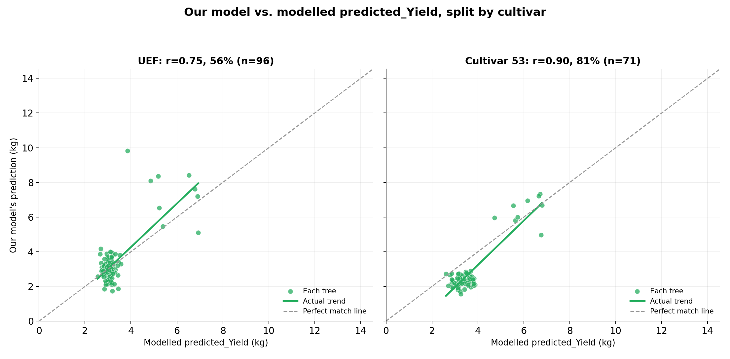
We Also Checked the Two Models
Against Each Other
r = 0.745 · R² = 55.6%
The two models agree fairly closely with each other.
That agreement is expected, not reassuring on its own: both models use cultivar and overlapping growth measurements as inputs, so part of it simply comes from sharing ingredients.
Two models agreeing is not the same as either one being right about the real harvest. Only the direct checks against actual yield, on the following pages, establish that.
Kedma Plot A · Almond Yield Forecasting
6

Slide 7
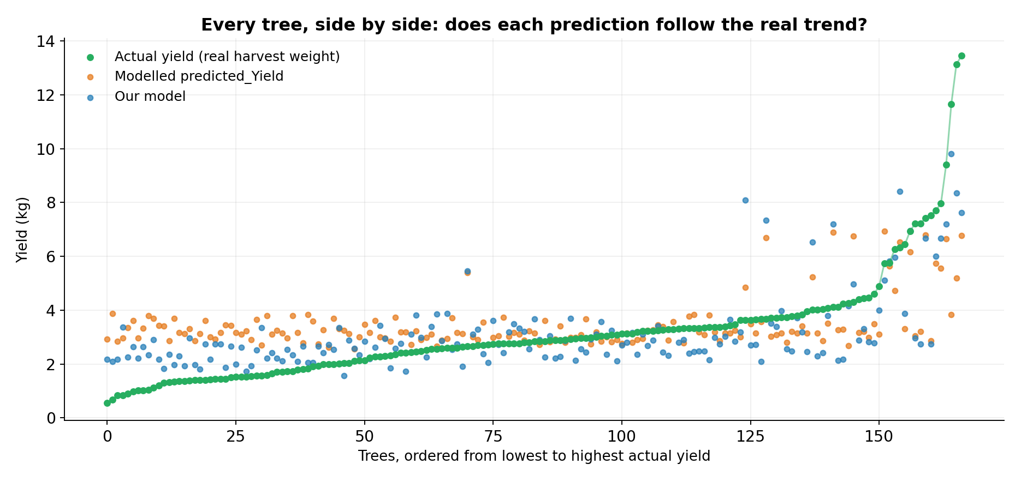
Not Just a Better Average.
A Better Fit, Tree by Tree.
Trees ordered by actual yield (n=167). Our forecast tracks the real harvest closely across the whole range, especially the highest-yielding trees, where the existing model stays flat.
Kedma Plot A · Almond Yield Forecasting
7

Slide 8
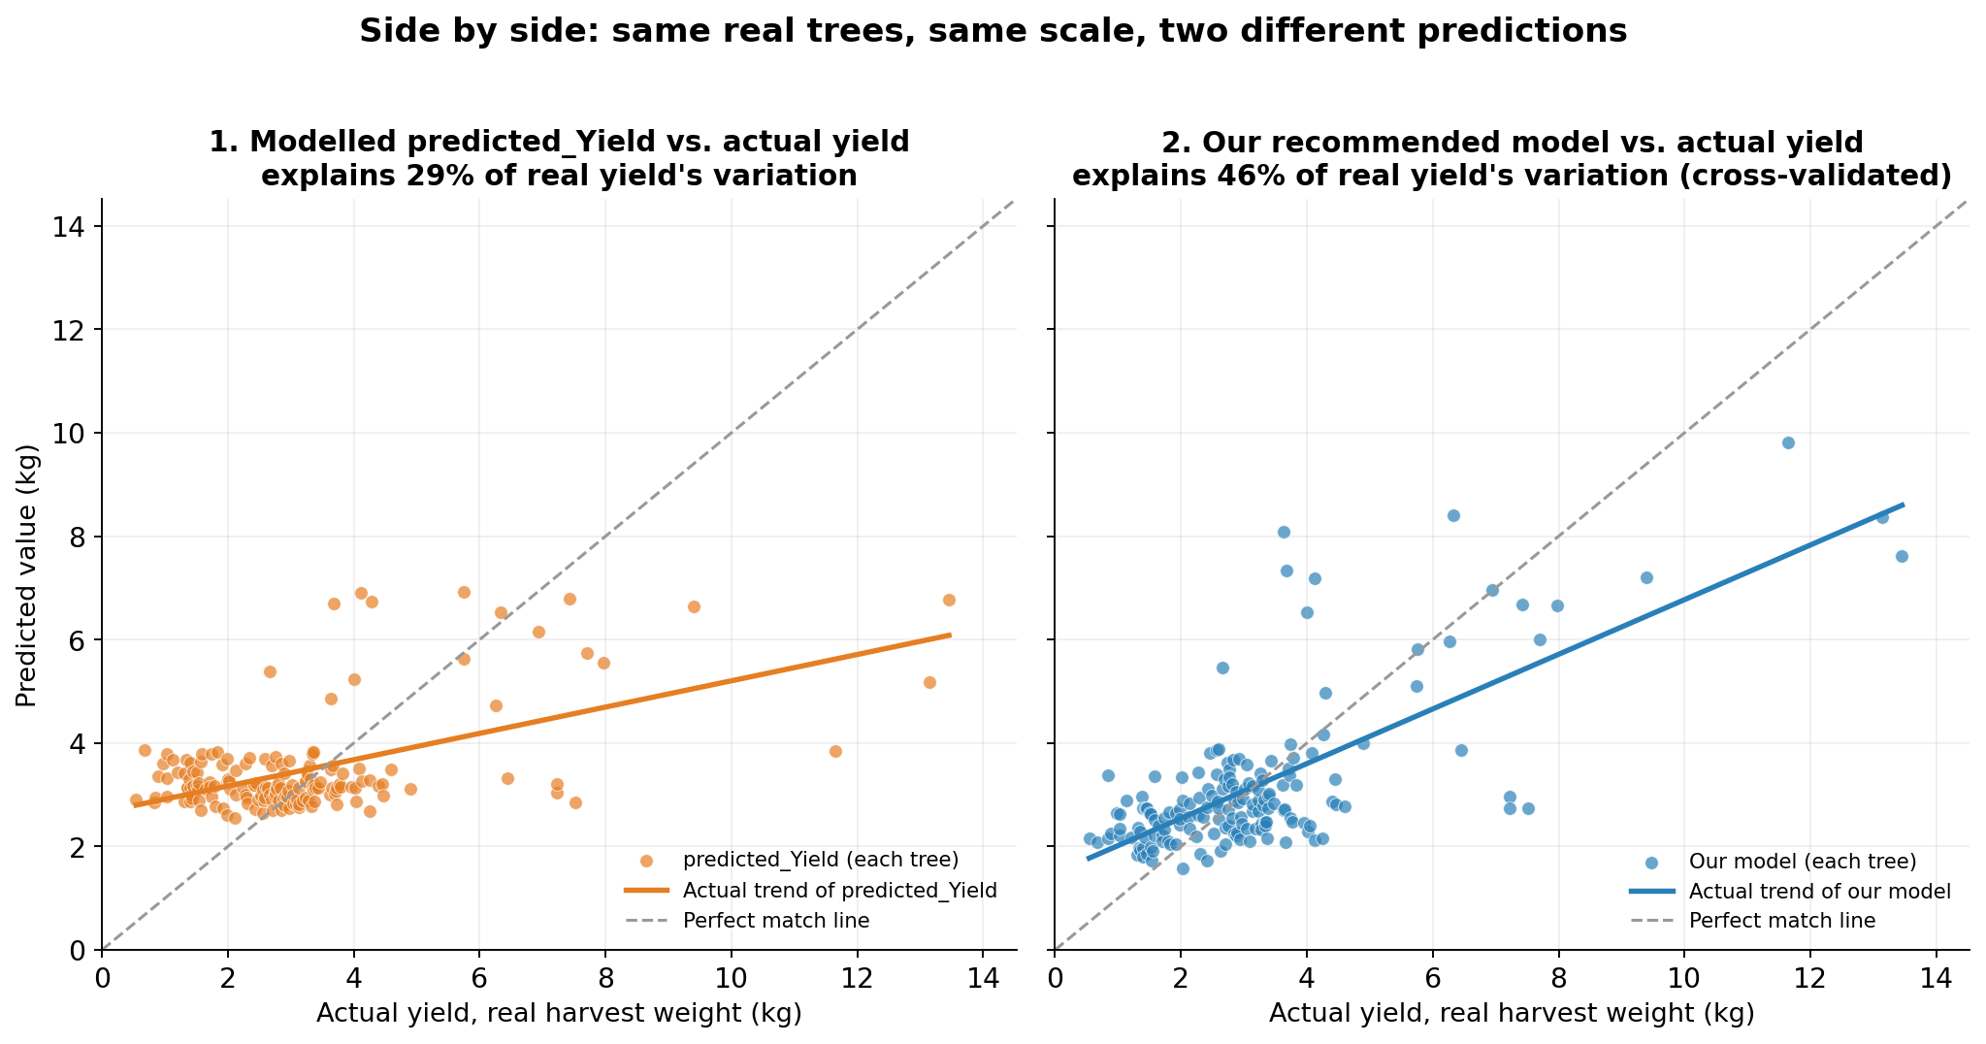
Checked Against the Real Harvest,
Not Against Itself
Same 167 trees, same axis scale, side by side. Dots closer to the dashed diagonal are more accurate; our model's trend line tracks it far more closely than the existing model's.
Kedma Plot A · Almond Yield Forecasting
8

Slide 9
The Gap Widens Exactly Where
Growers Need It Most
CULTIVAR: UEF · n=96 · mean actual yield 3.38 kg
CULTIVAR 53 · n=71 · mean actual yield 2.85 kg
28.5% → 46.9%
1.43 → 0.94 kg
of real yield variation explained (existing model vs. ours, fit to training data)
average forecast error per tree (existing model vs. ours), a 34% cut, the largest gain of any group
Average error: 1.01 kg vs. 0.99 kg, about the same either way for this cultivar.
Variation explained: 43.7% → 60.2% (fit to training data)
Bloom-yield direction: more bloom → more yield (r=+0.29)
Bloom-yield direction: more bloom → less yield (r=-0.26)
Kedma Plot A · Almond Yield Forecasting
9

Slide 10
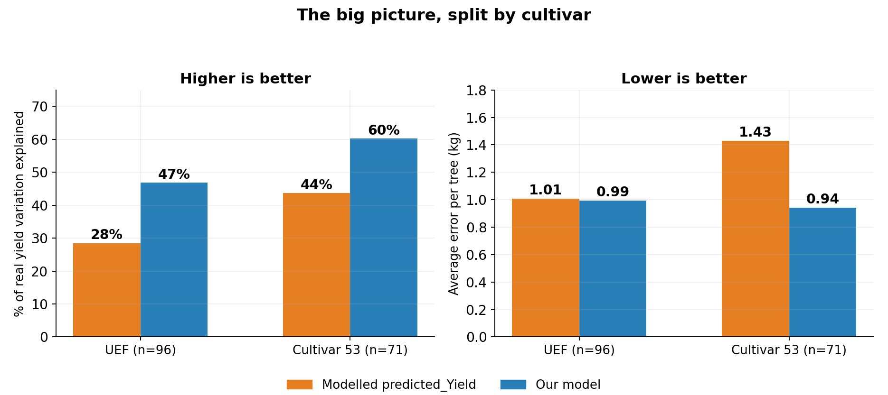
The Same Story, Visually,
Both Cultivars
Our model (blue) sits closer to the real, weighed harvest than the existing model (orange) in both cultivars, on both variation explained and average error.
Kedma Plot A · Almond Yield Forecasting
10

Slide 11
How the Model Actually Works
Yield ~ cultivar + bloom intensity × cultivar + winter chill + canopy growth
Bloom intensity (EBI)
Per-tree Enhanced Bloom Index extracted from February UAV 4-band imagery, the drone's core signal.
Cultivar interaction
The bloom-yield relationship is fit separately per cultivar, not averaged across them, since it runs in opposite directions (statistically confirmed: F=11.58, p=0.0009).
Winter chill
Chill Portions from the Dynamic Model (Fishman et al. 1987), the standard scientific measure of chilling accumulation.
Canopy growth
Field-measured spring canopy growth, rounding out what bloom imagery alone can't capture.
Fit by ordinary least squares regression on 167 tree-year observations (149 distinct trees, 2022-2023), the orchard's two best-represented cultivars, UEF and cultivar 53.
Kedma Plot A · Almond Yield Forecasting
11

Slide 12
What a Tree-Level Forecast Unlocks
1
Harvest planning
2
Cultivar-specific management
Know labor, storage, and logistics needs weeks before picking starts.
See which blocks are underperforming before the yield gap shows up at the scale.
3
Early-season insight
4
Built to scale
The bloom signal is available in February, five months before harvest.
The same drone-plus-model approach extends to any block with cultivar and bloom data.
Kedma Plot A · Almond Yield Forecasting
12

Slide 13
Tested Honestly, Built to Get Sharper
Every headline number in this deck is cross-validated: tested on trees the model never saw during training (46% variation explained), not the more flattering 53% it reaches by matching its own training data. Current validation covers 162 measured-yield trees across the 2022 and 2023 seasons at Kedma Plot A.
ROADMAP
1
More harvest seasons
Each additional measured season sharpens accuracy further, this is the single biggest lever, more so than any new feature or model.
2
More blocks and cultivars
Extend beyond Plot A to validate the approach across the wider orchard (cultivar 54 and beyond).
3
Additional signals
Water-stress and canopy-structure indices are already in testing and will be added once they clear the same cross-validation bar.
Kedma Plot A · Almond Yield Forecasting
13

Slide 14
The Orchard Already Tells You
What It Will Yield.
We taught the drone to listen.
Let's talk about bringing this to your orchard.
KEDMA PLOT A · ISRAEL

