Slide 1
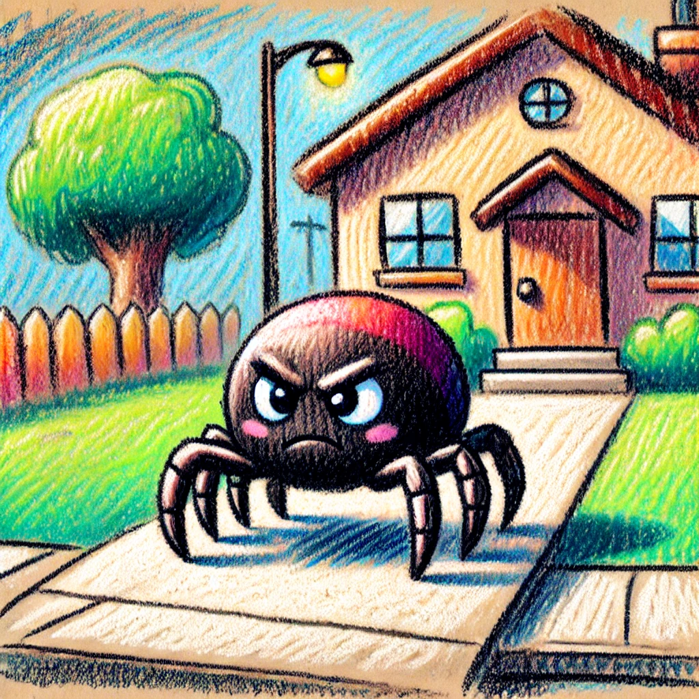
הֵיי תִּרְאוּ הִנֵּה עַכָּבִישׁ!
“מִשְׁפָּחָה חָרָא אֲנִי אֵלֵךְ לַכְּבִישׁ”

Slide 2
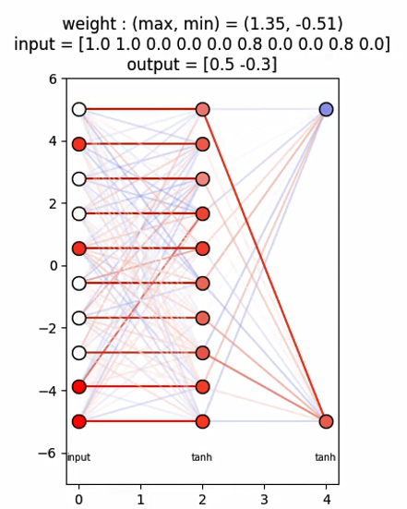
Input layer
hidden layer(s)
Output layer
Activation functions

Slide 3
hidden layer(s)
Input layer
Output layer
Hunger & Thirst *
velocity
Flag
Distance angle
Target #1
Eyes input
Activation functions

Slide 4
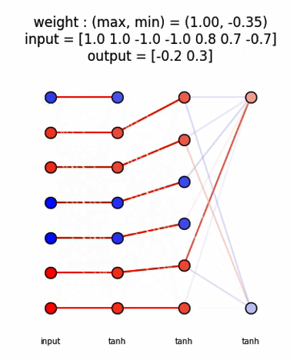


hidden layer(s)
Input layer
Output layer
$$Δ|v|$$
Flag
Distance angle
Eyes input
Target #1: grass
velocity: x,y
Hunger & Thirst *
$$Δangle(v)$$
Activation functions

Slide 5
update
Plot animation
step
Use brain
Update position
Who die
who reproduce + eat
die
reproduce
Update KDtree

