Slide 1
Unit-I
Design and Analysis of Algorithms

Slide 2
Algorithm
Definition
An algorithm is a finite set of instructions that accomplishes a particular task.
All algorithms must satisfy the following criteria.
Criteria
  Input : Zero or more quantities are externally supplied.
  Output : At least one quantity is produced.
  Definiteness : Each instruction is clear and unambiguous.
  Statements such as “add 6 or 7 to x” or “Compute 5/0” are not permitted”

Slide 3
  4. Finiteness : The algorithm should terminate after a finite number of steps.
  5. Effectiveness : Instruction is basic enough to be carried out.

Slide 4
Pseudo code for expressing algorithms
We present most of our algorithms using pseudo code that resembles C and Pascal.
  Comments begin with // and continue until end of the line.
  Blocks are indicated with matching braces: { and }.
      A compound statement
      Body of a procedure.
  3.
    i. An identifier begins with a letter.
    ii. The data types of variables are not explicitly declared.
    iii. The types will be clear from the context.
    iv. Whether a variable is global or local to a procedure will also be evident from
    the context.
    v. We assume simple data types such as integer, float, char, boolean, and so
    on.
    vi. Compound data types can be formed with records.

Slide 5
node = record
{
datatype_1 data_1;
:
datatype_n data_n;
node *link
}
data items of a record can be accessed
with → and period( . )
C style :-
struct node
{
datatype_1 data_1;
:
datatype_n data_n;
struct node *link
}

Slide 6
  4. Assignment of values to variables is done using the assignment statement.
  < variable > := < expression >
  5. There are two boolean values true and false. To produce these values, logical operators and, or and not and the relational operators <, ≤,=, ≠, ≥ and > are provided.
  6. Elements of multidimensional arrays are accessed using [ and ]. For example the (i,j)th element of the array A is denoted as A[i,j].
  7. The following looping statements are used: for, while, and repeat until.

Slide 7
The general form of a while loop:
while( condition ) do
{
statement_1;
:
statement_n;
}

Slide 8
The general form of a for loop:
for variable := value1 to value2 step step do
  Here value1, value2, and step are arithmetic expressions.
  The clause “step step” is optional and taken as +1 if it does not occur.
  step could be either positive or negative.
  variable is tested for termination at the start of each iteration.

Slide 9
  The for loop can be implemented as a
  while loop as follows:
  variable:=value1;
  incr:=step;
  while( ( variable – value2)*step ≤ 0) do
  {
  <statement 1>
  :
  <statement n>
  variable :=variable+incr;
  }

Slide 10
The general form of a repeat-until loop:
  repeat
  <statement 1>
  :
  <statement n>
  until ( condition )
  The statements are executed as long as
  condition is false.

Slide 11
  8. A conditional statement has the following
  forms:
  if < condition > then < statement >
  if < condition > then
  < statement 1>
  else
  < statement 2>
  9. Input and output are done using the instructions read and write.
  Ex: read n;
  write n;

Slide 12
10. Procedure or function starts with the word
Algorithm.
General form :
Algorithm Name( <parameter list> )
{
body
}
where Name is the name of the procedure.
  Simple variables to procedures are passed by value.
  Arrays and records are passed by reference

Slide 13
Ex:-Algorithm that finds and returns the maximum of n given numbers
Algorithm max(a,n)
// a is an array of size n
{
Result:=a[1];
for i:=2 to n do
if a[i]>Result then Result:=a[i];
return Result;
}

Slide 14
Ex:-Write an algorithm to sort an array of n integers using bubble sort.
Algorithm(a,n)
// a is an array of size n
{
for i:=1 to n-1 do
{
for j:=1 to n-i do
{
if( a[j] >a[j+1] ) then
t=:a[j]; a[j]:=a[j+1]; a[j]:=t;
}
}
}

Slide 15
Performance Analysis
(machine independent)
There are many things upon which the performance will depend.
  Does the program efficiently use primary and Secondary storage?
  Is the program's running Time acceptable for the task?
  Does it do what we want it to do?
  Does it work correctly according to the specifications of the task?
  Does the program contain documentation that shows how to use it and how it works?
  Is the program's code readable?

Slide 16
Practice Practice Practice
How to achieve them?
  Good programming style, experience, and practice
  Discuss and think.
Think
Think
Think

Slide 17
Space Complexity
The space needed by a program has the following components.
  Instruction space
    Instruction space is the space needed to store the compiled version of the program instructions.
    The amount of instruction space that is needed depends on the compiler used to compile the program into machine code.

Slide 18
  Data space
    Data space is the space needed to store all constant and variable values. Data space has two components.
      Space needed by constants( ex; 1 and 2 in max of n num algorithm) and simple variables( such as i, j, n etc).
      Space needed by a dynamically allocated objects such as arrays and class instances.
    Space taken by the variables and constants varies from language to language and platform to platform.

Slide 19
  Environmental stack space
    The environment stack is used to save information needed to resume execution of partially completed functions.
    Each time a function is invoked the following data are saved on the environment stack.
      The return address .
      The values of all local variables and formal parameters in the function being invoked( necessary for recursive functions only).

Slide 20
Recursive algorithm
Algorithm rfactorial(n)
// n is an integer
{ fact=1;
if (n=1 or n=0) return fact;
else
fact=n*rfactorial(n-1);
return fact;
}
Each time the recursive function rfactorial is invoked,
the current values of n and fact and the program location to return to on completion are saved in the environment stack.

Slide 21
Execution
n : 2
R:
n : 3
int rfactorial(n){ //3500
fact=1
if (n=0 or n=1)return fact
else
fact=n*rfactorial(n-1); //4000
return fact;}
int rfactorial(n){
fact=1;
if (n=0 or n=1)return fact;
else
fact=n*rfactorial(n-1);
return fact;
}
void main()
{int R=rfactorial(3);
printf(R);}
int rfactorial(n){ //2500
fact=1;
if (n=0 or n=1)return fact;
else
fact=n*rfactorial(n-1); //3000
return fact;
}
void main()
{int R=rfactorial(3);
printf(R);} //2000
R=6
fact=6
n : 1
n=3
fact=1
R
2000
n=2
fact=1
3000
int rfactorial(n){
if (n=0 or n=1)
return 1;
else
fact=n*rfactorial(n-1);
return fact;
}
4000
fact=2
fact=1
Stack

Slide 22
Summary of space complexity
The space needed by a program depends on several factors.
We cannot make an accurate analysis of the space requirements of a program unless we know the computer or compile that will be used.
However, we can determine the components that depend on the characteristics of the problem instance (e.x., the number of inputs and outputs or magnitude of the numbers involved ) to be solved.
  Ex:-1. Space requirements of a program that sorts n elements can be expressed as a function of n.
  2. Space requirements of a program that adds two m×n matrices can be expressed as a function of m, n.

Slide 23
Contd..
  The size of the instruction space is independent of the problem instance to be solved.
  The contribution of the constants and simple variables to the data space is also independent of the problem instance to be solved.
  Most of the dynamically allocated memory( ex., arrays, class instances etc) depends on problem instance to be solved.
  The environmental stack space is generally independent of the problem instance unless recursive functions are in use.

Slide 24
Contd..
  Therefore, We can divide the total space needed by a
  program into two parts:
i) Fixed Space Requirements (C)
Independent of the characteristics of the problem instance ( I )
    instruction space
    space for simple variables and constants.
  ii) Variable Space Requirements (S_{P}(I))
  depend on the characteristics of the problem instance ( I )
    Number of inputs and outputs associated with I
    recursive stack space ( formal parameters, local variables, return address ).
  Therefore, the space requirement of any problem P can be written as
  S(p)=C +S_{p}( Instance characteristics )

Slide 25
Note:
  When analyzing the space complexity of an algorithm, we concentrate only on estimating
  S_{p} (Instance characteristics ).
  We do not concentrate on estimating fixed part c .
  We need to identify the instance characteristics of the problem to measure S_{p}

Slide 26
Example1
Algorithm abc(a,b,c)
{
return a+b+b*c+(a+b-c)/(a+b)+4.0;
}
Problem instance characterized by the specific values of a,b,and c.
If we assume one word (4 bytes) is adequate to store the values of each a, b, and c , then the space needed by abc is independent of the instance characteristics.
Therefore, S_{abc}( instance characteristics)=0

Slide 27
Example2
Algorithm sum(a,n)
{
s:=0;
for i:=1 to n do
s:=s+a[i];
return s;
}
Problem instance characterized by n.
The amount of space needed does not depend on the value of n.
Therefore, S_{sum}(n)=0
Recall: Address of the
first element of the array will be passed .

Slide 28
Example3
Algorithm RSum(a,n)
{
if(n ≤ 0) then return 0;
else return RSum(a,n-1)+a[n];
}
Type | Name | Number of bytes
formal parameter: int | a | 2
formal parameter: int | n | 2
return address ( used internally) |  | 2
Total per one recursive call |  | 6
Total no.of recursive calls n, therefore S_{RSum} (n)=6(n+1)

Slide 29
Example4
Calculate space complexity s_{p}(n) for the following algorithm
Algorithm rfactorial(n)
{
fact=1;
if (n=0 or n=1)return fact;
else
fact=n*rfactorial(n-1);
return fact;
}

Slide 30
Contd..
Time Complexity:
T(P)=C+T_{P}(I)
  The time, T(P), taken by a program, P, is the sum of its compile time C and its run (or execution) time, T_{P}(I).
  The compile time does not depend on the instance characteristics.
  We will concentrate on estimating run time T_{p}(I).

Slide 31
If we know the characteristics of the compiler to be used, we can determine the
  No. of additions , subtractions, multiplications, divisions, compares, and so on.
Then we can obtain an expression for T_{p}(n) Of the form
  T_{P}(n)=c_{a}ADD(n)+ c_{s}SUB(n)+ c_{m} MUL(n)+ c_{d} DIV(n)+……..
  where,
  n denotes the instance characteristics.
  c_{a}, c_{s}, c_{m}, c_{d} and so on denote the time needed for an addition , subtraction, multiplication, division and so on. And
  ADD, SUB, MUL, DIV, and so on are functions whose values are the no.of additions, subtractions, multiplications, divisions, and so on.

Slide 32
Obtaining such an exact formula is an impossible task, since time needed for an addition, subtraction, and so on, depends an numbers being added, subtracted, and so on.
The value of Tp(n) for any given n can be obtained only experimentally.
Even with the experimental approach, one could face difficulties.
In a multi user system the execution time of a program p depends on the number of other programs running on the computer at the time program p is running.

Slide 33
Contd..
As there were some problems in determining the execution time using earlier methods, we will go one step further and count only the number of program steps.
program step
program step is loosely defined as a syntactically or semantically meaningful program segment whose execution time is independent of the instance characteristics.
  Example
  result = a + b + b * c + (a + b - c) / (a + b) + 4.0;
  sum = a + b + c;

Slide 34
The number of steps assigned to any program statement depends on the kind of statement.
Comments are counted as zero number of steps.
An assignment statement which does not involve any calls to other functions counted as one step.
Loops, such as the for, while, and repeat-until, we consider the step counts only for the control part of the statement.
The control parts for for and while statements have the following forms:
  for i:= <expr1> to <expr2> do
  while ( <expr> ) do

Slide 35
Each execution of the control part of a while statement is one, unless <expr> is a function of instance characteristics.
The step count for each execution of the control part of a for statement is one, unless <expr1> and <expr2> are functions of the instance characteristics.
The step count for each execution of the condition of a conditional statements is one, unless condition is a function of instance characteristics.
If any statement ( assignment statement, control part, condition etc.) involves function calls, then the step count is equal to the number of steps assignable to the function plus one.

Slide 36
Methods to compute the step count
  1) Introduce global variable count into programs with initial value zero.
    Statements to increment count by the appropriate amount are introduced into the program.
    The value of the count by the time program terminates is the number steps taken by the program.
  2) Tabular method
    Determine the total number of steps contributed by each statement per execution × frequency
    Add up the contribution of all statements

Slide 37
Method-I: Introduce variable count into programs
EX:- Iterative sum of n numbers
Algorithm sum(a, n)
{
s:=0;
  count:=count+1; // for assignment statement
for i:=1 to n do
{ count:=count+1; // For for
s:=s+a[i];
count:=count+1; // for assignment statement
}
count:=count+1; // for last time of for
return s;
count:=count+1; // for return
}
2n + 3 steps
Note : Step count tells us how the run time for a program changes with
changes in the instance characteristics.

Slide 38
Ex:- Addition of two m×n matrices
Algorithm Add(a,b,c,,m,n)
{
  for i:=1 to m do
  {
  for j:=1 to n do
  {
  c[i,j]:=a[i,j]+b[i,j];
  }
  }
  }
2mn + 2m+1 steps

Slide 39
EX:- Recursive sum of n numbers
Algorithm RSum(a,n)
{
count:=count+1; // for the if conditional
if(n ≤ 0) then
{
return 0;
count:=count+1; // for the return
}
else
{
return RSum(a,n-1)+a[n];
count:=count+1; // For the addition, function invocation and return
}
}

Slide 40
When analyzing a recursive program for its step count, we often obtain a recursive formula for the step count.
We obtain the following recursive formula for above (RSum) algorithm.
t_{RSum} (n)=
2
If n=0
2+ t_{RSum}(n-1)
If n>0

Slide 41
One way of solving such recursive formula is by repeated substitutions for each occurrence of the function t_{RSum} on the right side until all such occurrences disappear:
t_{RSum} (n) = 2+t_{RSum}(n-1)
= 2+2+t_{RSum}(n-2)
= 2(2)+t_{RSum}(n-2)
= 2+2+2+_{tRSum}(n-3)
= 2(3)+t_{RSum}(n-3)
:
:
= n(2) +t_{RSum}(n-n)
=2n+t_{RSum}(0)
= 2n+2
The step count for Rsum is 2n+2

Slide 42
Method-II: Tabular method
EX:- Iterative sum of n numbers
Statement | s/e | frequency | Total steps
Algorithm sum(a, n) { s:=0 ; for i:=1 to n do s:=s+a[i]; return s; } | 0 0 1 1 1 1 0 | -- -- 1 n+1 n 1 -- | 0 0 1 n+1 n 1 0
Total |  |  | 2n+3

Slide 43
EX:- Addition of two m×n matrices
Statement | s/e | frequency | Total steps
Algorithm Add(a,b,c,m, n) { for i:=1 to m do for j:=1 to n do c[i,j]:=a[i,j]+b[i,j] ; } | 0 0 1 1 1 0 | -- -- m+1 m(n+1) mn -- | 0 0 m+1 mn+m mn 0
Total |  |  | 2mn+2m+1

Slide 44
EX:- Recursive sum of n numbers
Statement | s/e | Frequency n=0 n>0 | Total steps n=0 n>0
Algorithm RSum(a,n) { if( n ≤ 0 ) then return 0; else return Rsum(a,n-1)+a[n] ; } | 0 0 1 1 1+x 0 | -- -- -- -- 1 1 1 0 0 1 -- -- | 0 0 0 0 1 1 1 0 0 1+x 0 0
Total |  |  | 2 2+x
x=t_{RSum}(n-1)

Slide 45
Best, Worst, Average Cases
Not all inputs of a given size take the same number of program steps.
Sequential search for K in an array of n integers:
  Begin at first element in array and look at each element in turn until K is found.
1. Best-Case Step count:-
Minimum number of steps executed by the algorithm for the given parameters.
2. Worst-Case Step count:-
Maximum number of steps executed by the algorithm for the given parameters.
3. Average-Case Step count:-
Average number of steps executed by an algorithm.
Notes:
Best: Find at first position. Cost is 1 compare.
Worst: Find at last position. Cost is n compares.
Average: (n+1)/2 compares IF we assume the element with value K is equally likely to be in any position in the array.

Slide 46
Contd..
5 ms
Worst -case time
Running
Time
4 ms
3 ms
Best-case time
2 ms
1 ms
A
B
C
D
E
F
G
Input
Average-case time =
A time + B time+ ………..+G time
----------------------------------------------------
7 ( total number of possible inputs )

Slide 47
Inexactness of step count.
  Both the instructions x=y; and x=y+z+(x/y) count as one step.
  Therefore, two analysts may arrive at 4n²+6n+2 and 7n²+3n+4 as the step count for the same program.
  Any step count of the form c₁n²+c₂n+c₃ could be a correct step count for the program.
  Because of the inexactness of what a step count stands for, the exact step count is not very useful for comparison of algorithms.

Slide 48
Asymptotic efficiency
Asymptotic efficiency means study of algorithms efficiency for large inputs.
To compare two algorithms with running times f(n) and g(n), we need a rough measure that characterizes how fast each function grows as n grows.
Hint: use rate of growth
Compare functions asymptotically!
  (i.e., for large values of n)

Slide 49
Rate of Growth
Ex:- f(n)=n²+100n+log₁₀n+1000
n | f(n) | n2 |  | 100n |  | log10n |  | 1000
 | value | value | % | value | % | value | % | value | %
1 | 1,101 | 1 | 0.1 | 100 | 9.1 | 0 | 0.0 | 1,000 | 90.83
10 | 2,101 | 100 | 4.76 | 1,000 | 47.6 | 1 | 0.05 | 1,000 | 47.60
100 | 21,002 | 10,000 | 47.6 | 10,000 | 47.6 | 2 | 0.001 | 1,000 | 4.76
1,000 | 1,101,003 | 1,000,000 | 90.8 | 100,000 | 9.1 | 3 | 0.0003 | 1,000 | 0.09
10,000 | 101,001,004 | 100,000,000 | 99.0 | 1,000,000 | 0.99 | 4 | 0.0 | 1,000 | 0.001
1,00000 | 10,010,001005 | 10,000,000,000 | 99.9 | 10,000,000 | 0.099 | 5 | 0.0 | 1,000 | 0.00

Slide 50
The low order terms and constants in a function are relatively insignificant for large n
n² + 100n + log₁₀n + 1000 ~ n²
i.e., we say that n² + 100n + log₁₀n + 1000 and n² have the same rate of growth
Some more examples
n⁴ + 100n² + 10n + 50 is ~ n⁴
10n³ + 2n² is ~ n³
n³ - n² is ~ n³
constants
  10 is ~ 1
  1273 is ~ 1

Slide 51

Asymptotic/order Notations
Asymptotic/order notation describes the behavior of functions for the large inputs.
Big Oh(O) notation:
  The big oh notation describes an upper bound on the asymptotic growth rate of the function f.
Definition: [Big “oh’’]
  f(n) = O(g(n)) (read as “f of n is big oh of g of n”) iff there exist positive constants c and n₀ such that
  f(n) ≤ cg(n) for all n, n ≥ n₀.

Slide 52
The definition states that the function f(n) is at most c times the function g(n) except when n is smaller than n₀.
In other words, f(n) grows slower than or same rate as” g(n).
When providing an upper –bound function g for f, we normally use a single term in n.
Examples
  f(n) = 3n+2
    3n + 2 <= 4n, for all n >= 2, ∴3n + 2 = Ο (n)
  f(n) = 10n²+4n+2
    10n²+4n+2 <= 11n², for all n >= 5, ∴ 10n²+4n+2 = Ο (n²)
  f(n)=6*2^{n}+n²=O(2^{n}) /* 6*2^{n}+n² ≤7*2^{n} for n≥4 */

Slide 53
It also possible to write 10n²+4n+2 = O(n³) since 10n²+4n+2 <=7n³ for n>=2
Although n³ is an upper bound for 10n²+4n+2, it is not a tight upper bound; we can find a smaller function (n²⁾ that satisfies big oh relation.
But, we can not write 10n²+4n+2 =O(n), since it does not satisfy the big oh relation for sufficiently large input.

Slide 54

Omega (Ω) notation:
  The omega notation describes a lower bound on the asymptotic growth rate of the function f.
Definition: [Omega]
  f(n) = Ω(g(n)) (read as “f of n is omega of g of n”) iff there exist positive constants c and n₀ such that f(n) ≥ cg(n) for all n,
  n ≥ n₀.

Slide 55
The definition states that the function f(n) is at least c times the function g(n) except when n is smaller than n₀.
In other words,f(n) grows faster than or same rate as” g(n).
Examples
  f(n) = 3n+2
    3n + 2 >= 3n, for all n >= 1, ∴3n + 2 = Ω (n)
  f(n) = 10n²+4n+2
    10n²+4n+2 >= n², for all n >= 1, ∴ 10n²+4n+2 = Ω (n²)
It also possible to write 10n²+4n+2 = Ω(n) since 10n²+4n+2 >=n for n>=0
Although n is a lower bound for 10n²+4n+2, it is not a tight lower bound; we can find a larger function (n²⁾ that satisfies omega relation.
But, we can not write 10n²+4n+2 = Ω(n³), since it does not satisfy the omega relation for sufficiently large input.

Slide 56

Theta (Θ) notation:
  The Theta notation describes a tight bound on the asymptotic growth rate of the function f.
Definition: [Theta]
  f(n) = Θ(g(n)) (read as “f of n is theta of g of n”) iff there exist positive constants c₁, c₂, and n₀ such that c₁g(n) ≤ f(n) ≤ c₂g(n) for all n, n ≥ n₀.

Slide 57
The definition states that the function f(n) lies between c1 times the function g(n) and c2 times the function g(n) except when n is smaller than n₀.
In other words,f(n) grows same rate as” g(n).
Examples:-
  f(n) = 3n+2
    3n <= 3n + 2 <= 4n, for all n >= 2, ∴ 3n + 2 = Θ (n)
  f(n) = 10n²+4n+2
    n²<= 10n²+4n+2 <= 11n², for all n >= 5, ∴ 10n²+4n+2 = Θ (n²)
But, we can not write either 10n²+4n+2= Θ(n) or 10n²+4n+2= Θ(n³), since neither of these will satisfy the theta relation.

Slide 58
Little Oh(O) notation:
  The big oh notation describes a strict upper bound on the asymptotic growth rate of the function f.
Definition: [Little “oh’’]
  f(n) = o(g(n)) (read as “f of n is little oh of g of n”) iff
Lim
n->∞
f(n)
= 0
g(n)

Slide 59
The definition states that the function f(n) is less than c times the function g(n) except when n is smaller than n₀.
In other words, f(n) grows slower than” g(n).
Examples
  f(n) = 3n+2=o(n²)
    Since
  However, 3n+2 ≠ o(n)
Lim
n->∞
3n+2
= 0
n²

Slide 60
Big-Oh, Theta, Omega and Little-oh
Tips :
Think of O(g(n)) as “less than or equal to” g(n)
  Upper bound: “grows slower than or same rate as” g(n)
Think of Ω(g(n)) as “greater than or equal to” g(n)
  Lower bound: “grows faster than or same rate as” g(n)
Think of Θ(g(n)) as “equal to” g(n)
  “Tight” bound: same growth rate
Think of o(g(n)) as “less than to” g(n)
  Strict Upper bound: “grows slower than ” g(n)
(True for large N)

Slide 61
Functions ordered by growth rate
Function | Name
1 | Growth is constant
logn | Growth is logarithmic
n | Growth is linear
nlogn | Growth is n-log-n
n² | Growth is quadratic
n³ | Growth is cubic
2^{n} | Growth is exponential
n! | Growth is factorial
1 < logn < n < nlogn < n² < n³ < 2^{n} < n!

Slide 62
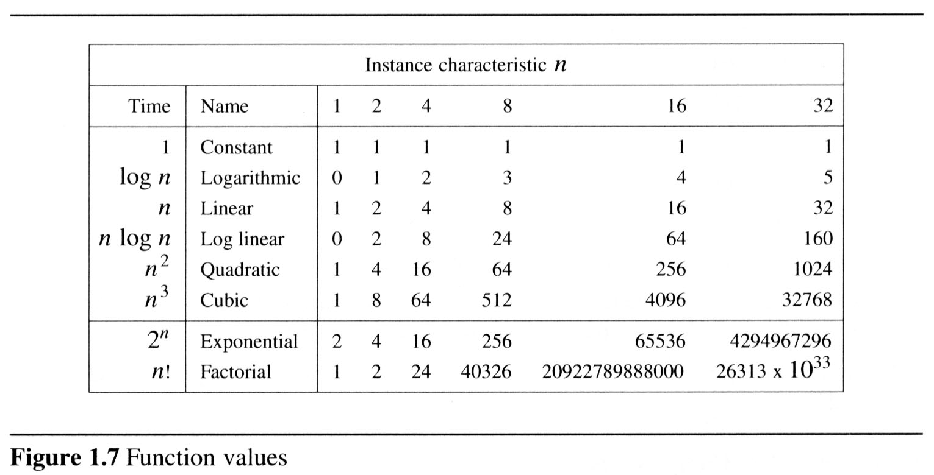
  To get a feel for how the various functions grow with n, you are advised to study the following figs:

Slide 63
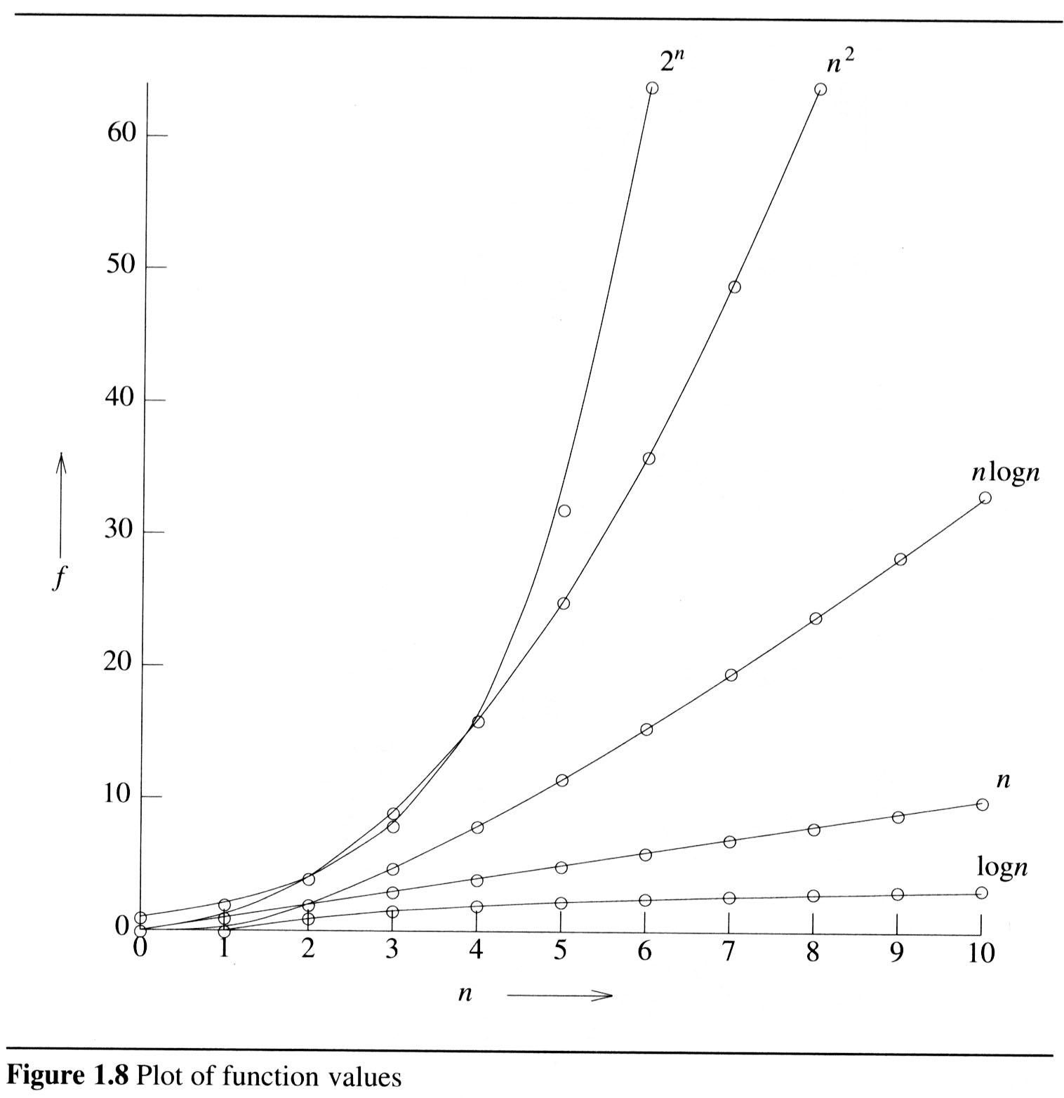
2

Slide 64
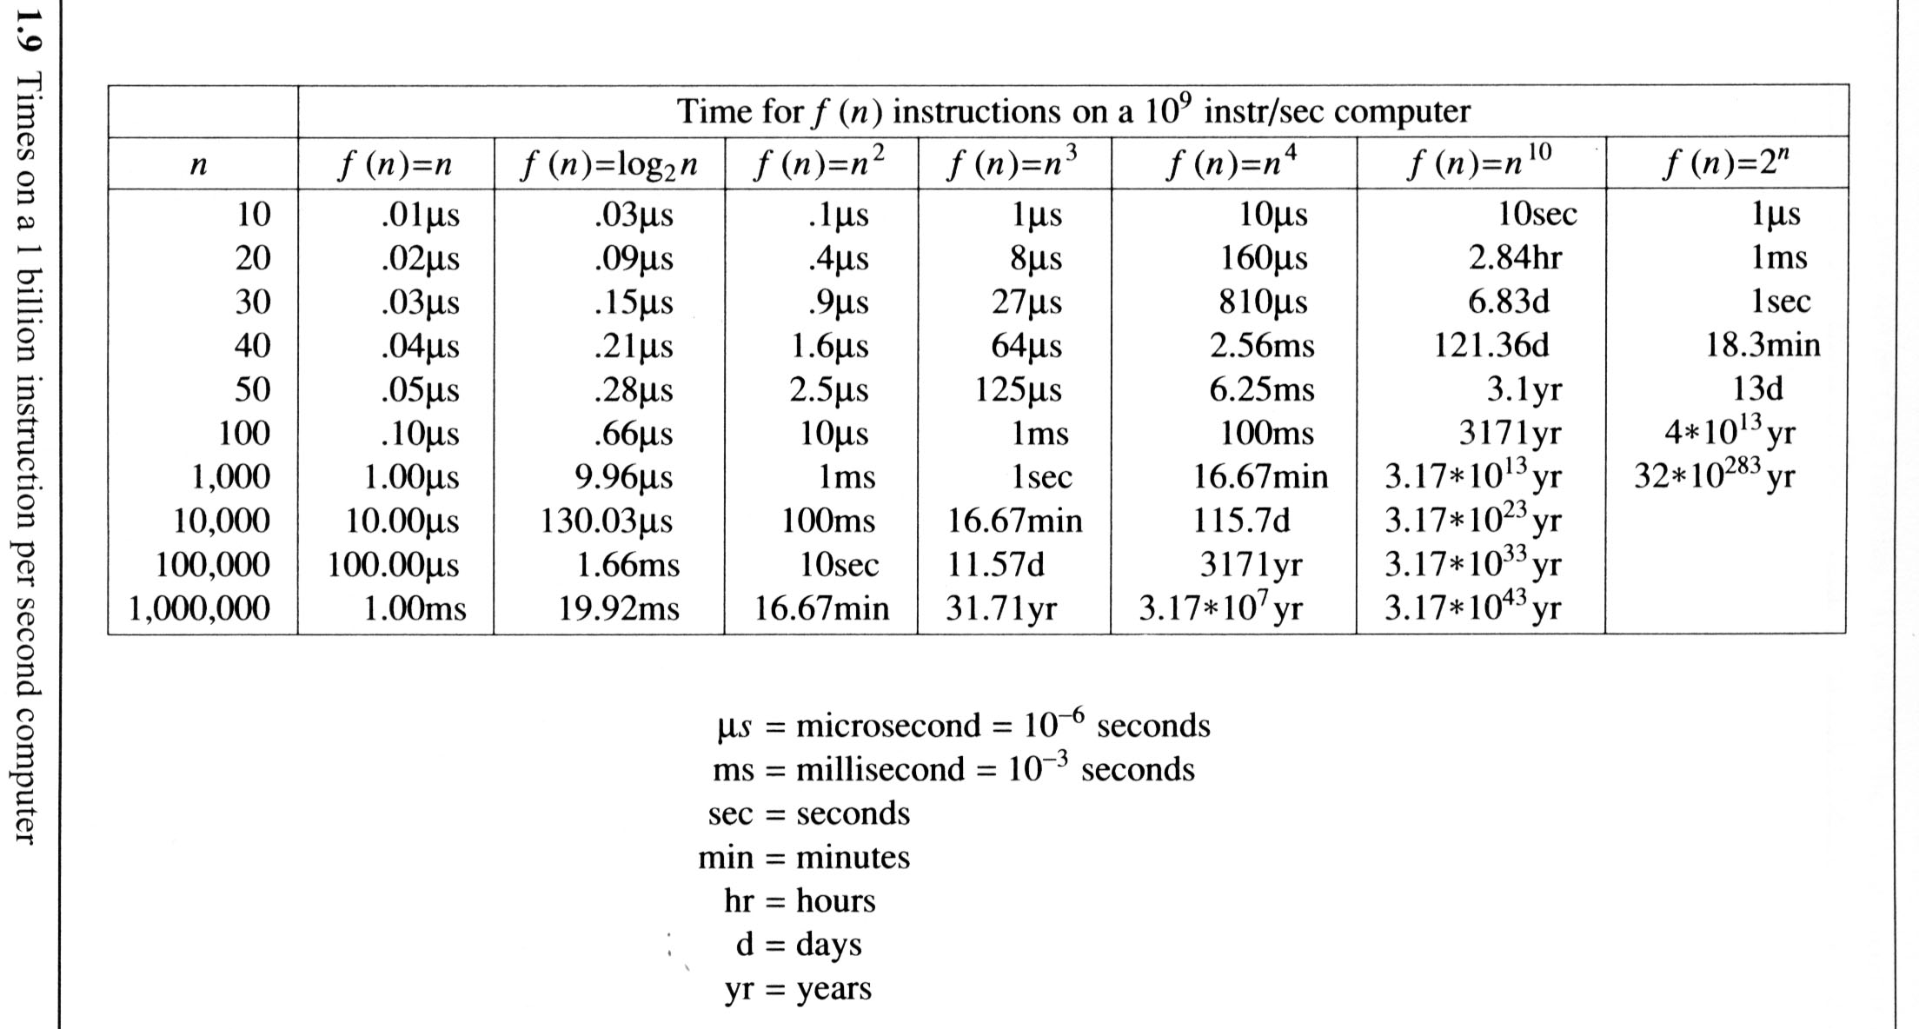
The following fig gives the time needed by a 1 billion instructions per second computer to execute a program of complexity f(n) instructions.

Slide 65
Probabilistic analysis

Slide 66
The Hiring Problem
You are using an employment agency to hire a new assistant.
The agency sends you one candidate each day.
You interview the candidate and must immediately decide whether or not to hire that person. But if you hire, you must also fire your current office assistant—even if it’s someone you have recently hired.
Cost to interview is c_{i} per candidate.
Cost to hire is c_{h} per candidate.
You want to have, at all times, the best candidate seen so far.
When you interview a candidate who is better than your current assistant, you fire the current assistant and hire the candidate.
You will always hire the first candidate that you interview.
Problem: What is the cost of this strategy?

Slide 67
Pseudo-code to Model the Scenario
Hire-Assistant (n)
best ← 0 ;;Candidate 0 is a least qualified candidate
for i ← 1 to n
do interview candidate i
if candidate i is better than candidate best
then best ← i
hire candidate i
Cost Model:
We are not concerned with the running time of Hire-Assistant.
We want to determine the total cost of hiring the best candidate.
If n candidates interviewed and m hired, then cost is nc_{i}+mc_{h}.
Have to pay nc_{i} to interview, no matter how many we hire.
So, focus on analyzing the hiring cost mc_{h}.
m varies with order of candidates.

Slide 68
Best-Case Analysis
Best case is when the agency sends you the best applicant on the first day.
Cost is nc_{i}+c_{h}.

Slide 69
Worst-case Analysis
In the worst case, we hire all n candidates.
This happens if each candidate is better than all those who came before. Candidates come in increasing order of quality.
Cost is nc_{i}+nc_{h}.
If this happens, we fire the agency.
What should happen in the average case?

Slide 70
Probabilistic analysis
Probabilistic analysis is the use of probability in the analysis of problems.
Generally, we use probabilistic analysis to analyze the running time of an algorithm.
Sometimes, we can also use it to analyze quantities such as the hiring cost in procedure Hire-Assistant.

Slide 71
Hiring problem-Average –case Analysis
An input to the hiring problem is an ordering of the n applicants.
There are n! different inputs.
To use probabilistic analysis, we assume that the candidates arrive in a random order .
Then we analyze our algorithm by computing an expected running time.
The expectation is taken over the distribution of the possible inputs.
Thus, we are averaging the running time over all possible inputs.

Slide 72
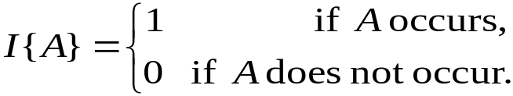
Indicator Random Variable
A powerful technique for computing the expected value of a random variable.
Convenient method for converting between probabilities and expectations.
Takes only 2 values, 1 and 0.
Indicator Random Variable X_{A}=I{A} for an event A of a sample space is defined as:
The expected value of an indicator Random Variable associated with an event A is equal to the probability that A occurs.

Slide 73
Indicator RV – Example1
Problem: Determine the expected number of heads in one coin flip.
Sample space is s{ H,T}
Indicator random variable
X_{A}= I{ coin coming up with heads}=1/2
The expected number of heads obtained in one flip of the coin is equal to the expected value of indicator random variable.
Therefore, E[X_{A}] = 1/2

Slide 74
Indicator RV – Example2
Problem: Determine the expected number of heads in n coin flips.
Let X be the random variable denoting the total number of heads in n coin flips.
Define n indicator random variables, X_{i}, 1 ≤ i ≤ n.
Let X_{i} be the indicator random variable for the event that the i^{th} flip results in a Head.
X_{i} = I{the i^{th} flip results in H}
Then X = X₁ + X₂ + …+ X_{n} = ∑_{i=1..n} X_{i}.
E[X_{i}] = Pr{H} = ½, 1 ≤ i ≤ n.
Expected number of heads is
E[X] = E[∑_{i=1..n} X_{i}].
= ∑_{i=1..n} E[ X_{i}] = ∑_{i=1..n} ½ = n/2.

Slide 75
Back to the Hiring Problem
We want to know the expected cost of our hiring algorithm, in terms of how many times we hire an applicant.
Random variable X(s) is the number of applicants that are hired, given the input sequence s.
Indicator random variable X_{i} for applicant I = 1 if applicant i is hired, 0 otherwise.
What is E[X]?

Slide 76
Probability of Hiring i-th Applicant
Probability of hiring i is probability that i is better than the previous i-1 applicants…
  Pr[X_{i} = 1] = 1/i.
Suppose n = 4 and i = 3.
Ex:-Probability that 3rd applicant is better than the 2 previous ones.
1234
1243
1324
1342
1423
1432
2134
2143
2314
2341
2413
2431
3124
3142
3214
3241
3412
3421
4123
4132
4213
4231
4312
4321
8/24 = 1/3

Slide 77
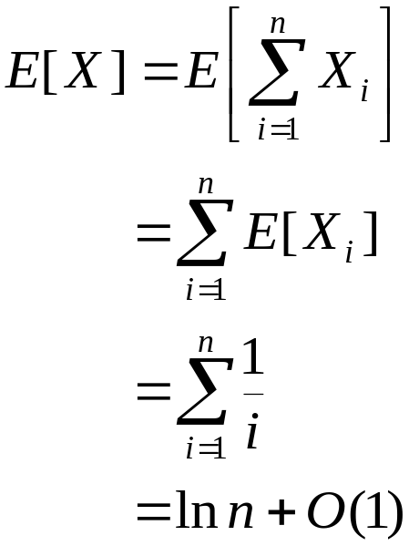
Analysis of the Hiring Problem
Compute E[X], the number of candidates we expect to hire.
1
Expected hiring cost = O(c_{h}ln n).

Slide 78
Amortized Analysis
Data structures are subjected to a sequence of operations rather than one operation.
In this sequence, one operation possibly performs certain modifications that have an impact on the run time of the next operation in the sequence.
One way of assessing the worst case run time of the entire sequence is to add worst case efficiencies for each operation.
This may result in an excessively large and unrealistic time complexity.

Slide 79
Amortized analysis concentrates on finding the average complexity of a worst case sequence of operations.
Amortized analysis considers interdependence between operations.
  For example, if an array is sorted and only a very few new elements are added, then re-sorting this array will be must faster than sorting it for the first time.

Slide 80
Amortized Analysis
AMORTIZED ANALYSIS:
You try to estimate an upper bound of the total
work T(n) required for a sequence of n operations…
Some operations may be cheap some may be expensive.
Overall, your algorithm does T(n) of work for n operations …
Therefore, by simple reasoning, the amortized cost of each
operation is T(n)/n

