Slide 1
Unit-iv

Slide 2
Greedy Method
Greedy algorithm obtains an optimal solution by making a sequence of decisions.
Decisions are made one by one in some order.
Each decision is made using a greedy-choice property or greedy criterion.
A decision, once made, is (usually) not changed later.

Slide 3
A greedy algorithm always makes the decision that looks best at the moment.
It does not always produce an optimal solution.
It works best when applied to problems with the greedy-decision property.
A feasible solution is a solution that satisfies the constraints.
An optimal solution is a feasible solution that optimizes the objective function.

Slide 4
Greedy method control abstraction/ general method
Algorithm Greedy(a,n)
// a[1:n] contains the n inputs
{
solution= //Initialize solution
for i=1 to n do
{
x:=Select(a);
if Feasible(solution,x) then
solution=Union(solution,x)
}
return solution;
}

Slide 5


Example: Largest k-out-of-n Sum
Problem
  Pick k numbers out of n numbers such that the sum of these k numbers is the largest.
Exhaustive solution
  There are choices.
  Choose the one with subset sum being the largest
Greedy Solution
    FOR i = 1 to k
    pick out the largest number and
    delete this number from the input.
    ENDFOR
Is the greedy solution always optimal?

Slide 6
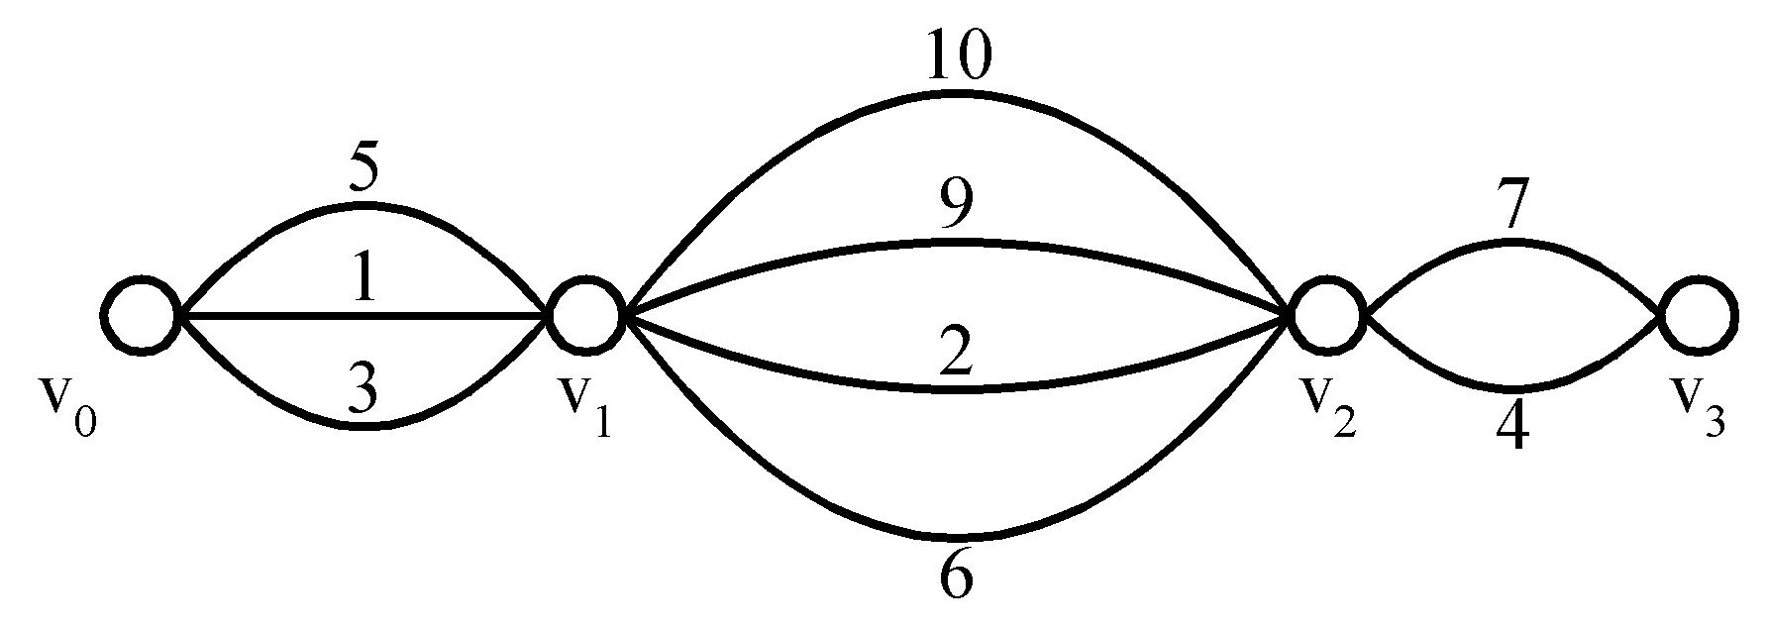
Example:
Shortest Path on a Special Graph
Problem
  Find a shortest path from v₀ to v₃
Greedy Solution

Slide 7
Example:
Shortest Paths on a Special Graph
Problem
  Find a shortest path from v₀ to v₃
Greedy Solution
Is the solution optimal?

Slide 8
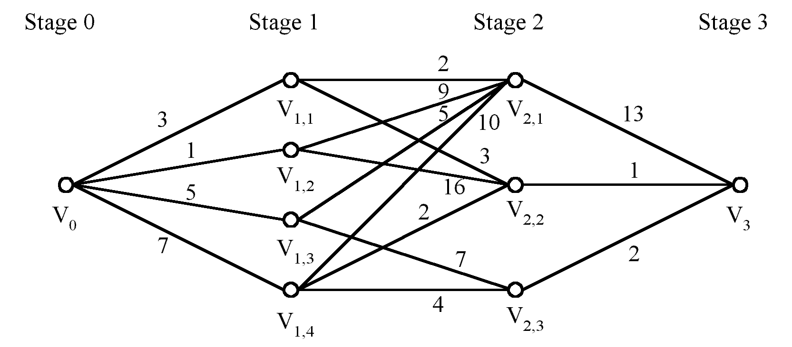
Example:
Shortest Paths on a Multi-stage Graph
Is the greedy solution optimal?
Problem
  Find a shortest path from v₀ to v₃

Slide 9
Example:
Shortest Paths on a Multi-stage Graph
Is the greedy solution optimal?
✗
Problem
  Find a shortest path from v₀ to v₃
The optimal path

Slide 10
Example:
Shortest Paths on a Multi-stage Graph
Is the greedy solution optimal?
✗
What algorithm can be used to find the optimum?
Problem
  Find a shortest path from v₀ to v₃
The optimal path

Slide 11
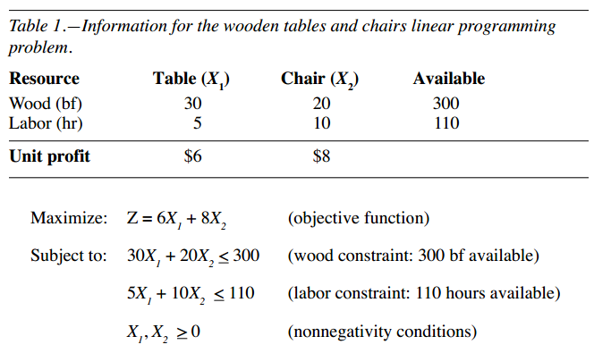

Slide 12
The Fractional Knapsack Problem
Given: A set S of n items, with each item i having
  p_{i} - a positive profit
  w_{i} - a positive weight
Goal: Choose items, allowing fractional amounts(x_{i}), to maximize total profit but with weight at most m.
maximize ∑ p_{i}x _{i}
1 ≤ i ≤ n
subjected to ∑ w_{i}x_{i} ≤ m
1 ≤ i ≤ n
and 0 ≤ xi ≤ 1, 1 ≤ i ≤ n

Slide 13

The Fractional Knapsack Problem
Greedy decision property:-
Select items in decreasing order of profit/weight.
“knapsack”
Solution:
1 ml of i₅
2 ml of i₃
6 ml of i₄
1 ml of i₂
Items:
1
2
3
4
5
w_{i} :
4 ml
8 ml
2 ml
6 ml
1 ml
p_{i} :
$12
$32
$40
$30
$50
10 ml
Value:
3
4
20
5
50
($ per ml)

Slide 14
Solution vector
  (x₁,x₂,x₃,x₄,x₅)= (0,1/8,1,1,1)
Profit =12*0 + 32*1/8 + 40*1 + 30*1 + 50*1
= 0+4+40+30+50
=124.

Slide 15
Greedy algorithm for the fractional Knapsack problem
Algorithm GreedyKnapsack(m,n)
//P[1:n] and w[1:n] contain the profits and weights
// respectively of the n objects ordered such that
//p[i]/w[i]>=p[i+1]/w[i+1].
//m is the knapsack size and x[1:n] is the solution
// Vector.
{
for i=1 to n do x[i]=0; // Initialize x.
U=m;
for i=1 to n do
{
if ( w[i]>U ) then break;
x[i]=1; U=U-w[i];
}
if ( i <=n) then x[i]= U/w[i];
}
If you do not consider the time to sort the items, then the time taken by the
above algorithm is O(n).

Slide 16
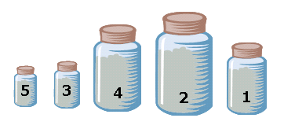
“knapsack”
Items:
Solution:
1 ml of i₅
2 ml of i₃
6 ml of i₄
1 ml of i₂
1
2
3
4
5
w_{i} :
4 ml
8 ml
2 ml
6 ml
1 ml
p_{i} :
$12
$32
$40
$30
$50
Value:
3
4
20
5
50
($ per ml)
10 ml
w_{i} :
1 ml
2 ml
6 ml
8 ml
4 ml
p_{i} :
$50
$40
$30
$32
$12
Value:
50
20
5
4
3
($ per ml)
10 ml

Slide 17






X 0 1 2 3 4
w_{i} :
2ml
6ml
8 ml
1 ml
2 ml
6 ml
8ml
4 ml
1/8
0
1
0
1
0
1
0
0
p_{i} :
$50
$40
$30
$32
$12
Value:
50
20
5
4
3
($ per ml)
_{10 ml}
1 ml
_{10 ml}
09
09
1
7

Slide 18
0/1 Knapsack Problem
An item is either included or not included into the knapsack.
Formally the problem can be stated as
maximize ∑ p_{i}x_{i}
1 ≤ i ≤ n
subjected to ∑ w_{i}x_{i} ≤ m
1 ≤ i ≤ n
and x_{i}=0 or 1, 1 ≤ i ≤ n

Slide 19









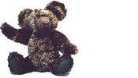





Which items should be chosen to maximize the amount of money while still keeping the overall weight under m kg ?
m
Is the fractional knapsack algorithm applicable?

Slide 20
The greedy method works for fractional knapsack problem, but it does not for 0/1 knapsack problem.
Ex:-
30
20
$80
30
item3
$120
20
20
item2
30
$100
item1
$100
20
20
10
10
$100
10
$60
$60
$60
$100
$120
=$160
=$220
=$240
Knapsack
Capacity 50 gms
(a)
(b)
(c)

Slide 21
There are 3 items, the knapsack can hold 50 gms.
The value per gram of item 1 is 6, which is greater than the value per gram of either item2 or item3.
The greedy approach ( Decreasing order of profit’s/weight’s), does not give an optimal solution.
As we can see from the above fig., the optimal solution takes item2 and item3.
For the fractional problem, the greedy approach (Decreasing order of profit’s/weight’s) gives an optimal solution as shown in fig c.

Slide 22
Spanning Tree
A tree is a connected undirected graph that contains no cycles.
A spanning tree of a graph G is a subgraph of G that is a tree and contains all the vertices of G.

Slide 23
Properties of a Spanning Tree
The spanning tree of a n-vertex undirected graph has exactly n – 1 edges.
It connects all the vertices in the graph.
A spanning tree has no cycles.

Slide 24
Ex:-
1
A
B
A
1
B
A
B
5
4
2
4
2
4
6
D
C
D
C
D
C
3
3
3
1
1
Undirected Graph
A
B
A
B
2
2
4
D
C
D
C
3
…
Some Spanning Trees

Slide 25
Minimum Cost Spanning Tree / Minimum Spanning Tree (MST)
A minimum spanning tree is the one among all the spanning trees with the smallest total cost.
1
1
A
B
A
B
4
2
4
2
5
D
C
D
C
3
3
Undirected Graph
Minimum Spanning Tree

Slide 26
Applications of MSTs
Computer Networks
  To find how to connect a set of computers using the minimum amount of wire.

Slide 27
MST-Prim’s Algorithm
Start with minimum cost edge.
Select next minimum cost edge (i,j) such that i is a vertex already included in the tree, j is a vertex not yet included.
Continue this process until the tree has n - 1 edges.

Slide 28


Slide 29
1 2 3 4 5 6 7 8 9
t [1:n-1,1:2]
1
2
3
4
5
6
7
8
9
0
1
∞
∞
∞
∞
∞
8
∞
1
2
1
0
8
∞
∞
∞
∞
11
∞
1
∞
8
0
7
∞
4
∞
∞
2
2
∞
∞
7
0
9
14
∞
∞
∞
∞
∞
∞
9
0
10
∞
∞
∞
.
.
.
∞
∞
4
14
10
0
2
∞
∞
∞
∞
∞
∞
∞
2
0
4
16
8
11
∞
∞
∞
∞
4
0
7
∞
∞
2
∞
∞
∞
16
7
0
COST
n-1
tree -t
2
8
3
7
4
1 2 3 4 5 . . . n-1 n
1
9
11
2
0
0
∞
∞
6
12
1
9
4
14
5
7
16
near
8
10
8
7
6
4
2

Slide 30
Prim’s Algorithm
t [1:n-1,1:2]
2
8
3
7
4
2
3
4
1
2
1
9
1 2
2
1
1
5
1
i
5
11
9
4
14
2 3
7
16
2
8
10
3 9
8
7
6
8
4
7
2
6
.
.
.
3 6
6 7
2
3
4
7 8
1
9
5
3 4
n-1
4 5
8
7
6

Slide 31
1. near[j] is a vertex in the tree such that cost [j,near[j]] is
minimum among all choices for near[j]
t
l
2
3
2
j
cost[ j, near[j] ]
k
1
1
3
near[3]=2
cost[ 3,2 ]=8
4
near[4]=1
cost[ 4,1 ]= ∞
1
near[1]=0
near[5]=1
cost[ 5,1 ]= ∞
5
2
near[2]=0
near[6]=1
cost[ 6,1 ]= ∞
6
3
near[3]=0
7
near[7]=1
cost[ 7,1 ]= ∞
8
near[8]=1
cost[ 8,1 ]=8
9
near[9]=1
cost[ 9,1 ]= ∞
2. Select next min cost edge.

Slide 32
Prim’s Algorithm
1 Algorithm Prim(E, cost, n, t)
2 // E is the set of edges in G.
//cost[1:n,1:n] is the cost matrix such that cost[i,j] is either
4 // positive real number or ∞ if no edge (i,j) exists. cost[i,j]=0, if i=j.
5 // A minimum spanning tree is computed and stored
6 // as a set of edges in the array t[1:n-1,1:2]
{
Let (k,l) be an edge of minimum cost in E
9 mincost=cost[k,l];
t[1,1]=k; t[1,2]=l;
for i=1 to n do // initialize near
if( cost[i,l]< cost[i, k] then near[i]=l;
else near[i]= k;
13 near[k]=near[l]=0;
2
8
3
7
4
1
9
2
1
11
9
4
14
5
7
16
8
10
8
4
7
2
6

Slide 33
14 for i=2 to n-1 do
15{
// Find n-1 additional edges for t.
17 Let j be an index such that near[j]≠0 and
cost[j,near[j]] is minimum;
19 t[i,1]=j; t[i,2]=near[j];
20 mincost=mincost+cost[j,near[j]];
near[j]=0;
22 for k=1 to n do // update near[]
23 if( ( near[k] ≠0 ) and (cost[k,near[k]>cost[k,j])) then
24 near[k]=j;
25 }
26 return mincost;
27 }
2
8
3
7
4
1
9
2
1
11
9
4
14
5
7
16
8
10
8
4
7
2
6

Slide 34
Time complexity of Prims algorithm
Line 8 takes o(E).
The for loop of line 11 takes o(n).
17 and 18 and the for loop of line 22 require o(n) time.
Each iteration of the for loop of line 14 takes o(n) time.
Therefore, the total time for the for loop of line 14 is o(n²).
Hence, time complexity of Prim is o(n²).

Slide 35
Kruskal’s Method
Start with a forest that has no edges.
Add the next minimum cost edge to the forest if it will not cause a cycle.
Continue this process until the tree has n - 1 edges.

Slide 36
Kruskal’s Algorithm
2
8
3
7
4
1
9
2
1
11
✗
9
4
14
5
✗
7
16
8
10
8
7
2
6
4
2
3
4
1
9
5
8
7
6

Slide 37
9
4
5
5
3
8
4
9
3
6
8
6
2
1
2
2
4
4
7
7
8
8
9
10
14
16
1
9
7
7
3
Does not form cycle
3
8
2
1
4
6
6
3
7
2
4
9
5
1
8
7
6
Forms cycle

Slide 38
Early form of minimum cost spanning tree alg
t=0;
while((t has less than n-1 edges) and (E!=0)) do
{
choose an edge (v,w) from E of lowest cost;
delete (v,w) from E;
if(v,w) does not create a cycle in t then
add(v,w) to t;
else discard (v,w);
}

Slide 39
UNION(I,j)
{ // where i, j are the roots of the trees.. and i != j
integer i,j
PARENT(i) = j // or PARENT(j)=i
}
FIND(i)
{ // Find the root of the tree containing element i
integer i,j
j=i
while PARENT(j)>-1 do
j=PARENT(j)
repeat
return(j)
}
UNION
1
4
2
3
5
6

Slide 40
MST-Kruskal’s Algorithm
Algorithm kruskal(E,cost,n,t)
// E is the set of edges in G.G has n vertices.cost[u,v] is the cost of edge(u,v).
//t is the set of edges in the minimum –cost spanning tree.the final cost
// is returned.
//
{
Construct a heap out of the edge costs using Hepify;
for i=1 to n do parent[i]=-1;
//each vertex is in a different set.
i=0;
mincost=0;

Slide 41
while((i<n-1) and (heap not empty)) do
{
delete a minimum cost edge (u,v) from the heap and reheapify using Adjust;
j=Find(u);
K=Find(v);
if(j!=k) then
{
i=i+1;
t[I,1]=u;
t[I,2]=v;
mincost=mincost+cos[u,v];
Union(j,k);
}
}
If(i!=n-1) then
write(“no spanning tree”);
else
return mincost;
}
2
8
3
7
4
1
2
9
11
14
1
9
4
5
7
16
8
10
8
7
6
4
2

Slide 42
Time complexity of kruskal’s algorithm
With an efficient Find-set and union algorithms, the running time of kruskal’s algorithm will be dominated by the time needed for sorting the edge costs of a given graph.
Hence, with an efficient sorting algorithm( merge sort ), the complexity of kruskal’s algorithm is
o( ElogE).

Slide 43
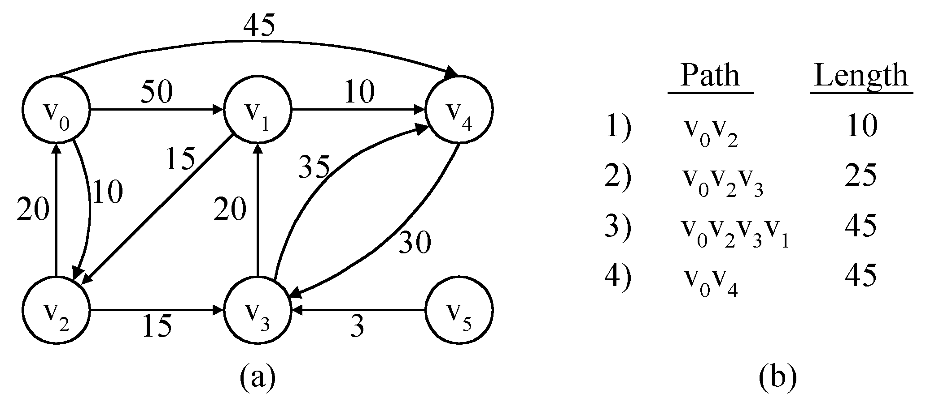
The Single-Source Shortest path Problem ( SSSP)
Given a positively weighted directed graph G with a source vertex v, find the shortest paths from v to all other vertices in the graph.
Ex :-
v
V₁
V₂
V₅
V₁V₃
V₁V₃V₄
V₁V₃V₄V₂
V₃
V₄
V₆
V₁V₅
5) V₁V₃V₄V₆ 28

Slide 44
45
45
50
2
10
5
50
2
✓
10
5
1
1
15
✓
15
35
35
10
20
20
30
20
10
20
30
3
15
4
3
6
3
15
4
3
6
✓
✓
✓
Iteration | S | Dist[2] | Dist[3] | Dist[4] | Dist[5] | Dist[6]
Initial | {1} | 50 | 10 | ∞ | 45 | ∞
✓
1 { 1,3 } 50 10 25 45 ∞
✓
✓
2 { 1,3,4 } 45 10 25 45 28
✓
✓
3 { 1,3,4,6 } 45 10 25 45 28
✓
✓
4 { 1,3,4,5,6 } 45 10 25 45 28
✓
✓
5 { 1,2,3,4,5,6 }

Slide 45
SSSP-Dijkstra’s algorithm
Dijkstra’s algorithm assumes that cost(e)≥0 for each e in the graph.
Maintains a set S of vertices whose SP from v ( source) has been determined.
a) Select the next minimum distance node u, which is not in S.
(b) for each node w adjacent to u do
  if( dist[w]>dist[u]+cost[u,w]) ) then
dist[w]:=dist[u]+cost[u,w];
Repeat step (a) and (b) until S=n (number of vertices).

Slide 46
1 Algorithm ShortestPaths(v,cost,dist,n)
2 //dist[j], 1≤ j≤ n, is the length of the shortest path
3 //from vertex v to vertex j in a digraph G with n vertices.
4 // dist[v] is set to zero. G is represented by its cost adjacency
5 // matrix cost[1:n, 1;n].
6 {
7 for i:= 1 to n do
8 { // Initialize S.
9 s[i]:=false; dist[i]:=cost[v,i];
10 }
11 s[v]:=true; // put v in S.

Slide 47
12 for num:=2 to n-1 do
13 {
14 Determine n-1 paths from v.
15 Choose u from among those vertices not in S such that dist[u] is minimum;
17 s[u]:=true; // Put u in S.
18 for ( each w adjacent to u with s[w]= false) do
19 // Uupdate distance
20 if( dist[w]>dist[u]+cost[u,w]) ) then
21 dist[w]:=dist[u]+cost[u,w];
22 }
23 }

Slide 48
Find the spanning Tree and shortest path from vertex 1
1
45
55
25
3
4
30
2
8
40
20
5
50
5
15
7
35
10
6

Slide 49
1
1
25
3
4
30
45
2
8
55
25
20
40
3
4
30
5
8
5
15
7
2
40
20
5
50
10
5
15
7
1
6
Min cost Spanning Tree
35
10
45
55
25
6
3
4
30
Graph
2
8
5
5
15
7
10
6
Shortest Path from the vertex 1

Slide 50
Time complexity of Dijkstra’s Algorithm
The for loop of line 7 takes o(n).
The for loop of line 12 takes o(n).
  Each execution of this loop requires o(n) time at lines 15 and 18.
  So the total time for this loop is o(n²).
Therefore, total time taken by this algorithm is o(n²).

Slide 51
Job sequencing with deadlines
We are given a set of n jobs.
Deadline di>=0 and a profit pi>0 are associated with each job i.
For any job profit is earned if and only if the job is completed by its deadline.
To complete a job, a job has to be processed by a machine for one unit of time.
Only one machine is available for processing jobs.
A feasible solution of this problem is a subset of jobs such that each job in this subset can be completed by its deadline
The optimal solution is a feasible solution which will maximize the total profit.
The objective is to find an order of processing of jobs which will maximize the total profit.

Slide 52
Ex:-n=4, ( p1,p2,p3,p4 )= ( 100,10,15,27 )
( d1,d2,d3,d4 )= ( 2,1,2,1 )
day1
day2
day3
day4
day5
0
1
2
3
4
5
time

Slide 53
Ex:-n=4, ( p1,p2,p3,p4 )=( 100,10,15,27 )
( d1,d2,d3,d4 )=( 2,1,2,1 )
The maximum deadline is 2 units, hence the feasible solution set
must have <=2 jobs.
feasible processing
solution sequence value
1. (1,2) 2,1 110
2. (1,3) 1,3 or 3,1 115
3. (1,4) 4,1 127
4. (2,3) 2,3 25
5. (3,4) 4,3 42
6. (1) 1 100
7. (2) 2 10
8. (3) 3 15
9. (4) 4 27
Solution 3 is optimal.

Slide 54
Greedy Algorithm for job sequencing with deadlines
Sort p_{i} into decreasing order. After sorting p₁ ≥ p₂ ≥ p₃ ≥ … ≥ p_{i}.
Add the next job i to the solution set if i can be completed by its deadline. Assign i to time slot (r-1, r), where r is the largest integer such that 1 ≤ r ≤ d_{i} and
(r-1, r) is free.
3. Stop if all jobs are examined. Otherwise, go to step 2.

Slide 55
Ex:- 1) n=5, ( p1,…….,p5) = ( 20,15,10,5,1 ) and
( d1,…….d5) = ( 2,2,1,3,,3 )
The optimal solution is {1,2,4} with a profit of 40.
Ex:- 2) n=7, ( p1,…….,p7) = ( 3,5,20,18,1,6,30 ) and
( d1,……..d7) = ( 1,3,4,3,2,1,2 )
Find out an optimal solution.

Slide 56
Algorithm JS(d,j,n)
//d[i]≥1, 1 ≤ i ≤ n are the deadlines.
//The jobs are ordered such that p[1] ≥p[2] …… ≥p[n]
// j[i] is the i^{th} job in the optimal solution, 1≤ i
{
d[0]=j[0]=0; // Initialize
j[1]=1; // Include job 1
k=1;

Slide 57
for i=2 to n do
{ //Consider jobs in Descending order of p[i].
// Find position for i and check feasibility of
// insertion.
r=k;
while( ( D[ J[r]]> D[i] and ( D[J[r]] ≠ r )) do
r= r-1;
if( D[J[r]] <= D[i] and D[i] > r )) then
{
// Insert i into J[].
for q=k to (r+1) step -1 do J[q+1] = J[q];
J[r+1] :=i;
k:=k+1;
}
}
return k;
}
Time taken by this algorithm is o(n²)
1 2 3 4
P
100 27 15 10
i
0 1 2 3 4
D
0
3 2 1 2
r
0 1 2 3 4
J
0
1
2
3
k

