Slide 1
Strings Fundamentals

Slide 2
Three types of strings
In Python 3.X there are three string types: str is used for Unicode text (including
ASCII), bytes is used for binary data (including encoded text), and bytearray is a mutable variant of bytes. Files work in two modes: text, which represents content
as str and implements Unicode encodings, and binary, which deals in raw bytes
and does no data translation.
• In Python 2.X, unicode strings represent Unicode text, str strings handle both 8- bit text and binary data, and bytearray is available in 2.6 and later as a back-port from 3.X. Normal files’ content is simply bytes represented as str, but a codecs module opens Unicode text files, handles encodings, and represents content as
unicode objects.

Slide 3
String Basics
Common string literals and operations
Operation =Interpretation
S = '' Empty string
S = “ spam's" Double quotes, same as single
S = 's\np\ta\x00m' Escape sequences
S = """...multiline...""" Triple-quoted block strings
S = r'\temp\spam' Raw strings (no escapes)
B = b'sp\xc4m' Byte strings in 2.6, 2.7, and 3.X
U = u'sp\u00c4m' Unicode strings in 2.X and 3.3+

Slide 4
Continued…
S1 + S2 Concatenate
S * 3 repeat
,
S[i]
S[i:j] Index, slice, length
len(S)
"a %s parrot" % kind String formatting expression
"a {0} parrot".format(kind) String formatting method in 2.6, 2.7, and 3.X
S.find('pa') String methods
S.rstrip() remove
S.replace('pa', 'xx') replacement,
S.split(',') split on delimiter,

Slide 5
Continued…
S.isdigit() content test,
S.lower() case conversion,
S.endswith('spam') end test,
'spam'.join(strlist) delimiter join
S.encode('latin-1') Unicode encoding
B.decode('utf8') Unicode decoding
for x in S: print(x) Iteration, membership
'spam' in S
[c * 2 for c in S]
re.match('sp(.*)am', line) Pattern matching: library module

Slide 6
Accessing Values in Strings
Python does not support a character type; these are treated as strings of length one, thus
also considered a substring.
To access substrings, use the square brackets for slicing along with the index or indices to
obtain your substring.

Slide 7
Example
var1 = 'Hello World!'
var2 = "Python Programming"
print ("var1[0]: ", var1[0])
print ("var2[1:5]: ", var2[1:5])
OUTPUT
var1[0]: H
var2[1:5]: ytho

Slide 8
Updating Strings
You can "update" an existing string by (re)assigning a variable to another string. The new
value can be related to its previous value or to a completely different string altogether.
For example-
var1 = 'Hello World!'
print ("Updated String :- ", var1[:6] + 'Python')
OUTPUT
Updated String :- Hello Python

Slide 9
Escape Characters
a -Bell or alert
b - Backspace
\cx - Control-x
\C-x - Control-x
\e - Escape
\f – Formfeed
\n - Newline
\nnn - Octal notation, where n is in the range 0.7
\r - Carriage return
\s – Space
\t – tab
\v - Vertical tab
\x - Character x
\xnn -Hexadecimal notation, where n is in the
range 0.9, a.f, or A.F

Slide 10
String Special Operators
Assume string variable a holds 'Hello' and variable b holds 'Python', then-
+ -- Concatenation -- Adds values on either side of theoperator
a + b will give HelloPython
* Repetition - Creates new strings, concatenating multiple copies of the same string
a*2 will give – HelloHello
[] Slice - Gives the character from the given index a[1] will give e

Slide 11
[ : ] Range Slice - Gives the characters from the given range
a[1:4] will give ell
in Membership - Returns true if a character exists in the given string
H in a will give 1
not in Membership - Returns true if a character does not exist in the given string
M not in a will give 1
r/R Raw String - Suppresses actual meaning of Escape characters. The syntax for raw strings is exactly the same as for normal strings with the exception of the raw string operator, the letter "r," which precedes the quotation marks. The "r" can be lowercase (r) or uppercase (R) and must be placed immediately preceding the first quote mark.
print r'\n' prints \n
and
print R'\n'prints \n

Slide 12
String Formatting Operator -- %
Example
print ("My name is %s and weight is %d kg!" % ('Zara', 21))
%c character
%s string conversion via str() prior to formatting
%i signed decimal integer
%d signed decimal integer
%u unsigned decimal integer

Slide 13
Continued…
%o octal integer
%x hexadecimal integer (lowercase letters)
%X hexadecimal integer (UPPERcase letters)
%e exponential notation (with lowercase 'e')
%E exponential notation (with UPPERcase 'E')
%f floating point real number
%g the shorter of %f and %e
%G the shorter of %f and %E

Slide 14
Triple Quotes
Python's triple quotes comes to the rescue by allowing strings to span multiple lines,
including verbatim NEWLINEs, TABs, and any other special characters.
para_str = """this is a long string that is made up of several lines ""“
Print(str)

Slide 15
Built-in String Methods
1. capitalize()- Capitalizes first letter of string
2. center(width, fillchar)- Returns a string padded with fillchar with the original string centered to a total of width columns.
3. count(str, beg= 0,end=len(string)) - Counts how many times str occurs in string or in a substring of string if starting index beg and ending index end are given.

Slide 16
4. decode(encoding='UTF-8',errors='strict')- Decodes the string using the codec registered for encoding. encoding defaults to the default string encoding.
5. encode(encoding='UTF-8',errors='strict')-Returns encoded string version of string; on error, default is to raise a ValueError unless errors is given with 'ignore' or 'replace'.
6. endswith(suffix, beg=0, end=len(string))- Determines if string or a substring of string (if starting index beg and ending index end are given) ends with suffix; returns true if so and false otherwise.

Slide 17
7. expandtabs(tabsize=8)- Expands tabs in string to multiple spaces; defaults to 8 spaces per tab if tabsize not provided.
8. find(str, beg=0 end=len(string)) - Determine if str occurs in string or in a substring of string if starting index beg and ending index end are given returns index if found and -1 otherwise.
index(str, beg=0, end=len(string))- Same as find(), but raises an exception if str not found.
10. isalnum()- Returns true if string has at least 1 character and all characters are alphanumeric and false otherwise.

Slide 18
11. isalpha()- Returns true if string has at least 1 character and all characters are alphabetic and false otherwise.
12. isdigit()- Returns true if the string contains only digits and false otherwise.
13. islower()- Returns true if string has at least 1 cased character and all cased characters are in lowercase and false otherwise.
14. isnumeric()- Returns true if a unicode string contains only numeric characters and false otherwise.

Slide 19
15. isspace() - Returns true if string contains only whitespace characters and false otherwise.
16. istitle() - Returns true if string is properly "titlecased" and false otherwise.
17. isupper() - Returns true if string has at least one cased character and all cased characters are in uppercase and false otherwise.
18. join(seq) - Merges (concatenates) the string representations of elements in sequence seq into a string, with separator string.

Slide 20
19. len(string) - Returns the length of the string
20. ljust(width[, fillchar]) - Returns a space-padded string with the original string left-justified to a total of width columns.
21. lower() - Converts all uppercase letters in string to lowercase.
22. lstrip() - Removes all leading whitespace in string.
23. maketrans() - Returns a translation table to be used in translate function.

Slide 21
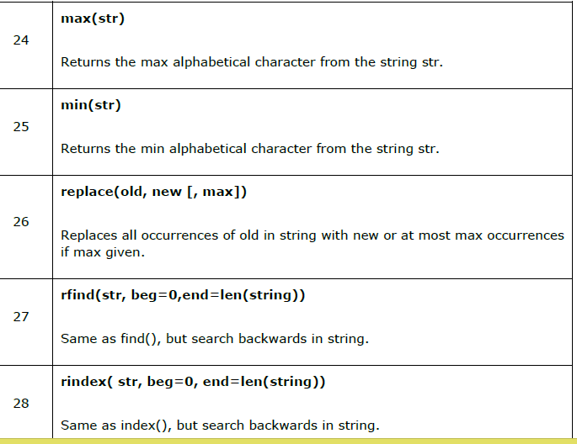

Slide 22
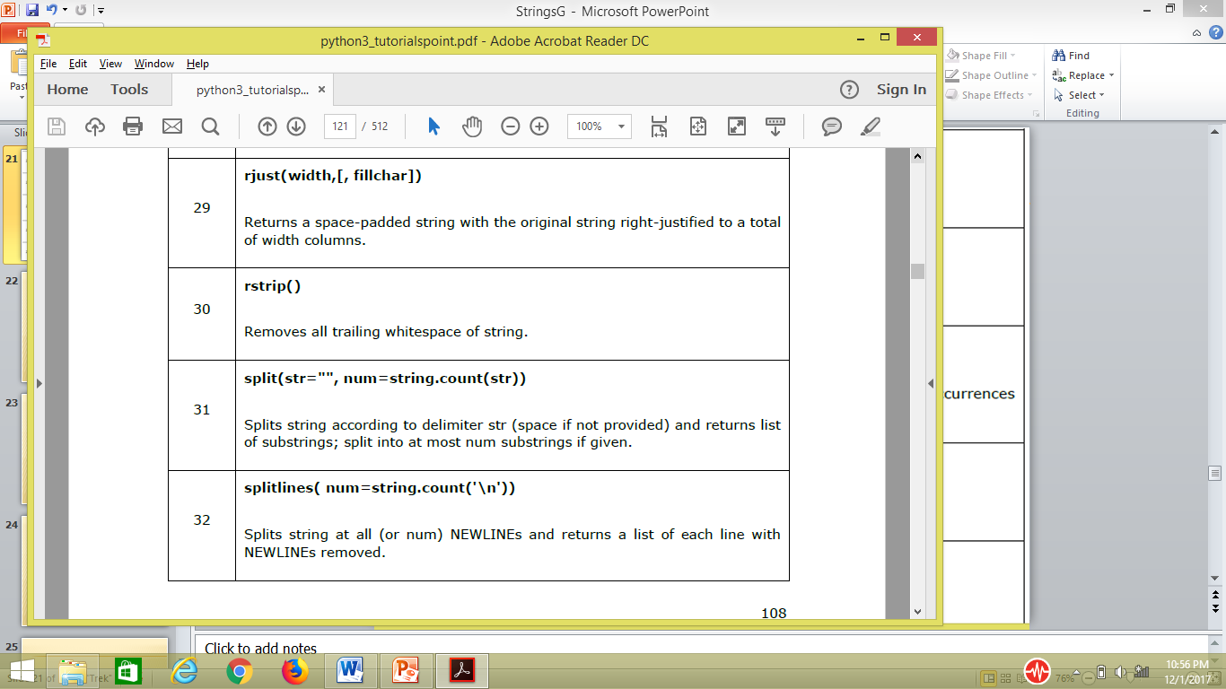

Slide 23
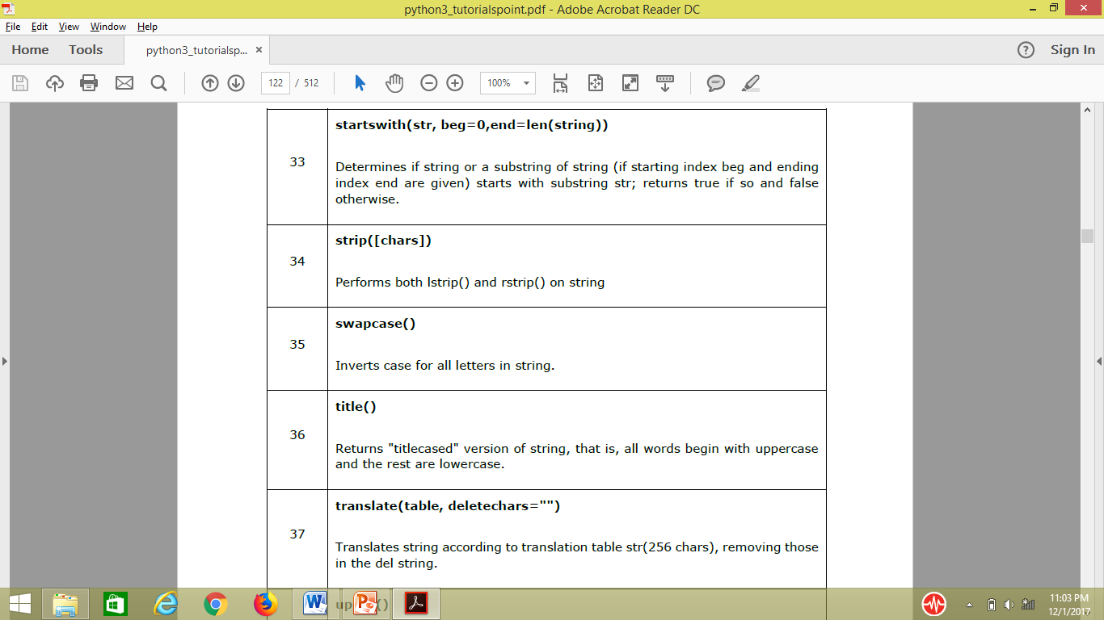

Slide 24
