Slide 1
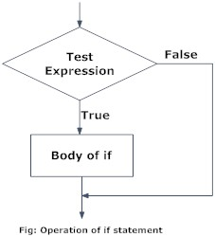
if…elif…else statement is used in Python for decision making.
Python if Statement Syntax
if test expression:
statement(s)

Slide 2
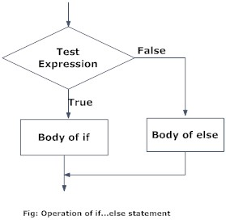
Syntax of if...else
if test expression:
Body of if
else:
Body of else

Slide 3
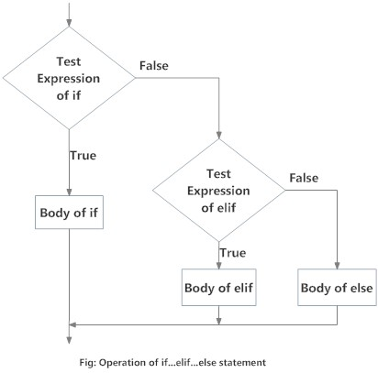
Syntax of if...elif...else
if test expression:
Body of if
elif test expression:
Body of elif
else:
Body of else

Slide 4
if Statements
>>> x = int(input("Please enter an integer: "))
Please enter an integer: 42
>>> if x < 0:
... x = 0
... print('Negative changed to zero')
... elif x == 0:
... print('Zero')
... elif x == 1:
... print('Single')
... else:
... print('More')
... More

Slide 5
for loop in Python
The for loop in Python is used to iterate over a sequence (list, tuple, string) or other iterable objects. Iterating over a sequence is called traversal.
Syntax of for Loop
for val in sequence:
Body of for
Here, val is the variable that takes the value of the item inside the sequence on each iteration.

Slide 6
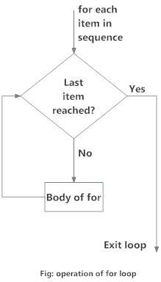

Slide 7
# Program to find the sum of all numbers stored in a list
# List of numbers
numbers = [6, 5, 3, 8, 4, 2, 5, 4, 11]
# variable to store the sum
sum = 0
# iterate over the list
for val in numbers:
sum = sum+val
# Output: The sum is 48
print("The sum is", sum)

Slide 8
for Statements
>>> # Measure some strings:
... words = ['cat', 'window', 'defenestrate']
>>> for w in words:
... print(w, len(w))
... cat 3
window 6
defenestrate 12

Slide 9
range() function
We can generate a sequence of numbers using range() function.
EX: range(10) will generate numbers from 0 to 9 (10 numbers).
We can also define the start, stop and step size as range(start,stop,step size).
step size defaults to 1 if not provided.

Slide 10
Ex:
Output: range(0, 10)
print(range(10))
# Output: [0, 1, 2, 3, 4, 5, 6, 7, 8, 9] print(list(range(10)))
# Output: [2, 3, 4, 5, 6, 7]
print(list(range(2, 8)))
# Output: [2, 5, 8, 11, 14, 17] print(list(range(2, 20, 3)))

Slide 11
We can use the range() function in for loops to iterate through a sequence of numbers.
It can be combined with the len() function to iterate though a sequence using indexing.
# Program to iterate through a list using indexing
genre = ['pop', 'rock', 'jazz']
# iterate over the list using index
for i in range(len(genre)):
print("I like", genre[i])

Slide 12
for loop with else
A for loop can have an optional else block as well. The else part is executed if the items in the sequence used in for loop exhausts.
break statement can be used to stop a for loop. In such case, the else part is ignored.
Hence, a for loop's else part runs if no break occurs.
digits = [0, 1, 5]
for i in digits:
print(i)
else:
print("No items left.")

Slide 13
while loop in Python
The while loop in Python is used to iterate over a block of code as long as the test expression (condition) is true.
while test_expression:
Body of while

Slide 14
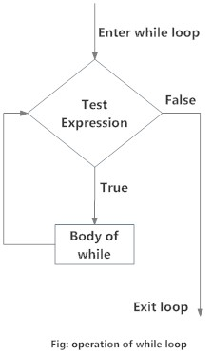

Slide 15
# Program to add natural numbers upto n
# sum = 1+2+3+...+n
# To take input from the user
n = int(input("Enter n: "))
# initialize sum and counter
sum = 0
i = 1
while i <= n:
sum = sum + i
i = i+1 # update counter
# print the sum
print("The sum is", sum)

Slide 16
while loop with else
Same as that of for loop, we can have an optional else block with while loop as well.
The else part is executed if the condition in the while loop evaluates to False. The while loop can be terminated with a break statement.

Slide 17
Example
counter = 0
while counter < 3:
print("Inside loop")
counter = counter + 1
else:
print("Inside else")

Slide 18
Assignment
Python Program to Check if a Number is Positive, Negative or 0
Python Program to Check if a Number is Odd or Even
Python Program to Check Leap Year
Python Program to Find the Largest Among Three Numbers
Python Program to Check Prime Number
Python Program to Print all Prime Numbers in an Interval
Python Program to Find the Factorial of a Number
Python Program to Display the multiplication Table
Python Program to Print the Fibonacci sequence
Python Program to Check Armstrong Number

