Slide 1
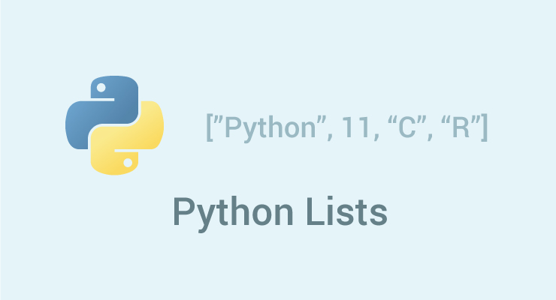

Slide 2
How to create a list?
In Python programming, a list is created by placing all the items (elements) inside a square bracket [ ], separated by commas.
It can have any number of items and they may be of different types (integer, float, string etc.).

Slide 3
# empty list my_list = []
# list of integers
my_list = [1, 2, 3]
# list with mixed datatypes
my_list = [1, "Hello", 3.4]
Also, a list can even have another list as an item. This is called nested list.
# nested list
my_list = ["mouse", [8, 4, 6], ['a']]

Slide 4
How to access elements from a list?
List Index
We can use the index operator [] to access an item in a list. Index starts from 0. So, a list having 5 elements will have index from 0 to 4.
Trying to access an element other that this will raise an IndexError. The index must be an integer. We can't use float or other types, this will result into TypeError.
Nested list are accessed using nested indexing.

Slide 5
Negative indexing
Python allows negative indexing for its sequences. The index of -1 refers to the last item, -2 to the second last item and so on.
my_list = ['p','r','o','b','e']
# Output: e
print(my_list[-1])
# Output: p
print(my_list[-5])

Slide 6
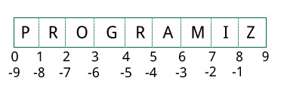
How to slice lists in Python?
We can access a range of items in a list by using the slicing operator (colon).

Slide 7
my_list = ['p','r','o','g','r','a','m','i',‘n‘ ,’g’]
# elements 3rd to 5th
print(my_list[2:5])
# elements beginning to 4th
print(my_list[:-5])
# elements 6th to end
print(my_list[5:])
# elements beginning to end
print(my_list[:])

Slide 8
How to change or add elements to a list?
List are mutable, meaning, their elements can be changed unlike string or tuple.
We can use assignment operator (=) to change an item or a range of items.
odd = [2, 4, 6, 8]
# change the 1st item
odd[0] = 1
# Output: [1, 4, 6, 8]
print(odd)
# change 2nd to 4th items
odd[1:4] = [3, 5, 7]
# Output: [1, 3, 5, 7]
print(odd)

Slide 9
append(), extend()
odd = [1, 3, 5]
odd.append(7)
# Output: [1, 3, 5, 7]
print(odd)
odd.extend([9, 11, 13])
# Output: [1, 3, 5, 7, 9, 11, 13]
print(odd)

Slide 10
We can also use + operator to combine two lists. This is also called concatenation.
odd = [1, 3, 5]
# Output: [1, 3, 5, 9, 7, 5]
print(odd + [9, 7, 5])
#Output: ["re", "re", "re"]
print(["re"] * 3)

Slide 11
we can insert one item at a desired location by using the method insert() or insert multiple items by squeezing it into an empty slice of a list.
odd = [1, 9]
odd.insert(1,3)
# Output: [1, 3, 9]
print(odd)
odd[2:2] = [5, 7]
# Output: [1, 3, 5, 7, 9]
print(odd)

Slide 12
How to delete or remove elements from a list?
We can delete one or more items from a list using the keyword del. It can even delete the list entirely.
mylist = ['p','r','o','b','l','e','m‘]
# delete one item
del mylist[2]
# Output: ['p', 'r', 'b', 'l', 'e', 'm']
print(mylist)
# delete multiple items
del mylist[1:5]
# Output: ['p', 'm']
print(mylist)
# delete entire list
del mylist
# Error: List not defined
print(mylist)

Slide 13
We can use remove() method to remove the given item or pop() method to remove an item at the given index.
my_list.remove('p')
print(my_list.pop(1))
The pop() method removes and returns the last item if index is not provided. This helps us implement lists as stacks (first in, last out data structure).
We can also use the clear() method to empty a list.
my_list.clear()

Slide 14
List Comprehension
List comprehension is an elegant and concise way to create new list from an existing list in Python.
List comprehension consists of an expression followed by for statement inside square brackets.
pow2 = [2 ** x for x in range(10)]
# Output: [1, 2, 4, 8, 16, 32, 64, 128, 256, 512]
print(pow2)

Slide 15
Iterating Through a List
for fruit in ['apple','banana','mango']: print("I like",fruit)

Slide 16
Python List Methods
append() - Add an element to the end of the list
extend() - Add all elements of a list to the another list
insert() - Insert an item at the defined index
remove() - Removes an item from the list
pop() - Removes and returns an element at the given index
clear() - Removes all items from the list
index() - Returns the index of the first matched item
count() - Returns the count of number of items passed as an argument
sort() - Sort items in a list in ascending order
reverse() - Reverse the order of items in the list
copy() - Returns a shallow copy of the list
len()-Return the length (the number of items) in the list.
list()-Convert an iterable (tuple, string, set, dictionary) to a list.
max()-Return the largest item in the list.
min()-Return the smallest item in the list
sorted()-Return a new sorted list (does not sort the list itself).
sum( )-Return the sum of all elements in the list.

