Slide 1
Packages in Python

Slide 2
What are packages?
We don't usually store all of our files in our computer in the same location. We use a well-organized hierarchy of directories for easier access.
As our application program grows larger in size with a lot of modules, we place similar modules in one package and different modules in different packages. This makes a project (program) easy to manage and conceptually clear.

Slide 3
Similar, as a directory can contain sub-directories and files, a Python package can have sub-packages and modules.
A directory must contain a file named __init__.py in order for Python to consider it as a package. This file can be left empty but we generally place the initialization code for that package in this file.

Slide 4
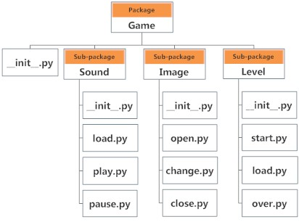
Suppose we are developing a game, one possible organization of packages and modules could be as shown in the figure below.

Slide 5
Importing module from a package
We can import modules from packages using the dot (.) operator.
For example, if want to import the start module in the above example, it is done as follows.
import Game.Level.start

