Slide 1
UNIT-5
CHAPTER-16

Slide 2
Introduction
Use cases, actors, include, and extend
Modeling the behavior of an element
Realizing use cases with collaborations

Slide 3
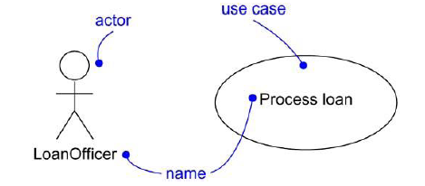
Use Cases : Terms and Concepts
UseCase : A use case is a description of a set of sequences of actions, including variants, that a system performs to yield an observable result of value to an actor. Graphically, a use case is rendered as an ellipse.
Ex: Process Loan
Actor : An actor represents a coherent set of roles that users of use cases play when interacting with these use cases. Typically, an actor represents a role that a human, a hardware device, or even another system plays with a system. Actors are rendered as stick figures.
Ex: Loan Officer

Slide 4
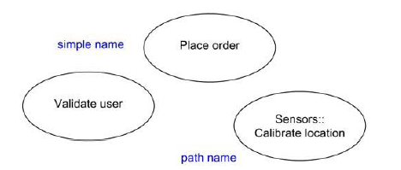
Names
A use case name must be unique within its enclosing package.
A simple name is a textual string.
A path name is the use case name prefixed by the name of the package in which that use case lives.

Slide 5
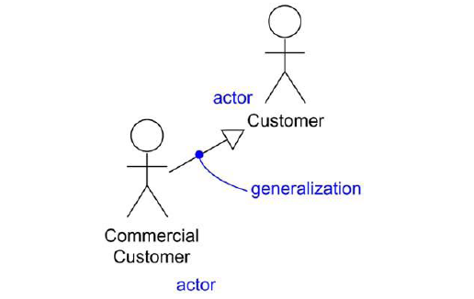
Actors are rendered as stick figures. You can define general kinds of
actors (such as Customer) and specialize them (such as Commercial Customer) using generalization relationships.

Slide 6
Use Cases and Flow of Events
A use case describes what a system (or a subsystem, class, or interface) does but it not specify how it does it.
When you model, it's important that you keep clear the separation of concerns between this outside and inside view.
You can specify the behavior of a use case by describing a flow of events in text clearly enough for an outsider to understand it easily.
When you write this flow of events, you should include how and when the use case starts and ends, when the use case interacts with the actors and what objects are exchanged, and the basic flow and alternative flows of the behavior.

Slide 7
Example of ATM Machine
Main flow of events:
The use case starts when the system prompts the Customer for a PIN number. The Customer can now enter a PIN number via the keypad. The Customer commits the entry by pressing the Enter button. The system then checks this PIN number to see if it is valid. If the PIN number is valid, the system acknowledges the entry, thus ending the use case.
Exceptional flow of events:
The Customer can cancel a transaction at any time by pressing the Cancel button, thus restarting the use case. No changes are made to the Customer's account.
Exceptional flow of events:
The Customer can clear a PIN number anytime before committing it and reenter a new PIN number.
Exceptional flow of events:
If the Customer enters an invalid PIN number, the use case restarts. If this happens three times in a row, the system cancels the entire transaction, preventing the Customer from interacting with the ATM for 60 seconds.

Slide 8
Use Cases and Scenarios
A use case actually describes a set of sequences in which each
sequence represents one possible flow through all the variations. Each sequence is called a scenario.
A scenario is a specific sequence of actions that illustrates behavior.
Scenarios are to use cases as instances are to classes, meaning that a scenario is basically one instance of a use case.
For example, in a human resources system, you might find the use case Hire employee. This general business function might have many possible
Variations:
---You might hire a person from another company (the most common scenario);
--- you might transfer a person from one division to another (common in international companies);
---You might hire a foreign national (which involves its own special rules). Each of these variants can be expressed in a different sequence.

Slide 9
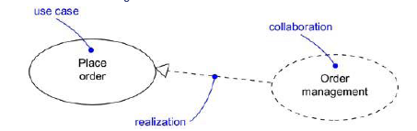
Use Cases and Collaborations
A use case captures the intended behavior of the system (or subsystem, class, or interface), without having to specify how that behavior is implemented.
However, to implement use cases, a society of classes and other elements that work together to implement the behavior of this use case are created.
This society of elements, including both its static and dynamic structure, is
modeled in the UML as a collaboration.
You can explicitly specify the realization of a use case by a collaboration.

Slide 10
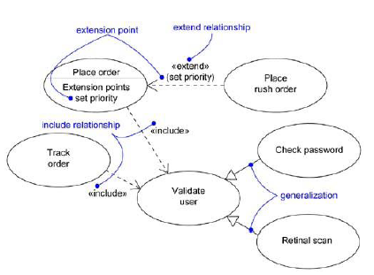
Organizing Use Cases

Slide 11
Include Relationship
An include relationship between use cases means that the base use case explicitly incorporates the behavior of another use case at a location specified in the base.
The included use case never stands alone, but is only instantiated as part of some larger base that includes it. You can think of include as the base use case pulling behavior from the supplier use case.
An include relationship can be used to avoid describing the same flow of events several times, by putting the common behavior in a use case of its own (the use case that is included by a base use case).
An include relationship is rendered as a dependency, stereotyped as include.
To specify the location in a flow of events in which the base use case includes the behavior of another, you simply write include followed by the name of the use case you want to include, as in the following flow for Track order.
Main flow of events:
Obtain and verify the order number. include (Validate user). For each part in the order, query its status, then report back to the user.

Slide 12
Extend Relationship
An extend relationship between use cases means that the base use case implicitly incorporates the behavior of another use case at a location specified indirectly by the extending use case. The base use case may stand alone, but under certain conditions, its behavior may be extended by the behavior of another use case. This base use case may be extended only at certain points called, extension points.
An extend relationship is used to model the optional system behavior.
An extend relationship is rendered as a dependency, stereotyped as extend. You may list the extension points of the base use case in an extra compartment.
For example, the flow for Place order might read as follows:
Main flow of events:
include (Validate user). Collect the user's order items. (set priority).
Submit the order for processing. In this example, set priority is an extension point.

Slide 13
Common Modeling Techniques
Applying use cases to elements in this way is important for three reasons:
It provides a way for domain experts to specify its outside view to a degree sufficient for developers to construct its inside view. Use cases provide a forum for your domain experts, end users, and developers to communicate to one another.
Use cases provide a way for developers to approach an element and understand it.
Use cases serve as the basis for testing each element as it evolves during development.

Slide 14
To model the behavior of an element,
Identify the actors that interact with the element. Candidate actors include groups that require certain behavior to perform their tasks or that are needed directly or indirectly to perform the element's functions.
Organize actors by identifying general and more specialized roles.
For each actor, consider the primary ways in which that actor interacts with the element.
Consider also interactions that change the state of the element or its environment or that involve a response to some event.
Consider also the exceptional ways in which each actor interacts with the element.
Organize these behaviors as use cases, applying include and extend relationships to factor common behavior and distinguish exceptional behavior.

Slide 15
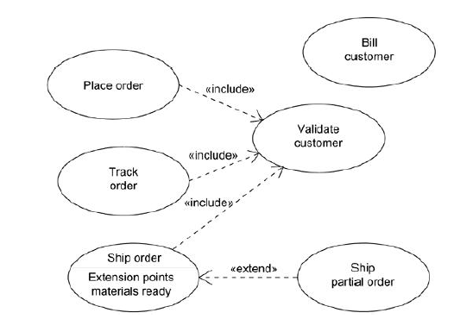
Example

Slide 16
UNIT-5
CHAPTER-17

Slide 17
Use Case Diagrams
Modeling the context of a system
Use case diagrams are important for visualizing, specifying, and documenting the behavior of an element.
Modeling the requirements of a system
They make systems, subsystems, and classes approachable and understandable by presenting an outside view of how those elements may be used in context.
Forward and reverse engineering
Use case diagrams are also important for testing executable systems through forward engineering and for comprehending executable systems through reverse engineering.

Slide 18
Terms and Concepts
A use case diagram is a diagram that shows a set of use cases and actors and their relationships.
A use case diagram is just a special kind of diagram and shares the same common properties as do all other diagrams• a name and graphical contents that are a projection into a model.
Use case diagrams commonly contain
· Use cases
· Actors
· Dependency, generalization, and association relationships
Like all other diagrams, use case diagrams may contain notes and constraints.

Slide 19
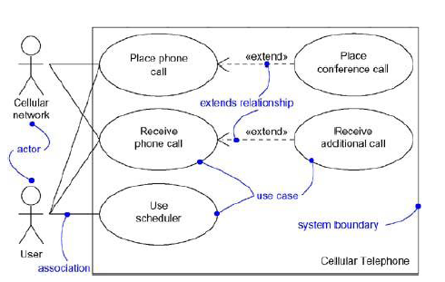
Example

Slide 20
When you model the static use case view of a system, you apply use case diagrams in one of two ways.
1. To model the context of a system Modeling the context of a system involves drawing a line around the whole system and asserting which actors lie outside the system and interact with it.
2. To model the requirements of a system Modeling the requirements of a system involves specifying what that system should do (from a
point of view of outside the system), independent of how that system should do it.
A usecase diagram lets you view the whole system as a black box.

Slide 21
Modeling the Context of a System
To model the context of a system,
Identify the actors that surround the system by considering which groups require help from the system to perform their tasks; which groups are needed to execute the system's functions; which groups interact with external hardware or other software systems; and which groups perform secondary functions for administration and maintenance.
Organize actors that are similar to one another in a generalization/specialization hierarchy.
Where it aids understandability, provide a stereotype for each such actor.
Populate a use case diagram with these actors and specify the paths of communication from each actor to the system's use cases.

Slide 22
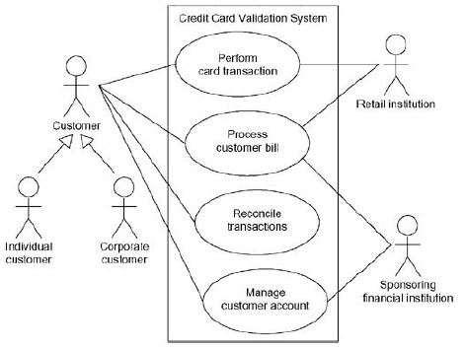
Example

Slide 23
Modeling the Requirements of a System
To model the requirements of a system,
Establish the context of the system by identifying the actors that surround it.
For each actor, consider the behavior that each expects or requires the system to provide.
Name these common behaviors as use cases.
Factor common behavior into new use cases that are used by others; factor variant behavior into new use cases that extend more main line flows.
Model these use cases, actors, and their relationships in a use case diagram.
Adorn these use cases with notes that assert nonfunctional requirements; you may have to attach some of these to the whole system.

Slide 24
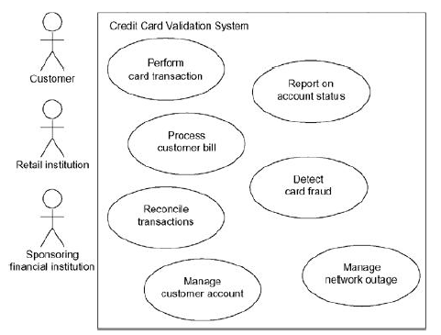
Example

Slide 25
Forward and Reverse Engineering
Most of the UML's diagrams, including class, component, and statechart diagrams, are clear candidates for forward and reverse engineering because each has an analog in the executable system.
Use case diagrams are a bit different : Use cases describe how an element
behaves, not how that behavior is implemented, so it cannot be directly forward or reverse engineered.
Forward engineering is the process of transforming a model into code through a mapping to an implementation language. A use case diagram can be forward engineered to form tests for the element to which it applies.
Reverse engineering is the process of transforming code into a model through a mapping from a specific implementation language.
Automatically reverse engineering a use case diagram is pretty much beyond the state of the art, simply because there is a loss of information when moving from a specification of how an element behaves to how it is implemented.

Slide 26
To forward engineer a use case diagram,
For each use case in the diagram, identify its flow of events and its exceptional flow of events.
Depending on how deeply you choose to test, generate a test script for each flow, using the flow's preconditions as the test's initial state and its post conditions as its success criteria.
As necessary, generate test scaffolding to represent each actor that interacts with the use case. Actors that push information to the element or are acted on by the element may either be simulated or substituted by its real-world equivalent.
Use tools to run these test each time you release the element to which the use case diagram applies.

Slide 27
To reverse engineer a use case diagram,
Identify each actor that interacts with the system.
For each actor, consider the manner in which that actor interacts with the system, changes the state of the system or its environment, or responds to some event.
Trace the flow of events in the executable system relative to each actor. Start with primary flows and only later consider alternative paths.
Cluster related flows by declaring a corresponding use case. Consider modeling variants using extend relationships, and consider modeling common flows by applying include
relationships.
Render these actors and use cases in a use case diagram, and establish their relationships.

Slide 28
UNIT-5
CHAPTER-19

Slide 29
Activity Diagrams
Modeling a workflow
Modeling an operation
Forward and reverse engineering

Slide 30
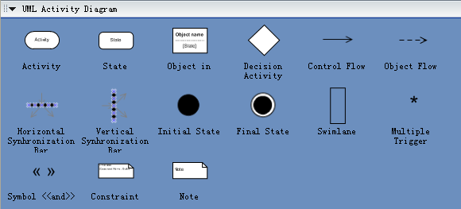

Slide 31
ACTIVITY DIAGRAM
Activity diagrams are used to model the dynamic aspects of a system.
It involves modeling the sequential (and possibly concurrent) steps in a computational process.
With an activity diagram, you can also model the flow of an object as it moves from state to state at different points in the flow of control.
Activity diagrams may stand alone to visualize, specify, construct, and document the dynamics of a society of objects, or they may be used to model the flow of control of an operation.
Whereas interaction diagrams emphasize the flow of control from
object to object, activity diagrams emphasize the flow of control from activity to activity.
An activity is an ongoing nonatomic execution within a state machine.
Activities ultimately result in some action, which is made up of executable atomic computations that results in a change in state of the system or the return of a value.
Activity diagrams are not only important for modeling the dynamic aspects of a system, but also for constructing executable systems through forward and reverse engineering

Slide 32
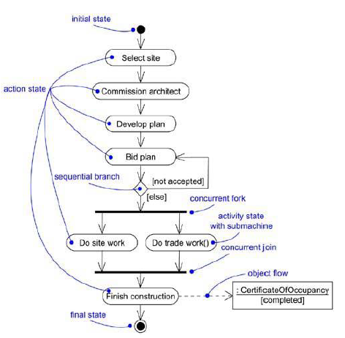

Slide 33
Terms and Concepts
An activity diagram shows the flow from activity to activity.
It is an ongoing nonatomic execution within a state machine.
Activities ultimately result in some action, which is made up of executable
atomic computations that result in a change in state of the system or the return of a value.
Actions encompass calling another operation, sending a signal, creating or destroying an object, or some pure computation, such as evaluating an expression.
Graphically, an activity diagram is a collection of vertices and arcs.
Activity diagrams commonly contain
· Activity states and action states
· Transitions
· Objects

Slide 34
Action States and Activity States
In the flow of control modeled by an activity diagram, things happen. You might evaluate some expression that sets the value of an attribute or that returns some value.
Alternately, you might call an operation on an object, send a signal to an object, or even create or destroy an object.
These executable, atomic computations are called action states because they are states of the system, each representing the execution of an action.

Slide 35
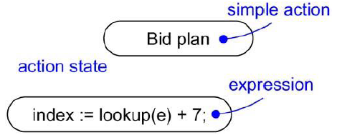

Slide 36
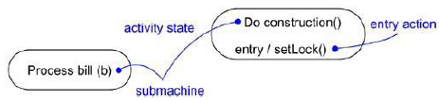
In contrast, activity states can be further decomposed, their activity being represented by other activity diagrams.
Furthermore, activity states are not atomic, meaning that they may be
interrupted and, in general, are considered to take some duration to complete.
An action state as a special case of an activity state. An action state is an activity state that cannot be further decomposed.
Similarly, you can think of an activity state as a composite, whose
flow of control is made up of other activity states and action states.
Zoom into the details of an activity state, and you'll find another activity diagram.
There's no notational distinction between action and activity states, except that an activity state may have additional parts, such as entry and exit actions (actions which are involved on entering and leaving the state, respectively) and submachine specifications.

Slide 37
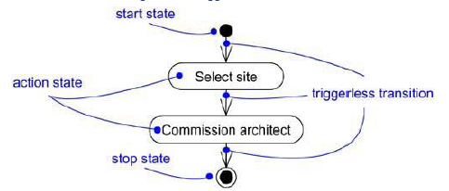
Triggerless transitions
Triggerless transitions may have guard conditions, meaning that such a transition will fire only if that condition is met.
When the action or activity of a state completes, flow of control passes immediately to the next action or activity state.

Slide 38
Branching
,
Branches are a notational convenience, semantically equivalent to multiple transitions with Guards.
Simple, sequential transitions are common, but they aren't the only kind of path you'll need to model a flow of control. As in a flowchart, you can include a branch, which specifies alternate paths taken based on some Boolean expression.
A branch may have one incoming transition and two or more outgoing ones. On each outgoing transition, you place a Boolean expression, which is evaluated only once on entering the branch.
Across all these outgoing transitions, guards should not overlap (otherwise,the flow of control would be ambiguous), but they should cover all possibilities (otherwise, the flow of control would freeze).
As a convenience, you can use the keyword else to mark one outgoing transition, representing the path taken if no other guard expression evaluates to true.
Branching and iteration are possible in interaction diagrams.

Slide 39
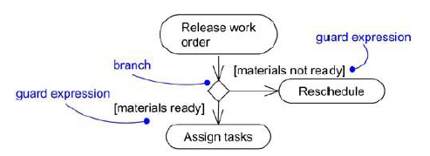

Slide 40
Forking and Joining
Each concurrent flow of control lives in the context of an independent active object, which is typically modeled as either a process or a thread.
Simple and branching sequential transitions are the most common paths you'll find in activity diagrams.
In the UML, you use a synchronization bar to specify the forking and joining of these parallel flows of control. A synchronization bar is rendered as a thick horizontal or vertical line.
A fork may have one incoming transition and two or more outgoing transitions, each of which represents an independent flow of control. Below the fork, the activities associated with each of these paths continues in parallel.
Conceptually, the activities of each of these flows are truly concurrent, although, in a running system, these flows may be either truly concurrent (in the case of a system
deployed across multiple nodes) or sequential yet interleaved (in the case of a system deployed
across one node), thus giving only the illusion of true concurrency.

Slide 41
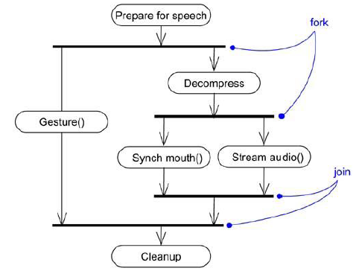

Slide 42
SWIMLANES
A swimlane is a kind of package
Each swimlane has a name unique within its diagram. A swimlane really has no deep semantics, except that it may represent some real-world entity.
Each swimlane represents a high-level responsibility for part of the overall activity of an activity diagram, and each swimlane may eventually be implemented by one or more classes.
In an activity diagram partitioned into swimlanes, every activity belongs to exactly one swimlane, but transitions may cross lanes.

Slide 43
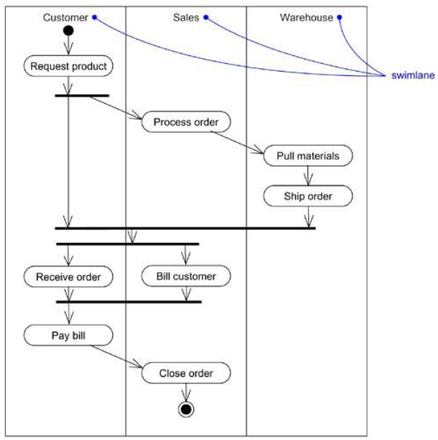

Slide 44
Object Flows
Objects may be involved in the flow of control associated with an activity diagram.
For example, in the workflow of processing an order as in the previous figure, the vocabulary of your problem space will also include such classes as Order and Bill. Instances of these two classes will be produced by certain activities (Process order will create an Order object, for example);
Other activities may modify these objects (for example, Ship order will change the state of the Order object to filled).
The things that are involved in an activity diagram, connected using a dependency to the activity or transition that creates, destroys, or modifies them are specified.
This use of dependency relationships and objects is called an object flow because it represents the participation of an object in a flow of control.

Slide 45
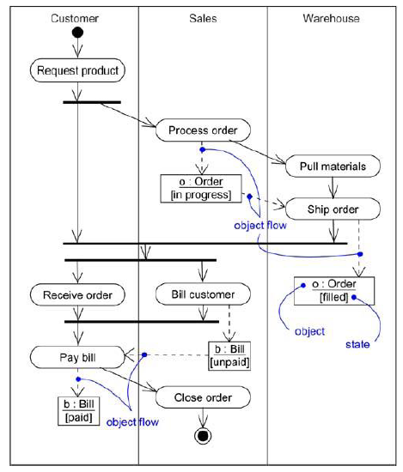

Slide 46
When you model the dynamic aspects of a system, you'll typically use activity diagrams in two ways.
To model a workflow
The activities as viewed by the actors that collaborate with the system are focused.
Workflows often lie on the fringe of software-intensive systems and are used to visualize, specify, construct, and document business processes that involve the system under development.
Hence, modeling object flow is particularly important.
2. To model an operation
Here activity diagrams are used as flowcharts, to model the details of a computation.
In this use of activity diagrams, the modeling of branch, fork, and join states is particularly important.
The context of an activity diagram used in this way involves the parameters of the operation and its local objects.

Slide 47
Modeling a Workflow
No software-intensive system exists in isolation; there's a context in which a system lives, and that context always encompasses actors that interact with the system.
Especially for mission critical, enterprise software, automated systems work in the context of higher-level business processes.
These business processes are kinds of workflows because they
represent the flow of work and objects through the business.

Slide 48
To model a workflow,
Establish a focus for the workflow. For nontrivial systems, it's impossible to show all interesting workflows in one diagram.
Select the business objects that have the high-level responsibilities for parts of the overall workflow. These may be real things from the vocabulary of the system, or they may be more abstract. In either case, create a swimlane for each important business object.
Identify the preconditions of the workflow's initial state and the postconditions of the workflow's final state. This is important in helping you model the boundaries of the workflow.
Beginning at the workflow's initial state, specify the activities and actions that take place over time and render them in the activity diagram as either activity states or action states.
For complicated actions, or for sets of actions that appear multiple times, collapse these into activity states, and provide a separate activity diagram that expands on each.
Render the transitions that connect these activity and action states. Start with the
sequential flows in the workflow first, next consider branching, and only then consider forking and joining.
If there are important objects that are involved in the workflow, render them in the activity diagram, as well. Show their changing values and state as necessary to communicate the intent of the object flow.

Slide 49
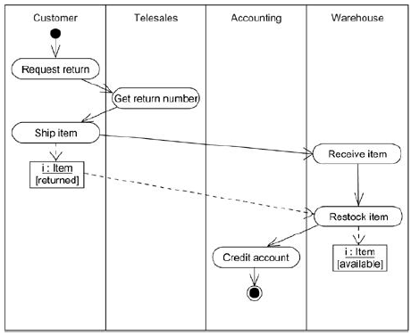
Example

Slide 50
Modeling an Operation
An activity diagram can be attached to any modeling element for the purpose of visualizing, specifying, constructing, and documenting that element's behavior.
Activity diagrams can be attached to classes, interfaces, components, nodes, use cases, and collaborations.
The most common element to which is attached to an activity diagram is an operation.
An activity diagram is simply a flowchart of an operation's actions.
It’s primary advantage is that all the elements in the diagram are semantically tied to a rich underlying model.
For example, any other operation or signal that an action state
references can be type checked against the class of the target object.

Slide 51
To model an operation,
Collect the abstractions that are involved in this operation. This includes the operation's parameters (including its return type, if any), the attributes of the enclosing class, and certain neighboring classes.
Identify the preconditions at the operation's initial state and the postconditions at the operation's final state. Also identify any invariants of the enclosing class that must hold during the execution of the operation.
Beginning at the operation's initial state, specify the activities and actions that take place over time and render them in the activity diagram as either activity states or action states.
Use branching as necessary to specify conditional paths and iteration.
Only if this operation is owned by an active class, use forking and joining as necessary to specify parallel flows of control.

Slide 52
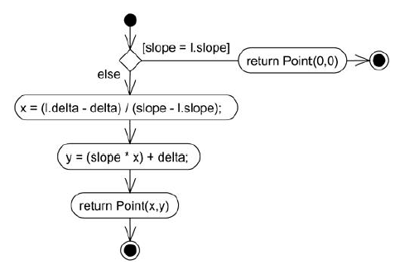
Example

Slide 53
Forward and Reverse Engineering
Forward engineering (the creation of code from a model) is possible for activity diagrams, especially if the context of the diagram is an operation.
For example, using the previous activity diagram, a forward engineering tool could generate the following C++ code for the operation intersection.
Point Line::intersection (l : Line) {
if (slope == l.slope) return Point(0,0);
int x = (l.delta - delta) / (slope - l.slope);
int y = (slope * x) + delta;
return Point(x, y);
}
There's a bit of cleverness here, involving the declarationof the two local variables. A less sophisticated tool might have first declared the two variables and then set their values.

Slide 54
Reverse Engineering
Reverse engineering (the creation of a model from code) is also possible for activity diagrams, especially if the context of the code is the body of an operation.
In particular, the previous diagram could have been generated from the implementation of the class Line.
More interesting than the reverse engineering of a model from code is the animation of a model against the execution of a deployed system.
For example, given the previous diagram, a tool could animate the action states in the diagram as they were dispatched in a running system.
Even better, with this tool also under the control of a debugger, the speed of execution can be controlled, possibly by setting breakpoints to stop the action at interesting points in time to examine the attribute values of individual objects.

Slide 55
Customer
Telesales
Accounting
Warehouse
Request
Return
Get Return
Number
Ship Item
Receive
Item
Item
[returned]
Restock
Item
Credit
Item
Account
[available]

