Slide 1
Components
A component is a physical and replaceable part of a system that conforms to and provides the realization of a set of interfaces.
Components are used to model the physical things that may reside on a node, such as executables, libraries, tables, files, and documents.

Slide 2
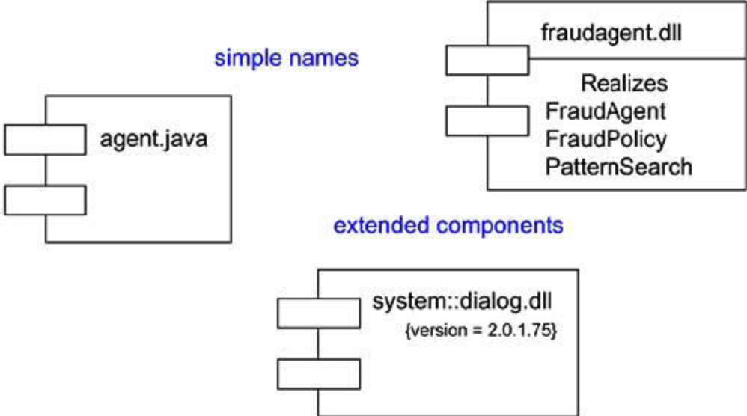
Typical Components

Slide 3
Components and Classes
Classes represent logical abstractions; components represent physical things that live in the world of bits. In short, components may live on nodes, classes may not.
Components represent the physical packaging of otherwise logical components and are at a different level of abstraction.

Slide 4
Components Characteristics
First, a component is physical. It lives in the world of bits, not concepts.
Second, a component is replaceable.
A component is substitutable- it is possible to replace a component with another that conforms to the same interfaces.
Third, a component is part of a system.
A component rarely stands alone. Rather, a given component collaborates with other components and in so doing exists in the architectural or technology context in which it is intended to be used.
A component is logically and physically cohesive and thus denotes a meaningful structural and/or behavioral chunk of a larger system.
A component may be reused across many systems. Therefore, a component represents a fundamental building block on which systems can be designed and composed.

Slide 5
Kind of Components
Deployment components:
These are the components necessary and sufficient to form an executable system, such as dynamic libraries (DLLs) and executables (EXEs).
The UML's definition of component is broad enough to address classic object models, such as COM+, CORBA, and Enterprise Java Beans, as well as alternative object models, perhaps involving dynamic Web pages, database tables, and executables using proprietary communication mechanisms.

Slide 6
Work product components: These components are essentially the residue of the development process, consisting of things such as source code files and data files from which deployment components are created.
These components do not directly participate in an executable system but are the work products of development that are used to create the executable system.

Slide 7
Execution components:These components are created as a consequence of an executing system, such as a COM+ object, which is instantiated from a DLL.

Slide 8
Stereo Types
1. executable: Specifies a component that may be executed on a node
2. library: Specifies a static or dynamic object library
3. table: Specifies a component that represents a database table
4. file: Specifies a component that represents a document containing source code or data
5. document: Specifies a component that represents a document

Slide 9
Modeling Executables and Libraries
The most common purpose for which you'll use components is to model the deployment components that make up your implementation.

Slide 10
Steps Involved
Identify the partitioning of your physical system. Consider the impact of technical, configuration management, and reuse issues.
Model any executables and libraries as components, using the appropriate standard elements. If your implementation introduces new kinds of components, introduce a new appropriate stereotype.
Model the significant interfaces that some components use and others realize.
Model the relationships among these executables, libraries, and interfaces

Slide 11
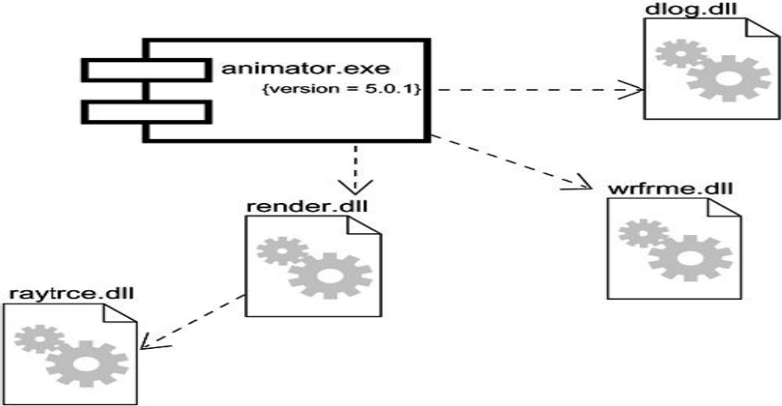

Slide 12
Modeling Tables, Files, and Documents
An implementation might include data files, help documents, scripts, log files, initialization files, and installation/removal files. To model these:
Identify the ancillary components that are part of the physical implementation of your system.
Model these things as components. If your implementation introduces new kinds of artifacts, introduce a new appropriate stereotype.

Slide 13
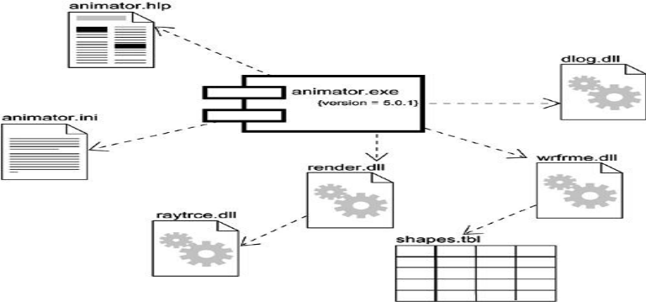
As necessary to communicate your intent, model the relationships among these ancillary components and the other executables, libraries, and interfaces in your system.

Slide 14
Modeling an API
To model an API,
Identify the programmatic seams in your system and model each seam as an interface, collecting the attributes and operations that form this edge.
Expose only those properties of the interface that are important to visualize in the given context; otherwise, hide these properties, keeping them in the interface's specification for reference, as necessary.
Model the realization of each API only insofar as it is important to show the configuration of a specific implementation.

Slide 15
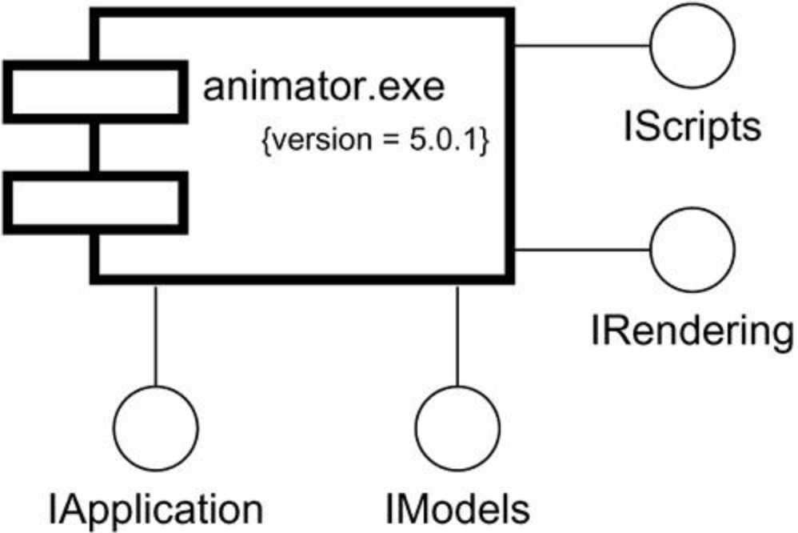

Slide 16
Modeling Source Code
To model source code:
Depending on the constraints imposed by your development tools, model the files used to store the details of all your logical elements, along with their compilation dependencies.
If it's important for you to bolt these models to your configuration management and version control tools, you'll want to include tagged values, such as version, author, and check in/check out information, for each file that's under configuration management.
As far as possible, let your development tools manage the relationships among these files, and use the UML only to visualize and document these relationships.

Slide 17
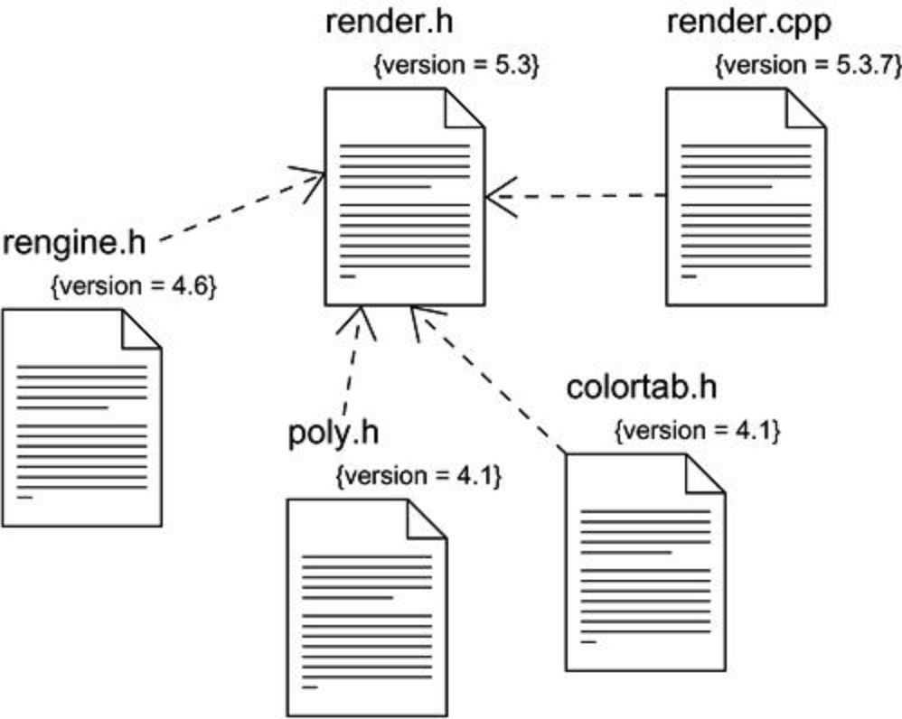

Slide 18
Component diagram
Component diagrams provide a physical view of the current model. A component diagram shows the organizations and dependencies among software components, including source code components, binary code components, and executable components. These diagrams also show the externally-visible behavior of the components by displaying the interfaces of the components. Calling dependencies among components are shown as dependency relationships between components and interfaces on other components. Note that the interfaces actually belong to the logical view, but they can occur both in class diagrams and in component diagrams.

Slide 19
Contents of Component Diagram
Component Packages
Components
Interfaces

Slide 20
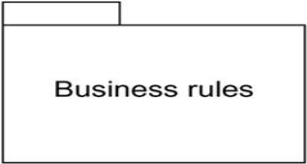
Component Package
Component packages represent clusters of logically related components, or major pieces of your system.

Slide 21
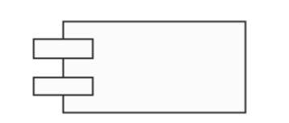
Components
A component represents a software module (source code, binary code, executable, DLL, etc.) with a well-defined interface. The interface of a component is represented by one or several interface elements that the component provides.

Slide 22
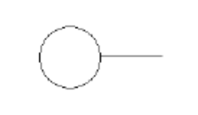
Interfaces
An interface specifies the externally-visible operations of a class and/or component, and has no implementation of its own. An interface typically specifies only a limited part of the behavior of a class or component.

Slide 23
Deployment
The components you develop or reuse as part of a software-intensive system must be deployed on some set of hardware in order to execute.
Node represents the hardware on which these components are deployed and execute.
A node is a physical element that exists at run time and represents a computational resource.

Slide 24
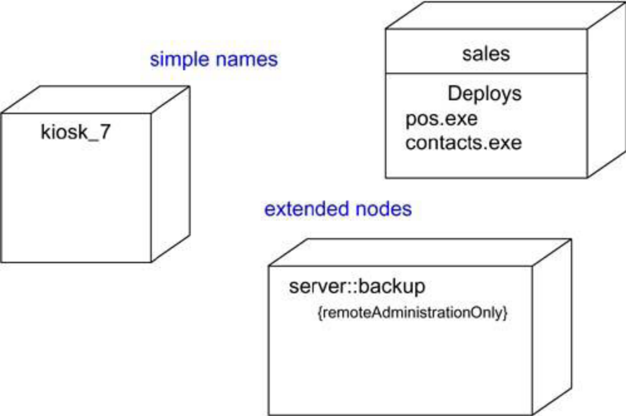

Slide 25
Components
Components are things that participate in the execution of a system; nodes are things that execute components.
Components represent the physical packaging of otherwise logical elements; nodes represent the physical deployment of components

Slide 26
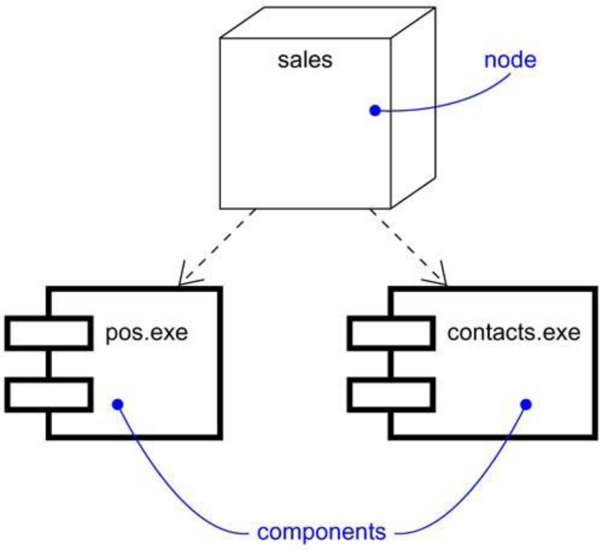

Slide 27
Connections
Nodes can be organized by specifying dependency and association relationship.
An association generally represents a physical connection among nodes, such as an Ethernet connection, a serial line, a satellite connection etc.

Slide 28
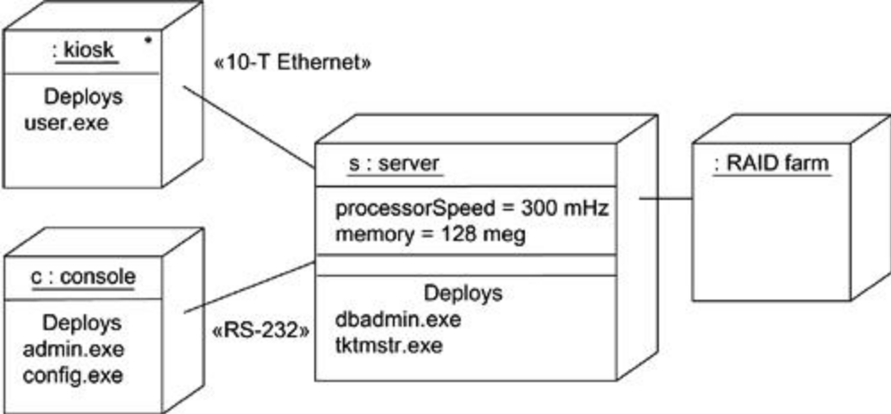

Slide 29
Modeling Processors and Devices
Identify the computational elements of your system's deployment view and model each as a node.
If these elements represent generic processors and devices, then stereotype them as such .If they are kinds of processors and devices that are part of the vocabulary of your domain, then specify an appropriate stereotype with an icon for each.
As with class modeling, consider the attributes and operations that might apply to each node.

Slide 30
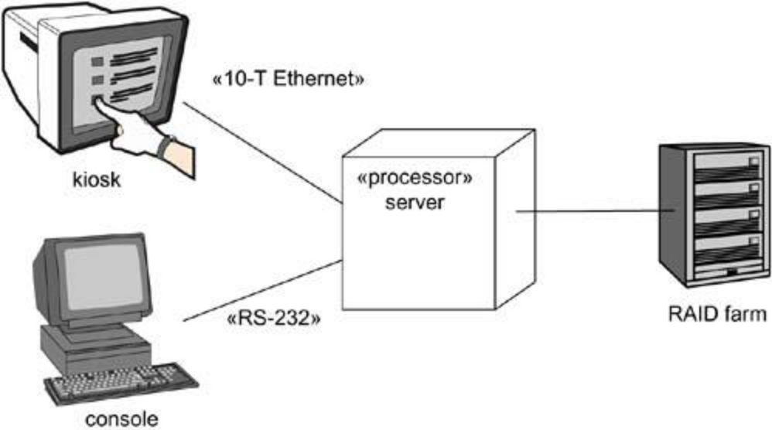

Slide 31
Deployment diagram:
A deployment diagram shows processors, devices, and connections. Each model contains a single deployment diagram which shows the connections between its processors and devices, and the allocation of its processes to processors.

Slide 32
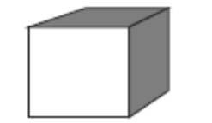
Contents of Deployment Diagram
Processor:-A processor is a hardware component capable of executing programs.

Slide 33
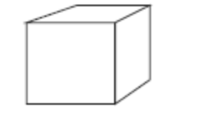
Devices:-A device is a hardware component with no computing power. Each device must have a name. Device names can be generic, such as "modem" or "terminal."

Slide 34
Connections:-A connection represents some type of hardware coupling between two entities. An entity is either a processor or a device. The hardware coupling can be direct, such as an RS232 cable, or indirect, such as satellite-to-ground communication. Connections are usually bi-directional.

