Slide 1
Document Object Model(DOM)
The document object represents the whole html document.When html document is loaded in the browser, it becomes a document object. It is the root element that represents the html document. It has properties and methods. By the help of document object, we can add dynamic content to our web page.
As mentioned earlier, it is the object of window. So
window.document
Is same as
document

Slide 2
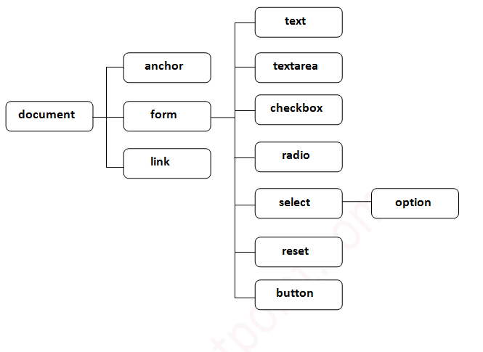
Properties of document object

Slide 3
Methods of document object
Method | Description
write("string") | writes the given string on the doucment.
writeln("string") | writes the given string on the doucment with newline character at the end.
getElementById() | returns the element having the given id value.
getElementsByName() | returns all the elements having the given name value.
getElementsByTagName() | returns all the elements having the given tag name.
getElementsByClassName() | returns all the elements having the given class name.

Slide 4
Accessing field value by document object
<script type="text/javascript">
function printvalue(){
var name=document.form1.name.value;
alert("Welcome: "+name);
}
</script>
<form name="form1">
Enter Name:<input type="text" name="name"/>
<input type="button" onclick="printvalue()" value="print name"/>
</form>

Slide 5
Javascript - document.getElementById() method
The document.getElementById() method returns the element of specified id.
In the previous page, we have used document.form1.name.value to get the value of the input value. Instead of this, we can use document.getElementById() method to get value of the input text. But we need to define id for the input field.

Slide 6
example
<script type="text/javascript">
function getcube(){
var number=document.getElementById("number").value;
alert(number*number*number);
}
</script>
<form>
Enter No:<input type="text" id="number" name="number"/><br/>
<input type="button" value="cube" onclick="getcube()"/>
</form>

Slide 7
Javascript - document.getElementsByName() method
The document.getElementsByName() method returns all the element of specified name.
The syntax of the getElementsByName() method is given below:
document.getElementsByName("name")

Slide 8
Example
<script type="text/javascript">
function totalelements()
{
var allgenders=document.getElementsByName("gender");
alert("Total Genders:"+allgenders.length);
}
</script>
<form>
Male:<input type="radio" name="gender" value="male">
Female:<input type="radio" name="gender" value="female">
<input type="button" onclick="totalelements()" value="Total Genders">
</form>

Slide 9
Javascript - document.getElementsByTagName() method
The document.getElementsByTagName() method returns all the element of specified tag name.
The syntax of the getElementsByTagName() method is given below:
document.getElementsByTagName("name")

Slide 10
Example1
<script type="text/javascript">
function countpara(){
var totalpara=document.getElementsByTagName("p");
alert("total p tags are: "+totalpara.length);
}
</script>
<p>This is a pragraph</p>
<p>Here we are going to count total number of paragraphs by getElementByTagName() method.</p>
<p>Let's see the simple example</p>
<button onclick="countpara()">count paragraph</button>

Slide 11
Example2
<script type="text/javascript">
function counth2(){
var totalh2=document.getElementsByTagName("h2");
alert("total h2 tags are: "+totalh2.length);
}
function counth3(){
var totalh3=document.getElementsByTagName("h3");
alert("total h3 tags are: "+totalh3.length);
}
</script>
<h2>This is h2 tag</h2>
<h2>This is h2 tag</h2>
<h3>This is h3 tag</h3>
<h3>This is h3 tag</h3>
<h3>This is h3 tag</h3>
<button onclick="counth2()">count h2</button>
<button onclick="counth3()">count h3</button>

Slide 12
Javascript - innerHTML
The innerHTML property can be used to write the dynamic html on the html document.
It is used mostly in the web pages to generate the dynamic html such as registration form, comment form, links etc.

Slide 13
Example
<script type="text/javascript" >
function showcommentform() {
var data="Name:<input type='text' name='name'><br>Comment:<br><textarea rows='5' cols='80'></textarea>
<br><input type='submit' value='Post Comment'>";
document.getElementById('mylocation').innerHTML=data;
}
</script>
<form name="myForm">
<input type="button" value="comment" onclick="showcommentform()">
<div id="mylocation"></div>
</form>

