Slide 1
JavaScript

Slide 2
Need For JavaScript
  Limitations of HTML
    Static web pages
    No provision for validation of content
    Lack of dynamicity

Slide 3
What is JavaScript ?
Java script is a light-weight ,interpreted,open source, client side scripting language (Decoding is happened in the browser so no need of server)developed by NETSCAPE in 1995.
In beginning it was known as Livescript, later changed to Java script
An object-based programming language
Allows creation of interactive web pages
Allows user entries to be processed as required
It is open and cross-platform

Slide 4
Advantages of Java Script
Less server interaction − You can validate user input before sending the page off to the server. This saves server traffic, which means less load on your server.
Immediate feedback to the visitors − They don't have to wait for a page reload to see if they have forgotten to enter something.
Increased interactivity − You can create interfaces that react when the user hovers over them with a mouse or activates them via the keyboard.

Slide 5
Richer interfaces − You can use JavaScript to include such items as drag-and-drop components and sliders to give a Rich Interface to your site visitors.

Slide 6
Limitations of JavaScript
We cannot treat JavaScript as a full-fledged programming language. It lacks the following important features −
Client-side JavaScript does not allow the reading or writing of files. This has been kept for security reason.
JavaScript cannot be used for networking applications because there is no such support available.
JavaScript doesn't have any multithreading or multiprocessor capabilities.

Slide 7
Javascript Development Tools
One of major strengths of JavaScript is that it does not require expensive development tools. You can start with a simple text editor such as Notepad. Since it is an interpreted language inside the context of a web browser, you don't even need to buy a compiler.
Microsoft FrontPage − Microsoft has developed a popular HTML editor called FrontPage. FrontPage also provides web developers with a number of JavaScript tools to assist in the creation of interactive websites.

Slide 8
Macromedia Dreamweaver MX − Macromedia Dreamweaver MX is a very popular HTML and JavaScript editor in the professional web development crowd. It provides several handy prebuilt JavaScript components, integrates well with databases, and conforms to new standards such as XHTML and XML.
Macromedia HomeSite 5 − HomeSite 5 is a well-liked HTML and JavaScript editor from Macromedia that can be used to manage personal websites effectively.

Slide 9
HTML to define the content of web pages
CSS to specify the layout of web pages
JavaScript to program the behavior of web pages
    In HTML, JavaScript code must be inserted between <script> and </script> tags

Slide 10
What a JavaScript can do?
Put dynamic text into an HTML page
React to events
Read and write HTML elements
Used to validate data
Used to detect the visitor's browser
Used to create cookies (is a small piece of data sent from a website and stored in the user's web browser while the user is browsing it.)

Slide 11
JavaScript in Chrome
Here are the steps to turn on or turn off JavaScript in Chrome −
Click the Chrome menu at the top right hand corner of your browser.
Select Settings.
Click Show advanced settings at the end of the page.
Under the Privacy section, click the Content settings button.
In the "Javascript" section, select "Do not allow any site to run JavaScript" or "Allow all sites to run JavaScript (recommended)".

Slide 12
The script tag takes two important attributes −
Language − This attribute specifies what scripting language you are using. Typically, its value will be javascript. Although recent versions of HTML (and XHTML, its successor) have phased out the use of this attribute.
Type − This attribute is what is now recommended to indicate the scripting language in use and its value should be set to "text/javascript“
So your JavaScript segment will look like −
<script language="javascript" type="text/javascript“>JavaScript code </script>.

Slide 13
There is a flexibility given to include JavaScript code anywhere in an HTML document. However the most preferred ways to include JavaScript in an HTML file are as follows −
Script in <head>...</head> section.
Script in <body>...</body> section.
Script in <body>...</body> and <head>...</head> sections.
Script in an external file and then include in <head>...</head> section.

Slide 14
JavaScript in <head>...</head> section
If you want to have a script run on some event, such as when a user clicks somewhere, then you will place that script in the head as follows −

Slide 15
<html>
<head>
<script type="text/javascript">
function sayHello()
{ alert("Hello World")
}
</script>
</head>
<body>
<input type="button" onclick="sayHello()" value="Say Hello" /> </body>
</html>

Slide 16
JavaScript in <body>...</body> section
If you need a script to run as the page loads so that the script generates content in the page, then the script goes in the <body> portion of the document. In this case, you would not have any function defined using JavaScript. Take a look at the following code.

Slide 17
<html>
<head>
</head>
<body>
<script type="text/javascript">
document.write("Hello World") ;
</script>
<p>This is web page body </p>
</body>
</html>

Slide 18
JavaScript in External File
As you begin to work more extensively with JavaScript, you will be likely to find that there are cases where you are reusing identical JavaScript code on multiple pages of a site
<html>
<head>
<script type="text/javascript" src="filename.js" >
</script>
</head>
<body> .......
</body> </html>

Slide 19
For example, you can keep the following content in filename.jsfile and then you can use sayHello function in your HTML file after including the filename.js file.
Contents of filename.js
Function sayHello()
{ alert("Hello World") ;
}

Slide 20
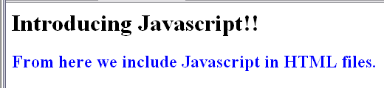
Example (simple_jsfile.html) with output
<HTML>
<HEAD>
<TITLE> A program in Javascript </TITLE>
<SCRIPT LANGUAGE="Javascript">
document.writeln("<H1>Introducing Javascript!!</H1>");
document.writeln("<H2 style='COLOR:blue'>From here we include Javascript in HTML files.</H2>");
</SCRIPT>
</HEAD>
<BODY>
</BODY>
</HTML>
Written with <script> tag.
HTML elements put in quotes in document.write ().

Slide 21
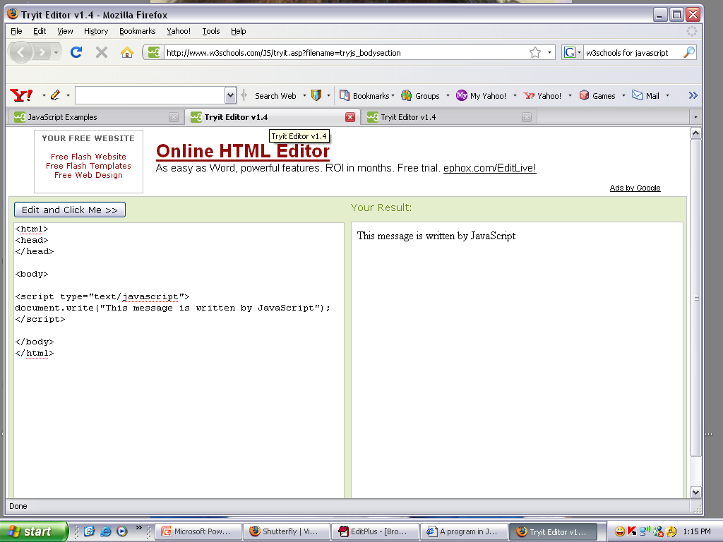
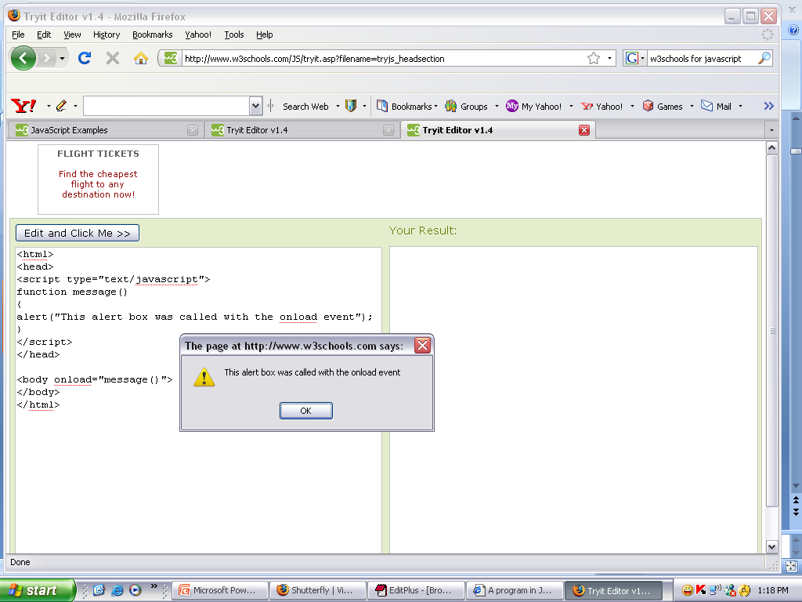
Example: Script in <body> and <head> sections

Slide 22
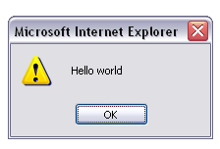
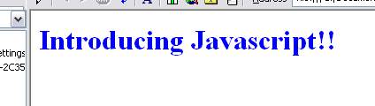
Example 4
<HTML>
<HEAD>
<TITLE> A program in Javascript </TITLE>
<SCRIPT LANGUAGE="Javascript">
alert("Hello world");
</SCRIPT>
</HEAD>
<BODY>
<H1 style='COLOR:blue'>Introducing Javascript!!</H1>
</BODY>
</HTML>

Slide 23
Use the var keyword only for declaration or initialization, once for the life of any variable name in a document. You should not re-declare same variable twice.
JavaScript is untyped language. This means that a JavaScript variable can hold a value of any data type. Unlike many other languages, you don't have to tell JavaScript during variable declaration what type of value the variable will hold. The value type of a variable can change during the execution of a program and JavaScript takes care of it automatically.

Slide 24
JavaScript has
Variables
Values
Literals
Expressions
Operators types

Slide 25
1. Variables
Use Symbolic names for values.
Declaring Variables
  Two ways
    E.g: x = 42
    E.g: var x = 42
    E.g: var number1,number2;
Naming Variables
  Must start with a letter or underscore(“_”)
  case-sensitive
Variable Scope
Local Variable
Global Variable

Slide 26
2. Values
Numbers
Logical values :true/false
Strings such as “Whats up”
Null (Special Keyword)
Undefined

Slide 27
3. Literals
Used to represent values in Javascript
Types of Literals
  Array literals
  Boolean literals
  Floating-point literals
  Integers literals
  Object literals
  String literals

Slide 28
4. Expressions
Expression
  Valid set of literals, variables and expressions that evaluates to a single value.
A regular expression is an object that describes a pattern of characters.

Slide 29
5. Operators - Types of operators
  Assignment
  Comparison
  Arithmetic
  Bitwise
  Logical
  String
  Special

Slide 30
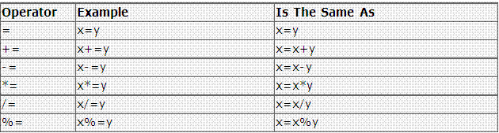
5.A Assignment Operators

Slide 31
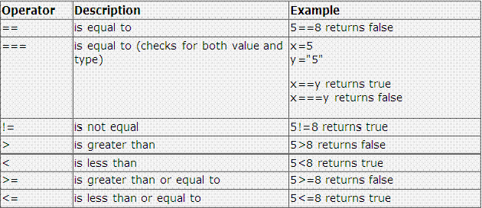
5.B Comparison Operators

Slide 32
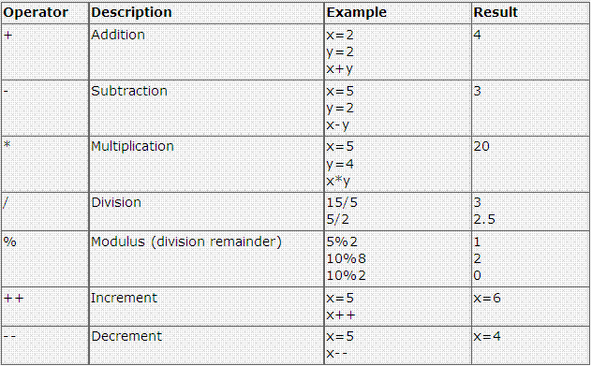
5.C Arithmetic Operators

Slide 33
5.D Bitwise Operators
Operator | Usage
Bitwise AND | a&b
Bitwise OR | a|b
Bitwise XOR | a^b
Bitwise NOT | ~a

Slide 34
5.E Logical Operators
Operator | Usage
&& | expr1 && expr2
|| | expr1 || expr2
! | ! expr1

Slide 35
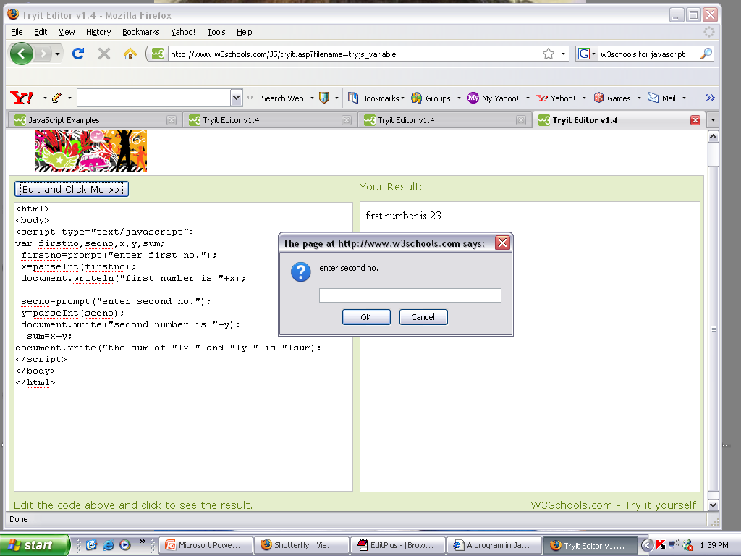
Example

Slide 36
5.F String Operators
Concatenation Operator (+)
For e.g:
  txt1="What a very"
  txt2=“ nice day!"
  txt3=txt1+txt2
  The variable txt3 now contains "What a very nice day!".

Slide 37
5.G Special Operators
conditional
comma
delete
new
this
typeof
void

Slide 38
Operator precedence table
Operator Type | Individual Operators
Comma | ,
Assignment | = += -= *= /= %= <<= >>= <<<= >>>= &= ^= |=
Conditional | ?:
Logical-operators | || &&
Bitwise-operators | | ^ &
Equality | == !=
Bitwise shift | << >> >>>
Addition / Subtraction | + -
Multiply / Divide | * / %
Negation / Increment | ! ~ - + ++ -- typeof void delete
Call | ()
Create Instance | new
Member | . []

Slide 39
Pop-up Boxes
Alert Box:
    An alert dialog box is mostly used to give a warning message to the users.
    Alert box gives only one button "OK" to select and proceed.
    For example, if one input field requires to enter some text but the user does not provide any input, then as a part of validation, you can use an alert box to give a warning messag
  e.g.: alert(“hello!!”)

Slide 40
Confirm Box:
    A confirmation dialog box is mostly used to take user's consent on any option.
    It displays a dialog box with two buttons: Ok,Cancel.
    If the user clicks on the OK button, the window method confirm() will return true.
    If the user clicks on the Cancel button, then confirm() returns false..
  e.g.: confirm(“sometext”)

Slide 41
Prompt Box:
    A prompt box is often used if you want the user to input a value before entering a page.
    The prompt dialog box is very useful when you want to pop-up a text box to get user input.
    Thus, it enables you to interact with the user. The user needs to fill in the field and then click OK.
  e.g: prompt(“sometext”,”defaultvalue”)

Slide 42
Statements
Three types of statements
  Conditional statements
    E.g.: if….else and switch
  Loop statements
    E.g.: for , while , do while,
    Terms used in looping: label, break and continue
  Object Manipulation Statements
    E.g.: for …..in and with

Slide 43
Working with Objects
Object is an entity, having state, behavior and identity.
State of an object represents what is its current state.
Behavior indicates what actions can be performed with that object.
Identity gives unique identification for the object.

Slide 44
Predefined Objects
Math String Date Array Boolean Number

Slide 45
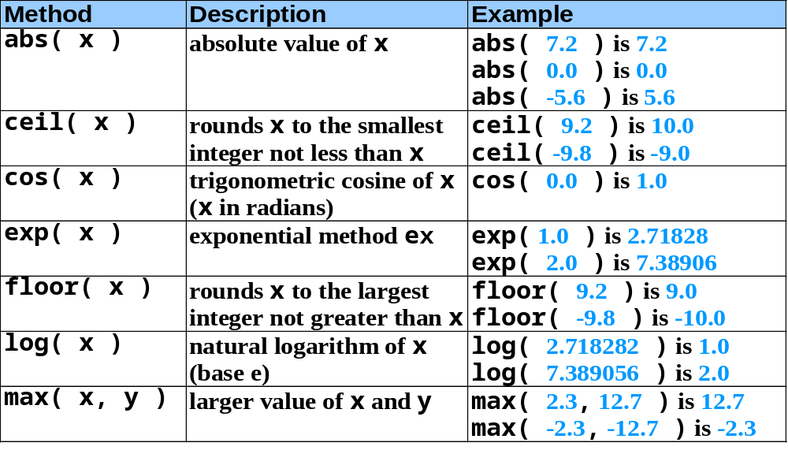
Math Object methods
The Math object allows you to perform mathematical tasks.

Slide 46
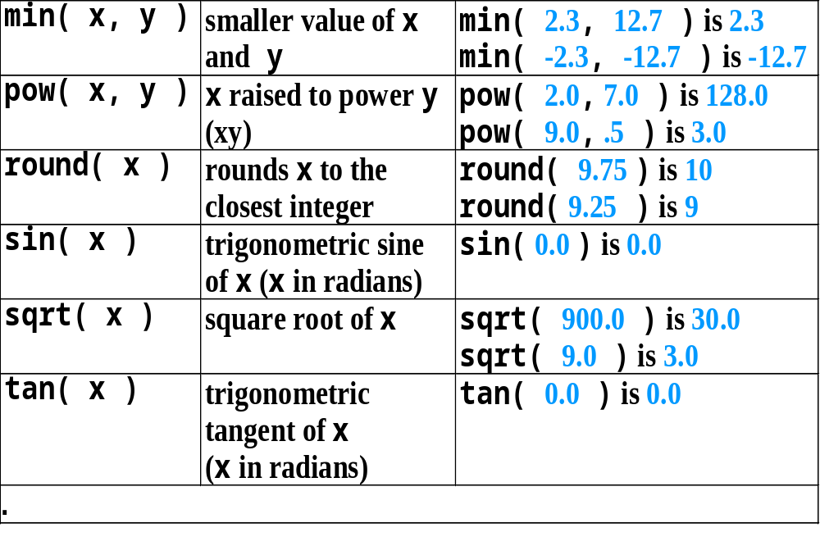
Math Object methods( contd.)

Slide 47
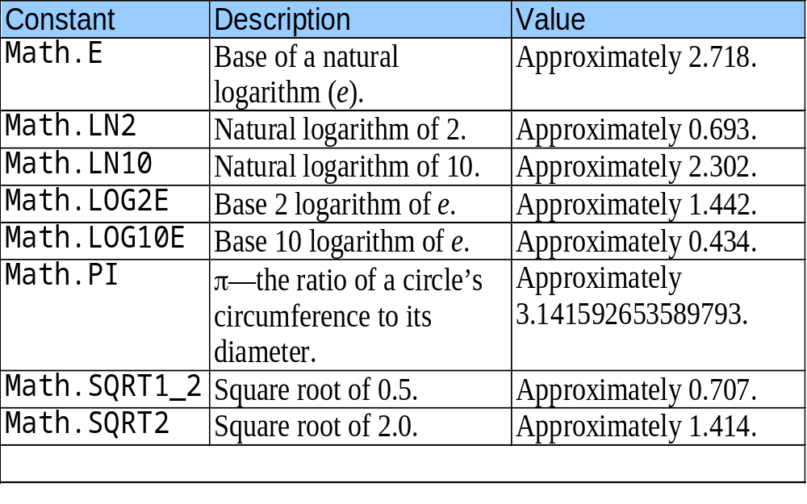
Math Object properties

Slide 48
String Object
Appropriate for processing names, addresses, credit card information, etc.
A JavaScript string simply stores a series of characters like "John Doe".
A string can be any text inside quotes. You can use single or double quotes:
There are two ways to create String object.
  i) s=“welcome”;
  OR
  ii) s =new String(“welcome”);

Slide 49
String indexes are zero-based: The first character is in position 0, the second in 1, and so on.

Slide 50
Fundamentals of Characters and Strings
Characters
  Fundamental building blocks of JavaScript programs
String
  Series of characters treated as a single unit

Slide 51
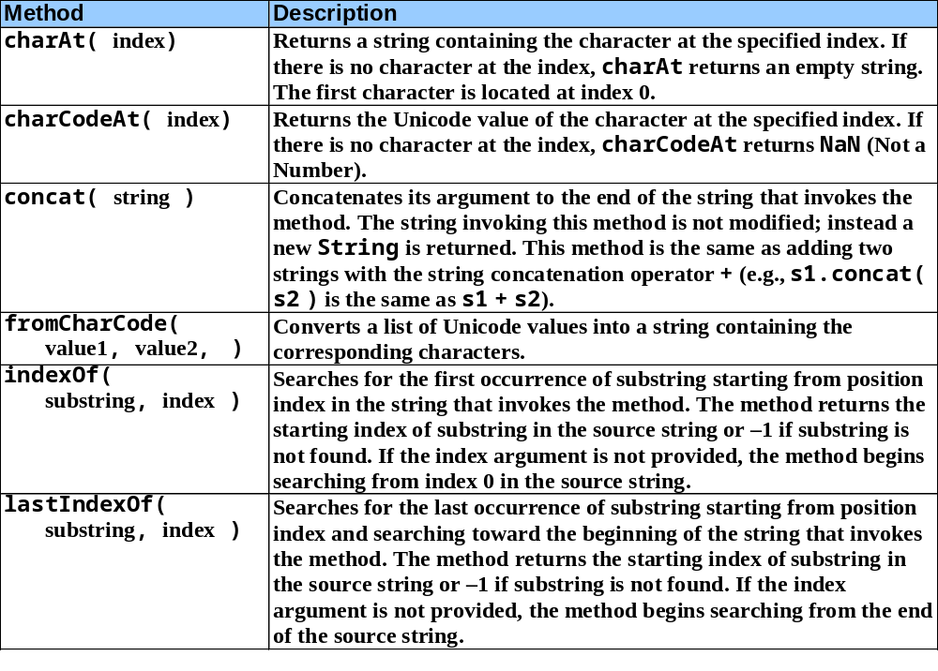
Methods of the String Object

Slide 52
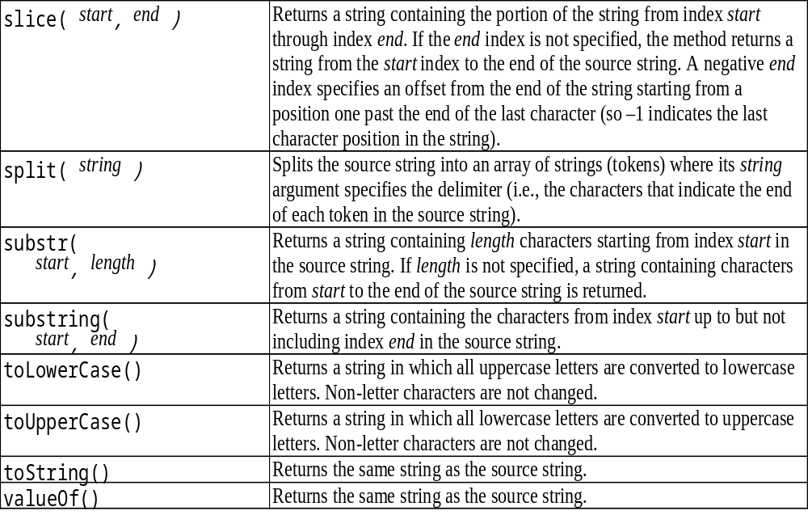
Methods of the String Object (contd)

Slide 53
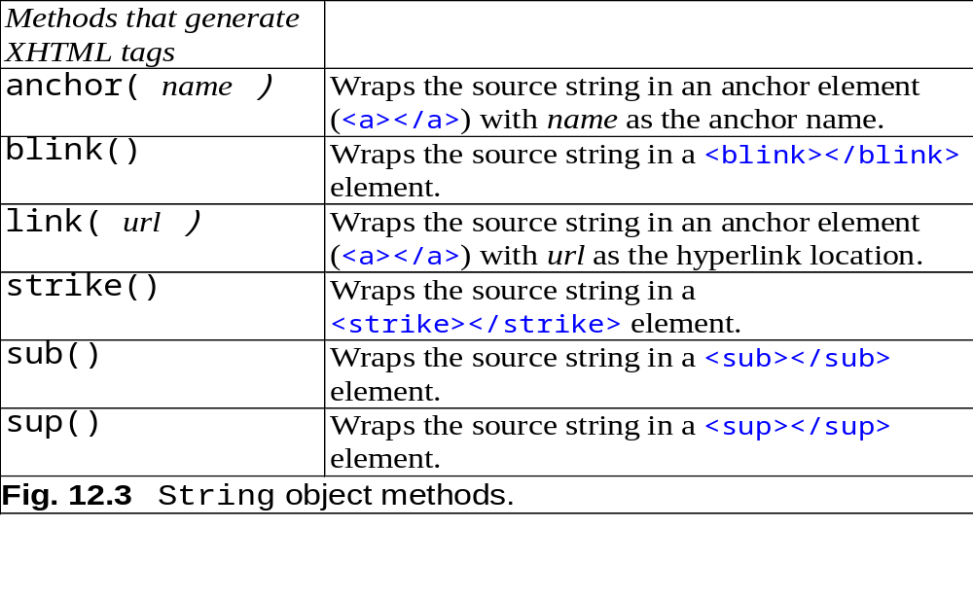
Methods of the String Object (contd.)

Slide 54
Properties of String Object
Name | Description
length | It gives the number of characters in the string.

Slide 55
Date Object
The Date object is used to work with dates and times.
Date objects are created with new Date().
Provides methods for date and time manipulations.
There are two separate notions of time:
  i) UTC :- Universal time, also known as Greenwich Mean Time.
  ii) Local :- Local time is the time on the machine which is executing the script.

Slide 56
Creating Date object
There are different ways to create date object.
i) d=new Date()
ii) d=new Date(year,month,day[,hour,minute,second)
iii) d=new Date(milliseconds );
construct a new date object based upon the number of milliseconds elapsed since 00:00:00 hours on 01/01/1970.
iv) d=new Date(string )
ex:- d=new Date(“April 9, 1988 14:02.35”);

Slide 57
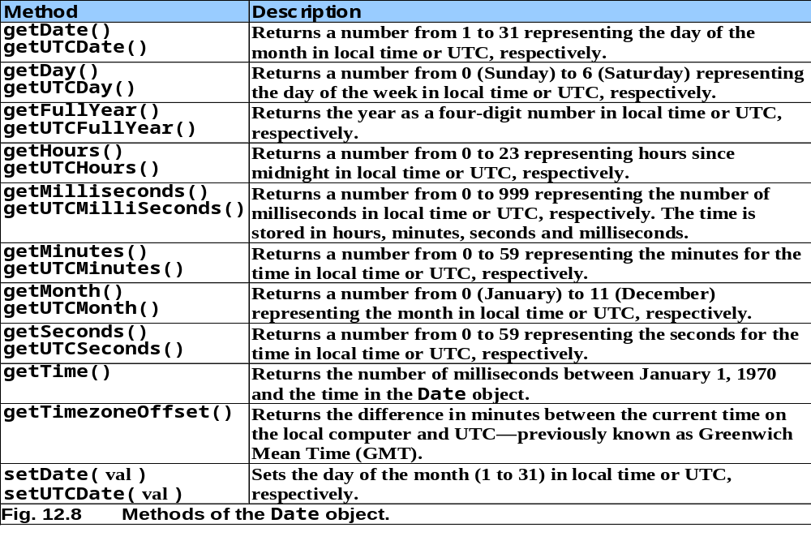
Date Object

Slide 58
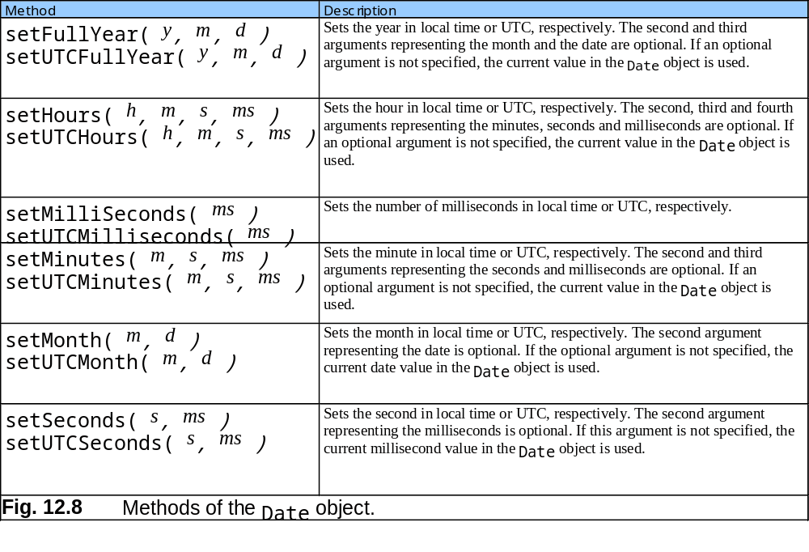
Date Object

Slide 59
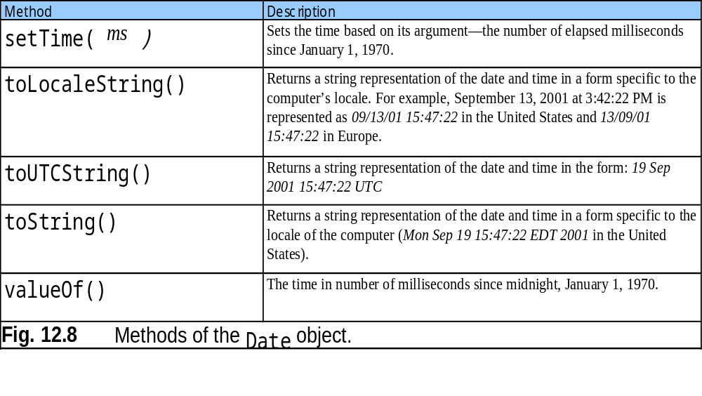
Date Object

Slide 60
Arrays
  The Array object is used to store multiple values in a single variable:
  Data structures of related items
    Also called Collections
  Dynamic
  Each element referenced by a number
    Start at “zeroth element”
    Subscript or index
  Accessing a specific element
    Name of array
    Brackets
    Number of element
  Arrays know their length
    length property

Slide 61
Arrays
Name of array
c[ 0 ]
-45
c[ 1 ]
6
c[ 2 ]
0
c[ 3 ]
72
c[ 4 ]
1543
c[ 5 ]
-89
c[ 6 ]
0
c[ 7 ]
62
c[ 8 ]
-3
c[ 9 ]
1
Position number (index
or subscript) of the
c[ 10 ]
6453
c
element within array
c[ 11 ]
78
Fig. 11.1 A 12-element array.

Slide 62
Declaring and Allocating Arrays
Arrays in memory
  Objects
  Operator new
    Allocates memory for objects
    Dynamic memory allocation operator
    var c;
    c = new Array( 12 );

Slide 63
Examples Using Arrays
Arrays grow dynamically
  Allocate more space as items are added
Must initialize array elements
  Default value is undefined

Slide 64
Examples Using Arrays
Possible to declare and initialize in one step
  Specify list of values
    Initializer list
  var n = [ 10, 20, 30, 40, 50 ];
  var n = new Array( 10, 20, 30, 40, 50 );
  Also possible to only initialize some values
    Leave uninitialized elements blank
    Uninitialized elements default to “undefined”
  var n = [ 10, 20, , 40, 50 ];

Slide 65
Examples Using Arrays
for…in statement
  Perform an action for each element in an array
  Iterates over array elements
  Ignores non-existent elements

Slide 66
Multidimensional Arrays
Two-dimensional arrays
  Rows and columns
    Specify row first, then column
  Two subscripts

Slide 67
Multidimensional Arrays
Column 0
Column 1
Column 2
Column 3
Row 0
a[ 0 ][ 0 ]
a[ 0 ][ 1 ]
a[ 0 ][ 2 ]
a[ 0 ][ 3 ]
Row 1
a[ 1 ][ 0 ]
a[ 1 ][ 1 ]
a[ 1 ][ 2 ]
a[ 1 ][ 3 ]
Row 2
a[ 2 ][ 0 ]
a[ 2 ][ 1 ]
a[ 2 ][ 2 ]
a[ 2 ][ 3 ]
Column subscript (or index)
Row subscript (or index)
Array name
Fig. 11.12 Two-dimensional array with three rows and four columns.

Slide 68
Multidimensional Arrays
Declaring and initializing multidimensional arrays
  Group by row in square brackets
  Treated as arrays of arrays
  Creating array b with one row of two elements and a second row of three elements:
  var b = [ [ 1, 2 ], [ 3, 4, 5 ] ];

Slide 69
Multidimensional Arrays
Also possible to use new operator
  Create array b with two rows, first with five columns and second with three:
var b;
b = new Array( 2 );
b[ 0 ] = new Array( 5 );
b[ 1 ] = new Array( 3 );

Slide 70
Methods of Array Object
reverse()
- It reverses the order of the elements.
2. join(string)
- Creates string containing all array elements.
  Specify separator

Slide 71
3. slice(start,end)
- It returns a sub-array.( excluding end argument char)
4. sort()
  Defaults to string comparison
  To sort numbers comparison function will be passed as an argument.
  This comparison function will exchange its arguments in the array if it returns positive value.

Slide 72
every() Checks if every element in an array pass a test
some() Checks if any of the elements in an array pass a test
filter() Creates a new array with every element in an array that pass a test
pop() Removes the last element of an array, and returns that element
push() Adds new elements to the end of an array, and returns the new length

Slide 73
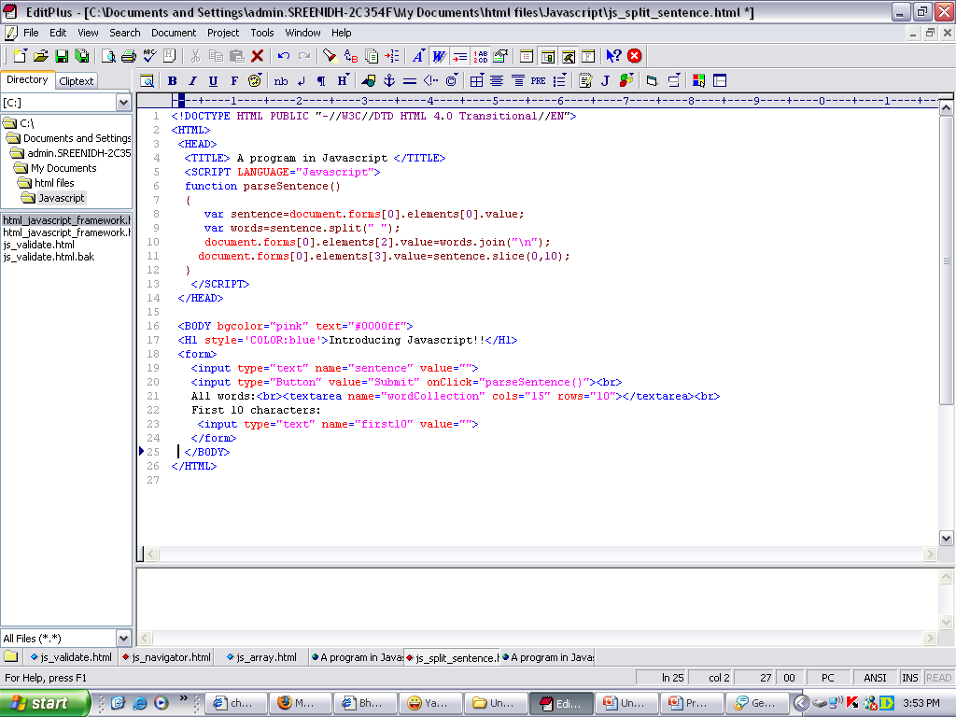
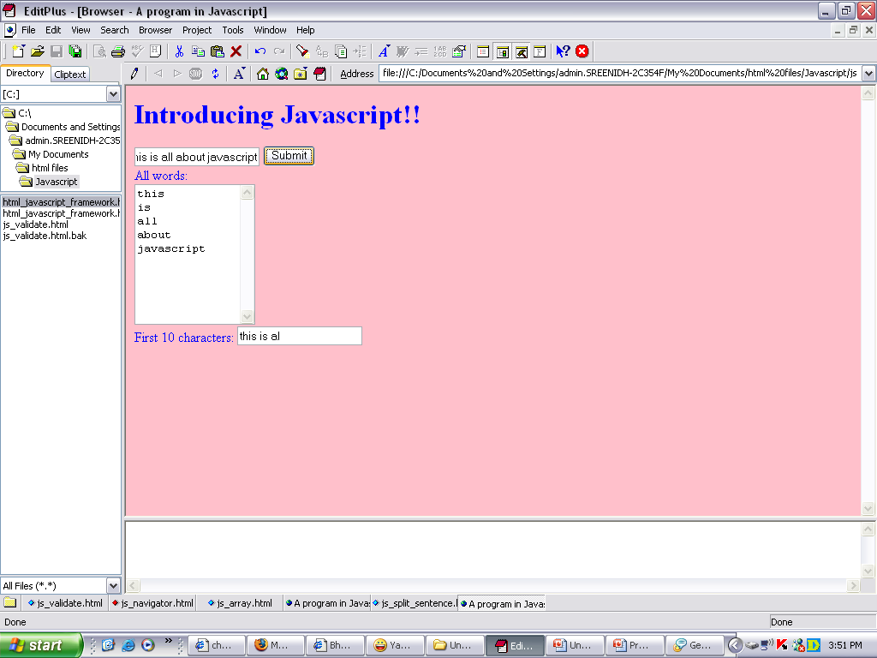
Example for Arrays and methods

Slide 74
JavaScript Functions
A function contains code that will be executed by an event or by a call to the function.
You may call a function from anywhere within a page .
Functions can be defined both in the <head> and in the <body> section of a document.
However, to assure that a function is loaded by the browser before it is called, it could be wise to put functions in the <head> section.

Slide 75
Syntax
function functionname(var1,var2,...,varX)
{
some code
}

Slide 76
Ex:
<html>
<head>
<script type="text/javascript">
function displaymessage()
{
alert("Hello World!");
}
</script>
</head>
<body>
<form>
<input type="button" value="Click me!" onclick="displaymessage()" >
</form>
</body>
</html>

Slide 77
The return Statement
The return statement is used to specify the value that is returned from the function.
So, functions that are going to return a value must use the return statement.

Slide 78
Ex :
<html>
<head>
<script type="text/javascript">
function product(a,b)
{
return a*b;
}
</script>
</head>
<body>
<script type="text/javascript">
document.write(product(4,3));
</script>
</body>
</html>

Slide 79
Event Handler
Outline
1 Introduction
2 Event ONCLICK
3 Event ONLOAD
4 Tracking the Mouse with Event ONMOUSEMOVE
5 Rollovers with ONMOUSEOVER and ONMOUSEOUT
6 Form Processing with ONFOCUS and ONBLUR
7 More Form Processing with ONSUBMIT and ONRESET
Key board events
Event Bubbling

Slide 80
Introduction
HTML DOM allows JavaScript to react to HTML events:
A JavaScript can be executed when an event occurs, like when a user clicks on an HTML element.
To execute code when a user clicks on an element, add JavaScript code to an HTML event attribute:

Slide 81
Examples of HTML events:
When a user clicks the mouse
When a web page has loaded
When an image has been loaded
When the mouse moves over an element
When an input field is changed
When an HTML form is submitted
When a user strokes a key

Slide 82
Event model
  Scripts respond to user actions who is
    Moving mouse
    Scrolling screen
    Entering keystrokes etc.
  Content more dynamic

Slide 83
Event ONCLICK
ONCLICK event
  Fires when user clicks mouse on a specific item

Slide 84
Event ONLOAD
ONLOAD event
  Fires when element finishes loading successfully
  Often used in BODY tag
    Initiate scripts as soon as page loads

Slide 85
Tracking the Mouse with Event ONMOUSEMOVE
ONMOUSEMOVE event
  Fires constantly whenever mouse in motion
event object
  Contains info about triggered event
  srcElement
    Pointer to element object that triggered event
  offsetX and offsetY
    Give location of mouse cursor relative to top-left corner of object in which event triggered

Slide 86
1<!DOCTYPE html PUBLIC "-//W3C//DTD HTML 4.0 Transitional//EN">
2<HTML>
3
4<!-- Fig 16.4: onmousemove.html -->
5<!-- Demonstrating the ONMOUSEMOVE event -->
6
7<HEAD>
8<TITLE>DHTML Event Model - ONMOUSEMOVE event</TITLE>
9<SCRIPT LANGUAGE = "JavaScript">
10 function updateMouseCoordinates()
11 {
12 coordinates.innerText = event.srcElement.tagName +
13 " (" + event.offsetX + ", " + event.offsetY + ")";
14 }
15
Define function updateMouseCoordinates
1.1 Use properties of event object to track mouse cursor
16</SCRIPT>
17</HEAD>
18
19<BODY ONMOUSEMOVE = "updateMouseCoordinates()">
20
21<SPAN ID = "coordinates">(0, 0)</SPAN><BR>
22<IMG SRC = "deitel.gif" STYLE = "position: absolute; top: 100;
23 left: 100">
24
25</BODY>
26</HTML>

Slide 87
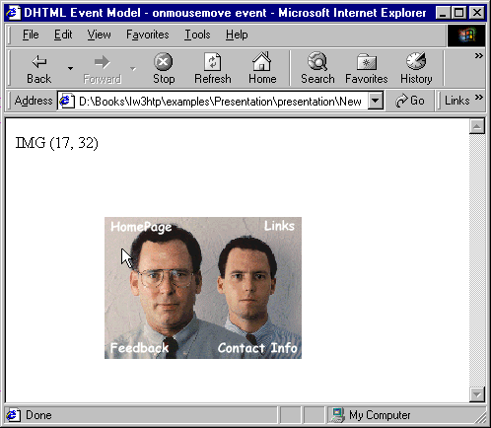
Demonstrating the OMOUSEMOVE event
Updated text (keeps changing as you move the mouse)

Slide 88
Rollovers with ONMOUSEOVER and ONMOUSEOUT
ONMOUSEOVER event
  Fires when mouse cursor moves over an element
ONMOUSEOUT event
  Fires when mouse cursor leaves the element
Combine events for rollover effect
  Pre-load images

Slide 89
1 <!DOCTYPE html PUBLIC "-//W3C//DTD HTML 4.0 Transitional//EN">
2 <HTML>
3
4 <!-- Fig 16.6: onmouseoverout.html -->
5 <!-- Events ONMOUSEOVER and ONMOUSEOUT -->
6
7 <HEAD>
8 <TITLE>DHTML Event Model - ONMOUSEOVER and ONMOUSEOUT</TITLE>
9 <SCRIPT LANGUAGE = "JavaScript">
10
11 captionImage1 = new Image();
12 captionImage1.src = "caption1.gif";
13 captionImage2 = new Image();
14 captionImage2.src = "caption2.gif";
15
16 function mOver()
17 {
18 if ( event.srcElement.id == "tableCaption" ) {
19 event.srcElement.src = captionImage2.src;
1.1 Pre-load images
1.2 Define functions mOver and mOut
20 return;
21 }
22
23 // If the element which triggered ONMOUSEOVER has an ID,
24 // Change its color to its ID.
25 if ( event.srcElement.id )
26 event.srcElement.style.color = event.srcElement.id;
27 }
28
29 function mOut()
30 {
31 if ( event.srcElement.id == "tableCaption" ) {
32 event.srcElement.src = captionImage1.src;

Slide 90
33 return;
34 }
35
36 // If it has an ID, change the text inside to the text of
37 // the ID.
38 if ( event.srcElement.id )
39 event.srcElement.innerText = event.srcElement.id;
40 }
41
42 document.onmouseover = mOver;
43 document.onmouseout = mOut;
44
45</SCRIPT>
46</HEAD>
47
48<BODY STYLE = "background-color: wheat">
49
50<H1>Guess the Hex Code's Actual Color</H1>
51
52<P>Can you tell a color from its hexadecimal RGB code value?
53Look at the hex code, guess the color. To see what color it
54corresponds to, move the mouse over the hex code. Moving the
55mouse out will display the color name.</P>
56
57<TABLE STYLE = "width: 50%; border-style: groove;
58 text-align: center; font-family: monospace;
59 font-weight: bold">
60
61 <CAPTION>
62 <IMG SRC = "caption1.gif" ID = "tableCaption">
63 </CAPTION>
64
65 <TR>
66 <TD><A ID = "Black">#000000</A>

Slide 91
67 <TD><A ID = "Blue">#0000FF</A>
68 <TD><A ID = "Magenta">#FF00FF</A>
69 <TD><A ID = "Gray">#808080</A>
70 </TR>
71 <TR>
72 <TD><A ID = "Green">#008000</A>
73 <TD><A ID = "Lime">#00FF00</A>
74 <TD><A ID = "Maroon">#800000</A>
75 <TD><A ID = "Navy">#000080</A>
76 </TR>
77 <TR>
78 <TD><A ID = "Olive">#808000</A>
79 <TD><A ID = "Purple">#800080</A>
80 <TD><A ID = "Red">#FF0000</A>
81 <TD><A ID = "Silver">#C0C0C0</A>
82 </TR>
83 <TR>
84 <TD><A ID = "Cyan">#00FFFF</A>
85 <TD><A ID = "Teal">#008080</A>
86 <TD><A ID = "Yellow">#FFFF00</A>
87 <TD><A ID = "White">#FFFFFF</A>
88 <TR>
89</TABLE>
90
91</BODY>
92</HTML>

Slide 92
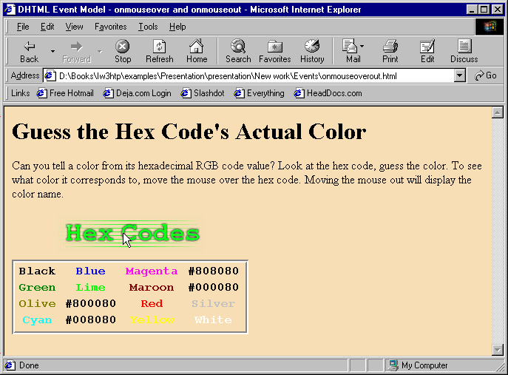
Events ONMOUSEOVER and ONMOUSEOUT

Slide 93
Form Processing with ONFOCUS and ONBLUR
ONFOCUS event
  Fires when an element gains focus
    User clicks on form field
    User uses Tab key to highlight element
ONBLUR event
  Fires when an element loses focus

Slide 94
1 <!DOCTYPE html PUBLIC "-//W3C//DTD HTML 4.0 Transitional//EN">
2 <HTML>
3
4 <!-- Fig 16.7: onfocusblur.html -->
5 <!-- Demonstrating the ONFOCUS and ONBLUR events -->
6
7 <HEAD>
8 <TITLE>DHTML Event Model - ONFOCUS and ONBLUR</TITLE>
9 <SCRIPT LANGUAGE = "JavaScript">
10
11 var helpArray =
12 [ "Enter your name in this input box.",
13 "Enter your email address in this input box, " +
14 "in the format user@domain.",
15 "Check this box if you liked our site.",
16 "In this box, enter any comments you would " +
17 "like us to read.",
18 "This button submits the form to the " +
19 "server-side script",
Use ONFOCUS and ONBLUR events to provide a form with help messages
20 "This button clears the form",
21 "This TEXTAREA provides context-sensitive " +
22 "help. Click on any input field or use the TAB " +
23 "key to get more information about the input field." ];
24
25 function helpText( messageNum )
26 {
27 myForm.helpBox.value = helpArray[ messageNum ];
28 }
29 </SCRIPT>
30 </HEAD>
31
32 <BODY>

Slide 95
33
34<FORM ID = "myForm">
35Name: <INPUT TYPE = "text" NAME = "name"
36 ONFOCUS = "helpText(0)" ONBLUR = "helpText(6)"><BR>
37Email: <INPUT TYPE = "text" NAME = "email"
38 ONFOCUS = "helpText(1)" ONBLUR = "helpText(6)"><BR>
39Click here if you like this site
40<INPUT TYPE = "checkbox" NAME = "like" ONFOCUS = "helpText(2)"
41 ONBLUR = "helpText(6)"><BR><HR>
42
43Any comments?<BR>
44<TEXTAREA NAME = "comments" ROWS = 5 COLS = 45 ONFOCUS =
45 "helpText(3)" ONBLUR = "helpText(6)"></TEXTAREA><BR>
46<INPUT TYPE = "submit" VALUE = "Submit" ONFOCUS = "helpText(4)"
47 ONBLUR = "helpText(6)">
48<INPUT TYPE = "reset" VALUE = "Reset" ONFOCUS = "helpText(5)"
49 ONBLUR = "helpText(6)">
50
51<TEXTAREA NAME = "helpBox" STYLE = "position: absolute;
52 right: 0; top: 0" ROWS = 4 COLS = 45>
53This TEXTAREA provides context-sensitive help. Click on any
54input field or use the TAB key to get more information about the
55input field.</TEXTAREA>
56</FORM>
57
58</BODY>
59</HTML>

Slide 96
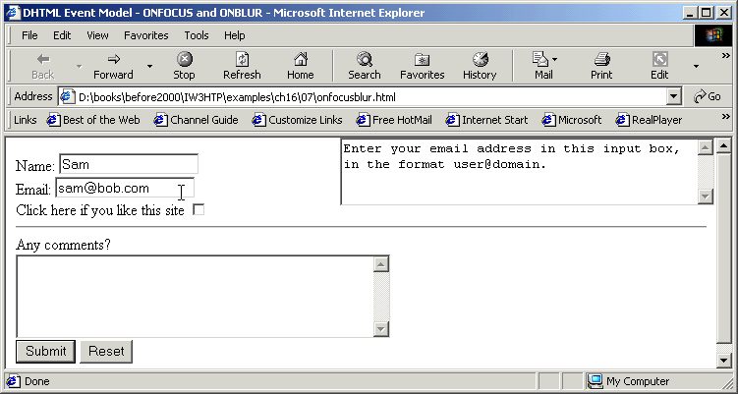
Events ONFOCUS and ONBLUR

Slide 97
More Form Processing with ONSUBMIT and ONRESET
ONSUBMIT event
  Fires when a form is submitted
ONRESET event
  Fires when a form is reset

Slide 98
1 <!DOCTYPE html PUBLIC "-//W3C//DTD HTML 4.0 Transitional//EN">
2 <HTML>
3
4 <!-- Fig 16.8: onsubmitreset.html -->
5 <!-- Demonstrating the ONSUBMIT and ONRESET events -->
6
7 <HEAD>
8 <TITLE>DHTML Event Model - ONSUBMIT and ONRESET events</TITLE>
9 <SCRIPT LANGUAGE = "JavaScript">
10
11 var helpArray =
12 [ "Enter your name in this input box.",
13 "Enter your email address in this input box, " +
14 "in the format user@domain.",
15 "Check this box if you liked our site.",
16 "In this box, enter any comments you would " +
17 "like us to read.",
18 "This button submits the form to the " +
19 "server-side script",
Use ONSUBMIT and ONRESET events to confirm the user’s clicking the button
Set returnValue to false to cancel the default action of the event on the element (browser submits form)
20 "This button clears the form",
21 "This TEXTAREA provides context-sensitive " +
22 "help. Click on any input field or use the TAB " +
23 "key to get more information about the input field." ];
24
25 function helpText( messageNum )
26 {
27 myForm.helpBox.value = helpArray[ messageNum ];
28 }
29
30 function formSubmit() {
31 window.event.returnValue = false;
32

Slide 99
33 if ( confirm ( "Are you sure you want to submit?" ) )
34 window.event.returnValue = true;
35 }
36
37 function formReset() {
38 window.event.returnValue = false;
39
40 if ( confirm ( "Are you sure you want to reset?" ) )
41 window.event.returnValue = true;
42 }
43
44</SCRIPT>
45</HEAD>
46
47<BODY>
48
49<FORM ID = "myForm" ONSUBMIT = "formSubmit()"
50 ONRESET = "formReset()">
51Name: <INPUT TYPE = "text" NAME = "name" ONFOCUS = "helpText(0)"
Set returnValue back to true since the user has confirmed that the form should be submitted
52 ONBLUR = "helpText(6)"><BR>
53Email: <INPUT TYPE = "text" NAME = "email"
54 ONFOCUS = "helpText(1)" ONBLUR = "helpText(6)"><BR>
55Click here if you like this site
56<INPUT TYPE = "checkbox" NAME = "like" ONFOCUS = "helpText(2)"
57 ONBLUR = "helpText(6)"><HR>
58
59Any comments?<BR>
60<TEXTAREA NAME = "comments" ROWS = 5 COLS = 45
61 ONFOCUS = "helpText(3)" ONBLUR = "helpText(6)"></TEXTAREA><BR>
62<INPUT TYPE = "submit" VALUE = "Submit" ONFOCUS = "helpText(4)"
63 ONBLUR = "helpText(6)">
64<INPUT TYPE = "reset" VALUE = "Reset" ONFOCUS = "helpText(5)"

Slide 100
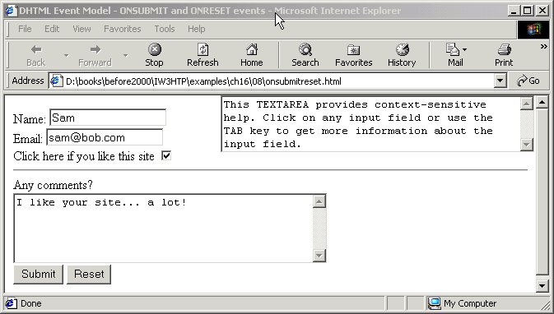
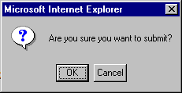
65 ONBLUR = "helpText(6)">
66
67<TEXTAREA NAME = "helpBox" STYLE = "position: absolute; right:0;
68 top: 0" ROWS = 4 COLS = 45>
69This TEXTAREA provides context-sensitive help. Click on any
70input field or use the TAB key to get more information about the
71input field.</TEXTAREA>
72</FORM>
73
74</BODY>
75</HTML>
2. Page rendered by browser

Slide 101
Key board events
onkeyup
    --Raises when key is up
onkeydown
raises when key is down
3. onkeypress
    --raises when key is pressed
4. onhelp
raises whenever f1 key is pressed.

Slide 102
Event Bubbling
Event bubbling
  Events fired in child elements also “bubble” up to their parent elements for handling
  Cancel bubbling using cancelBubble property of event object
  Forgetting to cancel event bubbling when necessary may cause unexpected results in your scripts

Slide 103
1<!DOCTYPE html PUBLIC "-//W3C//DTD HTML 4.0 Transitional//EN">
2<HTML>
3
4<!-- Fig 16.9: bubbling.html -->
5<!-- Disabling event bubbling -->
6
7<HEAD>
8<TITLE>DHTML Event Model - Event Bubbling</TITLE>
9
10<SCRIPT LANGUAGE = "JavaScript">
11 function documentClick()
12 {
13 alert( "You clicked in the document" );
14 }
15
16 function paragraphClick( value )
17 {
18 alert( "You clicked the text" );
19 if ( value )
Use cancelBubble property to cancel event bubbling
1.1 Define function documentClick
2.1 P elements pass true or false for event bubbling
20 event.cancelBubble = true;
21 }
22
23 document.onclick = documentClick;
24</SCRIPT>
25</HEAD>
26
27<BODY>
28
29<P ONCLICK = "paragraphClick( false )">Click here!</P>
30<P ONCLICK = "paragraphClick( true )">Click here, too!</P>
31</BODY>
32</HTML>

Slide 104
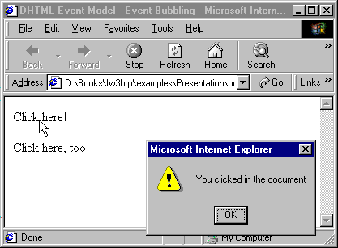

Event bubbling
The event has bubbled up to the document level
The event has been canceled

