Slide 1
XML
eXtensible Markup Language

Slide 2
XML stands for Extensible Markup Language
XML is a markup language much like HTML
XML was designed to store and transport data
XML was designed to be self-descriptive
XML is a W3C Recommendation

Slide 3
Ex:
<note>
<to>Tove</to>
<from>Jani</from>
<heading>Reminder</heading>
<body>Don't forget me this weekend!</body>
</note>

Slide 4
XML Does Not Use Predefined Tags
The XML language has no predefined tags.
The tags in the example above (like <to> and <from>) are not defined in any XML standard. These tags are "invented" by the author of the XML document.
HTML works with predefined tags like <p>, <h1>, <table>, etc.
With XML, the author must define both the tags and the document structure.

Slide 5
Ex: Passing Data between Systems
Suppose that you’ve got book data that you want to pass between Suppose that you’ve got book data that you want to pass between some systems
Suppose that you’ve got book data that you want to pass between some systems
“My Life and Times” Paul McCartney July 1998
94303-12021-43892 McMillin Publishing.
“Illusions The Adventures of a Reluctant Messiah”
Richard Bach 1977 0-440-34319-4 Dell Publishing Co..
“The First and Last Freedom” J. Krishnamurti 1954
0-06-064831-7 Harper & Row.

Slide 6
Passing Data between Systems
You may structure your data as shown below:
First thing you might do is agree on how you will structure your data:
Title / Author / Date / ISBN / Publisher
“My Life and Times”/Paul McCartney/July 1998/94303-12021-43892/McMillin Publishing.
“Illusions The Adventures of a Reluctant Messiah”/Richard Bach/1977/0-440-34319-4/Dell Publishing Co..
“The First and Last Freedom”/J. Krishnamurti/1954/0-06-064831-7/Harper & Row.
Here we are using a slash to delimit (separate) each field and a
new line to delimit each record.

Slide 7
Alternatively
<Book>
<Title>My Life and Times</Title>
<Author>Paul McCartney</Author>
<Date>July, 1998</Date>
<ISBN>94303-12021-43892</ISBN>
<Publisher>McMillin Publishing</Publisher>
</Book>
<Book>
<Title>Illusions The Adventures of a Reluctant Messiah</Title>
<Author>Richard Bach</Author>
<Date>1977</Date>
<ISBN>0-440-34319-4</ISBN>
<Publisher>Dell Publishing Co.</Publisher>
</Book>
<Book>
<Title>The First and Last Freedom</Title>
<Author>J. Krishnamurti</Author>
<Date>1954</Date>
<ISBN>0-06-064831-7</ISBN>
<Publisher>Harper &amp; Row</Publisher>
</Book>
Here we are delimiting each data item with a start and end tag.
We are enclosing each record also within a start-end tag.

Slide 8
Diff b/w HTML & XML
HTML was designed to display data, with focus on how data looks.
XML was designed to describe, store and carry data, with focus on what data is

Slide 9
It describes the data
In HTML, the markup <b>415-555-1234</b> is quite meaningless. what is this number?
Is it a product number, a phone number or an employee number?
Markup like
<phone_number>415-555-1234<phone_number>
is much more helpful. This way we can describe data in XML by taking appropriate tag.

Slide 10
It can store the data
XML can also be used to store data in files.
  Applications can be written to store and retrieve information from the XML file.

Slide 11
It can carry the data
Other applications can access your XML files as data sources, like they are accessing databases.

Slide 12
XML Does not DO Anything
    Maybe it is a little hard to understand, but XML does not DO anything
    XML was created to structure, store, and transport information
    The following example is a note to Tove from Jani, stored as XML:
<note>
<to>Tove</to>
<from>Jani</from>
<heading>Reminder</heading>
<body>Don't forget me this weekend!</body>
</note>

Slide 13
    The note above is quite self descriptive. It has sender and receiver information, it also has a heading and a message body
    It is just pure information wrapped in tags. Someone must write a piece of software to extract or display it.

Slide 14
With XML You Invent Your Own Tags
    The tags in the previous example (like <to> and <from>) are not defined in any XML standard. These tags are "invented" by the author of the XML document.
  The tags used in HTML (and the structure of HTML) are predefined. HTML documents can only use tags defined in the HTML standard (like <p>, <h1>, etc.)
  XML allows the author to define his own tags.

Slide 15
XML Elements Must be Properly Nested
In HTML, you might see improperly nested elements:
<b><i>This text is bold and italic</b></i>
In XML, all elements must be properly nested within each other:
<b><i>This text is bold and italic</i></b>
      In the example above, "Properly nested" simply means that since the <i> element is opened inside the <b> element, it must be closed inside the <b> element.

Slide 16
XML Building blocks
Element
Delimited by angle brackets
General format: <element> … </element>
Empty element: <element/>
Attribute
Name-value pairs that occur inside start-tags after element name, like: <element attribute=“value”>

Slide 17
XML Tags are Case Sensitive
XML tags are case sensitive.
The tag <Letter> is different from the tag <letter>.
Opening and closing tags must be written with the same case:
EX:
<Message>This is incorrect</message>
<message>This is correct</message>

Slide 18
Entity References
Some characters have a special meaning in XML.
If you place a character like "<" inside an XML element, it will generate an error because the parser interprets it as the start of a new element.
  This will generate an XML error:
<message>salary < 1000</message>
  To avoid this error, replace the "<" character with an entity reference:
<message>salary &lt; 1000</message>
There are 5 pre-defined entity references in XML:
1) &lt; < less than 2) &gt; > greater than 3) &amp; & ampersand 4) &apos; ' apostrophe 5) &quot; " quotation mark

Slide 19
Document Entities
Entities refer to a data item, typically text.
  General entity references start with & and end with ;
  The entity reference is replaced by its true value when parsed.
  The characters < > & “ ‘ require entity references to avoid conflicts with the XML application ( parser )
  &lt; &gt; &amp; &quot; &apos;

Slide 20
Prolog
The part of an XML document that is kept before the XML data
The XML prolog is optional. If it exists, it must come first in the document.
  Includes
part-I : XML declaration: version [, encoding]
part – II : Document Type declaration ( optional )

Slide 21
XML Declaration ( Part-I )
version :- Tells the XML processor which version to use .
encoding :- Defines the character encoding used in the document.
      ASCII :- 7 bits character set -128 characters.
      ISO-8859-1:- 8 bits character set – 256 characres
      ( ASCII + Western European letters and symbols ).

Slide 22
Syntax :-
Examples
<?xml version=“1.0”?>
<?xml version=“1.0”? encoding=“US-ASCII”>

Slide 23
Document Type Declaration ( part-II )
Here various parameters will be specified
  DTD declaration ( internal / external ).
  Name of the root element.
  Entity declaration.
  Syntax:- ( External DTD )
  <!DOCTYPE root-element url-of-dtd
  [
  entity-definition
  ]
  >
  <!DOCTYPE root-element SYSTEM/PUBLIC url-of-dtd
  [
  entity-definition
  ]
>

Slide 24
An XML document with correct syntax is called "Well Formed".
An XML document validated against a DTD is both "Well Formed" and "Valid".
Ex:- ( External DTD )
<!DOCTYPE note SYSTEM “Note.dtd”
[
entity-definitions
]
>
Some DTDs are available as international standars, such as those recommendations of W3C which relate to HTML.
Other DTDs are developed by individuals and organizations for their own use.
SYSTEM – for individuals and organizations.
PUBLIC – for International.

Slide 25
Example
<?xml version="1.0" encoding="UTF-8"?>
<!DOCTYPE note SYSTEM "Note.dtd">
<note>
<to>Tove</to>
<from>Jani</from>
<heading>Reminder</heading>
<body>Don't forget me this weekend!</body>
</note>

Slide 26
XML DTD
The purpose of a DTD is to define the structure of an XML document. It defines the structure with a list of legal elements:
Note.dtd file
<!DOCTYPE note
[
<!ELEMENT note (to,from,heading,body)>
<!ELEMENT to (#PCDATA)>
<!ELEMENT from (#PCDATA)>
<!ELEMENT heading (#PCDATA)>
<!ELEMENT body (#PCDATA)>
]>

Slide 27
The DTD above is interpreted like this
:
!DOCTYPE note defines that the root element of the document is note
!ELEMENT note defines that the note element must contain the elements: "to, from, heading, body"
!ELEMENT to defines the to element to be of type "#PCDATA"
!ELEMENT from defines the from element to be of type "#PCDATA"
!ELEMENT heading defines the heading element to be of type "#PCDATA"
!ELEMENT body defines the body element to be of type "#PCDATA"
#PCDATA means parse-able text data.

Slide 28
Ex:- ( Internal DTD )
<!DOCTYPE note
[
DTD definition
entity-definitions
]
>

Slide 29
Using DTD for Entity Declaration
A doctype declaration can also be used to define special characters and character strings, used in the document:

Slide 30
Example
<?xml version="1.0" encoding="UTF-8"?>
<!DOCTYPE note [
<!ENTITY nbsp "&#xA0;">
<!ENTITY writer "Writer: Donald Duck.">
<!ENTITY copyright "Copyright: W3Schools.">
]>
<note>
<to>Tove</to>
<from>Jani</from>
<heading>Reminder</heading>
<body>Don't forget me this weekend!</body>
<footer>&writer;&nbsp;&copyright;</footer>
</note>

Slide 31
<?xml version=“1.0” encoding=“US-ASCII”?>
<!DOCTYPE authorslist SYSTEM “authors.dtd >
<authorslist>
  <name>
  <firstname>chris</firstname>
  <lastname>bates</lastname>
  <book>web programming</book>
  <year>1999</year>
  </name>
  <name>
  <firstname>subramanyam</firstname>
  <lastname>allamaraju</lastname>
  <book>java server programming</book>
  <year>2000</year>
  </name>
  </authorslist>

Slide 32
XML Syntax
All XML elements must have a closing tag
XML tags are case sensitive
All XML elements must be properly nested
All XML documents must have a root tag
Attribute values must always be quoted
Comments in XML: <!-- This is a comment -->

Slide 33
XML Validation
"Well Formed" XML document
--correct XML syntax
"Valid" XML document
  “well formed”
  Conforms to the rules of a DTD (Document Type Definition)
XML DTD
  defines the legal building blocks of an XML document
  Can be inline in XML or as an external reference
XML Schema
  an XML based alternative to DTD, more powerful
  Support namespace and data types

Slide 34
Document Type Definition ( DTD)
Specifying Grammar
Defines structure of the documents
  Allowable tags and their attributes
  Tag nesting order
  Number of occurrence of tags
  Constraints on attribute values
  Entity definitions

Slide 35
An XML Example
We will define a person like this:
  A person is required to be either male or female
  A person has a name which consists of:
  A first name
  A last name
  One (optional) nickname
  A person has an occupation

Slide 36
Representating in Xml
<person gender=“male” >
<name>
<first>Charles</first>
<last>Myers</last>
<nickname>C.R.</nickname>
</name>
<occupation> college professor </occupation>
</person>

Slide 37
The “person” DTD
<!ELEMENT person (name, occupation)>
<!ELEMENT name (first, last, nickname?)>
<!ELEMENT first (#PCDATA)>
<!ELEMENT last (#PCDATA)>
<!ELEMENT nickname (#PCDATA)>
<!ELEMENT occupation (#PCDATA)>
<!ATTRIBUTE person gender (male | female) #REQUIRED>
#PCDATA means parse-able text data.

Slide 38
An Inline DTD example:
<?xml version="1.0"?>
<!DOCTYPE person [
<!ELEMENT person (name, occupation) >
<!ELEMENT name (first, last, nickname?)>
<!ELEMENT first (#PCDATA)>
<!ELEMENT last (#PCDATA)>
<!ELEMENT nickname (#PCDATA)>
<!ELEMENT occupation (#PCDATA)>
<!ATTLIST person gender (male | female) #REQUIRED>
] >
<person gender=“male”>
<name>
<first>Charles</first>
<last>Myers</last>
<nickname>C.R.</nickname>
</name>
<occupation>college professor</occupation>
</person>

Slide 39
An External DTD example:
<?xml version="1.0"?>
<!DOCTYPE person SYSTEM “persons.dtd">
<person gender=“male”>
<name>
<first>Charles</first>
<last>Myers</last>
<nickname>C.R.</nickname>
</name>
<occupation>college professor</occupation>
</person>

Slide 40
persons.dtd
<!ELEMENT person (name, occupation)>
<!ELEMENT name (first, last, nickname?)>
<!ELEMENT first (#PCDATA)>
<!ELEMENT last (#PCDATA)>
<!ELEMENT nickname (#PCDATA)>
<!ELEMENT occupation (#PCDATA)>
<!ATTLIST person gender (male | female) #REQUIRED>

Slide 41
Element declarations
Syntax :-
<!ELEMENT name content-model >
content – model :–Represents what kind of content ( data and elements ) can be used inside that element.

Slide 42
The Building Blocks of XML Documents
Seen from a DTD point of view, all XML documents are made up by the following building blocks:
Elements
Attributes
Entities
PCDATA
CDATA

Slide 43
PCDATA
PCDATA means parsed character data.
Think of character data as the text found between the start tag and the end tag of an XML element.
PCDATA is text that WILL be parsed by a parser. The text will be examined by the parser for entities and markup.
Tags inside the text will be treated as markup and entities will be expanded.
However, parsed character data should not contain any &, <, or > characters; these need to be represented by the &amp; &lt; and &gt; entities, respectively.
CDATA
CDATA means character data.
CDATA is text that will NOT be parsed by a parser. Tags inside the text will NOT be treated as markup and entities will not be expanded.

Slide 44
DTD - Elements
In a DTD, elements are declared with an ELEMENT declaration.
Declaring Elements
In a DTD, XML elements are declared with the following syntax:
<!ELEMENT element-name category>
or
<!ELEMENT element-name (element-content)>

Slide 45
Empty Elements
Empty elements are declared with the category keyword EMPTY:
<!ELEMENT element-name EMPTY>
Example:
<!ELEMENT br EMPTY>
XML example:
<br />

Slide 46
Elements with Parsed Character Data
Elements with only parsed character data are declared with #PCDATA inside parentheses:
<!ELEMENT element-name (#PCDATA)>
Example:
<!ELEMENT from (#PCDATA)>

Slide 47
Elements with any Contents
Elements declared with the category keyword ANY, can contain any combination of parsable data:
<!ELEMENT element-name ANY>
Example:
<!ELEMENT note ANY>

Slide 48
Elements with Children (sequences)
Elements with one or more children are declared with the name of the children elements inside parentheses:
<!ELEMENT element-name (child1)>
or
<!ELEMENT element-name (child1,child2,...)>
Example:
<!ELEMENT note (to,from,heading,body)>
When children are declared in a sequence separated by commas, the children must appear in the same sequence in the document. In a full declaration, the children must also be declared, and the children can also have children.

Slide 49
The full declaration of the "note" element is:
<!ELEMENT note (to,from,heading,body)>
<!ELEMENT to (#PCDATA)>
<!ELEMENT from (#PCDATA)>
<!ELEMENT heading (#PCDATA)>
<!ELEMENT body (#PCDATA)>

Slide 50
Declaring Only One Occurrence of an Element
<!ELEMENT element-name (child-name)>
Example:
<!ELEMENT note (message)>
The example above declares that the child element "message" must occur once, and only once inside the "note" element.

Slide 51
Declaring Minimum One Occurrence of an Element
<!ELEMENT element-name (child-name+)>
Example:
<!ELEMENT note (message+)>
The + sign in the example above declares that the child element "message" must occur one or more times inside the "note" element.

Slide 52
Declaring Zero or More Occurrences of an Element
<!ELEMENT element-name (child-name*)>
Example:
<!ELEMENT note (message*)>
The * sign in the example above declares that the child element "message" can occur zero or more times inside the "note" element.

Slide 53
Declaring Zero or One Occurrences of an Element
<!ELEMENT element-name (child-name?)>
Example:
<!ELEMENT note (message?)>
The ? sign in the example above declares that the child element "message" can occur zero or one time inside the "note" element.

Slide 54
Declaring either/or Content
<!ELEMENT note (to,from,header,(message|body))>
The example above declares that the "note" element must contain a "to" element, a "from" element, a "header" element, and either a "message" or a "body" element.

Slide 55
Declaring Mixed Content
<!ELEMENT note (#PCDATA|to|from|header|message)*>

Slide 56
DTD - Attributes
In a DTD, attributes are declared with an ATTLIST declaration.
Declaring Attributes
An attribute declaration has the following syntax:
<!ATTLIST element-name attribute-name attribute-type attribute-value>
DTD example:
<!ATTLIST payment type CDATA "check">
XML example:
<payment type="check" />

Slide 57
The attribute-type can be one of the following:
Type | Description
CDATA | The value is character data
(en1|en2|..) | The value must be one from an enumerated list
ID | The value is a unique id
IDREF | The value is the id of another element
IDREFS | The value is a list of other ids
NMTOKEN | The value is a valid XML name
NMTOKENS | The value is a list of valid XML names
ENTITY | The value is an entity
ENTITIES | The value is a list of entities
NOTATION | The value is a name of a notation
xml: | The value is a predefined xml value

Slide 58
The attribute-value can be one of the following:
Value | Explanation
value | The default value of the attribute
#REQUIRED | The attribute is required
#IMPLIED | The attribute is optional
#FIXED value | The attribute value is fixed

Slide 59
A Default Attribute Value
DTD:
<!ELEMENT square EMPTY>
<!ATTLIST square width CDATA "0">
Valid XML:
<square width="100" />

Slide 60
Use of #REQUIRED
Syntax
<!ATTLIST element-name attribute-name attribute-type #REQUIRED>
Example
DTD:
<!ATTLIST person number CDATA #REQUIRED>
Valid XML:
<person number="5677" />
Invalid XML:
<person />
Use the #REQUIRED keyword if you don't have an option for a default value, but still want to force the attribute to be present.

Slide 61
Use of #IMPLIED
Syntax
<!ATTLIST element-name attribute-name attribute-type #IMPLIED>
Example
DTD:
<!ATTLIST contact fax CDATA #IMPLIED>
Valid XML:
<contact fax="555-667788" />
Valid XML:
<contact />
Use the #IMPLIED keyword if you don't want to force the author to include an attribute, and you don't have an option for a default value.

Slide 62
Use of #FIXED
Syntax
<!ATTLIST element-name attribute-name attribute-type #FIXED "value">
Example
DTD:
<!ATTLIST sender company CDATA #FIXED "Microsoft">
Valid XML:
<sender company="Microsoft" />
Invalid XML:
<sender company="W3Schools" />
Use the #FIXED keyword when you want an attribute to have a fixed value without allowing the author to change it. If an author includes another value, the XML parser will return an error.

Slide 63
Enumerated Attribute Values
Syntax
<!ATTLIST element-name attribute-name (en1|en2|..) default-value>
Example
DTD:
<!ATTLIST payment type (check|cash) "cash">
XML example:
<payment type="check" />
or
<payment type="cash" />
Use enumerated attribute values when you want the attribute value to be one of a fixed set of legal values.

Slide 64
XML Elements vs. Attributes
In XML, there are no rules about when to use attributes, and when to use child elements.
Use of Elements vs. Attributes
Data can be stored in child elements or in attributes.
Take a look at these examples:
<person sex="female">
<firstname>Anna</firstname>
<lastname>Smith</lastname>
</person>
<person>
<sex>female</sex>
<firstname>Anna</firstname>
<lastname>Smith</lastname>
</person>
In the first example sex is an attribute. In the last, sex is a child element. Both examples provide the same information.

Slide 65
There are no rules about when to use attributes, and when to use child elements. My experience is that attributes are handy in HTML, but in XML you should try to avoid them. Use child elements if the information feels like data.

Slide 66
My Favorite Way
I like to store data in child elements.
The following three XML documents contain exactly the same information:
A date attribute is used in the first example:
<note date="12/11/2002">
<to>Tove</to>
<from>Jani</from>
<heading>Reminder</heading>
<body>Don't forget me this weekend!</body>
</note>

Slide 67
A date element is used in the second example
<note>
<date>12/11/2002</date>
<to>Tove</to>
<from>Jani</from>
<heading>Reminder</heading>
<body>Don't forget me this weekend!</body>
</note>

Slide 68
An expanded date element is used in the third: (THIS IS MY FAVORITE):
<note>
<date>
<day>12</day>
<month>11</month>
<year>2002</year>
</date>
<to>Tove</to>
<from>Jani</from>
<heading>Reminder</heading>
<body>Don't forget me this weekend!</body>
</note>

Slide 69
Avoid using attributes?
Should you avoid using attributes?
Some of the problems with attributes are:
attributes cannot contain multiple values (child elements can)
attributes are not easily expandable (for future changes)
attributes cannot describe structures (child elements can)
attributes are more difficult to manipulate by program code
attribute values are not easy to test against a DTD
If you use attributes as containers for data, you end up with documents that are difficult to read and maintain. Try to use elements to describe data. Use attributes only to provide information that is not relevant to the data.

Slide 70
Conditions for using Elements
Condition | Example
1. All XML elements must have a closing tag it is illegal to omit the closing tag. | <p>This is a paragraph (valid in HTML) <p>This is a paragraph</p> (in XML)
2. XML tags are case sensitive Opening and closing tags must therefore be written with the same case: | With XML, the tag <Letter> is different from the tag <letter>. <Message>This is incorrect</message> <message>This is correct</message>
3. All XML elements must be properly nested Improper nesting of tags makes no sense to XML. | <b><i>This text is bold and italic</i></b>
4. All XML documents must have a root tag The first tag in an XML document is the root tag. All elements can have sub elements (children). | All other elements must be nested within the root element. <root> <child> <subchild>.....</subchild> </child> </root>

Slide 71
Condition | Example
5. XML Elements are extensible and they have relationships. XML documents can be extended to carry more information. | <note> <date>1999-08-01</date> <to>Tove</to> <from>Jani</from> <heading>Reminder</heading>
6. XML Elements have simple naming rules. Elements are related as parents and children. | Book Title: My First XML Chapter 1: Introduction to XML What is HTML What is XML <book> <title>My First XML</title> <chapter_no>Chapter 1</chapter_no> <chapter>Introduction to XML <para>What is HTML</para> <para>What is XML</para> </chapter> </book>

Slide 72
There are five different kinds of content models
1. Empty elements
Declares an empty element—It uses the keyword EMPTY
<!ELEMENT name EMPTY>
2. Elements with no content restrictions
Declares an element that can contain any thing—it uses the keyword ALL
<!ELEMENT name ALL>
3.Elements containing only character data
For elements that contain character data but not elements. Use the content model (#PCDATA)
<!ELEMENT name (#PCDATA)>

Slide 73
#PCDATA – “parsed character data”
  Characters will be checked by an XML parser for entity references, if finds entities, then they will be replaced with entity values.
  4.Elements containing only elements
  expressed using a formula in special notation.
  <ELEMENT authorslist (name+) >
  <ELEMENT name (firstname,lastname,book,year) >
  5. Elements with mixed content
  <ELEMENT element_name (#PCDATA | element_name …) >

Slide 74
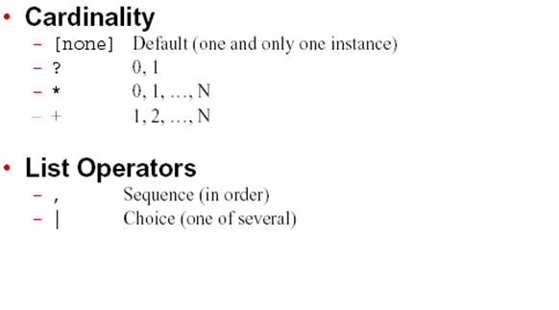

Slide 75
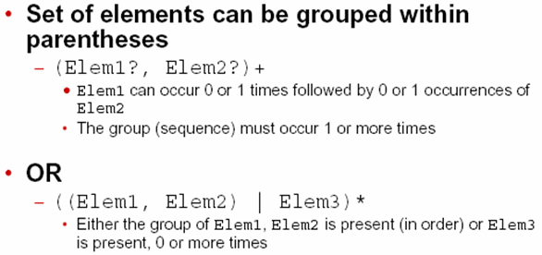
Grouping Elements

Slide 76
Defining attributes
Syntax :-
<!ATTLIST element_name
attr_name1 att_type1 att_desc1
attr_name2 att_type2 att_desc2
...........
>

Slide 77
Attribute type categories
String Types Tokenized Types Enumerated Types
CDATA ID Enumeration
IDREF
IDREFS

Slide 78
CDATA ( Character DATA )
  It is a string type attribute
  It can take any string as a value
  It should not contain escape characters such as <,>,&,’, and “ .
ID
  Attribute of type ID contains unique value. This means that the value of an ID attribute must not appear more than once throughout an XML document.
  ID resembles primary key concept used in databases.
  For example, attribute no ( question number ) of the element question should always have a unique value so that it can be used to identify a question uniquely.
  Examples <!ATTLIST question no ID #REQUIRED >
  <!ATTLIST employee id ID #REQUIRED >
  <!ATTLIST car serial ID #REQUIRED >

Slide 79
IDREF
  It is similar to that of foreign key concept in databases
  The attribute of type IDREF must refer to an ID value declared elsewhere in the document
  Example <!ATTLIST question no ID #REQUIRED >
  <!ATTLIST answer qno IDREF #REQUIRED >
  Here, the qno attribute of answer refers to a question for which it is the answer. So, the following XML document is valid:
  < question no=‘q1’ >
  What is the full form of DTD ?
  </question>
  < question no=‘q2’ >
  What is the full form of XML ?
  </question>
  < answer qno=‘q1’ >
  Document Type Definition
  </answer>

Slide 80
IDREFS
  It allows a list of ID values separated by white spaces
  Example
  <!ATTLIST student roll ID #REQUIRED >
  <!ATTLIST subject sid ID #REQUIRED >
  <!ATTLIST marks ref IDREFS #REQUIRED >
  Following is an example of how to use it:
  <student roll=‘501’> Samir Roy </student>
  <subject sid=‘s1’ > Web Technology </subject>
  <marks ref=‘r01 s1’> 82 </marks>

Slide 81
Enumerated value list
  Enumerated attribute values are used when we want the attribute value to be one of a fixed set of values.
  Ex:-
  <!ATTLIST schedule
  day ( mon | tue | wed | thu | fri | sat | sun ) “sun” >

Slide 82
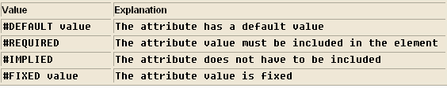
Attribute Description (att_desc1)

Slide 83
Default
  In this case the attribute is optional. This means that the XML author may or may not provide this attribute.
  When an attribute is declared with a default value, the value of the attribute is whatever value appears as the attribute’s content in the xml document.
  If the attribute does not appear , the XML processor provides the attribute with a value equal to the default value .
  <!ATTLIST line width CDATA ‘100’>
  Ex1: <line width=‘200’ />
  In the above example , the width attribute is specified with a value 200.
  Ex2: <line />
  In this example, no width attribute is specified. So, the xml processor will provide a width attribute with a value 100. So this example is equivalent to the following:
  <line width=‘100’ />

Slide 84
#REQUIRED
  The attribute is compulsory and must have an explicitly specified value for every occurrence of the element in the document.
  <!ATTLIST price currency CDATA #REQUIRED>
  It interprets that the attribute currency must appear for element price. So, the following is a valid example:
  <price currency=‘INR’ >100</price>
  However , the following is not:
  <price >100</price>

Slide 85
#IMPLIED
  It similar to the default attribute except that no default value is provided by the XML processor if an attribute of this type does not appear in the xml document.
  <!ATTLIST speed unit CDATA #IMPLIED>
  Following example is valid
  Ex1: <speed unit=‘rpm’>7200</speed>
  So as
  Ex2: <speed>7200</speed>
  In example2, the attribute unit is not provided. However, the xml processor will not supply any value to this attribute. So, it is the responsibility of the processing application to assume some value for this attribute and proceed further.

Slide 86
#FIXED “value”
  In this case, the attribute is not required, but if it occurs, it must have the specified value. If it is not present, it will appear to be the specified default .
  <ATTLIST speed unit CDATA #FIXED ‘rpm’>
  This declaration means that the attribute unit is optional. If it appears, its content must be rpm, and if the attribute does not appear, the xml processor will provide a unit attribute with the value rpm. So, the following example is valid
  <speed unit=‘rpm’>7200</speed>
  So is
  <speed> 7200</speed>
  However, the following is not
  <speed unit=‘rps’>120</speed>

Slide 87
XML Parsers
The parser is the engine for interpreting our XML documents
The parser reads the XML and prepares the information for your application.
How to use a parser
1. Create a parser object
2. Pass your XML document to the parser
3. Process the results

Slide 88
Types of Parsers
  DOM is the Document Object Model
  SAX is the Simple API for XML

Slide 89
Document Object Model (DOM)
DOM uses a tree based structure.
DOM reads an entire XML document and builds a Document Object.
  The Document object contains the tree structure.
  The top of the tree is the root node.
  The tree grows down from this root, defining the child elements.
  DOM is a W3C standard.
Using DOM, we can also perform insert nodes, update nodes, and deleting nodes.

Slide 90
What is DOM
The DOM defines a standard for accessing documents like
XML and HTML
The DOM is separated into 3 different parts / levels:
  Core DOM - standard model for any structured document
  XML DOM - standard model for XML documents
  HTML DOM - standard model for HTML documents
The DOM defines the objects and properties of all document elements, and the methods (interface) to access them.

Slide 91
XML DOM Properties
XMLDOM_Object.documentElement
  Returns the root element of the document
node.firstChild and Node.lastChild
  Returns the first or last child of a given Node
node.nextSibling and Node.previousSibling
  Returns the next or previous sibling of a given Node.
node.childNodes
  Returns the child nodes of given Node
node.nodeName
  Returns tagname of a Node
node.nodeTypedValue
  Returns content of a Node
node.attributes - the attributes of node ( array of refs)

Slide 92
XML DOM Methods
XMLDOM_Object.getElementsByTagName(name) - get all elements with a specified tag name
node.appendChild(node) - inserts a child to the given node
node.removeChild(node) - removes a child from the given node

Slide 93
XML example to construct DOM tree
<?xml version="1.0" encoding="ISO-8859-1"?>
<bookstore>
<book category="cooking">
<title lang="en">Everyday Italian</title>
<author>Giada De Laurentiis</author>
<year>2005</year>
<price>30.00</price>
</book>
<book category="children">
…… </book>
<book category="web">
….. </book>
Books.xml file
1
4
<book category="web" cover="paperback">
<title lang="en">Learning XML</title>
<author>Erik T. Ray</author>
<year>2003</year>
<price>39.95</price>
</book>
</bookstore>
2
3

Slide 94
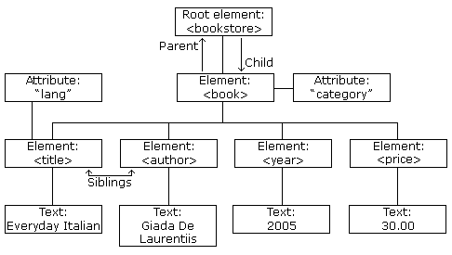
XML DOM Tree Example
XML DOM views an XML document as a node-tree.
All the nodes in the tree have a relationship to each other.

Slide 95
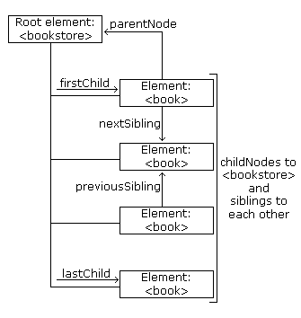
Look at the following XML fragment:
<bookstore>
<book category="cooking">
<title lang="en">Everyday Italian</title>
<author>Giada De Laurentiis</author>
<year>2005</year>
<price>30.00</price>
</book>
</bookstore>

Slide 96
XML DOM Parsing
Most browsers have a build-in XML parser to read and manipulate XML.
The parser converts XML into a JavaScript accessible object.
Parsing XML
XML DOM contains methods (functions) to traverse XML trees, access, insert, and delete nodes.
Before an XML document can be accessed and manipulated, it must be loaded into an XML DOM object.
parser reads XML into memory and converts it into an XML DOM object that can be accessed with JavaScript.

Slide 97
XML DOM Manipulations
Operation | Example
Get the Value of an Element | x=xmlDoc.getElementsByTagName("title")[0].childNodes[0]; txt=x.nodeValue;
get Value of an Attribute | txt=xmlDoc.getElementsByTagName("title")[0].getAttribute("lang");
Change the Value of an Element | x=xmlDoc.getElementsByTagName("title")[0].childNodes[0]; x.nodeValue="Easy Cooking";
Change the Value of an Attribute The setAttribute() method can be used | x=xmlDoc.getElementsByTagName("book"); for(i=0;i<x.length;i++) { x[i].setAttribute("edition","first"); }

Slide 98
Operation | Example
Create an Element createElement():creates a new element node. createTextNode(): creates a new text node. appendChild(): adds a child node to a node (after the last child). To create a new element with text content, it is necessary to create both an element node and a text node. | newel=xmlDoc.createElement("edition"); newtext=xmlDoc.createTextNode("First"); newel.appendChild(newtext); x=xmlDoc.getElementsByTagName("book"); x[0].appendChild(newel); Example explained: Create an <edition> element Create a text node with value = "First" Append the text node to the <edition> element Append the <edition> element to the first <book> element
Remove an Element removeChild(): removes a specified node (or element). The following code fragment will remove the first node in the first <book> element: | x=xmlDoc.getElementsByTagName("book")[0]; x.removeChild(x.childNodes[0]);

Slide 99
books.xml
<?xml version="1.0" ?>
<bookstore>
<book category="cooking“>
<title lang="en">Everyday Italian</title>
<author id="a">Giada De Laurentiis</author>
<isbn>111</isbn>
<publisher>TATA Mac Graw Hill </publisher>
<edition>edition1.0</edition>
<price>300.00</price>
</book>
<book category="children“>
<title lang="en">Harry Potter</title>
<author>J K. Rowling</author>
<isbn>112</isbn>
<publisher>TATA Mac Graw Hill </publisher>
<edition>edition1.0</edition>
<price>400.00</price>
</book>
</bookstore>

Slide 100
bookshtml_using_DOM.html
<html>
<head></head>
<body >
<table border="1" cellpadding="15" bgcolor="cyan" align="center“>
<tr><th>Title</th><th>Author</th><th>isbn</th><th>publisher</th><th>edition</th><th>price</th></tr>
<script type="text/javascript“>
dom=new ActiveXObject("Microsoft.XMLDOM");
dom.load("books.xml");
b=dom.getElementsByTagName("book");
for(i=0;i<b.length;i++) {
document.write("<tr>");
for(j=0;j<6;j++)
{
document.write("<td>"+b[i].childNodes[j].nodeTypedValue+"</td>");
}
document.write("</tr>");
}
</script>
</table>
</body>
</html>

Slide 101
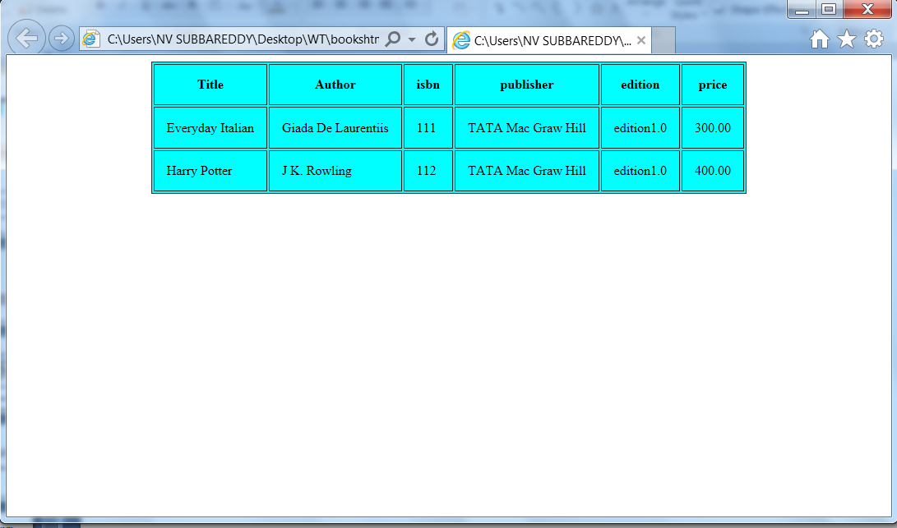
output

Slide 102
Internet Explorer uses the ActiveXObject("Microsoft.XMLHTTP") to create an instance of XMLHttpRequest object, other browsers use the XMLHttpRequest() method.
The responseXML transforms the XML content directly in XML DOM.
Once the XML content is transformed into JavaScript XML DOM, you can access any XML element by using JS DOM methods and properties. We have used DOM properties such as childNodes, nodeValue and DOM methods such as getElementsById(ID),getElementsByTagName(tags_name).

Slide 103
SAX ( Simple API for XML )
SAX parsers are event-driven
  The parser fires an event as it parses each XML element/item.
  It is up to you to decide what you want to do with those events, if you ignore them the information in the event is discarded.
  The developer can write a java code that handles the events.

Slide 104
SAX events
The SAX API defines a number of events
startDocument
  Signals the start of the document.
endDocument
  Signals the end of the document
startElement
  Signals the start of an element. The parser fires this event when all of the contents of the opening tag have been processed. That includes the name of the tag and any attributes it might have.
endElement
  Signals the end of an element.

Slide 105
SAXDemo.java
import java.io.File;
import java.io.FileReader;
import java.io.IOException;
import javax.xml.parsers.ParserConfigurationException;
import javax.xml.parsers.SAXParserFactory;
import org.xml.sax.AttributeList;
import org.xml.sax.InputSource;
import org.xml.sax.SAXException;
import org.xml.sax.SAXParseException;
public class SAXDemo extends org.xml.sax.HandlerBase {
public static void main(String[] args) throws IOException, SAXException,
ParserConfigurationException {
javax.xml.parsers.SAXParserFactory spf = SAXParserFactory.newInstance();
spf.setValidating(false); // No validation required
javax.xml.parsers.SAXParser sp = spf.newSAXParser();
org.xml.sax.InputSource input = new InputSource(new FileReader(args[0]));
input.setSystemId("file://" + new File(args[0]).getAbsolutePath());
SAXDemo handler = new SAXDemo();
sp.parse(input, handler);
}

Slide 106
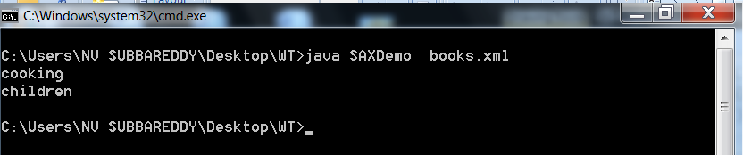
StringBuffer accumulator = new StringBuffer();
String servletName;
String servletClass;
String servletId;
public void startElement(String name, AttributeList attributes)
{
if (name.equals("book"))
{
servletId = attributes.getValue("category");
System.out.println(servletId);
}
}
}

Slide 107
Diff b/w DOM & SAX
DOM | SAX
Uses more memory and has more functionality | Uses less memory and provides less functionality
The entire file is stored in an internal Document object. This may consume many resources | The developer must handle each SAX event before the next event is fired.
Slow execution | Fast execution
Generally used at client -side | General used at sever-side

Slide 108
Namespaces
One document may use element named record to store data about vehicle registration, another may use record to represent employee details.
When you combine these two, there is an ambiguity about where they came from.

Slide 109
This XML carries information about a table (a piece of furniture):
<table>
<name>African Coffee Table</name>
<width>80</width>
<length>120</length>
</table
This XML carries HTML table information:
<table>
<tr>
<td>Apples</td>
<td>Bananas</td>
</tr>
</table>

Slide 110
If these XML fragments were added together, there would be a name conflict. Both contain a <table> element, but the elements have different content and meaning.
A user or an XML application will not know how to handle these differences.
Solving the Name Conflict Using a Prefix
Name conflicts in XML can easily be avoided using a name prefix.

Slide 111
This XML carries information about an HTML table, and a piece of furniture:
<h:table>
<h:tr>
<h:td>Apples</h:td>
<h:td>Bananas</h:td>
</h:tr>
</h:table>
<f:table>
<f:name>African Coffee Table</f:name>
<f:width>80</f:width>
<f:length>120</f:length>
</f:table>

Slide 112
XML Namespaces - The xmlns Attribute
When using prefixes in XML, a namespace for the prefix must be defined.
The namespace can be defined by an xmlns attribute in the start tag of an element.
The namespace declaration has the following syntax.
xmlns:prefix="URI".
namespace prefix “name” is a user defined name.
The value of the xmlns: attribute is a URL, usually belongs to the organization that maintains the namespace.

Slide 113
<root>
<h:table xmlns:h="http://www.w3.org/TR/html4/">
<h:tr>
<h:td>Apples</h:td>
<h:td>Bananas</h:td>
</h:tr>
</h:table>
<f:table xmlns:f="http://www.w3schools.com/furniture">
<f:name>African Coffee Table</f:name>
<f:width>80</f:width>
<f:length>120</f:length>
</f:table>
</root>

Slide 114
Namespace :”hardware”
Namespace :”food”
hammer
vegetable
bolt
bean
wood
fruit
nut
nut
<food:nut>
<hardware:nut>

Slide 115
XML Namespace :-
is a collection of names, identified by a URL , which are used in XML document as element names and attribute names.
  To begin using a namespace , you must first publicly declare it.
  It can be applied to just a single element, or it can be applied to an entire document by placing the declaration at document’s root element.

Slide 116
<root
xmlns:h="http://www.w3.org/TR/html4/"
xmlns:f="http://www.w3schools.com/furniture">
<h:table>
<h:tr>
<h:td>Apples</h:td>
<h:td>Bananas</h:td>
</h:tr>
</h:table>
<f:table>
<f:name>African Coffee Table</f:name>
<f:width>80</f:width>
<f:length>120</f:length>
</f:table>
</root>

Slide 117
Here is an example of a document combining two namespaces , myns and eq
<?xml version=“1.0”?>
<myns: journal xmlns:myns= “http://www.psycholabs.org/mynamespace/”>
<myns:experiment>
<myns:name> Effects of Caffeine on Psychokinetic Ability </myns:name>
<myns:date>March 4,2001</myns:date>
<myns:abstract>The experiment consists of a subject, a can of
caffeinated soda, and a goldfish tank. The ability to make a
goldfish turn in a circle through the power of a human's mental
  control is given by the well-known equation:
</myns:abstract>
<eq:formula xmlns:eq= “http://www.mathsstuff.org/”>
<eq:name> Probability </eq:name>
<eq:variable>p</eq:variable>
<eq:variable>m</eq:variable>
<eq:variable>M</eq:variable>
</eq:formula>
</myns:experiment>
</myns:journal>

Slide 118
XML Schema
XML Schema is commonly known as XML Schema Definition (XSD).
It is used to describe and validate the structure and the content of XML data.
XML schema defines the elements, attributes and data types. Schema element supports Namespaces.
It is similar to a database schema that describes the data in a database.

Slide 119
Limitations of DTD
Language :- DTDs are written in a language which is dissimilar to XML syntax. Schemas are written in XML syntax.
2. Data Constraints:- DTDs have minimal data constraints.
for ex:-
using an XML DTD , an element for pin code can be constrained as PCDATA, as in:
<!ELEMENT pincode #PCDATA>
unfortunately , this sets up the possibility that:
<pincode>ABC-123345-fbx</pincode>
though it does not represent a pincode in any form.

Slide 120
3. Data Types:-
- In DTD’s Designers are limited to few data types.
  Schemas provide more data types, which allow greater flexibility in expressing content.
    string, decimal, byte, float, long, boolean, time, date etc.
4. Namespaces
- Namespaces are not supported.

Slide 121
XML Schema
XML Schema is an XML-based alternative to DTD.
The XML Schema is also called as XML Schema Definition (XSD).

Slide 122
XML Schema
An XML Schema:
defines elements that can appear in a document
defines attributes that can appear in a document
defines which elements are child elements
defines the order of child elements
defines the number of child elements
defines whether an element is empty or can include text
defines data types for elements and attributes

Slide 123
SCHEMA ELEMENT
An XML Schema is composed of the top-level schema element.
The schema element definition must include the following namespace.
  http://www.w3.org/2001/XMLSchema
  Here is a sample XML schema document.
<?xml version=‘1.0’>
  <xs:schema xmlns:xs=‘http://www.w3.org/2001/XMLSchema’
  rules for conforming XML document
  </xs:schema>
  It indicates that the elements and data types used in the schema come from the http://www.w3.org/2001/XMLSchema name space.
  It also specifies that the elements and data types that come from the “http://www.w3.org/2001/XMLSchema “ name space should be prefixed with xs

Slide 124
There are two types of elements
1. Simple
2. Complex
  A simple type is one that does not contain attributes and other elements in the content.
  Otherwise, that element is called as complex type.
  Syntax:-
  Simple type :-
  <namespace_reference :element name=“name” type=“namespace_reference:”datatype”
  minoccurs=“min_value“ maxoccurs=“max_value />

Slide 125
Complex Type
<namespace_reference :element name=“name” >
<namespace_reference:complexType >
<xs:sequence>
<namespace_reference :element ref=“name” minoccurs=“min_value“ maxoccurs=“max_value />
</xs:sequence>
<namespace_reference:attribute name=“name” type=“namespace_reference:”datatype” />
</namespace_reference:complexType>
</namespace_reference :element>

Slide 126
A Simple XML Document
Ex-1
<?xml version="1.0"?>
<note>
<to> Tony </to>
<from> Jani </from>
<heading> Reminder </heading>
<body> Don't forget me this weekend! </body>
</note>

Slide 127
A DTD File
<!ELEMENT note (to, from, heading, body)>
<!ELEMENT to (#PCDATA)>
<!ELEMENT from (#PCDATA)>
<!ELEMENT heading (#PCDATA)>
<!ELEMENT body (#PCDATA)>

Slide 128
An XML Schema
<?xml version="1.0"?>
<xs:schema xmlns:xs="http://www.w3.org/2001/XMLSchema" >
<xs:element name="note">
<xs:complexType>
<xs:sequence>
<xs:element name="to" type="xs:string"/> <xs:element name="from" type="xs:string"/> <xs:element name="heading" type="xs:string"/> <xs:element name="body" type="xs:string"/> </xs:sequence>
</xs:complexType>
</xs:element>
</xs:schema>

Slide 129
EX-2
<?xml version="1.0"?>
<!DOCTYPE person SYSTEM “persons.dtd">
<person gender=“male”>
<name>
<first>Charles</first>
<last>Myers</last>
<nickname>C.R.</nickname>
</name>
</person>

Slide 130
An XML Schema
<?xml version="1.0"?>
<xs:schema xmlns:xs="http://www.w3.org/2001/XMLSchema" >
<xs:element name=“person">
<xs:complexType>
<xs:attribute name=“gender” type=“xs:string”/>
<xs:sequence>
<xs:element name=“first" type="xs:string"/> <xs:element name=“last" type="xs:string"/> <xs:element name=“nickname" type="xs:string"/> </xs:sequence>
</xs:complexType>
</xs:element>
</xs:schema>

Slide 131
Diff b/w DTD & XSD
DTD supports types ID,IDREF,CDATA etc.,
Schema supports all primitive and user defined data types
Schema hava minOccurs and maxOccurs attributes
XML Schemas are extensible to future additions
XML Schemas are richer and more powerful than DTDs
XML Schemas are written in XML

Slide 132
Displaying XML
XML documents do not carry information about how to display the data
We can add display information to XML with
  CSS (Cascading Style Sheets)
  XSLT (eXtensible Stylesheet Language Transformation) --- preferred

Slide 133
Displaying by using CSS
CSS important properties:
Position
left
right
top
font-style
font-size
color
background-color

Slide 134
Employee.xml
Style.css
<?xml version="1.0"?>
<?xml-stylesheet type="text/css"
href="style.css"?>
<person gender="male">
<name>
<first>Charles</first>
<last>Myers</last>
<nickname>C.R.</nickname>
</name>
</person>
first {
font-size:40px;
color:blue;
}
last {
font-size:40px;
color:red;
}
nickname {
font-size:40px;
color:green;
}

Slide 135
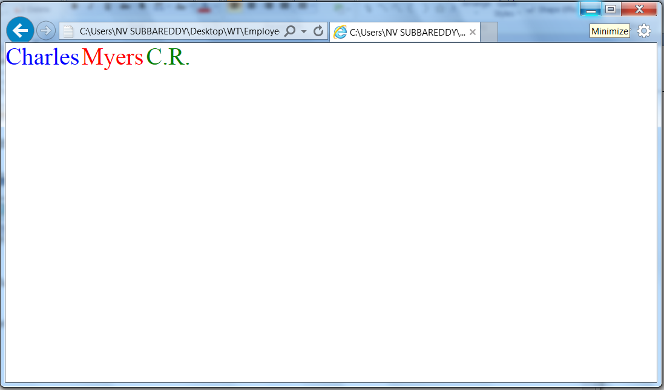
Output

Slide 136
XSLT
XSLT stands for Extensible Stylesheet Language Transformation.
XSLT is used to transform XML documents into other kinds of documents—usually into HTML.
XSLT transforms XML into HTML before it is displayed by the browser.
XSLT uses two input files:
  The XML document containing the actual data
  The XSL document containing information about how to display the xml elements.

Slide 137
There are two programming styles that can be used to transform XSLT into HTML.
  Procedural programming style
  Rule based programming style
It also possible to mix both programming styles.

Slide 138
Procedural programming style
Procedural operations
  Control structures : XSLT instructions such as xsl:for-each, xsl:if and xsl:choose etc. provide control structures like conditional execution or loops.
  Accessing content : The xsl:value-of instruction writes the content of the current node to the target document.
ex :-

Slide 139
myxsl.xsl file
myxml.xml
<?xml version="1.0"?>
<?xml-stylesheet type="text/xsl“
href="myxsl.xsl"?>
<bookOrder>
<shipTo country="US">
<name>Venus </name>
<street>Chapel Street</street>
<city>papermoon</city>
</shipTo>
<billTO country="UK">
<name>Rick </name>
<street> Marine </street>
</billTO>
<note>Special Valentine wrapping!</note>
<orderlist>
<item ISBN="5855-9">
<title>The mint lawn</title>
<quantity>1</quantity>
<price currency="USD">19</price>
<note>On stock</note>
</item>
</orderlist>
</bookOrder>
<HTML xmlns:xsl="http://www.w3.org/1999/XSL/Transform" xsl:version="1.0">
<BODY>
<H1>Book Order</H1>
<TABLE border="1" cellpadding="6">
<TR>
<TH>Title</TH>
<TH>ISBN</TH>
<TH>Price</TH>
</TR>
<xsl:for-each select="bookOrder/orderlist/item">
<TR>
<TD><xsl:value-of select="title"/></TD>
<TD><xsl:value-of select="@ISBN"/></TD>
<TD><xsl:value-of select="price/@currency"/>
<xsl:value-of select="price"/>
</TD>
</TR>
</xsl:for-each>
</TABLE>
</BODY>
</HTML>

Slide 140
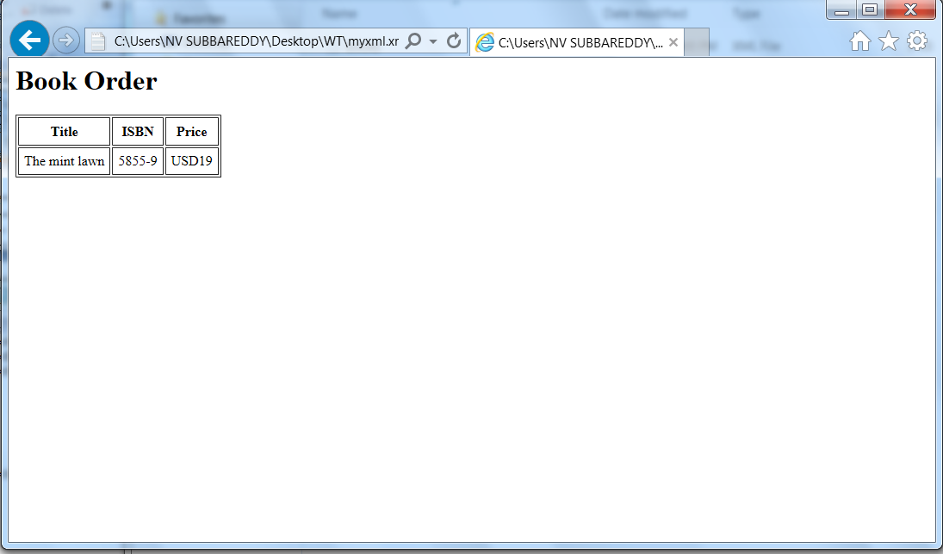
Output

Slide 141
version
  This attribute sets the XSLT version being used. The only choice available now is 1.0.
xmlns:xsl
  Here we will set the namespace for the XSLT-specific elements.
  A good namespace to use is http://www.w3.org/1999/XSL/Transform/.

Slide 142
Rule based programming style
  Consists of set of templates.
  xsl:template -defines a set of rules for transforming elements .
  The match attribute is used to associate a template with an XML element.
  Syntax:-
  <xsl:template match=element_name >
  Rules for transforming element
  </xsl:template>
  match="/" defines the template for root element.

Slide 143
xsl:apply-templates –applies all the templates defined in the document recursively.
    We can use the select attribute to specify the child nodes which you want to use inside a parent.

Slide 144
<xsl:stylesheet version="1.0"
xmlns:xsl="http://www.w3.org/1999/XSL/Transform">
<xsl:template match="/">
<html>
<body>
<h2>My CD Collection</h2>
<xsl:apply-templates />
</body>
</html>
</xsl:template>
<xsl:template match="cd">
<p>
<xsl:apply-templates select="title"/>
<xsl:apply-templates select="artist"/>
</p>
</xsl:template>
<xsl:template match="title">
Title: <span style="color:#ff0000">
<xsl:value-of select="."/></span>
<br />
</xsl:template>
<xsl:template match="artist">
Artist: <span style="color:#00ff00">
<xsl:value-of select="."/></span>
<br />
</xsl:template>
</xsl:stylesheet>
<?xml version="1.0"
encoding="ISO-8859-1"?>
<?xml:stylesheet type="text/xsl"
href="mycd.xsl"?>
<catalog>
<cd>
<title>Empire Burlesque</title>
<artist>Bob Dylan</artist>
<country>USA</country>
<company>Columbia</company>
<price>10.90</price>
<year>1985</year>
</cd>
</catalog>

Slide 145
css display property
Value | Description
none | The element will not be displayed
block | The element will be displayed as a block-level element, with a line break before and after the element
inline | Default. The element will be displayed as an inline element, with no line break before or after the element

Slide 146
employee.xml
style.css
<?xml version="1.0"?>
<?xml-stylesheet type="text/css“
href="style.css"?>
<person gender=“male”>
<name>
<first>Charles</first>
<last>Myers</last>
<nickname>C.R.</nickname>
</name>
</person>
first {
position:absolute;
left:300;
color:blue;
}
last {
display:block;
color:red;
}

Slide 147
XML Advantages/Goals
1. XML is used to Exchange Data
  With XML, data can be exchanged between incompatible systems
2. XML and B2B
  With XML, financial information can be exchanged over the Internet.
3. XML can be used to Share Data
  With XML, plain text files can be used to share data.

Slide 148
4. XML is free and extensible
  XML tags are not predefined. we must "invent" your own tags.
5. XML can be used to Store Data
  With XML, plain text files can be used to store data.
6. XML can be used to Create new Languages
  XML is the mother of WAP and WML.
7. HTML focuses on "look and feel”
  XML focuses on the structure of the data.

Slide 149


