Slide 1
Unit-V
Java Server Pages ( JSP )

Slide 2
Problems with servlets
In many servlet-based applications, request processing, business logic and generating the response are all handled by a single servlet class. An example servlet looks like this:

Slide 3
public class OrderServlet extends HttpServlet {
public void doGet(HttpServletRequest request,
HttpServletResponse response)
throws ServletException, IOException {
response.setContentType("text/html");
PrintWriter out = response.getWriter( );
if (isOrderInfoValid(request)) {
saveOrderInfo(request);
out.println("<html>");
out.println(" <head>");
out.println(" <title>Order Confirmation</title>");
out.println(" </head>");
out.println(" <body>");
out.println(" <h1>Order Confirmation</h1>");
renderOrderInfo(request);
out.println(" </body>");
out.println("</html>");
}
private void isOrderInfoValid(….) {
…....
}
private saveOrderInfo(….) {
…….
}
}

Slide 4
Detailed Java programming knowledge is required to develop and maintain all aspects of the application.
Changing the look and feel of the application, requires the servlet code to be updated and recompiled.
It's hard to take advantage of web page development tools when designing the application interface. If such tools are used to develop the web page layout, the generated HTML must then be manually embedded into the servlet code, a process that is time-consuming, error-prone, and extremely boring.
Adding jsp solves these problems by separating the request processing and business logic code from the presentation, as shown in the following fig.

Slide 5
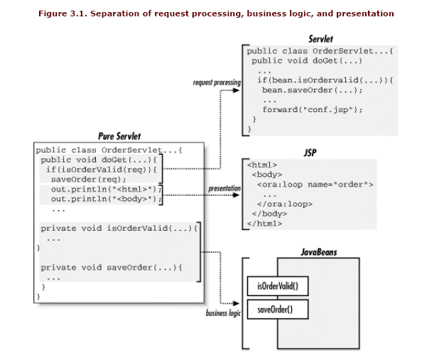

Slide 6
The anatomy/structure of a JSP Page
JavaServer Pages (JSP) technology provides a simplified and fast way to create web pages that display dynamically-generated content.
JSP technology is an extension to the Java servlet technology.
JSP are text based documents.
Two major components of JSP:
  Static content: provided by HTML or XML or even plain text.
  Dynamic content: generated by jsp elements.

Slide 7
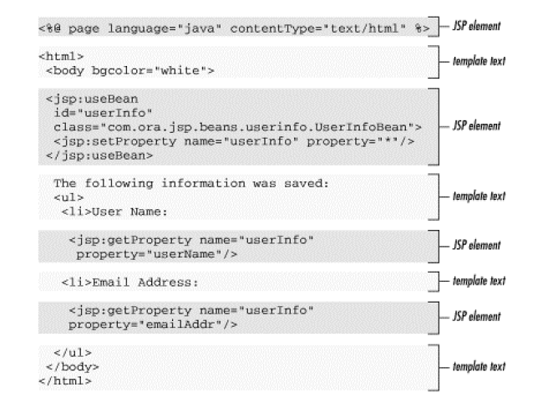

Slide 8
Everything in the page that is not a jsp element is called template text.
  Template text can be any text: HTML,XML or even a plain text.
When JSP page request is requested, the template text and dynamic content generated by the JSP elements are merged, and the result is sent as the response to the client.

Slide 9
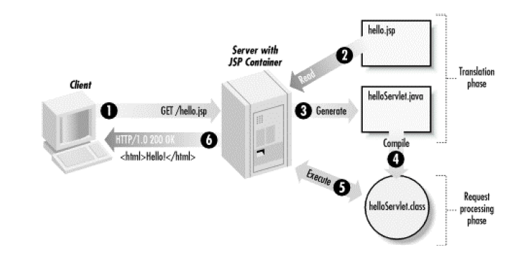
JSP Processing

Slide 10
The steps in the life cycle of jsp page are:
      Translation
      Compilation
      Loading
      Instantiation
      Initialization
      RequestProcessing
      Destruction

Slide 11
When client makes a request to Server, it first goes to container.
Then container checks whether the servlet class is older than jsp page( To ensure that the JSP file got modified).
If this is the case then container does the translation again (converts JSP to Servlet)
otherwise it skips the translation phase (i.e. if JSP webpage is not modified then it doesn’t do the translation to improve the performance as this phase takes time and to repeat this step every time is not time feasible)

Slide 12
As stated above whenever container receives request from client, it does translation only when servlet class is older than JSP page otherwsie it skips this phase (reason I explained above).
Then the container –
  compiles the corresponding servlet program
  Loads the corresponding servlet class
  Instantiates the servlet class
  Calls the jspInit() method to initialize the servlet instance( Jsp container will do this job only when the instance of servlet file is not running or if it is older than the jsp file.)

Slide 13
A new thread is then gets created, which invokes the_jspService() method, with a request (HttpServletRequest) and response (HttpServletRespnse) objects as parameters
Invokes the jspDestroy() method to destroy the instance of the servlet class.

Slide 14
JSP Application design with MVC
( Model View Controller )
Servlets are good at data processing: reading data, communicating with database, invoking business logic etc. But , generating HTML with servlets can be tedious.
That’s where JPS comes in: JSP lets you separate presentation from the dynamic content.

Slide 15
The solution is to use both sevlets and JSP.
This approach is known as MVC .
  The original request is handled by a servlet.
  The servlet invokes the business-logic and data access code and creates bean to represent the results ( model ).
  Then , the servlet decides which JSP page is appropriate to present the results and forwards the request there (view).
  The servlet decides what business logic code applies and which JSP page should present the results ( controller ).

Slide 16
Here the Controller receives all requests for the application and then works with the Model to prepare any data needed by the View. The View then uses the data prepared by the Controller to generate a final presentable response.
The model
The model is responsible for managing the data of the application. It responds to the request from the view and it also responds to instructions from the controller to update itself.

Slide 17
The view
A presentation of data in a particular format, triggered by a controller's decision to present the data. They are script based templating systems like JSP, ASP, PHP and very easy to integrate with AJAX technology.
The controller
The controller is responsible for responding to user input and perform interactions on the data model objects. The controller receives the input, it validates the input and then performs the business operation that modifies the state of the data model.

Slide 18
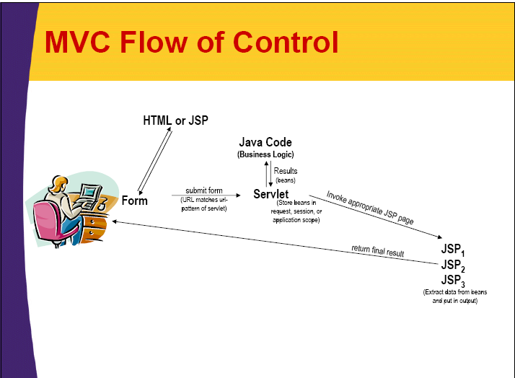

Slide 19
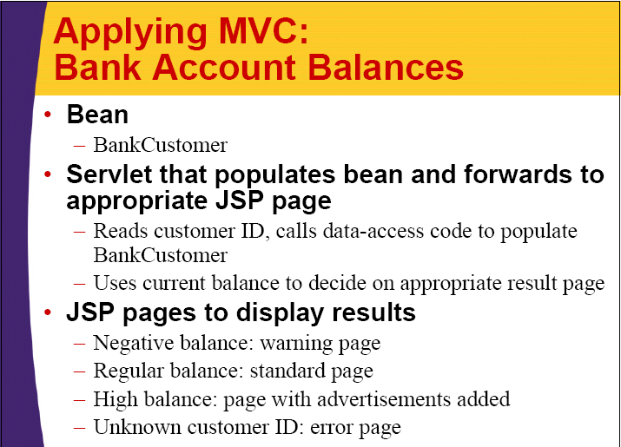

Slide 20
Bank Account Balances:
Servlet Code
public class ShowBalance extends HttpServlet {
public void doGet(HttpServletRequest request,
HttpServletResponse response)
throws ServletException, IOException {
BankCustomer customer = BankCustomer.getCustomer(request.getParameter("id"));
String address;
if (customer == null)
{
address ="/WEB-INF/bank-account/UnknownCustomer.jsp";
}
else if (customer.getBalance() < 0)
{
address ="/WEB-INF/bank-account/NegativeBalance.jsp";
}

Slide 21
else if (customer.getBalance() <10000)
{
address ="/WEB-INF/bank-account/NormalBalance.jsp";
}
else
address ="/WEB-INF/bank-account/HighBalance.jsp";
….
}

Slide 22
BankCustomer.java
import java.util.*;
/** Bean to represent customer **/
Public class BankCustomer{
private String id,firstName,lastName;
private double balance;
public BankCustomer(String id,
String firstName, String lastName, double balance)

Slide 23
{
this.id=id;
this.firstName=firstName
this.lastName=lastName;
this.balance=balance;
}
Public String getId() {
return(id);
}
Public String getFirstName() {
return(firstName);
}
Public String getLastName() {
return(lastName);
}
Public String getBalance() {
return(balance);
}
……..

Slide 24
/** small table of bank customers **/
Private static HashMap customers;
static{
customers=new HashMap();
customers.put(“id001”,
”Jhon”,
“Hacker”,
-3456.78));
customers.put(“id002”,
”Jane”,
“Hacker”,
1234.56));
customers.put(“id003”,
”Juan”,
“Hacker”,
987654.32));
}

Slide 25
/** Finds the customer with the given id **/
/** Returns null if there is no match **/
Public static BankCustomer getCustomer( String id )
{
return(( BankCustomer)customers.get(id);
}
}

Slide 26
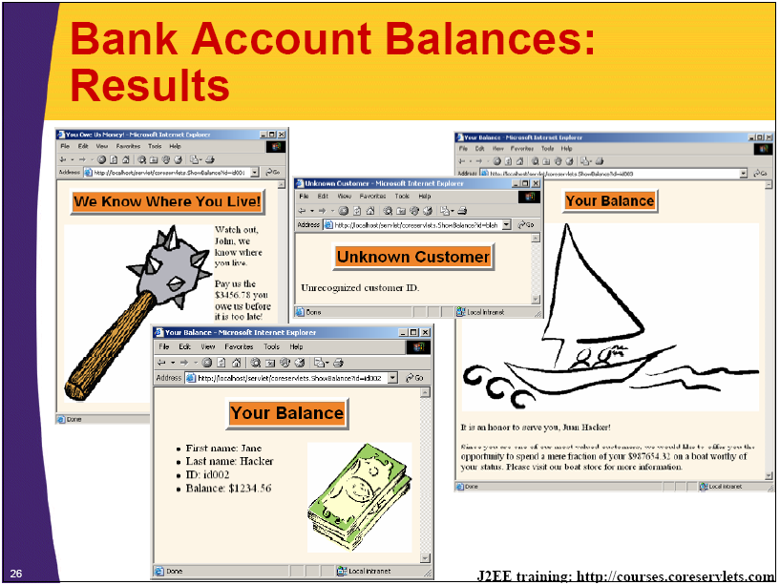

Slide 27
Jsp life cycle methods
jspInit()
  This method is called from the servlet init() method.
jspService()
  This method is called from the servlet service() method.
jspDestroy()
  This method is called from the servlet destrory() method.

Slide 28
Generating Dynamic Content
Using JSP Scripting elements
  JSP scripting elements insert java code into the servlet that is generated from the jsp page.
  There are three scripting elements
    Expressions :
      From <%=Java Expression %>
      It is used to display the vaue.
      The expression is evaluated and inserted into the servlet output statement.
    Scriptlets :
      Form <% Java Code %>
      It is used to insert java code
      The java code is inserted into the servlets _jspService method.
    Declarations :
      Form <% ! Variable/ Method declaration %>
      It is used to declare the variables and methods.
      These are inserted into the body of the servlet class, outside of service method.

Slide 29
Ex:- Expression - Displaying values
<%@ page language="java" contentType="text/html" %>
<html>
<head>
<title>Hello world!</title>
</head>
<body>
<%=“hello world!” %>
</body>
</html>

Slide 30
The code placed within JSP expression tag is written to the output stream of the response. So you need not write out.print() to write data. It is mainly used to print the values of variable or method.
Do not end your statement with semicolon in case of expression tag
Syntax of JSP expression tag
<%= statement %>

Slide 31
Servlet generated from jsp
import javax.servlet.*;
import javax.servlet.http.*;
import javax.servlet.jsp.*;
import javax.servlet.jsp.tagext.*;
import java.io.*;
import org.apache.jasper.*;
import org.apache.jasper.runtime.*;
public class _0005chello_0002ejsphello_jsp_1 extends HttpJspBase {
public void _ jspService(HttpServletRequest request,
HttpServletResponse response)
throws IOException, ServletException {
JspFactory _ jspxFactory = null;
PageContext pageContext = null;
HttpSession session = null;
ServletContext application = null;
ServletConfig config = null;
JspWriter out = null;
Object page = this;
String _value = null;
try {
_ jspxFactory = JspFactory.getDefaultFactory( );
response.setContentType("text/html");
pageContext = _ jspxFactory.getPageContext(this, request,
response,"", true, 8192, true);

Slide 32
application = pageContext.getServletContext( );
config = pageContext.getServletConfig( );
session = pageContext.getSession( );
out = pageContext.getOut( );
out.write("<HTML>\n <HEAD>\n <TITLE>" +
"Hello World</TITLE>\n </HEAD>\n" +
" <BODY>\n”);
out.println( “Hello World!” );
out.write("\n </BODY>\n" +
"</HTML>\r\n");
} catch (Exception ex) {
if (out.getBufferSize( ) != 0)
out.clear( );
pageContext.handlePageException(ex);
} finally {
out.flush( );
_ jspxFactory.releasePageContext(pageContext);
}
}
}

Slide 33
Ex:- Scriptlets – inserting java code
<%@ page language="java" contentType="text/html" %>
<html>
<head>
<title>Hello world!</title>
</head>
<body>
<%
      for(int i=1; i <= 10; i++){
        out.print(“hello world!<br>”);
      }
    %>
</body>
</html>

Slide 34
Ex:- Declarations – declaring variables and methods
<%@ page language="java" contentType="text/html" %>
<html>
<body>
    <%!
    int x = 0;
    int square(int x){
      return x * x;
    }
    %>
</body>
</html>

Slide 35
Implicit objects
While using scripting elements in a JSP page, we can access number of objects that are provided by JSP container.
JSP Implicit Objects are the Java objects that the JSP Container makes available to developers in each page and developer can call them directly without being explicitly declared.
These are called implicit objects.

Slide 36
implicit objects
object Name | Java Type
request | javax.servlet.http.HttpServletRequest
response | javax.servlet.http.HttpServletResponse
out | javax.servlet.jsp.JspWriter
config | config javax.servlet.ServletConfig
application | javax.servlet.ServletContext
session | javax.servlet.http.HttpSession

Slide 37
The request object is an instance of a javax.servlet.http.HttpServletRequest object. Each time a client requests a page the JSP engine creates a new object to represent that request.
The response object is an instance of a javax.servlet.http.HttpServletResponse object. Just as the server creates the request object, it also creates an object to represent the response to the client.
The out implicit object is an instance of a javax.servlet.jsp.JspWriter object and is used to send content in a response.
The config object is an instantiation of javax.servlet.ServletConfig and is a direct wrapper around the ServletConfig object for the generated servlet.

Slide 38
This object allows the JSP programmer access to the Servlet or JSP engine initialization parameters such as the paths or file locations etc.
The application object is direct wrapper around the ServletContext object for the generated Servlet and in reality an instance of a javax.servlet.ServletContext object.
This object is a representation of the JSP page through its entire lifecycle. This object is created when the JSP page is initialized and will be removed when the JSP page is removed by the jspDestroy() method.
The session object is an instance of javax.servlet.http.HttpSession and behaves exactly the same way that session objects behave under Java Servlets.
The session object is used to track client session between client requests.

Slide 39
javaBeans
Dynamic content is content generated by some server process, for instance the result of a database query.
This dynamic content is generally represented by a JavaBeans component.
JavaBean
A JavaBeans component, or just a bean for short, is a Java class that follows certain coding conventions, so that it can be used by tools as a component in a larger application.

Slide 40
Advantages of beans over scriptlets
No java syntax
  By using javaBeans , page authors can manipulate java objects using only XML-compatible syntax: no parentheses, semicolons, or curly braces.
Simpler object sharing
  When we use beans, you can much more easily share objects among multiple pages.

Slide 41
Bean coding conventions
A bean class must have a zero-argument (default) contructor.
  We can satisfy this requirement by explicitly defining such a constructor or by omitting all constructors, which results in a zero argument being created automatically.
A bean class should have no public instance variables.
  The bean should use accessor methods instead of allowing direct access to the instance variables.
Properties values should be accessed through methods called getXxx and setXxx.
  Ex:-
    String userName;
    getUserName()
    setUserName()

Slide 42
Using Beans in jsp pages: Basic tasks
jsp:useBean.This element cretes a new bean.
It is normally used as follows:
<jsp:useBean id=“beanName” class=‘package.class”/>
If you supply scope attribute, the jsp:useBean element can either build a new bean or access a preexisting one.
Declares the identifier
for bean object

Slide 43
jsp:getProperty.
  This element reads and output the value of a bean property.
  Reading a property is a shorthand notation for calling a method of the form getXxx.
  This element is used as follows:
<jsp:getProperty name=“beanName” property=“propertyname”/>
Identifies the actual
bean object

Slide 44
jsp:setProperty.
  This element modifies a bean property.
  Modifying a property is a shorthand notation for calling a method of the form setXxx.
  It is normally used as follows
<jsp:setproperty name=“beanName”
property=“propertyname” value=“propertyvalue”/>

Slide 45
Passing Control from One Page to Another
JSP supports this through the <jsp:forward> action:
  <jsp:forward page="userinfovalid.jsp" />
This action stops processing one page and starts processing the page specified by the page attribute.
The control never returns to the original page.
The target page has access to all information about the request, including all request parameters.
You can also add additional request parameters when you pass control to another page by using one or more nested
<jsp:param> action elements:

Slide 46
<jsp:forward page="userinfovalid.jsp" >
<jsp:param name="msg" value="Invalid email address" />
</jsp:forward>
Parameters specified with <jsp:param> elements are added to the parameters received with the original request. The target page, therefore, has access to both the original parameters and the new ones, and can access both types in the same way.

Slide 47
Passing Data from One Page to Another
JSP provides different scopes for sharing data objects between pages, requests, and users.
The scope defines for how long the object is available and whether it's available only to one user or to all application users.
The following scopes are defined:
  Page
  Request
  Session
  Application
  Syntax:-
<jsp:useBean id="logEntry" class="com.foo.LogEntryBean"
scope=“page/request/session/application” />

Slide 48
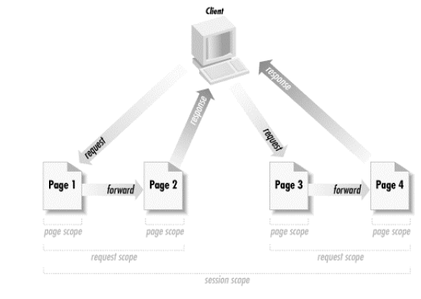
Lifetime of objects in different scopes
1
2
5
6
7
8
page scope
page scope
page scope
page scope
page scope
page scope
page scope
page scope
request scope
request scope
request scope
request scope
session scope
session scope
application scope

