Slide 1
Unit-VI

Slide 2
Database Programming Using JDBC (JDBC- Java Database Connectivity)
The JDBC API defines the Java interfaces and classes that programmers use to connect to databases and send queries.
A database vendor provides a set of API for accessing the data managed by a the database server.
A JDBC driver is a middleware layer that translates the JDBC API calls to the vendor specific APIs.
A Java program (that uses the JDBC API) loads the specified driver for a particular DBMS before it actually connects to a database.
The JDBC’s DriverManager class then sends all JDBC API calls to the loaded driver.

Slide 3
Types of JDBC Drivers?
There are 4 different types of JDBC drivers:
Type 1: JDBC-ODBC Bridge driver (Bridge)
Type 2: Native-API/partly Java driver (Native)
Type 3: All Java/Net-protocol driver (Middleware)
Type 4: All Java/Native-protocol driver (Pure)

Slide 4
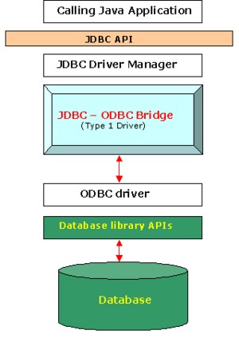
Type-1 (JDBC-To-ODBC Bridge Driver)
This driver converts JDBC method calls into ODBC function calls.
The JDBC-ODBC Bridge that comes with the JDK 1.1 is a good example of this kind of driver.
Bridge solutions generally require software to be installed on client systems, meaning that they are not good solutions for applications that do not allow you to install software on the client.

Slide 5
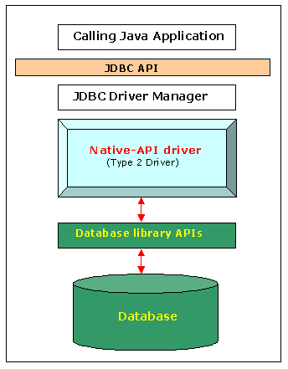
Type-2 (Native API / partly Java Driver)
The type 2 drivers are native API drivers.
This means that the driver contains Java code wrapper around native C or C++ methods provided by the individual database vendors that perform the database access.
This driver converts JDBC method calls into native calls of the database API
Again, this solution requires software on the client system.

Slide 6
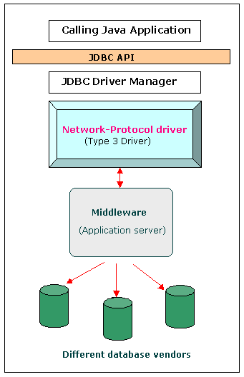
Type-3 (All java/Net- protocol Java Driver)
Type 3 drivers provide a client with a generic network API.
Then the database requests are passed through the network to the middle-tier server.
The middle-tier then translates the request to the database. The middle-tier server may in turn use Type1, Type 2 or Type 4 drivers.

Slide 7
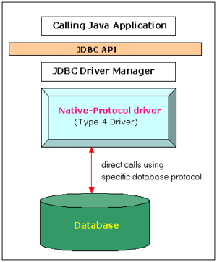
Type-4 (All java/Native- Protocol Driver)
This driver uses java networking libraries to communicate directly with the data base server.
This type of driver will come only from the database vendor.

Slide 8
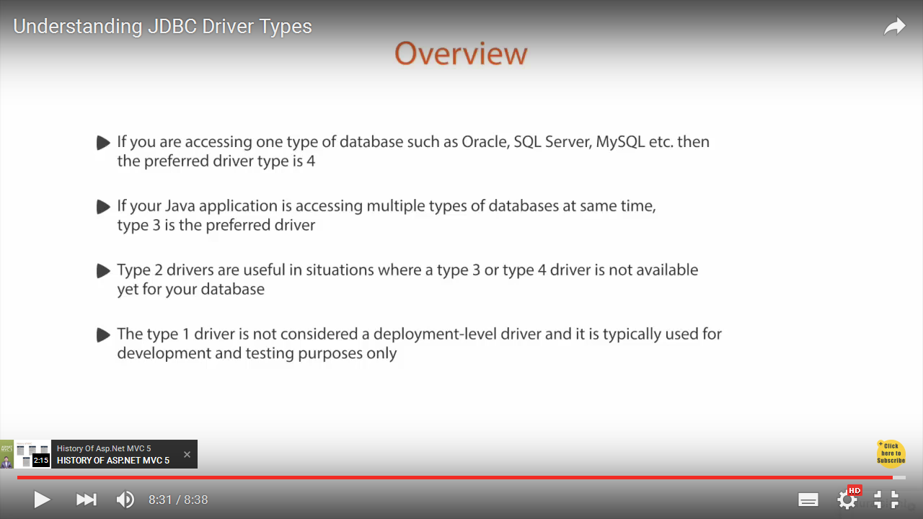

Slide 9
Accessing the database
There are 5 steps to connect any java application with the database in java using JDBC. They are as follows:
Register the driver class
Creating connection
Creating statement
Executing queries
Closing connection

Slide 10
Load the driver :
To load a driver , we will specify the class name of the database driver in the Class.forName method.
Database Driver Class Source
Access sun.jdbc.odbc.JdbcOdbcDriver Already in JDK
MySQL com.mysql.jdbc.Driver Website
Oracle oracle.jdbc.driver.OracleDriver Website

Slide 11
The forName() method of Class is used to register the driver class. This method is used to dynamically load the driver class.
Syntax:
public static void forName(String className)throws ClassNotFoundException
Example to register the OracleDriver class
Class.forName("oracle.jdbc.driver.OracleDriver");

Slide 12
2. Define the Connection URL
Once we have loaded the driver, we must specify the location of the database server. URLs referring to database from java use the jdbc: protocol and embed the server host, port, and database name ( reference ) with in the URL.
Examples:
String oracleURL=“jdbc:oracle:thin:@”+host+”:”+port+”:”+dbName;
String sybaseURL=“jdbc:sybase:Tds:@”+host+”:”+port+”:”+dbName;
String msAccessURL=“jdbc:odbc:”+dbName;

Slide 13
Establishing the connection
To make the actual network connection, pass the URL, database username and password to the getConnection method of the DriverManager class.
The getConnection() method of DriverManager class is used to establish connection with the database.
Syntax of getConnection() method
1) public static Connection getConnection(String url)throws SQLException
2) public static Connection getConnection(String url,String name,String password) throws SQLException
Ex:-
Connection con=
DriverManager.getConnection(oracleURL, username, password );

Slide 14
4. Create a statement object
Statement object is used to send queries to the database.
Ex:-
Statement stmt=connection.createStatement();

Slide 15
5. Execute a query
Once we have a statement object , we can use it to send SQL queries by using the execute query method.
Ex:-
String query=“select *from emp”;
ResultSet rs=stmt.executeQuery(query);

Slide 16
5. Process the Results
The simplest way to process the results is to use the next method of ResultSet to move through the table a row at a time.

Slide 17
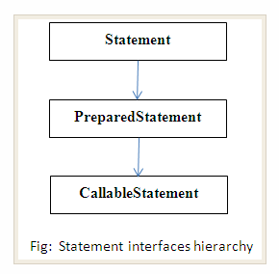
JDBC - Statements, PreparedStatement and CallableStatement
In JDBC there are 3-types of statements that we can use to interact with the DBMS.
These statements are:
Statement
PreparedStatement
CallableStatement

Slide 18
Statement
In terms of efficiency, it is suitable to use Statement only when we know that we will not need to execute the SQL query multiple times.
In contrast to PreparedStatement the Statement doesn’t offer support for the parameterized SQL queries.
Used for executing simple SQL statements like CRUD (create, retrieve, update and delete).

Slide 19
The Statement interface defines two methods for executing SQL commands.
public ResultSet executeQuery(String sql)
public int executeUpdate(String sql)
executeQuery returns a ResultSet
This is used for select statements.
executeUpdate returns the number of rows changed by the update statement
This is used for insert statements, update statements and delete statements

Slide 20
Ex
Include any example you have done in the lab based on Statement object.

Slide 21
PreparedStatement
The PreparedStatement accepts runtime values and these values can be passed as parameters.
This statement is useful when you want to execute same SQL command multiple times, like inserting records of students.
Ex :
PreparedStatement pstmt = con.prepareStatement(“insert into users values(?,?,?,?)");
pstmt.setString(1, name);
pstmt.setString(2, pword);
pstmt.setString(3, email);
pstmt.setString(4, pno);
pstmt.executeUpdatae();
The questions marks in the above statement are called as parameters.

Slide 22
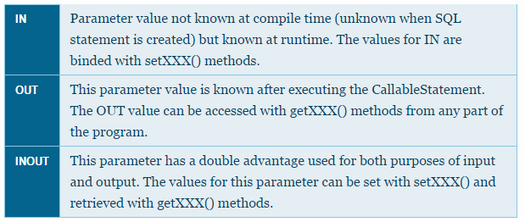
CallableStatement
It is exclusively used for executing stored procedures .
The CallableStatement also accepts runtime input parameters like PreparedStatement.
There are three types of parameters for stored procedures - IN, OUT and INOUT.

Slide 23
The output parameters need to be explicitly defined through the corresponding registerOutParameter() methods; whereas the input parameters are provided in the same manner as with the PreparedStatement.
Piece of code executing a function insertStudent() using CallableStatement is as shown below.
CallableStatement cst=con.prepareCall(“{ call insertStudent(?,?,?,?,?,?)}”);

Slide 24
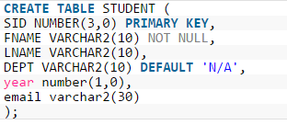
Ex:
Table

Slide 25
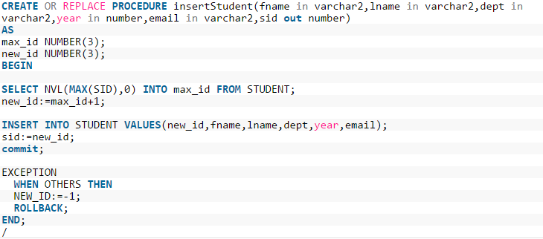
Stored Procedure

Slide 26
StoredProc.java
import java.sql.*;
import java.util.Scanner;
public class StoredProc {
public static void main(String[] args) {
// TODO Auto-generated method stub
Scanner sc=new Scanner(System.in);
Connection cn=null;
CallableStatement cst=null;
int id=0,yr;
String fname,lname,email,dept;
try{
Class.forName("oracle.jdbc.driver.OracleDriver");
con=DriverManager.getConnection("jdbc:oracle:thin:@localhost:1521:xe", "system", "system");
cst=cn.prepareCall("{call insertStudent(?,?,?,?,?,?)}");
System.out.println("Enter Student's First Name: ");
fname=sc.nextLine();
System.out.println("Enter Student's Last Name: ");
lname=sc.nextLine();
System.out.println("Enter Student's Email: ");
email=sc.nextLine();
System.out.println("Enter Student's Year: ");
yr=Integer.parseInt(sc.nextLine());
System.out.println("Enter Student's Dept: ");
dept=sc.nextLine();

Slide 27
cst.setString(1, fname);
cst.setString(2,lname);
cst.setString(3,dept);
cst.setInt(4, yr);
cst.setString(5, email);
cst.registerOutParameter(6, java.sql.Types.DECIMAL);
int r=cst.executeUpdate();
if(r>0)
id=cst.getInt(6);
if(id>0)
System.out.println("Details Inserted. SID: "+id);
}catch(Exception e)
{
e.printStackTrace();
}
finally{
try{
if(cst!=null)
cst.close();
if(cn!=null)
cn.close();
}catch(Exception e){}
}
}
}

Slide 28
Output
Enter Student's First Name:
Esha
Enter Student's Last Name:
Chakty
Enter Student's Email:
esha.chk@gmail.com
Enter Student's Year:
3
Enter Student's Dept:
CSE
Details Inserted. SID: 1
Enter Student's First Name:
Pavan
Enter Student's Last Name:
Kumar
Enter Student's Email:
pavan.k@gmail.com
Enter Student's Year:
3
Enter Student's Dept:
CSE
Details Inserted. SID: 2

Slide 29
Metadata through JDBC
DatabaseMetaData interface provides methods to get meta data about the database you have connected to.
You can obtain the DatabaseMetaData object from a Connection, as follows:
DatabaseMetaData dbmd = connection.getMetaData();
Commonly used methods of DatabaseMetaData interface are
public String getDriverName()throws SQLException: it returns the name of the JDBC driver.

Slide 30
public String getDriverVersion()throws SQLException: it returns the version number of the JDBC driver.
public String getUserName()throws SQLException: it returns the username of the database.
public String getDatabaseProductName()throws SQLException: it returns the product name of the database.
public String getDatabaseProductVersion()throws SQLException: it returns the product version of the database.

Slide 31
Simple Example of DatabaseMetaData interface
import java.sql.*;
class Dbmd {
public static void main(String args[])
{ try{
Class.forName("oracle.jdbc.driver.OracleDriver");
Connection con=DriverManager.getConnection("jdbc:oracle:thin:@localhost:1521:xe", "system", "system");
DatabaseMetaData dbmd = con.getMetaData();
System.out.println("Driver Name: "+dbmd.getDriverName());
System.out.println("Driver Version: "+dbmd.getDriverVersion());
System.out.println("UserName: "+dbmd.getUserName());
System.out.println("Database Product Name: "+dbmd.getDatabaseProductName());
System.out.println("Database Product Version: "+dbmd.getDatabaseProductVersion());
}catch(Exception e){System.out.println(e);}
}
}
Output:
Driver Name: Oracle JDBC driver
Driver Version: 8.1.7.0.0
UserName: SYSTEM
Database Product Name: Oracle
Database Product Version: Oracle Database 10g Express Edition Release 10.2.0.1.0
- Production

Slide 32
Accessing a Database from a JSP page
Include any Database accessing example you have done in the lab using JSP page.

Slide 33
Performing the CRUD operations
Write any Database program using JSP which includes CRUD operations.
Create
Update
Delete
Read
executeUpdate(…………)
executeQuery(…………)

Slide 34
Connection Pooling
Connection pooling is the maintenance of a group of database connections for reuse by applications on an application server.
Opening a new connection for each request is more costly to both the server and the client than keeping a small pool of connections open constantly, ready to be used by new requests.
When a request comes in, one of the pre-existing connections in the pool is assigned to it.
Once the request is complete, the connection returns to the pool and waits to service another request.

Slide 35
The javax.sql package
The classes and interfaces in this package provide new functionality,
The DataSource interface serves as a factory for Connection objects;
PooledConnection supports connection pooling, which allows an application to handle multiple database connections in a fairly transparent manner.
RowSet extends the ResultSet interface to a JavaBeans component that can be manipulated at design time and used with non-SQL data sources.

Slide 36
Struts

Slide 37
Introduction to Struts Framework
Struts is an open-source framework for building more
flexible, maintainable and structured Java web applications
There are two key components in a web application:
the data and business logic performed on this data
the presentation of data
Struts
helps structuring these components in a Java web app.
controls the flow of the web application, strictly
separating these components

Slide 38
This separation between presentation, business logic and
control is achieved by implementing the Model-View-Controller
(MVC) Design Pattern.
Struts is focused on Controller
– Struts is Model and View independent

Slide 39
There are several advantages to this approach:
The entire logical flow of the application is in a hierarchical text file( struts-config.xml ) . This makes it easier to view and understand, especially with large applications.
The page designer does not have to go through Java code to understand the flow of the application.
The Java developer does not need to recompile code when making flow changes.

Slide 40
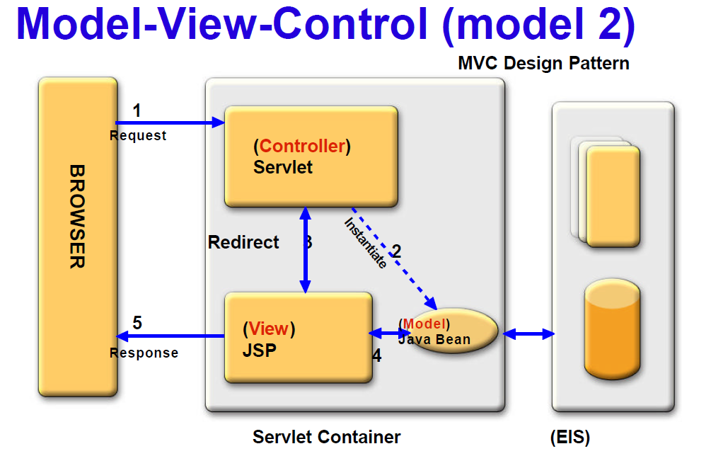
Data Base

Slide 41
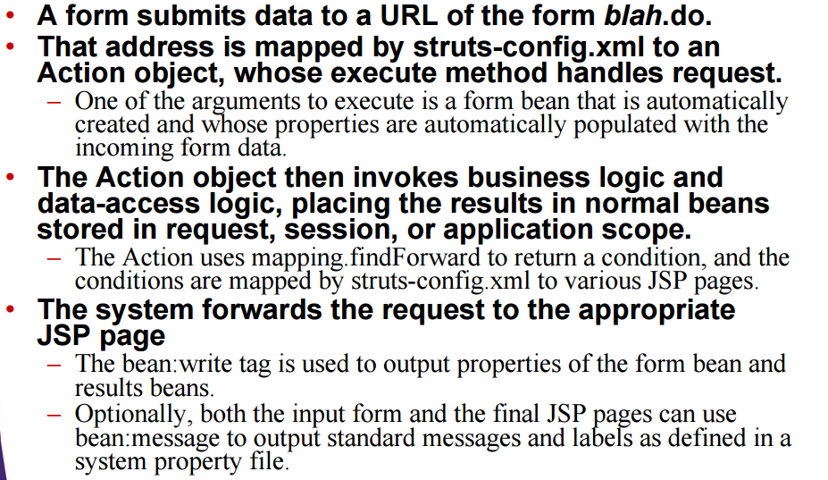
Struts application flow

Slide 42
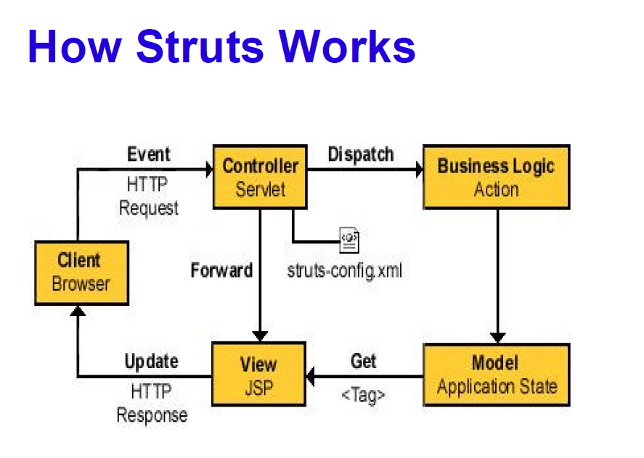
Contd..
Struts application flow

Slide 43
The ActionServlet Class
It is the core of the Struts Framework. It can be treated as a switch board of the application.
ActionServlet (Command) creates and uses an Action, an ActionForm, and an ActionForward.
The struts-config.xml file configures the Command.
During the creation of the Web project, Action and ActionForm are extended to solve the specific problem space.

Slide 44
The ActionForm Class
ActionForm maintains the session state for the Web application.
ActionForm is an abstract class that is sub-classed for each input form.
ActionForm represents a general concept of data that is set or updated by a HTML form.
E.g., you may have a UserActionForm that is set by an HTML Form.

Slide 45
The Struts framework will:
Check to see if a UserActionForm exists; if not, it will create an instance of the class.
Set the state of the UserActionForm using corresponding fields from the HttpServletRequest.
No more request.getParameter() calls. For instance, the Struts framework will take fname from request stream and call UserActionForm.setFname().
The Struts framework updates the state of the UserActionForm before passing it to the business wrapper UserAction.

Slide 46
The Action Class
The Action class is a wrapper around the business logic.
The purpose of Action class is to translate the HttpServletRequest to the business logic.
To use Action, subclass and overwrite the execute() method.

Slide 47
Importance of struts-config.xml
The struts-config.xml configuration file is a link between the View and Model components in the Web Application.
The configuration file basically contains three main elements:
<form-beans>
<global-forwards>
<action-mappings>
struts-config | Is the root node of the configuration file.
form-beans | Contains form bean definitions. The Form beans create ActionForm instances at runtime. The details of each form bean are provided in the <form-bean> element. The<form-property> elements within the form bean contain the property names and the property types of the form bean. Attributes of <form-bean> are: name: Must have a unique bean name. This name is used as reference in the action mappings. Often, this is also the name of the request or the session attribute under which the form is stored. type: The value is a fully-qualified classname of the ActionForm class used with the form bean. Example Entry <form-beans> <form-bean name=“login" type="com.dss.LoginActionForm"/> <form-property name=“uname" type="java.lang.String"/> <form-property name=“upwd" type="java.lang.String"/> ...... </form-bean>

Slide 48
global forwards | Contains the global forward definitions. The forward name is the logical name used to map to a specific JSP. The <forward> element contains the logical name and the name of the corresponding resource which it maps to. Attributes of <forward> are: name: Contains the logical name of the forward. This name is used in the Action class's execute() method to forward it to the next resource. Example: login path: Contains the context relative path of the resource to which the forward name maps. Example: path="/success.jsp Example Entry <forward name=“login" path=“/success.jsp" />

Slide 49
action-mappings | Contains the action definitions. Each action mapping is defined in an <action> element. The <forward> definition within <action>, maps the result of the action to the jsp page invoked Attributes of <action-mappings> are: path: Contains the name of the request received type: Contains the name of the action class invoked scope: Specifies the scope in which the Controller (ActionServlet) must look for the bean Attributes of (local) <forward> within <action-mappings> are the same as that of the global <forward>. Example Entry <action-mappings> <action name=“login" type="com.dss.LoginAction" path="/hello"> <forward name="success" path="/success.jsp"/> <forward name="failure" path="/failure.jsp"/> </action> </action-mappings>

Slide 50
Importance of a form bean
A form bean is a Java object that will be automatically filled in with the incoming form parameters and passed to the execute method. Requirements:
It must extend ActionForm.
The argument to execute is of type ActionForm. Cast the value to your real type, and then each bean property has the value of the request parameter with the matching name.
It must have a zero argument constructor.
The system will automatically call this default constructor

Slide 51
It must have settable bean properties that correspond to the request parameter names.
That is, it must have a setName method corresponding to each incoming request parameter that you want inserted automatically. The properties should be of type String (i.e., each setName method should take a String as an argument).
It must have gettable bean properties for each property that you want to output in the JSP page.
That is, it must have a getName method corresponding to each bean property that you want to display in JSP without using Java syntax.

Slide 52
Sample Application Development using Struts API
Login.html
<html>
<body >
<form method="get" action="hello.do">
Enter Name<input type="text" name="uname"/><br>
Enter password <input type="password" name="upwd"/><br>
<input type="submit" value="send"/>
</form>
</body>
</html>

Slide 53
Failure.jsp
<html>
<body >
<b>Login Failure </b>
</body>
</html>
Success.jsp
<html>
<body >
<b>Login Success </b>
</body>
</html>

Slide 54
web.xml
<web-app>
<welcome-file-list>
<welcome-file>login.html</welcome-file>
</welcome-file-list>
<servlet>
<servlet-name>as</servlet-name>
<servlet-class>org.apache.struts.action.ActionServlet</servlet-class>
<init-param>
<param-name>config</param-name>
<param-value>/WEB-INF/struts-config.xml </param-value>
</init-param>
</servlet>
<servlet-mapping>
<servlet-name>as</servlet-name>
<url-pattern>*.do</url-pattern>
</servlet-mapping>
</web-app>

Slide 55
struts-config.xml
<struts-config>
<form-beans>
<form-bean name=“login" type="com.dss.LoginActionForm"/>
</form-beans>
<action-mappings>
<action name=“login" type="com.dss.LoginAction" path="/hello">
<forward name="success" path="/success.jsp"/>
<forward name="failure" path="/failure.jsp"/>
</action>
</action-mappings>
</struts-config>

Slide 56
LogingActionForm.java
package com.dss;
import org.apache.struts.action.*;
public class LoginActionForm extends ActionForm
{
private String uname;
private String upwd;
public void setUname(String uname)
{ this.uname=uname; }
public String getUname()
{ return uname; }
public void setUpwd(String upwd)
{ this.upwd=upwd; }
public String getUpwd()
{ return upwd; }
}

Slide 57
LoginAction.java
package com.dss;
import org.apache.struts.action.*;
import javax.servlet.http.*;
public class LoginAction extends Action
{
public ActionForward execute(ActionMapping mapping, ActionForm form, HttpServletRequest req, HttpServletResponse res) throws Exception
{
LoginActionForm laf=(LoginActionForm)form;
String uname=laf.getUname();
String upwd=laf.getUpwd();
if((uname.equals(“snist")) && (upwd.equals(“csec")))
{
return mapping.findForward("success");
}
else
{
return mapping.findForward("failure");
}
}
}

