Slide 1
United States International University — Africa
DSA 3050A · Business Intelligence & Visualization
Dubai & Abu Dhabi Real Estate
Rental Market Intelligence Dashboard
Group Project — Group 6
Wilson Jnr Muhia - 669024
Betelhem Kebede - 670549
Cynthia Gathogo – 668745
Merhawit Kassa – 670554
Snit Kahsay – 670552
Hana Gashaw - 670555

Slide 2
BUSINESS PROBLEM
A single view of the UAE rental market
Real estate agents, investors, and analysts currently work with fragmented listing data across Dubai, Abu Dhabi, and the other emirates. There is no centralized, interactive tool to compare rental pricing, demand, and market performance by location and property type.
Key business questions
Which locations command the highest average rents?
Is the market growing month-on-month?
What share of listings are furnished vs. unfurnished?
Which property types are most in demand, by city?
How does rent per square foot vary by neighborhood?
Business Problem
02

Slide 3
THE DATASET
73,742 property listings across the UAE
73,742
17
8
2024
Rows
Source columns
Cities covered
Posting date range
Dubai (34,250) · Abu Dhabi (23,324) · Sharjah (9,516) · Ajman (4,704) · Al Ain (1,040) · Ras Al Khaimah (816) · Umm Al Quwain (65) · Fujairah (27)
Fields include address, rent, beds, baths, type, area, rent category, furnishing, purpose, posted date, listing age, location, city, latitude, and longitude.
Dataset
03

Slide 4
PREPARATION
Cleaning and shaping the data in Power Query
Cleaning
Structuring
Advanced
Renamed unclear columns
Corrected data types
Trimmed and cleaned text
Standardized inconsistent values
Split posted date into year, month, quarter
Built custom size and luxury categories
Removed unneeded columns
Built a full Date table
Created a reference query for Dubai
Grouped by location and type with multiple aggregations
Power Query
04

Slide 5
DATA MODEL
A clean star schema
FactProperty
DateTable
DimLocation
DimPropertyType
DimFurnishing
DimFrequency
DimPurpose
One fact table, six dimensions, one-to-many relationships with single-direction filtering — no relationships between dimensions.
Data Model
05

Slide 6
DAX MEASURES
15 measures across five categories
Aggregation
Total Listings, Average Rent, Average Area Sqft
Time Intelligence
Listings YTD, Average Rent MTD, Listings Previous Month, Listings Growth %
Ratio
Avg Rent per Sqft, % Furnished Listings, % Listings for Rent
Ranking
Rank by Location Avg Rent, Rank by Property Type Popularity, Top Location Flag
Conditional KPI
Rent Tier, Listing Age Status
DAX Measures
06

Slide 7
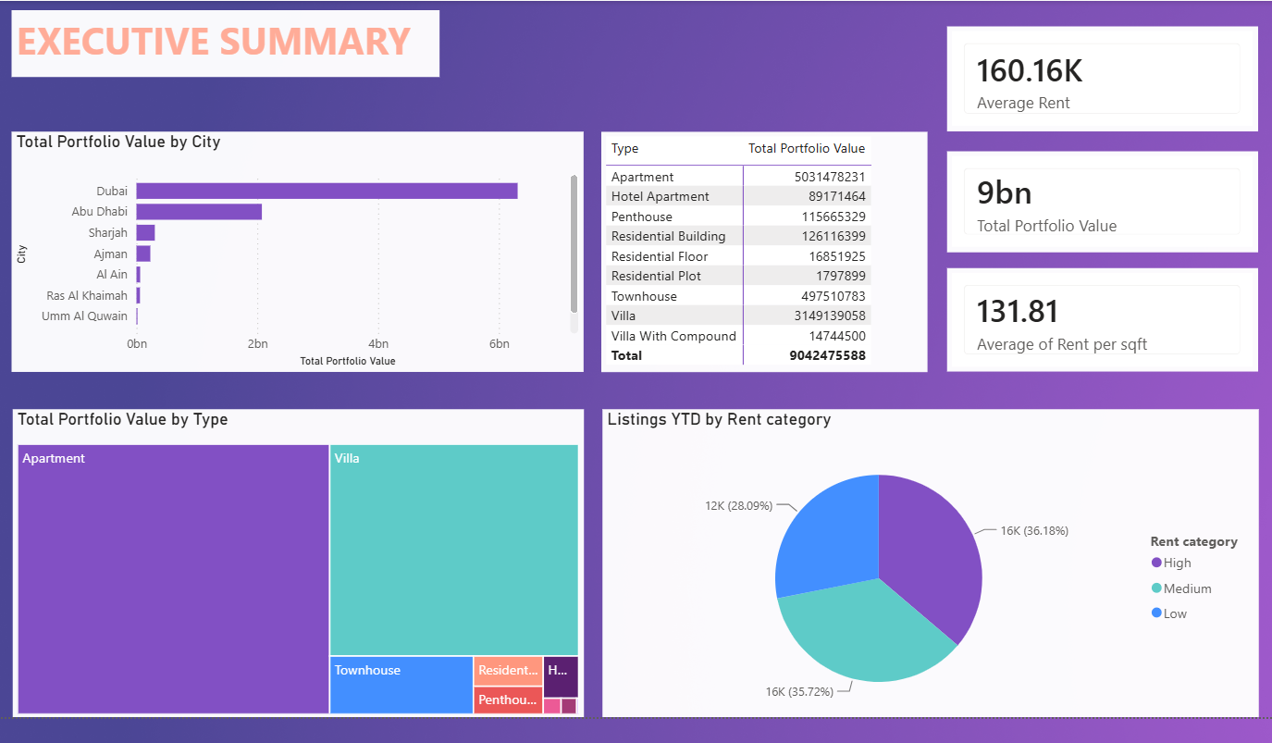
THE DASHBOARD
Executive Summary
Average rent, portfolio value, and rent per sqft KPIs, with portfolio value by city and type.
07

Slide 8
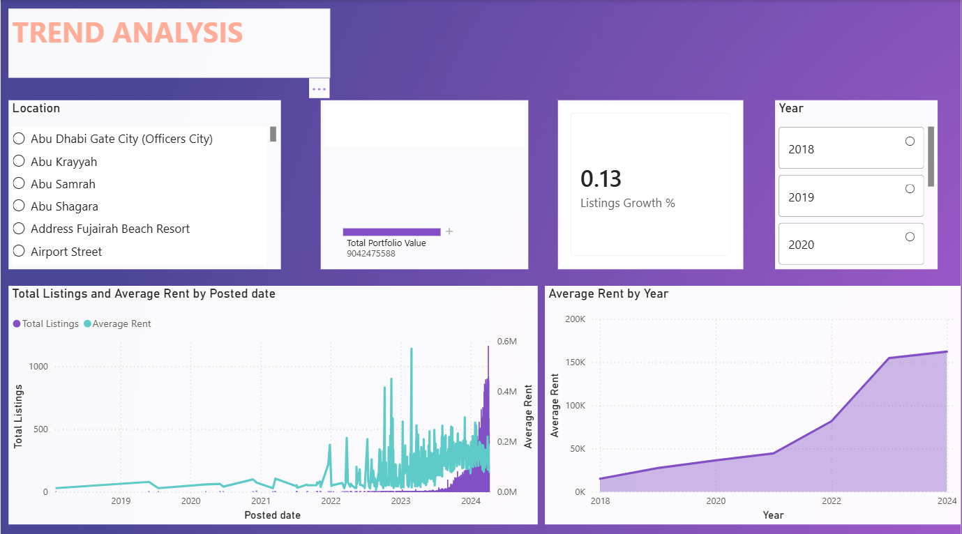
THE DASHBOARD
Trend Analysis
Listings and average rent over time, with year-over-year rent growth from 2018 to 2024.
08

Slide 9
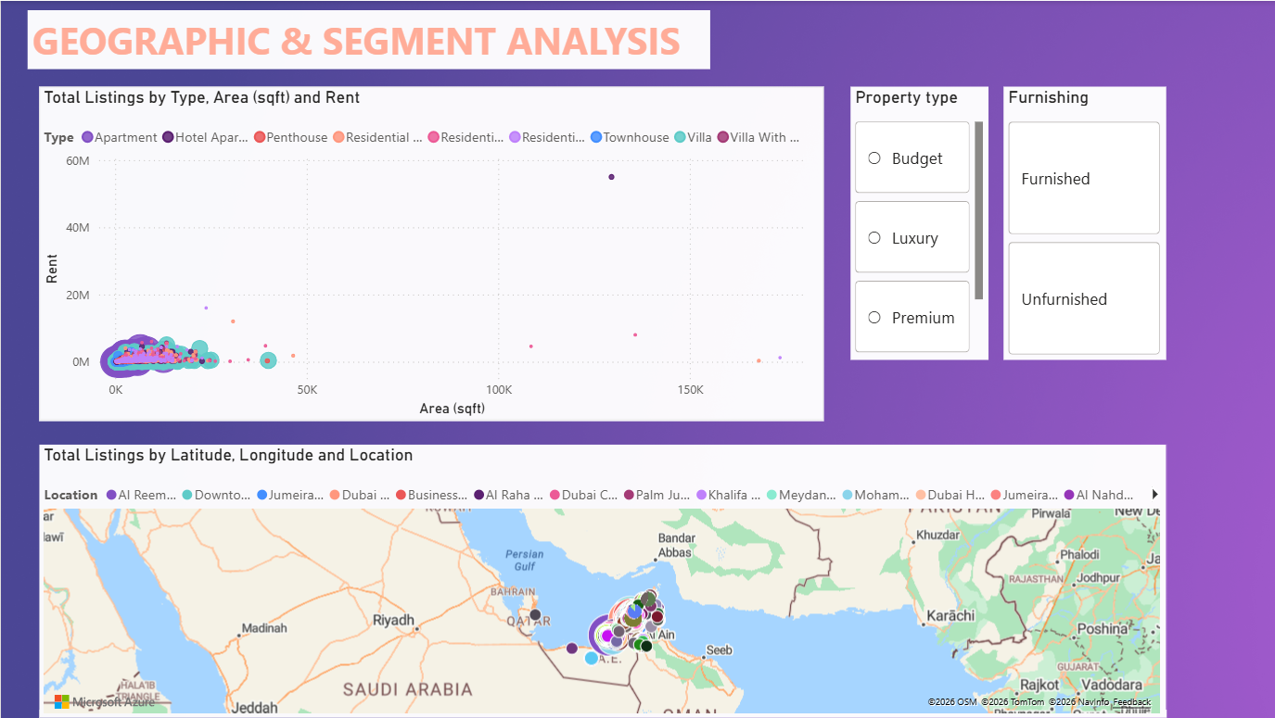
THE DASHBOARD
Geographic & Segment Analysis
Listings mapped by location, filterable by property type, budget tier, and furnishing.
09

Slide 10
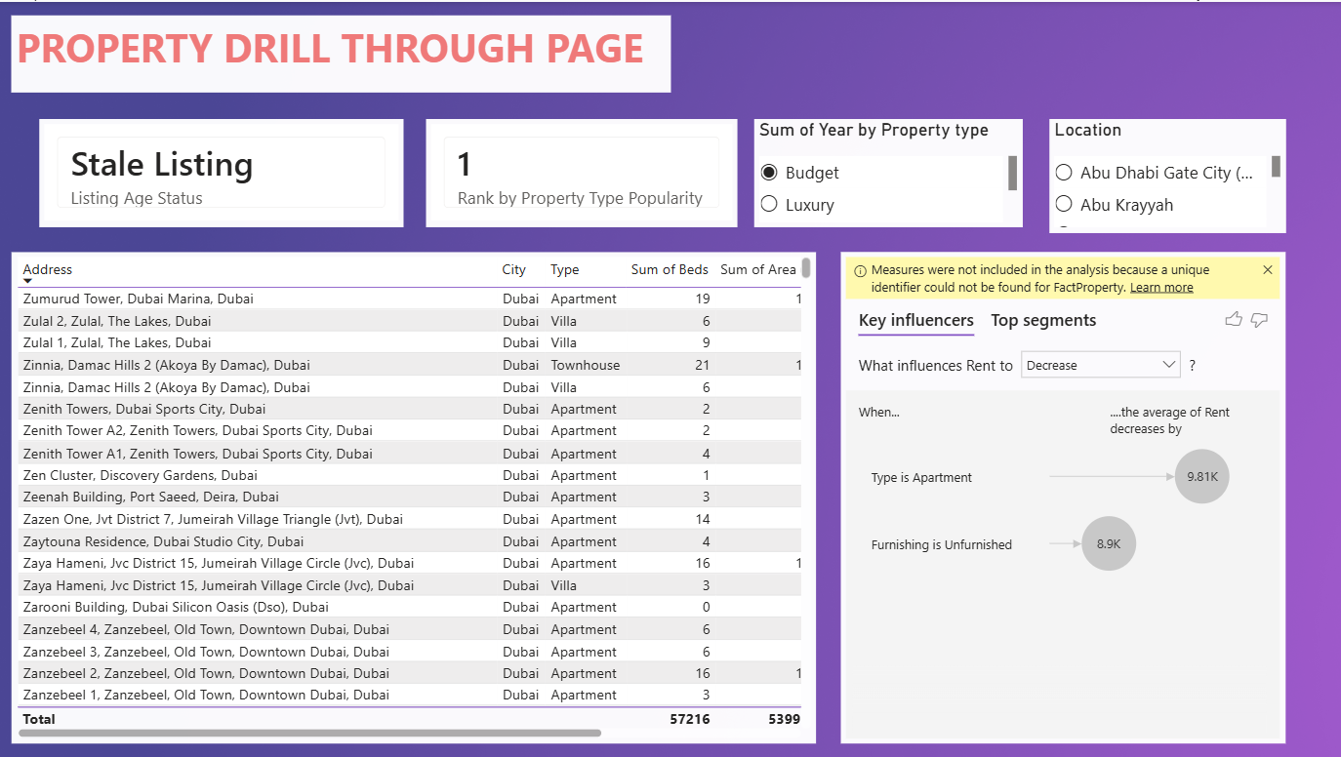
THE DASHBOARD
Property Drill-Through
Property-level detail with key influencers on what drives average rent up or down.
10

Slide 11
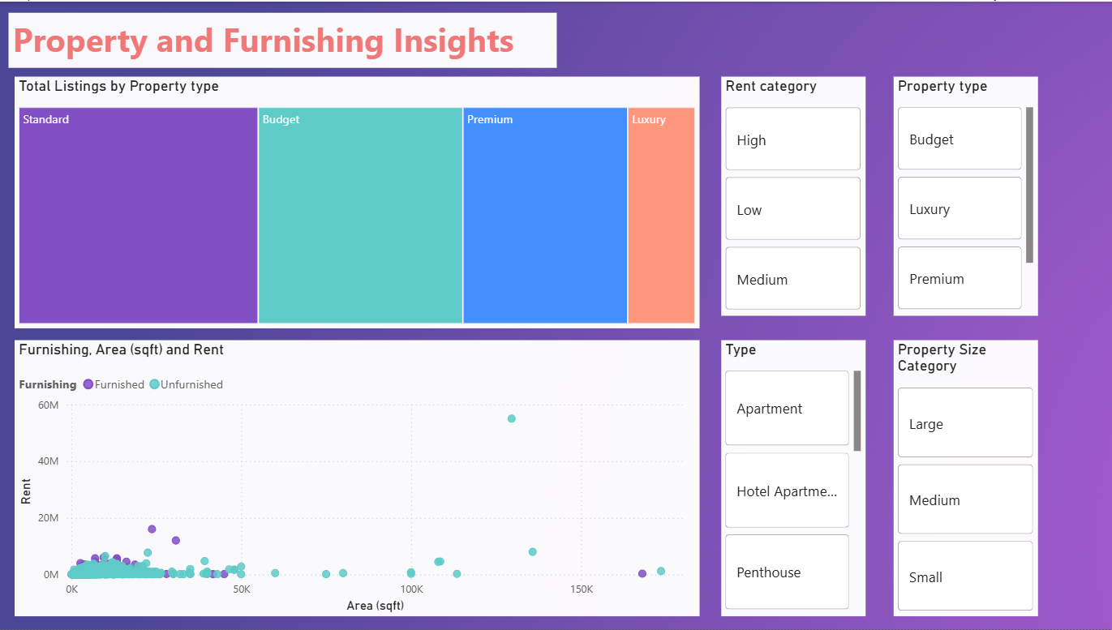
THE DASHBOARD
Property & Furnishing Insights
Listings by property type and rent category, with furnishing and area segmentation.
11

Slide 12
FINDINGS
Key insights
Dubai leads volume, Abu Dhabi leads price.
Dubai holds 46% of listings, but Abu Dhabi neighborhoods like Al Reem and Yas Island rank among the highest average rents — a distinct premium segment.
Unfurnished listings dominate.
The majority of listings are unfurnished, pointing to a long-term tenant market rather than short-term furnished demand.
Stale inventory is concentrated.
A meaningful share of listings sit inactive for more than 30 days, flagging possible overpricing or mismatched demand in specific segments.
Key Insights
12

Slide 13
NEXT STEPS
Recommendations
Target furnished short-term rental supply in high-demand, currently under-furnished locations.
Prioritize marketing spend on Abu Dhabi premium micro-markets such as Al Reem and Yas Island.
Flag and re-price stale listings automatically once they pass the 30-day threshold.
Use rank and tier measures to guide investors toward top-3 locations by average rent.
Extend the model with a Purpose dimension once for-sale listings are added, to compare rent vs. sale yield.
Recommendations
13

Slide 14
Thank you
Questions & discussion
Group 9 · Dubai & Abu Dhabi Real Estate Rental Market Intelligence Dashboard

