Slide 1






Bit N Build'26 Gujarat Round Hackathon
Hobby
Matchmaker
PS: Hobby Matchmaker for Aatmoday
Team Bug Bunnies
Institution: Parul Institute of technology
Niyati Sojitra (Leader)
Darshan Patil
Sah Amritakumari
Solanki Jatin
Notes:
Hobby Matchmaker is a web platform that helps people discover hobbies that match their interests, skills, personality, available time and preferences.

Slide 2








Problem & Proposed Solution
MAIN OBJECTIVES
The gap
Discover and explore hobbies
Personalized recommendations
Existing platforms give general hobby lists, but no personalized recommendations. Existing platforms provide general hobby lists but do not offer personalized recommendations.
Save interests and preferences
See difficulty, time, cost and materials
Our solution
The Hobby Matchmaker aims to provide a simple system that analyzes user preferences and matches them with suitable hobbies. Analyzes your interests, skills, time and budget to suggest hobbies that fit you.
Use free time productively
Easy, attractive interface
Notes:
Existing platforms only provide general hobby lists. Hobby Matchmaker analyses user preferences and matches them with suitable hobbies. Six main objectives are shown on the right.

Slide 3

Technology Stack
Frontend
Backend
Database
Languages used:
Language used:
MySql
HTML
Python
CSS
Frameworks & libraries:
JavaScript + API
Flask
Notes:
Nine steps in three phases: register and set preferences, get matched by the algorithm and see scores, then explore hobby details, save favorites and start the hobby.

Slide 4
User Flow/Architecture
Get Started
Get Matched
Explore
Register / Login
Run matching algorithm
View hobby details
1
4
7
Enter personal preferences
Calculate match score
Add to favorites
2
5
8
Answer hobby questionnaire
Display recommended hobbies
Start / explore the hobby
3
6
9
Notes:
Nine steps in three phases: register and set preferences, get matched by the algorithm and see scores, then explore hobby details, save favorites and start the hobby.

Slide 5
Approach & Impletation
Matching & Scores
What we ask you
Recommendation score
Your interests
Indoor or outdoor
Free time available
Budget
Individual or group
Activities you enjoy
Example match percentages shown to the user
Notes:
The questionnaire answers feed the matching algorithm, which calculates a match percentage for each hobby. The scores shown are examples: Drawing 92%, Music 78%, Photography 71%.

Slide 6

Admin Panel
Add new hobbies
Edit hobby information
Delete hobbies
Manage users
View basic system statistics
Helping people spend their free time productively.
Notes:
Frontend in HTML, CSS and JavaScript; backend in Python with Flask; database in MySQL. The admin panel lets administrators manage hobbies and users and see basic statistics.

Slide 7






Key Features
Register & Login
Questionnaire
Smart Matching
Search & Filter
Create an account and log in securely.
Interests, budget, free time, indoor or outdoor, solo or group.
Calculates suitable hobbies from your answers.
Filter by category, cost, difficulty, time and more.
Hobby Details
Favorites
Match Score
Admin Panel
Benefits, equipment, cost, time and beginner tips.
Save hobbies you like and view them later.
A matching percentage for every recommended hobby.
Add, edit and delete hobbies, manage users, view stats.
Notes:
Eight core features: registration and login, a preference questionnaire, personalized matching, search and filter, hobby details, favorites, recommendation score, and an admin panel.

Slide 8
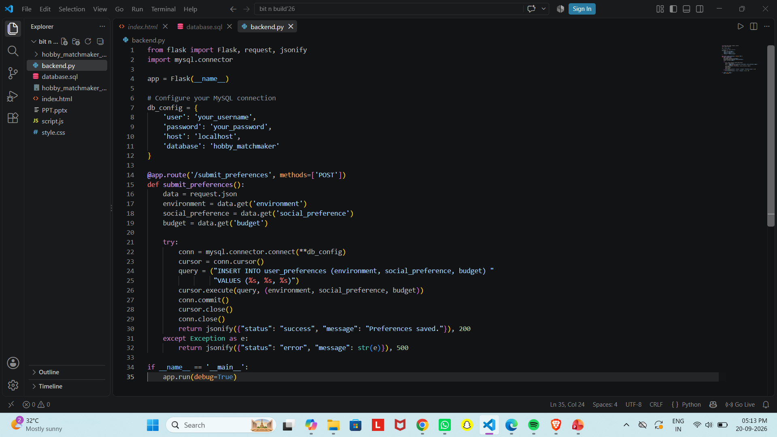
Team Contributions
Member 1 : Niyati (Backend & API)
Notes:
Thank the judges and audience, then invite questions.

Slide 9
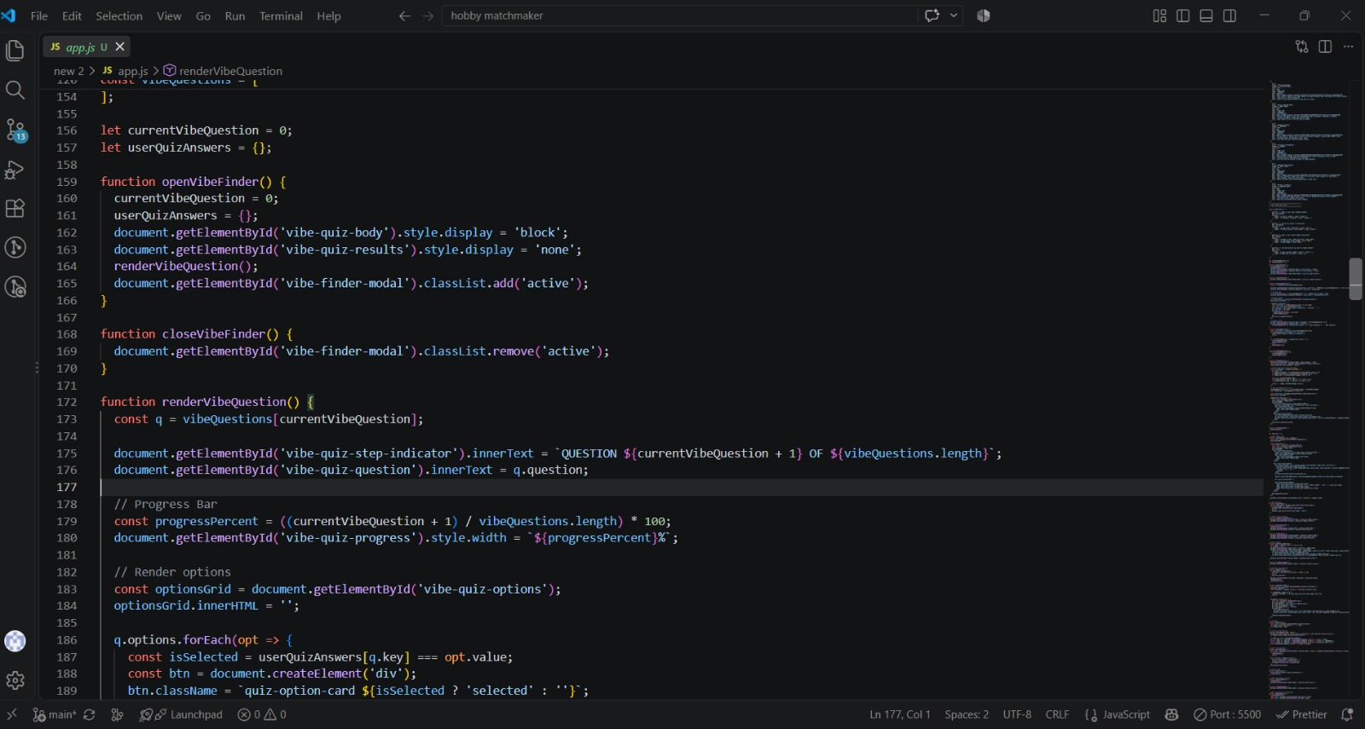
Team Contributions
Member 2 : Amrita (Frontend)
Notes:
Thank the judges and audience, then invite questions.

Slide 10
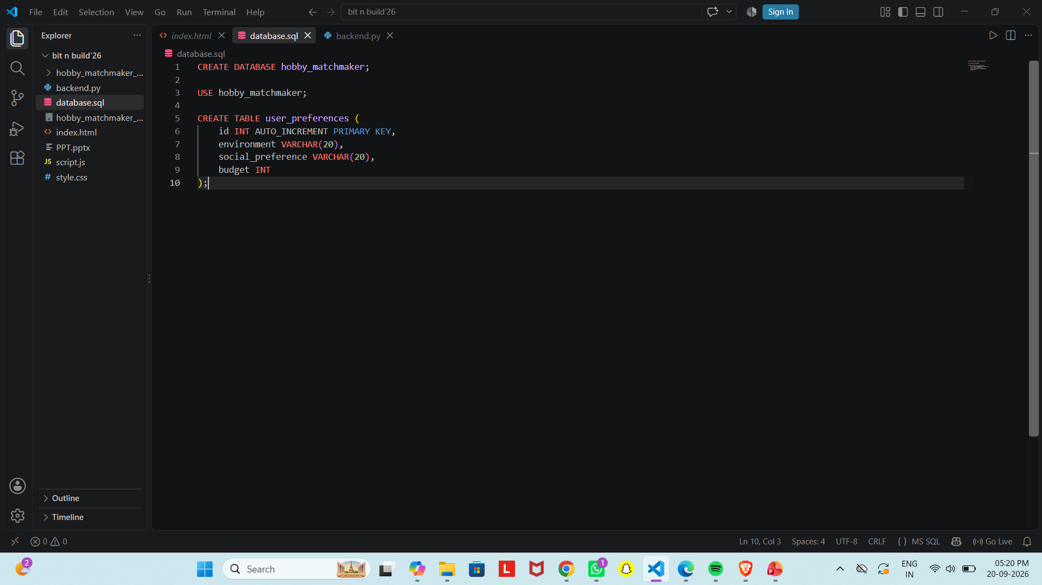
Team Contributions
Member 3 : Jatin (Database)
Notes:
Thank the judges and audience, then invite questions.

Slide 11
Project Link
Github link:
https://github.com/Sniyati1/Hobby-Matchmaker-for-Aatmoday
Notes:
Eight core features: registration and login, a preference questionnaire, personalized matching, search and filter, hobby details, favorites, recommendation score, and an admin panel.

Slide 12

Thank You!
Hobby Matchmaker for Aatmoday
Team Bug Bunnies | Bit N Build'26 Gujarat Round Hackathon
Notes:
Thank the judges and audience, then invite questions.

