Slide 1
Tran Mini Game
Brian Tran
BU MET CS651 Fall 2016
Web Dev w/ .NET Final Project
Professor Konstantopou

Slide 2
Introduction
Goal: create a simple multiplayer game.

Slide 3








Technology

Slide 4
Phaser
Open source framework for Canvas and WebGL
Far more intuitive to use than Crafy.js
Excellent documentation

Slide 5
Azure
Free 30 day Trial to host on azurewebsites.net
Easily published directly through Visual Studio 2015

Slide 6
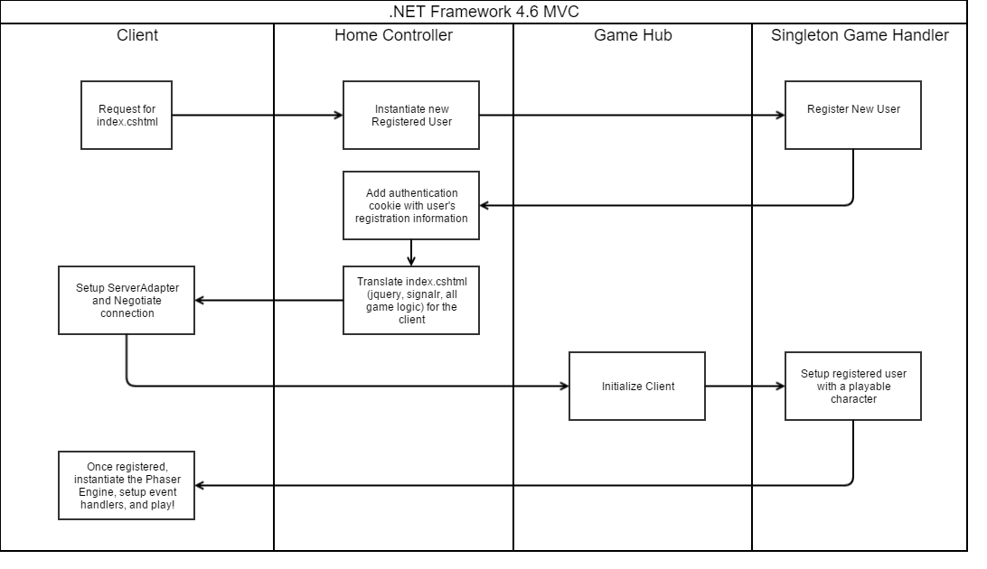
Registration Flow

Slide 7
Payloads
Made it far easier to translate server data to client data.
Compress the data on the server.
Send one single SignalR message back to the each user via the hub.

Slide 8
Demo!
Join me!
http://tranmini.azurewebsites.net/
Questions?
What can I improve?
Client animation vs. server animation?
Collision Detection?
Hiccups:
Bundle Config & TypeScript
“Jumping” Data

Slide 9
References
https://www.asp.net/signalr
https://github.com/NTaylorMullen/ShootR/tree/master/ShootR
https://phaser.io/docs/2.6.2/index

