Slide 1
Tran Mini Game
Brian Tran
BU MET CS651 Fall 2016
Web Dev w/ .NET Final Project

Slide 2
Introduction
Goal: create a simple multiplayer game.

Slide 3








Technology

Slide 4
Phaser
Open source framework for Canvas and WebGL
Far more intuitive to use than Crafy.js
Excellent documentation

Slide 5
Azure
Free 30 day Trial to host on azurewebsites.net
Easily published directly through Visual Studio 2015

Slide 6
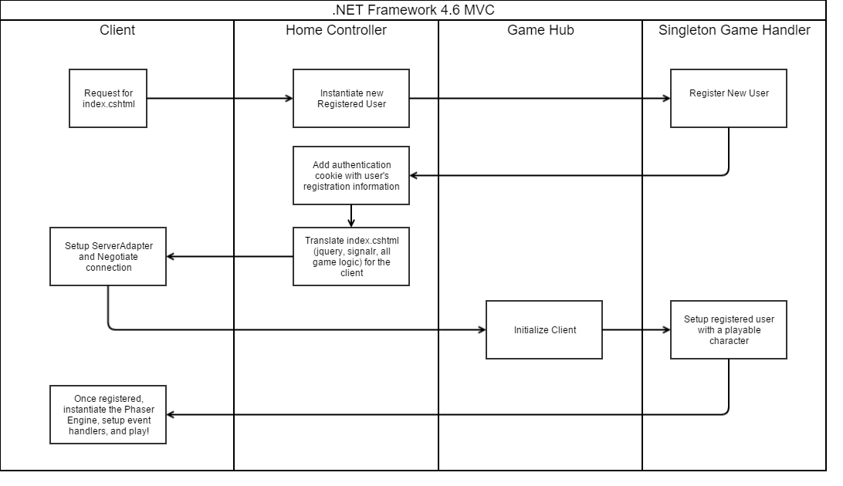
Registration Flow

Slide 7
Payloads
Made it far easier to translate server data to client data.

Slide 8
Demo!
Join me!
http://tranmini.azurewebsites.net/

