Slide 1

Sudoku Solver
Brian Tran
MET CS 664 - D1 Artificial Intelligence
Fall 2014
12/04/2014

Slide 2
Outline
Goal: Create a Sudoku Solver
User Interface
Unity & UI Architecture
Solver Algorithms:
Backtracking
Exact Cover
Conclusion

Slide 3



Try Solvoku now!
http://bit.ly/1s0qn4B
or http://bit.ly/1FReMes

Slide 4
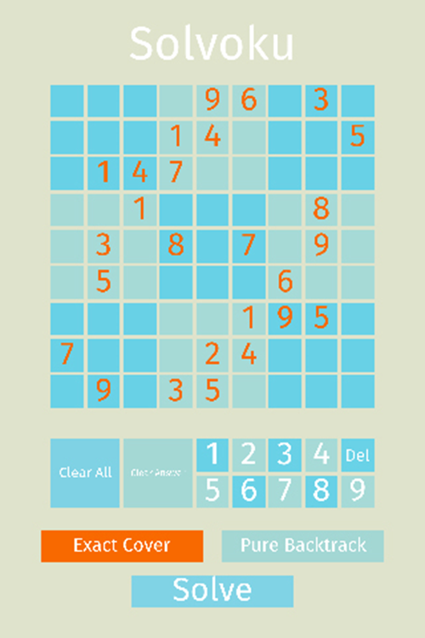
Unity Engine and UI Architecture
Four main parts to the design:
Sudoku Board
Handled by SudokuBoard.cs and SudokuSlot.cs
Handles display Sudoku slots.
Orange text slots are part of the original setup and white text slots are part of the answer.
Input
Handled by Main.cs and Button.cs
Select a slot and then input 1-9 or delete.
Can clear the entire board.
Can also clear just the answers (useful for testing the two algorithms).
Solver Selection
Handled by Main.cs and SolverSelectionButton.cs
Choose between Exact Cover Solver or Backtracking solver
Solve!
Handled by Main.cs
Once the Sudoku board has been setup, hit the solve button!

Slide 5
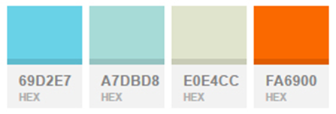
User Interface Design
Color Scheme:
Font: Fira Sans Regular

Slide 6
Solver Algorithm: Backtracking
Used for constraint satisfaction problems
Steps:
Go to the first empty cell.
Place a value
If the value is valid, continue recursively to the next empty cell.
If the value is invalid, reset the cell and BACKTRACK to the previous valid scenario.

Slide 7
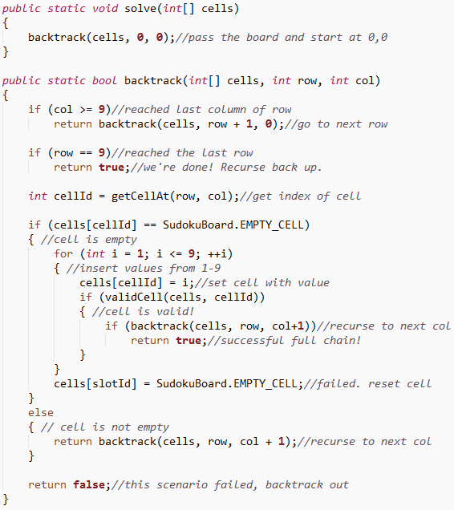
Solver Algorithm: Backtracking

Slide 8
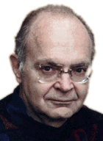
Solver Algorithm: Exact Cover Algorithm X
Donald Knuth’s Algorithm X is used to solve Exact Cover problems, such as Sudoku.
Given a matrix of 1’s and 0’s, Algorithm X will find a set or more of rows that will have exactly one 1 in each column.
0 0 1 0 1 1 0
1 0 0 1 0 0 1
0 1 1 0 0 1 0
1 0 0 1 0 0 0
0 1 0 0 0 0 1
0 0 0 1 1 0 1
Rows 1, 4, and 5 will be selected by Algorithm X because each column is covered by only one 1.
Donald Knuth

Slide 9
Algorithm X and Dancing Links
Dancing Links – Donald Knuth’s technique
Takes advantage of doubly-linked lists
Uses linked lists to represent the matrix.
Headers are used to keep track of the top of the matrix.
A node that exists represents a 1 within the matrix.

Slide 10
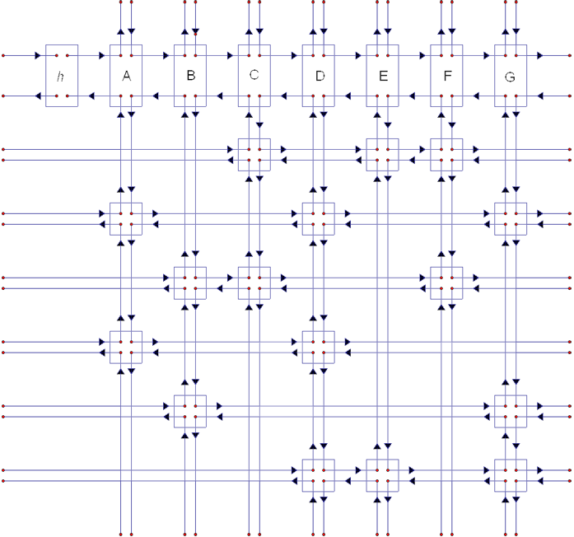
Algorithm X and Dancing Links
It’s just the matrix!
0 0 1 0 1 1 0
1 0 0 1 0 0 1
0 1 1 0 0 1 0
1 0 0 1 0 0 0
0 1 0 0 0 0 1
0 0 0 1 1 0 1

Slide 11
Dancing Links: Cover and Uncover
Algorithm uses backtracking to find the rows that fit the solution, but with a twist.
Instead of setting cell values, the algorithm uses methods “cover” and “uncover”
Cover – Removes a column from the matrix and removes all nodes within the same row.
Uncover – Inserts the column back into the matrix. Only works because of linked lists innate feature.

Slide 12
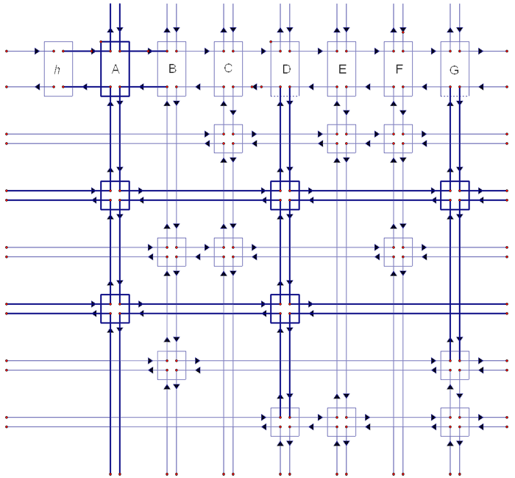
Cover Method
Column “A” is being removed
Row 2 has a node in Column A
Row 2 is removed
Row 4 has a node in Column A
Row 4 is removed

Slide 13
Algorithm X and Sudoku
Constraints!
Columns represent the constraints of the puzzle.
There are 4 constraints in Sudoku:
A position constraint – Each cell can contain a single digit (81 constraints)
A row constraint – Each row can contain 1 of each digit (9 rows x 9 digits constraints)
A column constraints – Each column can contain 1 of each digit (9 columns x 9 digits = 81 constraints)
A region constraint – Each region can contain 1 of each digit (9 regions x 9 digits = 81 constraints)
A total of 324 (81 + 81 + 81 + 81) constraints need to be satisfied.
324 columns!
Rows represent all 9 digits in 81 cells.
A total of 729 (9 digits x 81 cells) need to be setup to represent every possible candidate.

Slide 14
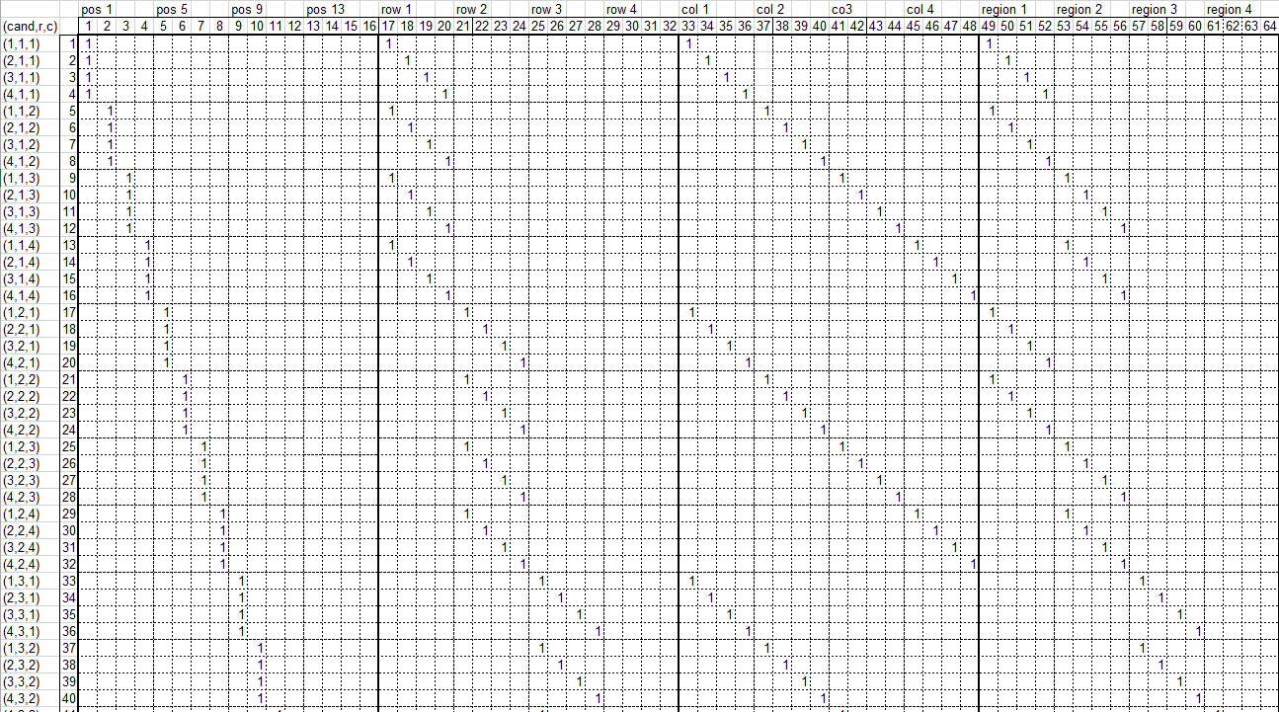
4x4 Sudoku Matrix Constraint

Slide 15
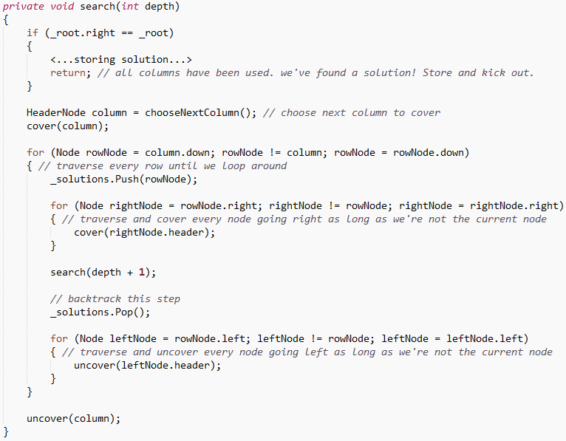
Backtracking with Dancing Links

Slide 16
Backtracking vs. Exact Cover Comparison
Stats:
Total Function Time: Total amount of time the function took to solve the Sudoku Board.
Total Actions: Actions are considered anything that is mutating a value.
Max Depth: How deep the recursion went. Actions and depth directly correlate.
Pure backtracking for an “Evil Sudoku Board”:
Total Function Time: 3ms
Total Actions: 260,005
Max Depth: 90
Exact Cover for the same “Evil Sudoku Board”:
Total Function Time: 1ms
Total Actions: 11,446
Max Depth: 55
Both algorithms finished at similar times.
Exact Cover (Algorithm X) is 23 times more efficient in terms of actions.
Exact Cover has a shallower recursion level by 35.

Slide 17
Conclusion: Backtracking and Dancing Links Are Awesome
Backtracking algorithm is a key aspect of Algorithm X and is the crux in solving puzzles in Sudoku as a constraint problem.
Dancing Links is a fascinating technique to handle large matrices.

Slide 18
Questions?

