Slide 1

Introduction to Git
James Gerity
February 4, 2016
Slides available at http://www.github.com/jgerity/talks

Slide 2
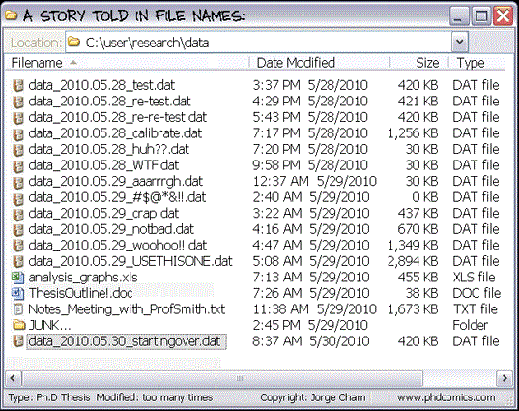
Is this familiar?
"Piled Higher and Deeper" by Jorge Cham www.phdcomics.com

Slide 3
Problems with this approach
Version history
Reproducible research
Screwing up is part of the process , but we’re afraid to destroy/lose work we’ve already done!
Collaboration
Everyone's crazy systems do not work well together
Gets out of sync very quickly
Can't tell what each person did without laborious manual documentation

Slide 4
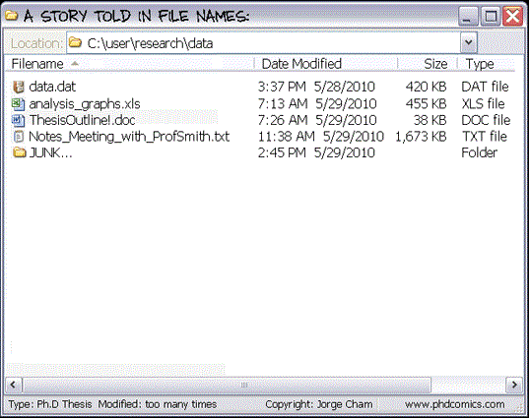
A better way… Version Control
OTHER VERSIONS
Message | Date | Size
Changed the setup | 4:29 PM 5/28/2010 | 421 KB
Second try | 5:43 PM 5/28/2010 | 420 KB
Calibrated the thing | 7:17 PM 5/28/2010 | 1,256 KB
"Piled Higher and Deeper" by Jorge Cham www.phdcomics.com
(image edited)

Slide 5
What is Git?
Git is distributed version control software.
Version control means it handles file versions
Distributed means everyone has a full copy of the repository, and all the information therein.
There is no ‘central’ database, by design.

Slide 6
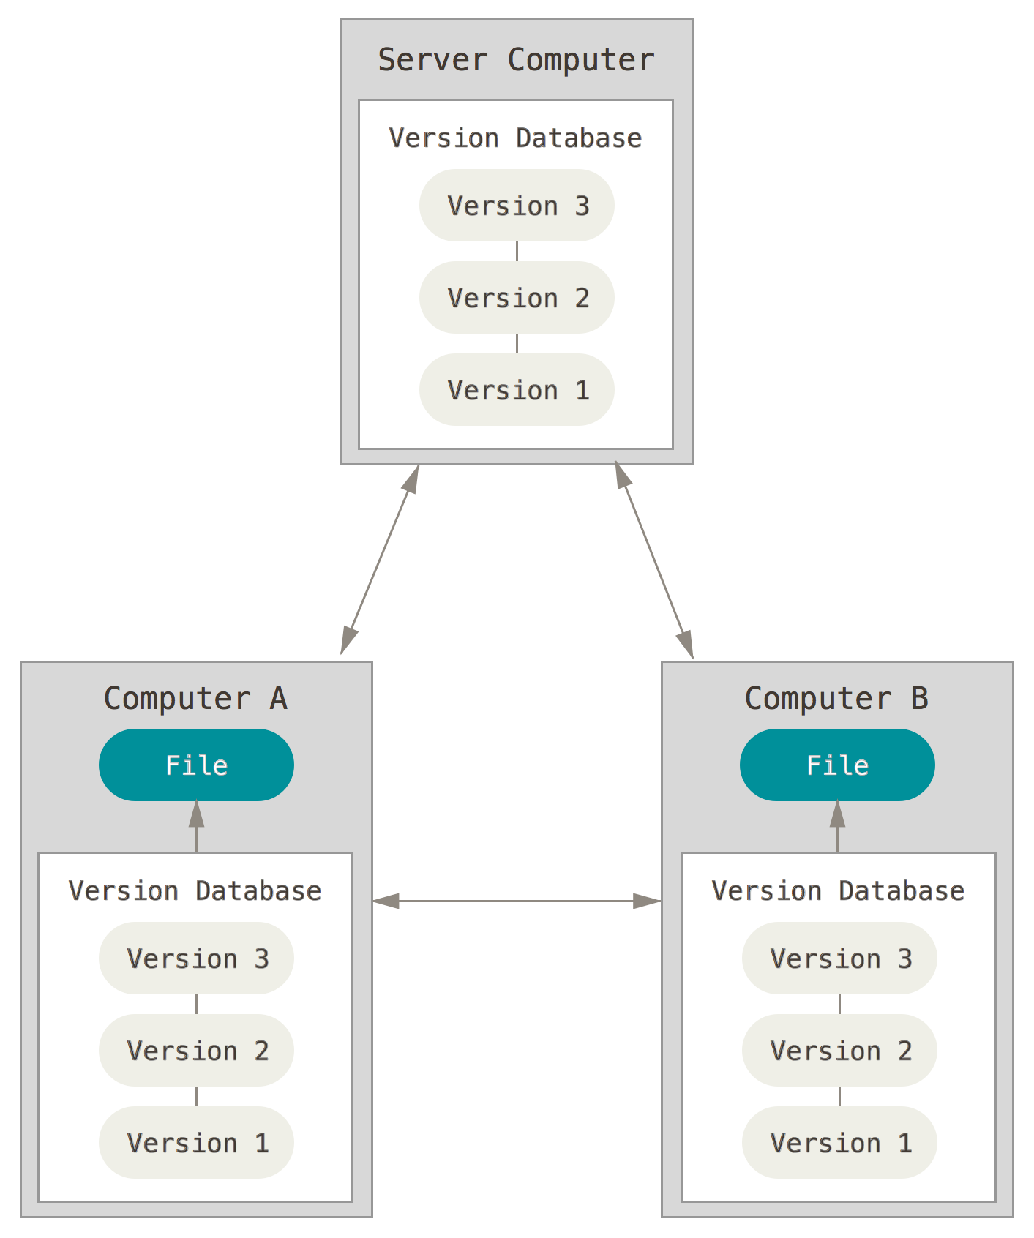
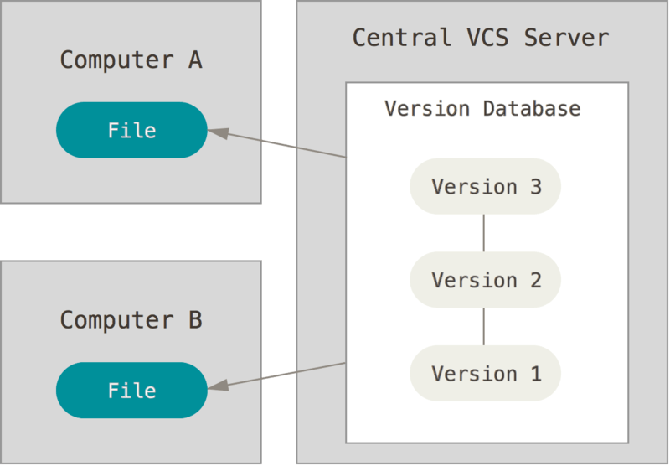
Centralized vs distributed model
Figures from the Git Book, used under CC-3.0: http://creativecommons.org/licenses/by/3.0/

Slide 7
The scope of this talk
The core concept of Git’s data model
How to do some basic operations in Git
I’ll briefly touch on more advanced topics like branching, merging, and working with remotes, but it’s beyond an introductory scope
Feel free to ask me some questions later!

Slide 8
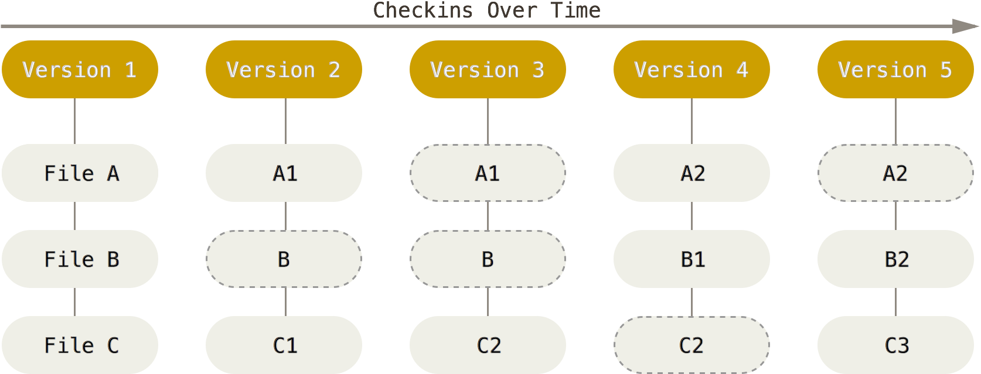
How Git works, the short version
Let’s start at version 1 with a set of files
Figure from the Git Book, edited, used under CC-3.0: http://creativecommons.org/licenses/by/3.0/

Slide 9
How Git works, the short version
We change files A and C and create a new version
File B didn’t change, so point to the old version of it.
Figure from the Git Book, edited, used under CC-3.0: http://creativecommons.org/licenses/by/3.0/

Slide 10
How Git works, the short version
We change C again, but not file A. We’ll keep pointing to version A1 of it.
Figure from the Git Book, edited, used under CC-3.0: http://creativecommons.org/licenses/by/3.0/

Slide 11
How Git works, the short version
Ad nauseum
Figure from the Git Book, used under CC-3.0: http://creativecommons.org/licenses/by/3.0/

Slide 12
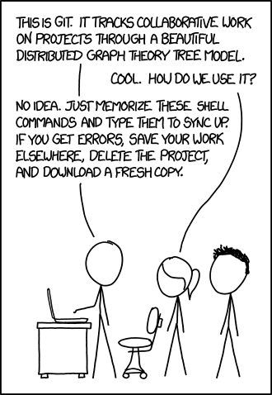
Is this familiar?
Tools are only as good as our ability to use them effectively!
Sometimes, Git is overkill
When it’s not…
Image courtesy of xkcd.com under CC-2.5: http://creativecommons.org/licenses/by-nc/2.5/

Slide 13
How Git works, the less-short version
To fully understand how Git works, you need to understand 3 types of objects:
Blobs (file data)
Trees (directory layout)
Commits (trees + metadata)

Slide 14
What’s under the hood? - blobs
At the most basic level, Git stores literal copies of files it is aware of. These are called blobs, and are stored in the .git folder.
.git/
If a file doesn’t change, we don’t need a new copy!

Slide 15
What’s under the hood? - trees
To point to different blobs and describe how they’re organized, we use trees. A tree is just a list of blobs and other trees. Think of them as directories.
Key point: trees do not contain blobs, they just point at them.
Blobs in .git/
tree1
tree2

Slide 16
What’s under the hood? - commits
A commit is the thing you’ll work with the most, but it’s just a special way to talk about a tree. A commit is a tree + metadata about that tree (what came before it, who authored the commit, etc.)

Slide 17
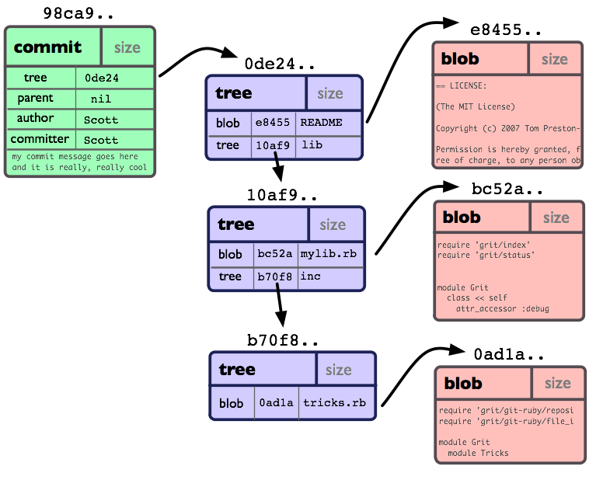
What’s under the hood? - commits
Figure from the Git Book, used under CC-3.0: http://creativecommons.org/licenses/by/3.0/

Slide 18
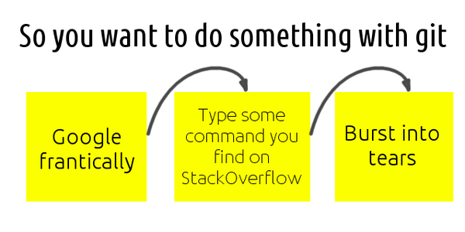
OK, so how do I actually do stuff in Git?

Slide 19
OK, so how do I actually do stuff in Git?
Always remember: the basic “unit” of a Git workflow is the commit
Commits
Figure from the Git Book, edited, used under CC-3.0: http://creativecommons.org/licenses/by/3.0/

Slide 20
OK, so how do I actually do stuff in Git?
When working with Git, commits are typically built in 3 steps:
Edit files (write code, etc.)
Tell git which files have changed
Tell git to save changes as a commit

Slide 21
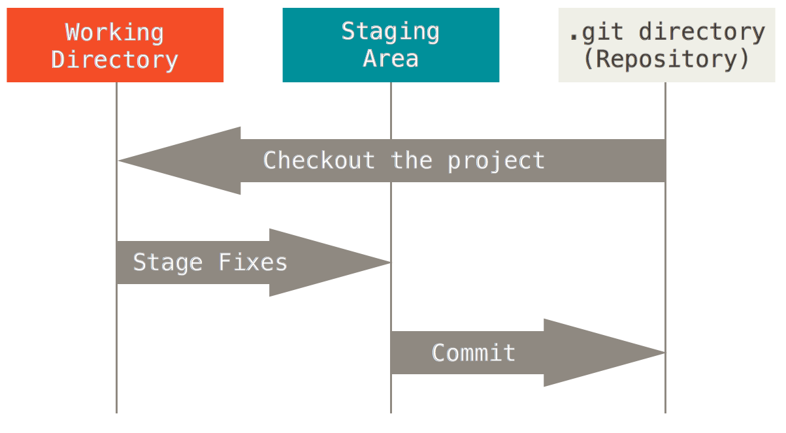
OK, so how do I actually do stuff in Git?
When working with Git, commits are typically built in 3 steps:
Figure from the Git Book, used under CC-3.0: http://creativecommons.org/licenses/by/3.0/

Slide 22
OK, so how do I actually do stuff in Git?
Running the git add filename command tells Git to ‘stage’ the specified file/directory
Figure from the Git Book, edited, used under CC-3.0: http://creativecommons.org/licenses/by/3.0/

Slide 23
OK, so how do I actually do stuff in Git?
Running the git commit command tells Git to compile all staged items into a commit
Figure from the Git Book, edited, used under CC-3.0: http://creativecommons.org/licenses/by/3.0/

Slide 24
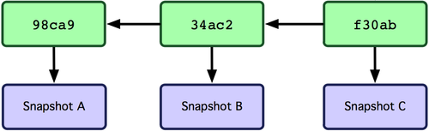
Commit history
Once you create a commit, it is stored in the database, and is likely the “newest version” of your repository.
Don’t forget, though, that Git’s database remembers what old commits looked like!
Time
Figure from the Git Book, used under CC-3.0: http://creativecommons.org/licenses/by/3.0/

Slide 25
What is GitHub?
Since Git is distributed, in order to share your work with others, you must distribute your repository to them.
…and for anyone to share their work with you, vice versa!
Typically, we want to store a repository somewhere to centralize all this pushing and pulling of repository data.

Slide 26
What is GitHub?
GitHub.com is just a free website that facilitates this exchange process
You, as the owner of a repository can make local changes and push them to GitHub (update the remote copy)
If I want to contribute to your work, I copy (fork) your repository, change it, and then request that you pull data from my repo

Slide 27
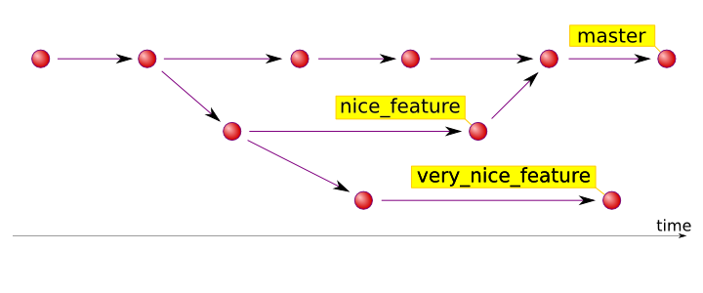
A tour of branches in Git
A branch is an object that points to a particular commit. There is always at least one branch, usually named “master.”
If we created a new commit, we’d move master ‘forward.’
Figure from http://hades.github.io/2010/01/git-your-friend-not-foe-vol-2-branches/

Slide 28
A tour of branches in Git
Here, we have a second branch called ‘nice_feature’ that tracks another set of commits.
Since the two branches diverge, we can work on one without changing the other, which is often beneficial to development.
Figure from http://hades.github.io/2010/01/git-your-friend-not-foe-vol-2-branches/

Slide 29
A tour of branches in Git
At some point, we want our new nice_feature to be integrated into the master branch’s code, too. Since their commits are separate, this is called merging the branches.
Figure from http://hades.github.io/2010/01/git-your-friend-not-foe-vol-2-branches/

Slide 30
A tour of branches in Git
Notice that a merge involves two parent commits, instead of one! There is a possibility of a conflict if we edit the same files.
Git is smart about merging, but sometimes you have to handle conflicts yourself.
Figure from http://hades.github.io/2010/01/git-your-friend-not-foe-vol-2-branches/

Slide 31
A tour of branches in Git
Notice that a merge involves two parent commits, instead of one! There is a possibility of a conflict if we edit the same files.
Git is smart about merging, but sometimes you have to resolve conflicts yourself!
Figure from http://hades.github.io/2010/01/git-your-friend-not-foe-vol-2-branches/

Slide 32
A tour of branches in Git
Of course, we’re not limited to two branches…
Figure from http://hades.github.io/2010/01/git-your-friend-not-foe-vol-2-branches/

Slide 33
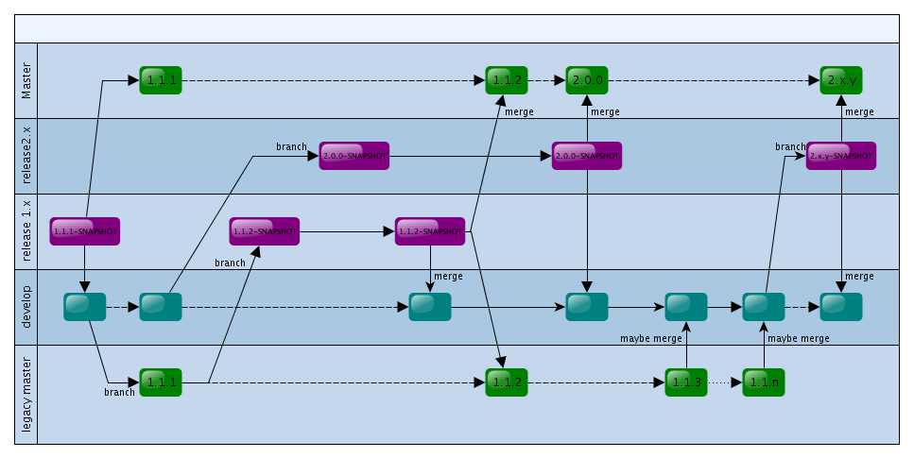
A tour of branches in Git
…or to merging only to one master branch
Image from OpenNCP project: https://openncp.atlassian.net/wiki/pages/viewpage.action?pageId=12812318

Slide 34
A tour of branches in Git
Punchline: commits can have more than one parent, which lets us branch off and create “alternative histories.”
If we want to merge these histories, we can use the same property of commits to do so.
These two facts together can create surprisingly powerful workflows
…but perhaps not ones you’ll use very often

Slide 35
Things I didn’t talk about
Setting up connections to remote repos
Reviewing history
We’ll do a little of this in our hands-on
‘Tagging’ commits
…
Git can do a lot, but you might not need it
Try typing ‘git help’ or add ‘--help’ to any cmd

Slide 36
Where to go to learn more
The Git Book – https://git-scm.com/book/
https://try.github.io
Interactive demos on branching http://pcottle.github.io/learnGitBranching
Tack ‘--help’ onto any command!
http://git-lectures.github.io/

Slide 37
Thank you!

Slide 38
Interactive demo
If you haven’t already, install git (or ssh to io)
https://git-scm.com/download
Make a directory called ‘gitdemo’
Open a terminal window and cd to the ‘gitdemo’ folder
On Windows: use the “git bash here” option in the right-click menu to open a terminal window

Slide 39
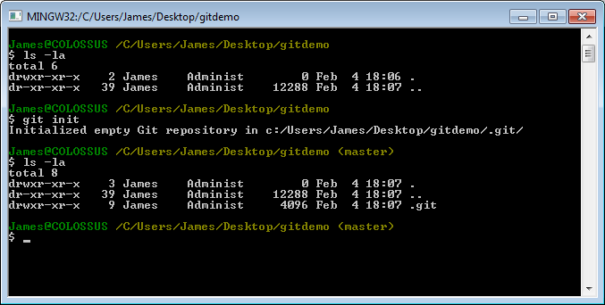
git init
Running git init will create a new repository in the .git/ folder.

Slide 40
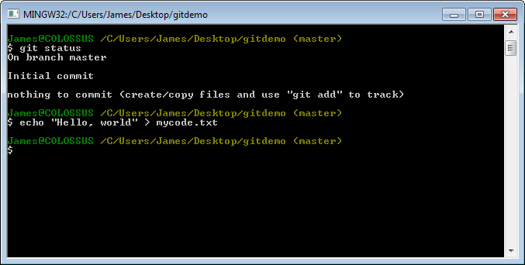
git add + git commit
Let’s create the file mycode.txt to represent some code

Slide 41
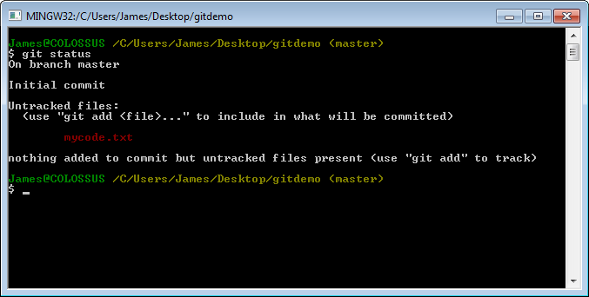
git add + git commit
Running git status, notice that git sees this file, but tells us it won’t be tracked

Slide 42
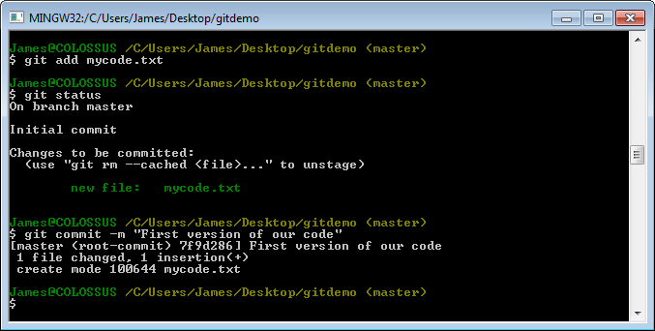
git add + git commit
So let’s tell it to track that file with git add and git commit the changes.

Slide 43
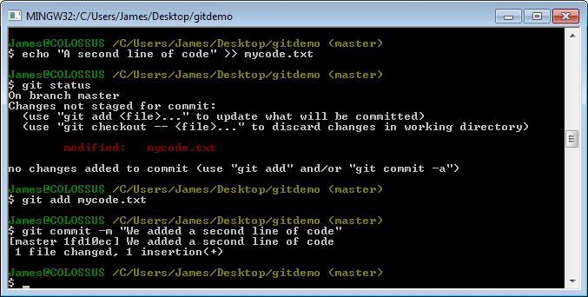
A second commit
Let’s edit the file and commit again
Notice we have to add again!

Slide 44
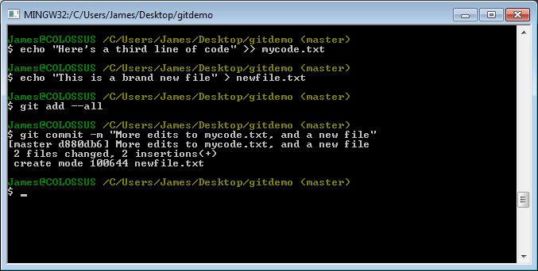
Adding files, deleting files
Let’s add a new file, edit the old one, and commit those changes.

Slide 45
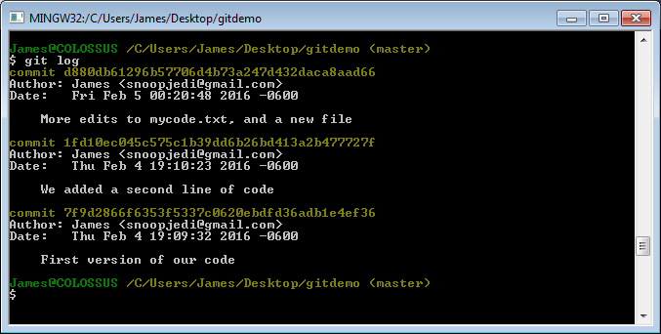
Viewing history
Once we’ve committed, we can check our history with git log

Slide 46
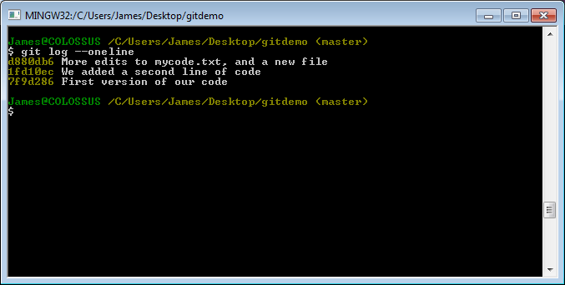
Viewing history
It’s usually easier to view the log with the option ‘--oneline’

Slide 47
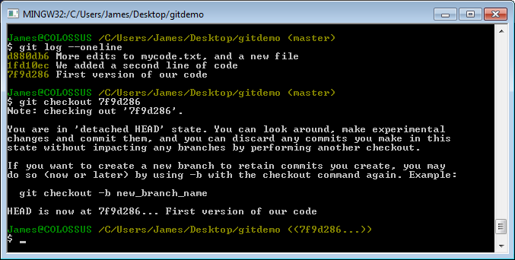
Time travel
If we want to look at an old commit, we can use git checkout

Slide 48
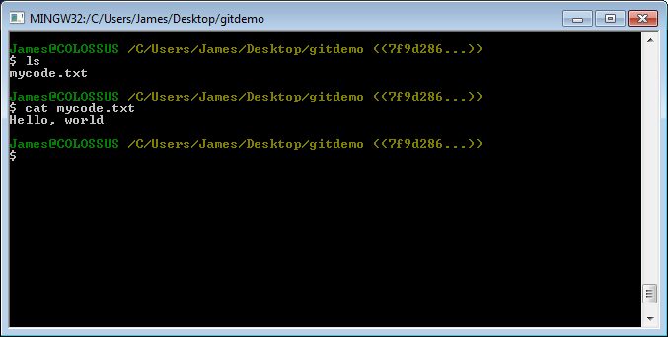
Time travel
If we want to look at an old commit, we can use git checkout

Slide 49
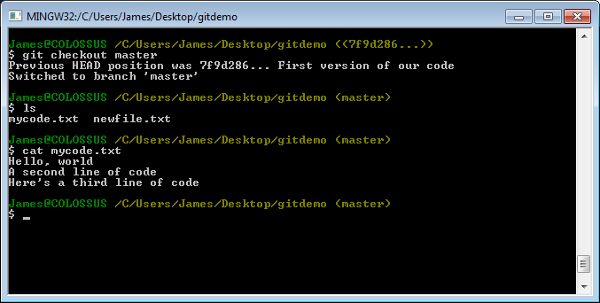
Time travel
To leave the detached HEAD state, we use git checkout to return to ‘master’

Slide 50
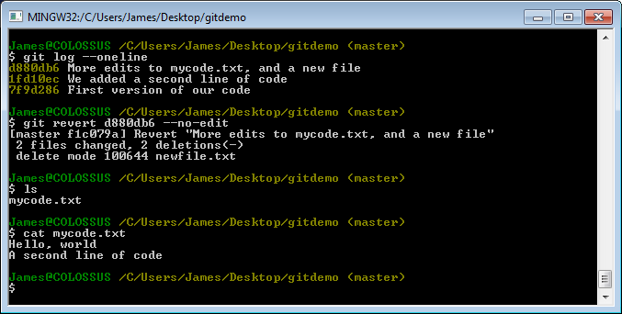
‘Undoing’ commits
Let’s use git revert to undo the changes one commit introduced.

Slide 51
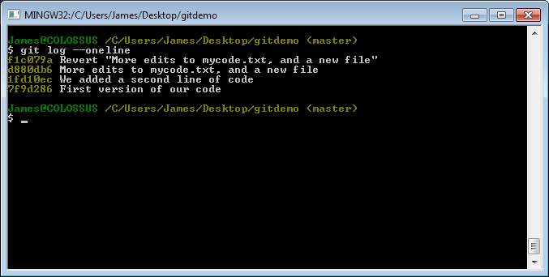
‘Undoing’ commits
git revert undoes changes, but it preserves history by making a new commit

Slide 52
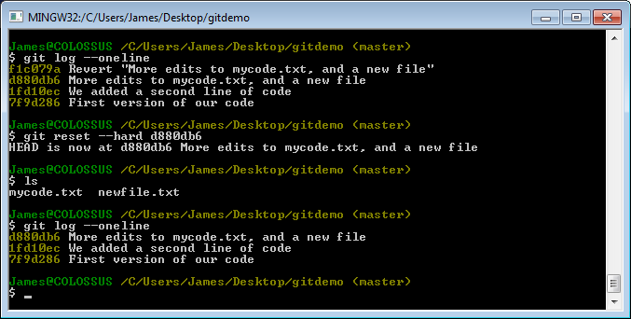
‘Undoing’ commits
Let’s undo the revert without preserving history, using git reset

Slide 53
‘Undoing’ commits
WARNING: since git reset destroys history, it’s usually bad for shared commits

Slide 54
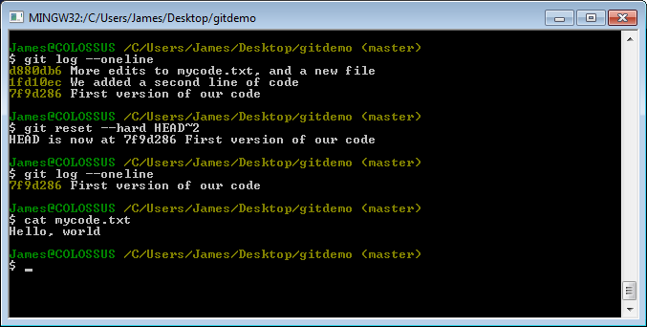
A handy shorthand for git reset
Using HEAD~N in git reset means “go to N commits behind where we are now”

Slide 55
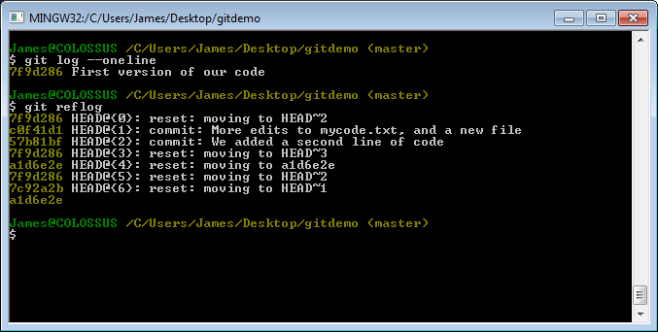
When git reset (or anything else) goes wrong
If you think you’ve lost a commit, don’t panic. Check git reflog

Slide 56
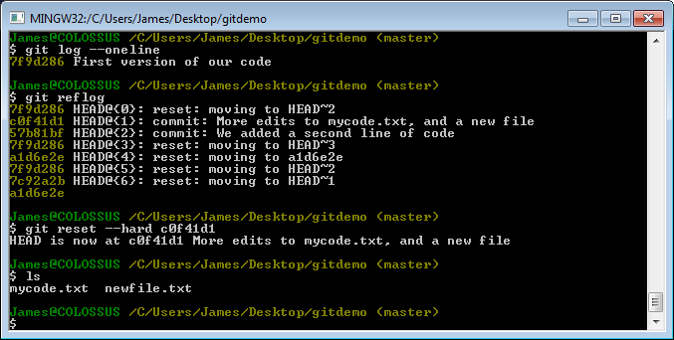
When git reset (or anything else) goes wrong
If the object is still in git reflog, we can get back to it with another git reset command.

