Slide 1

Computing Skills for Grad School
James Gerity
August 17, 2017
Slides available at http://www.github.com/jgerity/talks

Slide 2
Scope of this talk
More things to say than will fit in this talk, see the list of notes and reading material online.
And ask questions!
Programming is most rewarding as an auto-didactic process!

Slide 3
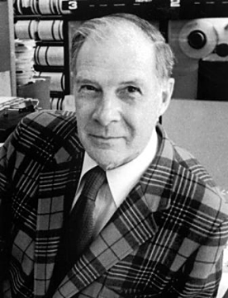
Computing’s purpose in science
“The purpose of computation is insight, not numbers” – Richard Hamming
By the way, intellectual property matters!
Image from Bell Labs courtesy Wikipedia under fair use
https://en.wikipedia.org/w/index.php?curid=40177109

Slide 4
Computing’s purpose in science
“Reproducibility and replication of studies are essential for the progress of science…The truth is computational science and engineering lacks an accepted standard of evidence.”
O. Mesnard and L. Barba, 2016 (arXiv:1605.04339)
The onus falls on you, the researcher!

Slide 5
The “fluffy” stuff
At the very least: keep different versions of simulations, data files, etc. in order
Version control software like git
(https://git-scm.com)
Remember Murphy’s Law and make backups (and test your recovery strategy)
Documentation matters: the poor sot who has to read your code in 6 months? It’s you.

Slide 6
IPython/Jupyter interface
A REPL is helpful when you want to type a handful of lines once, but not useful for long sessions
Jupyter notebooks allow the user to define “cells” of Python input which produce output, and can be run/edited arbitrarily.
Think Mathematica without the symbolic math

Slide 7
Writing code that doesn’t suck
Python makes it easier to write code that is simple to read
Enforced indentation and lack of braces helps
It doesn’t make writing bad code impossible!
Python’s PEP 8 is long, but has good guidelines
https://www.python.org/dev/peps/pep-0008/

Slide 8
The Zen of Python
When in doubt…
import this

Slide 9
Useful resources
CodeAcademy https://www.codecademy.com/learn/python
Scipy lectures https://scipy-lectures.github.io/
A long list of other resources available on GitHub, along with this presentation: https://github.com/jgerity/talks

Slide 10
Thank you!

Slide 11
Backup Slides

