Slide 1

Introduction to Python
James Gerity
September 1, 2016
Slides available at http://www.github.com/jgerity/talks

Slide 2
Scope of this talk
More things to say than will fit in this talk, see the list of notes and reading material online.
And ask questions!
Programming is most rewarding as an auto-didactic process!

Slide 3
What is Python?
Python in an interpreted programming language with dynamic typing

Slide 4
What is Python?
Python in an interpreted programming language with dynamic typing
Interpreted means instructions are “translated” from a high level to machine code

Slide 5
What is Python?
Python in an interpreted programming language with dynamic typing
The type of an object must be known to check validity of operations, optimize, etc. In Python, types are tracked dynamically, i.e. at runtime.
Contrast with static typing in e.g. C/C++ (declaring type with int, char, etc.)

Slide 6
What does a Python program look like?
The simplest Python programs fit on a single line.
python –c ‘print(“Hello world!”)’
Less trivial programs are stored in files (usually with the .py extension) and delimited by whitespace.
No {} to control ‘blocks’ in Python!

Slide 7
A second short program in Python
python loops_example.py
See online at https://repl.it/DEQG

Slide 8
A third program in Python
More complex programs make use of defined functions
python –i functions_example.py
See online at https://repl.it/DKCn

Slide 9
What is Python good for?
Development quality of life
More time writing easy to read code, quickly
Portability
As long as the target has a Python interpreter, we can run Python there!
Rich ecosystem
Great libraries exist for most common tasks

Slide 10
What is Python not good for?
In general, a Python program may be slower to execute than a similar program in another language (C/C++/Fortran).
How fast is “fast enough?” A few 100 ms of slowdown is usually worth it.
Best of both worlds: fast libraries for tasks that must go fast, with “glue code” in Python

Slide 11
Numeric types
int – integer with at least 32 bits precision
long – unlimited precision integer
boolean – truth value, True or False
float – a floating-point number (precision varies)
complex – complex number with floating point components
You can instantiate these quickly as (A+Bj)

Slide 12
Other types in Python
Object – the base type of any object. New classes generally inherit from this type.
str – a string like “I’m a string!”
list – a mutable sequence of values, [1,2,3]
tuple – an immutable sequence, (1,2,3)
dict – a mapping of keys and values
None – indicates no value
Many more types, full list available in the types module

Slide 13
Lists and tuples
Lists and tuples are linear sequences of objects, enumerated from 0.
Lists are mutable, meaning they can be changed. Contrast with immutable tuples.
Once a tuple is created, it never changes!

Slide 14
Exploring these types in REPL
Let’s explore each of these types using the Python interpreter’s REPL (Read, Eval, Print Loop)
python basictypes_example.py
https://repl.it/DJvj

Slide 15
Managing your Python environment
You will likely use libraries like numpy/scipy, astropy, matplotlib, pandas, hdf5.
pip and Anaconda are two excellent tools for managing what’s installed.
E.g. to install numpy: ‘pip install numpy’
Anaconda allows you to create separate collections of packages, for version conflicts, etc.

Slide 16
Three more Python Programs
Determining last Friday’s date
https://git.io/v6bXt
Reading data from a text file
https://git.io/viqsg
Brownian motion
http://scipy-cookbook.readthedocs.io/items/BrownianMotion.html

Slide 17
IPython/Jupyter interface
A REPL is helpful when you want to type a handful of lines once, but not useful for long sessions
Jupyter notebooks allow the user to define “cells” of Python input which produce output, and can be run/edited arbitrarily.
Think Mathematica without the symbolic math

Slide 18
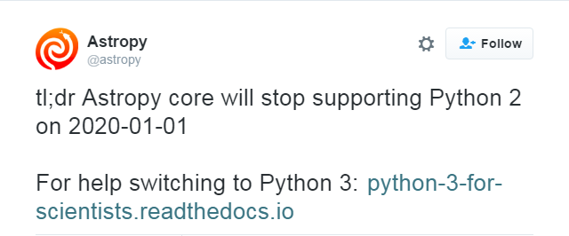
Python 2 vs Python 3
Integer division doesn’t do the intuitive thing in Python 2
Print function
Importing from __future__

Slide 19
Writing code that doesn’t suck
Python makes it easier to write code that is simple to read
Enforced indentation and lack of braces helps
It doesn’t make writing bad code impossible!
Python’s PEP 8 is long, but has good guidelines
https://www.python.org/dev/peps/pep-0008/

Slide 20
The Zen of Python
When in doubt…
import this

Slide 21
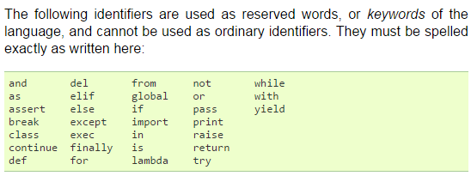
Things I didn’t mention…
A whole bunch of keywords

Slide 22
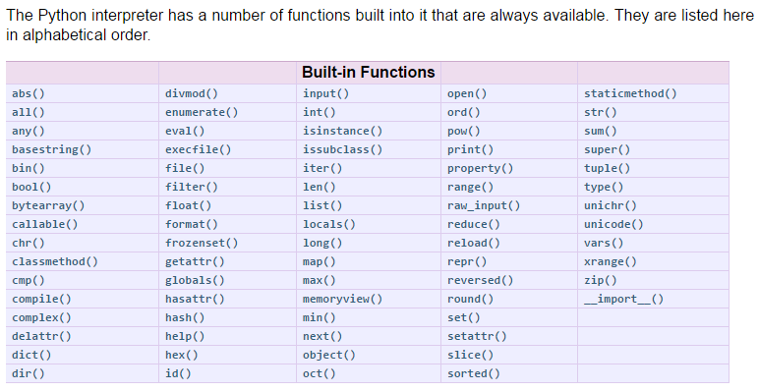
Things I didn’t mention…
A whole bunch of built-ins

Slide 23
Things I didn’t mention…
Classes and inheritance
What the hell is __name__?
Partial imports, module namespacing
from foo.bar import baz
String formatting
Iterables, generators
Decorators
Scope and closures

Slide 24
Things I didn’t mention…
Command line arguments
Debugging
Profiling
References (where are the pointers?!)
…
Perhaps you can tell me?

Slide 25
Useful resources
CodeAcademy https://www.codecademy.com/learn/python
Scipy lectures https://scipy-lectures.github.io/
A long list of other resources available on GitHub, along with this presentation: https://github.com/jgerity/talks

Slide 26
Thank you!

Slide 27
Feedback?

Slide 28
Backup Slides

Slide 29
First class functions
Functions in Python are first-class citizens, which means they can be passed around like any other variable
See firstclassfunctions_example.py for some examples of how this can be useful

Slide 30
Garbage collection
In C/C++ and others, memory is managed by the user. E.g. malloc() and free()
A lot of bugs happen in these steps.
In CPython, memory is handled by a private heap
Memory for an object is freed when there are no remaining references to that object.
Short version: if nobody can “point” to the object, the garbage collector knows to free it

