Slide 1

Computationally useful Python libraries: Numpy, SciPy, et al.
James Gerity
September 8, 2016
Slides available at http://www.github.com/jgerity/talks

Slide 2
Scope of this talk
We will not discuss plot/vis libraries here
matplotlib, bokeh, seaborn, plotly, ggplot, VTK
We will discuss libraries that make computational tasks easier.
There’s a lot more to cover than we have time for, so see the accompanying notes on GitHub

Slide 3
Built-ins
Fairly self-explanatory:
random, math, time, argparse
Data wrangling:
csv, xml, json, re
Quality of life:
itertools, os, sys, glob, pickle

Slide 4
Scipy
SciPy stack vs SciPy library
The stack is a collection of modules
The library is a set of numerical routines
The stack makes up a well-rounded target for basic scientific Python literacy

Slide 5
SciPy stack
http://www.scipy.org/stackspec.html
Python, Numpy, SciPy (library), Matplotlib, IPython, pandas, Sympy, nose

Slide 6
IPython/Jupyter (again)
http://try.jupyter.org/
Notebook interface
Terminal-in-a-cell trick

Slide 7
Numpy
N-D arrays are the basic type in numpy
A little bit like MATLAB vectors
Every array has a static datatype, so it can map to fast-executing code elsewhere.
Often, a “different” version of an array (e.g. a slice) is actually a view of the same data.

Slide 8
Numpy
Crash-course notebook intro to numpy: https://git.io/vi4sE
Lots more info in official docs

Slide 9
Misc. Numpy tips
ndarray.shape - one-stop shop for info on what an array looks like
Arithmetic operations default to elementwise. I.e. A*B does not mean inner product! Use numpy.dot() instead.
Useful functions: arange, linspace, eye, ones, zeros

Slide 10
Misc. Numpy tips
Division by zero, inf, NaN…
Array slicing using numpy.where etc.

Slide 11
Misc. Numpy tips
Broadcasting allows for operations using arrays of different shape, if they are the same size along one axis.
Try: np.arange(0,5) * np.eye(10).reshape(20,5)
Good write-up of broadcasting: http://scipy.github.io/old-wiki/pages/EricsBroadcastingDoc

Slide 12
SciPy library
Where numpy is all about shuffling arrays…
“SciPy is a collection of mathematical algorithms and convenience functions built on the Numpy extension of Python.”

Slide 13
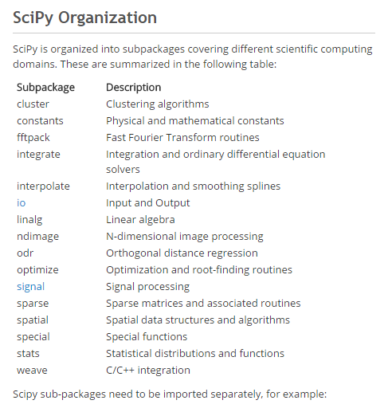
SciPy subpackages
tl;dr – there are a ton of them!
These are the ones we’ll talk about.

Slide 14
scipy.integrate
Simple example of integration
Brief discussion of options
Special callout of odeint

Slide 15
scipy.optimize
Multiple minimization algorithms
Fitting example from cookbook: http://scipy-cookbook.readthedocs.io/items/FittingData.html
Optimization is a very tricky subject, so be careful!
…but for common problems, this will do well
Non-linear solvers callout

Slide 16
scipy.signal
A variety of tools for splining and filtering of 1D/2D data
Chirp generation
Low/high/bandpass filter example (see cookbook)
Also of interest is scipy.fftpack, which has FFT / DCT / DST transform implementations.

Slide 17
scipy.stats
Large number of available distributions for sampling random variables
Some statistical tests, methods
http://www.scipy-lectures.org/packages/statistics

Slide 18
SciPy library
Tons of examples in the cookbook:
http://scipy-cookbook.readthedocs.io/
Full documentation:
http://docs.scipy.org/doc/scipy-0.18.0/reference/

Slide 19
Pandas
Basic structure: data frame
Like R, but in Python!

Slide 20
h5py

Slide 21
Astropy
Leo?

Slide 22
Thank you!

Slide 23
Backup Slides

Slide 24
Symbolic libraries: SymPy / Sage

Slide 25
Nose

Slide 26
Profiling (cProfile + ???)
If code is slow, the first step to going faster is knowing where and then why it is slow
You could spend hours optimizing a routine that wasn’t slow to begin with!

Slide 27
Numba
Going fast, but not a cure-all
JIT compilation
Numpy support
Vectorizing functions

Slide 28
Cython

