Slide 1
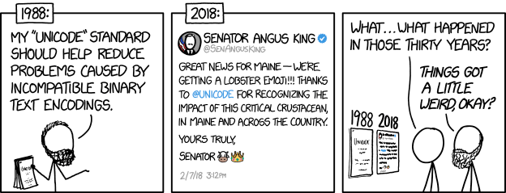
unicodedata
Image from XKCD (CC-BY 2.5)

Slide 2
unicodedata
or: How I Learned to Stop Worrying and Love the Unicode Standard
Image from XKCD (CC-BY 2.5)

Slide 3
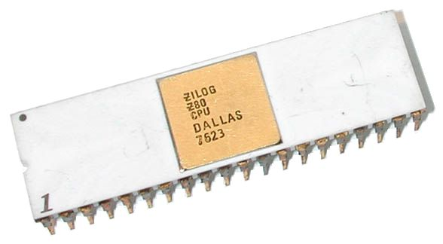
First: what even is text?!
A: there ain’t no such thing
Computers are built around numerical data (integers or bytes)
  All the way down to the hardware!
Image from Wikimedia Commons (CC-BY 2.5)

Slide 4
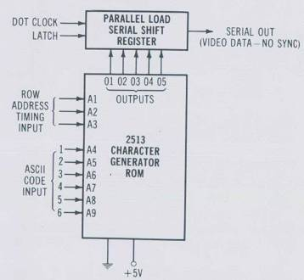
First: what even is text?!
Once upon a time, computers had entire chips dedicated to generating text characters!
Image from AtariArchives.org (fair use)

Slide 5
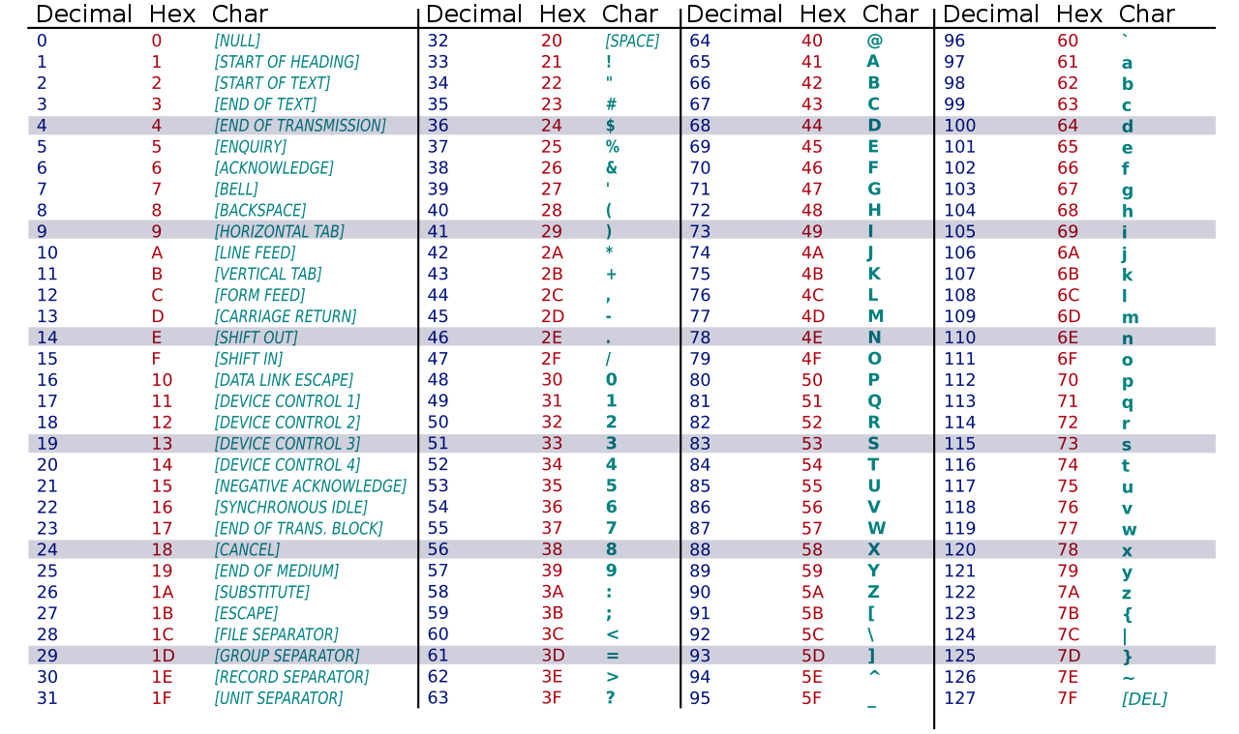
First: what even is text?!
So, we’ll define a coding that associates characters with numbers (i.e. “codes”)
  e.g. ASCII
  The IANA maintains an incomplete* list of these
*258 listed, but there are more!
Image from Wikimedia Commons (public domain)

Slide 6

English: not the only language in the world!
Wouldn’t it be great if there were a universal coding for text?
Image from XKCD (CC-BY 2.5)

Slide 7
What is Unicode?
In 1987, Joe Becker and others proposed a “wide-body ASCII” using more bits per code in order to represent many more characters
This idea eventually became the Unicode Standard
  1,114,112 “code points”
  149,186 of which are “assigned”

Slide 8
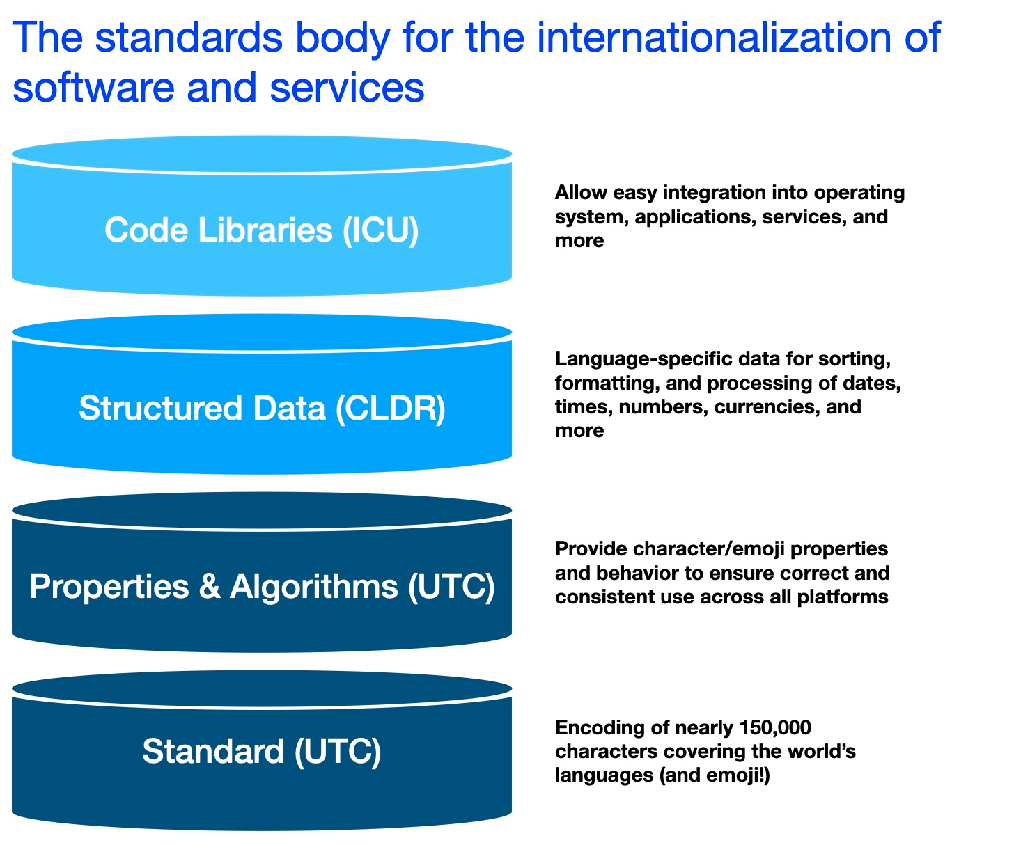
Unicode vs. Unicode Consortium?
Aside: when people say “Unicode”, they usually are referring to the Unicode Standard…
...but the name can also refer to the Unicode Consortium and its other work
Image from unicode.org (fair use)

Slide 9
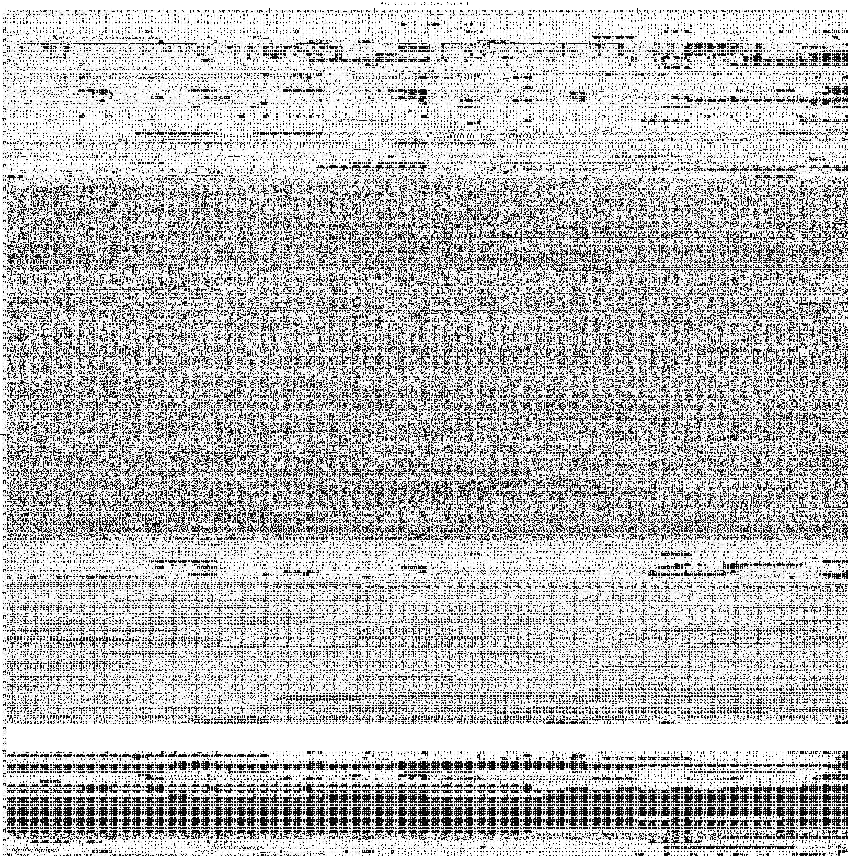
What is Unicode?
The Unicode Standard
  Lots of space for growth
  Encodings (numbers → bytes transformations) try to be compatible with other codings when possible
  e.g. UTF-8 is fully compatible with ASCII
Image from Wikimedia Commons (public domain)

Slide 10
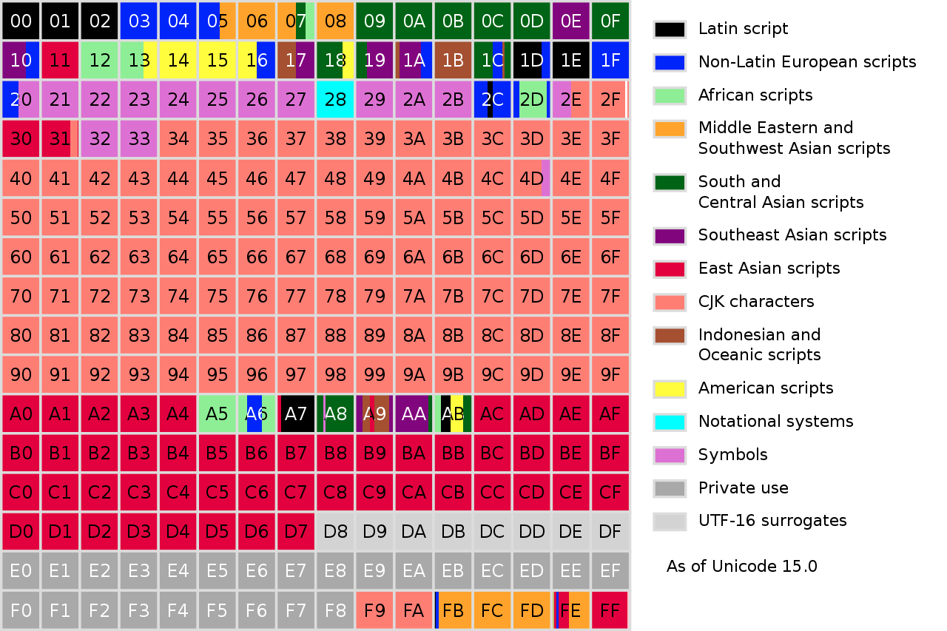
What is Unicode?
The Unicode Standard
  Has internal units of organization (planes, blocks, etc.)
  Previous slide is one plane out of 16!
Image from Wikimedia Commons (public domain)

Slide 11
What is Unicode?
The Unicode Character Database (UCD)
  Extra data associated with the characters defined by the Unicode Standard
  This data has (some) information about the meaning of the characters
…way simpler than you might think
  Basically a bunch of text files!

Slide 12
What is Unicode?
The UCD gives us information about each character:
  Name
  Category
  Properties
    e.g. numerical information
  Information about how this character interacts with other characters (e.g. is it a “combining” character?)
  …and more!

Slide 13
What is unicodedata?
A module wrapped around Unicode’s data files
  Note: only updates when Python does!
Most of the functions are named for their UCD counterparts
  e.g. unicodedata.category() tells us about the category of the given codepoint

Slide 14
What is unicodedata?
lookup()
name()
decimal(), digit(), numeric()
  These aren’t all the same concept!
category()
normalize()

Slide 15
unicodedata: examples
Get the name of a character
Lookup a character by name
Find all of the numerical characters in Unicode

Slide 16
unicodedata: normalization
“ça va” vs. “ça va?”
How do we compare strings that “look the same” to a human being, but which are distinct?
  There’s a Unicode guideline for that!
  Several normalization forms defined
Equivalent identifiers in Python
  パイソン and ﾊﾟｲｿﾝ are the same Python name
  This is actually a Unicode rule!

