Slide 1

Computationally useful Python libraries: Numpy, SciPy, et al.
James Gerity
September 12, 2016
Slides available at http://www.github.com/jgerity/talks

Slide 2
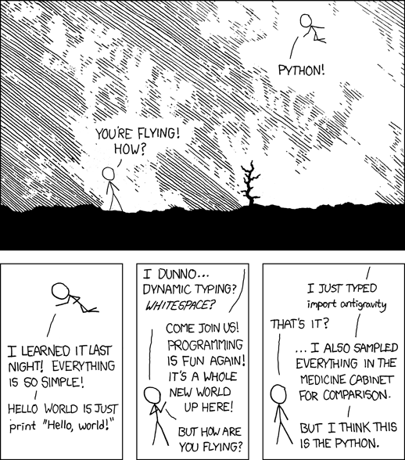
The power of Python modules
Image from http://xkcd.com/353 under CC BY-NC 2.5

Slide 3
Scope of this talk
We will not discuss plot/vis libraries here
matplotlib, bokeh, seaborn, plotly, ggplot, VTK
We will discuss libraries that make computational tasks easier.
There’s a lot more to cover than we have time for, so see the accompanying notes on GitHub

Slide 4
Built-ins
Some fairly self-explanatory ones:
random, math, time, argparse
Data wrangling:
csv, xml, json, re
Quality of life:
itertools, os, sys, glob, pickle, collections

Slide 5
Scipy
SciPy stack vs SciPy library
The stack is a collection of modules
The library is a set of numerical routines
The stack makes up a well-rounded target for basic scientific Python literacy

Slide 6
SciPy stack
http://www.scipy.org/stackspec.html
Python, Numpy, SciPy (library), Matplotlib, IPython, pandas, Sympy, nose

Slide 7
IPython/Jupyter (again)
http://try.jupyter.org/
Notebook interface
Terminal-in-a-cell trick

Slide 8
Numpy
N-D arrays are the basic type in numpy
A little bit like MATLAB vectors
Every array has a static datatype, so it can map to fast-executing code elsewhere.
Often, a “different” version of an array (e.g. a slice) is actually a view of the same data.

Slide 9
Numpy
Crash-course notebook intro to numpy: https://git.io/vi4sE
Lots more info in official docs

Slide 10
Misc. Numpy tips
ndarray.shape - one-stop shop for info on what an array looks like
Arithmetic operations default to elementwise. I.e. A*B does not mean inner product! Use numpy.dot() instead.
Useful functions: arange, linspace, eye, ones, zeros

Slide 11
Misc. Numpy tips
Division by zero, inf, NaN…
Array slicing using numpy.where etc.
Saving/loading arrays to/from files

Slide 12
Misc. Numpy tips
Broadcasting allows for operations using arrays of different shape, if they are the same size along one axis.
Try: np.arange(0,5) * np.eye(10).reshape(20,5)
Good write-up of broadcasting: http://scipy.github.io/old-wiki/pages/EricsBroadcastingDoc

Slide 13
SciPy library
Where numpy is all about shuffling arrays…
“SciPy is a collection of mathematical algorithms and convenience functions built on the Numpy extension of Python.”

Slide 14
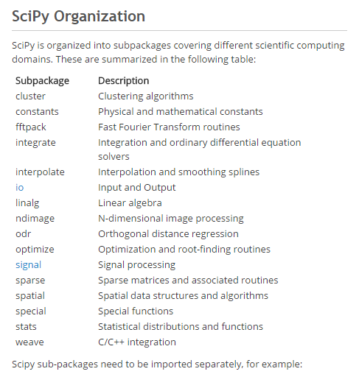
SciPy subpackages
tl;dr – there are a ton of them!
These are the ones we’ll talk about.

Slide 15
scipy.integrate
Simple example of integration
Brief discussion of options
Special callout of odeint

Slide 16
scipy.optimize
Multiple minimization algorithms
Fitting example from cookbook: http://scipy-cookbook.readthedocs.io/items/FittingData.html
Optimization is a very tricky subject, so be careful!
…but for common problems, this will do well
Non-linear solvers callout

Slide 17
scipy.signal
A variety of tools for splining and filtering of 1D/2D data
Chirp generation
Low/high/bandpass filter example (see cookbook)
Also of interest is scipy.fftpack, which has FFT / DCT / DST transform implementations.

Slide 18
scipy.stats
Large number of available distributions for sampling random variables
Some statistical tests, methods
http://www.scipy-lectures.org/packages/statistics

Slide 19
SciPy library
Tons of examples in the cookbook:
http://scipy-cookbook.readthedocs.io/
Full documentation:
http://docs.scipy.org/doc/scipy-0.18.0/reference/

Slide 20

Pandas
PANDAS
Basic structure: data frame
Like R, but in Python!
10 minutes to pandas: http://pandas.pydata.org/pandas-docs/version/0.18.1/10min.html

Slide 21
Astropy
!
I’M NOT AN ASTRONOMER
¯\_(ツ)_/¯
Astropy consists of a core package with common functionality:
units and constants
Juggling coordinate systems with multiple frames, units, etc. Seems to be mostly done with SkyCoord
Working with FITS files (astropy.io.fits)
Fitting/modeling routines (looks WIP)

Slide 22
Astropy
!
I’M NOT AN ASTRONOMER
¯\_(ツ)_/¯
There are also “affiliated” packages that provide additional functionality:
astroquery: convenience library for accessing online databases, e.g. Simbad, SDSS,…
ccdproc: for reducing raw CCD data
spectral_cube
halotools: tools for study/simulation of halos
…

Slide 23
Thank you!

Slide 24
Backup Slides

Slide 25
h5py

Slide 26
Symbolic libraries: SymPy / Sage

Slide 27
Nose

Slide 28
Profiling (cProfile + ???)
If code is slow, the first step to going faster is knowing where and then why it is slow
You could spend hours optimizing a routine that wasn’t slow to begin with!

Slide 29
Numba
Going fast, but not a cure-all
JIT compilation
Numpy support
Vectorizing functions

Slide 30
Cython

