Slide 1


Progress report on PIC simulations of a neutralized electron beam
James Gerity, Texas A&M University
October 20, 2016
Slides available at http://www.github.com/jgerity/talks

Slide 2
Nuclear physics questions to be answered
How are the sea quarks and gluons, and their spins, distributed in space and momentum inside the nucleon?
Where does the saturation of gluon densities set in?
How does the nuclear environment aﬀect the distribution of quarks and gluons and their interactions in nuclei?
See 2014 community whitepaper “Electron Ion Collider: The Next QCD Frontier” (arXiv:1212.1701)

Slide 3
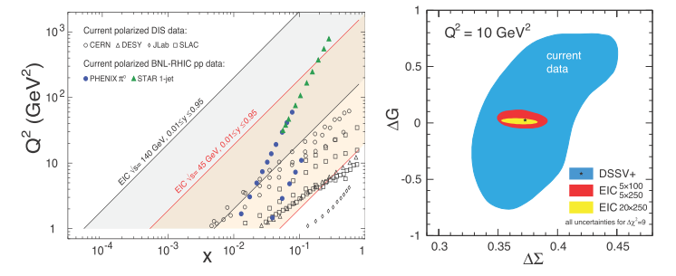
Why build an EIC?
An electron-ion collider with access to heavy ions and polarized spin would provide powerful probes of QCD
Accessible $Q^{2}$ with different parameter regimes
Uncertainties on gluon and quark helicity contributions to the proton spin
Figure from 2014 community whitepaper “Electron Ion Collider: The Next QCD Frontier” (arXiv:1212.1701)

Slide 4
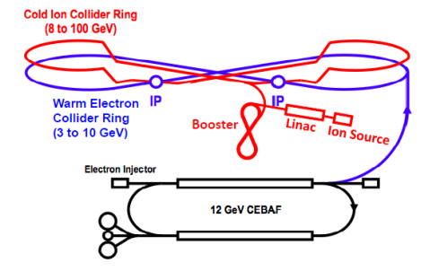
What is JLEIC?
Jefferson Lab’s EIC design
Fig. 8 geometry preserves spin polarization naturally
Figure from 2014 community whitepaper “Electron Ion Collider: The Next QCD Frontier” (arXiv:1212.1701)

Slide 5
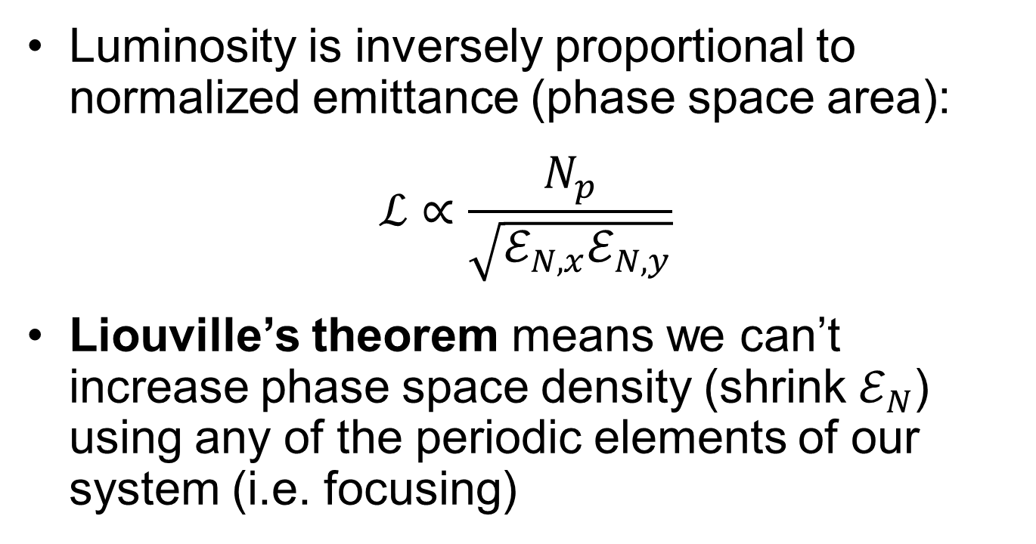
Electron cooling
Luminosity is inversely proportional to normalized emittance (phase space area):
$$ℒ∝\frac{N_{p}}{\sqrt{ℰ_{N,x}ℰ_{N,y}}}$$
Liouville’s theorem means we can’t increase phase space density (shrink $ℰ_{N}$) using any of the periodic elements of our system (i.e. focusing)

Slide 6
Electron cooling
In any accelerator, our beam of particles has a finite velocity spread.
Ion beam seen from stationary (lab) frame

Slide 7
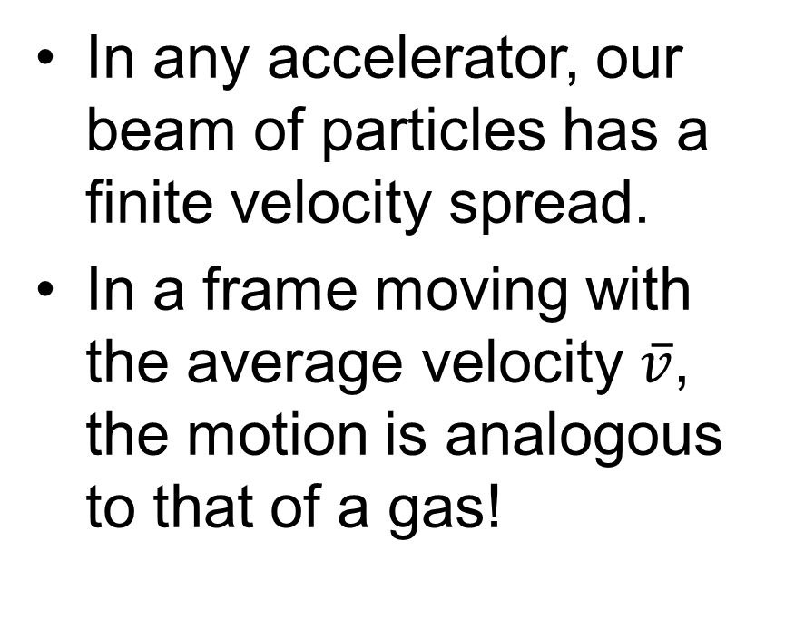
Electron cooling
In any accelerator, our beam of particles has a finite velocity spread.
In a frame moving with the average velocity $\overline{v}$, the motion is analogous to that of a gas!
Ion beam seen from moving frame

Slide 8
Electron cooling
How to cool a gas? Mix with a colder one!
Coulomb collision with ‘cold’ electrons drives velocity profiles to equilibrium
Ion beam seen from stationary (lab) frame
Ion beam seen from moving frame, with electrons

Slide 9
Motivation
Both EIC projects have novel electron cooling concepts
Many challenging R&D tasks are involved!
Conventional cooling is part of the baseline of both JLEIC and eRHIC
Any improvements to cooling would be beneficial
RadiaSoft and TAMU collaboration

Slide 10
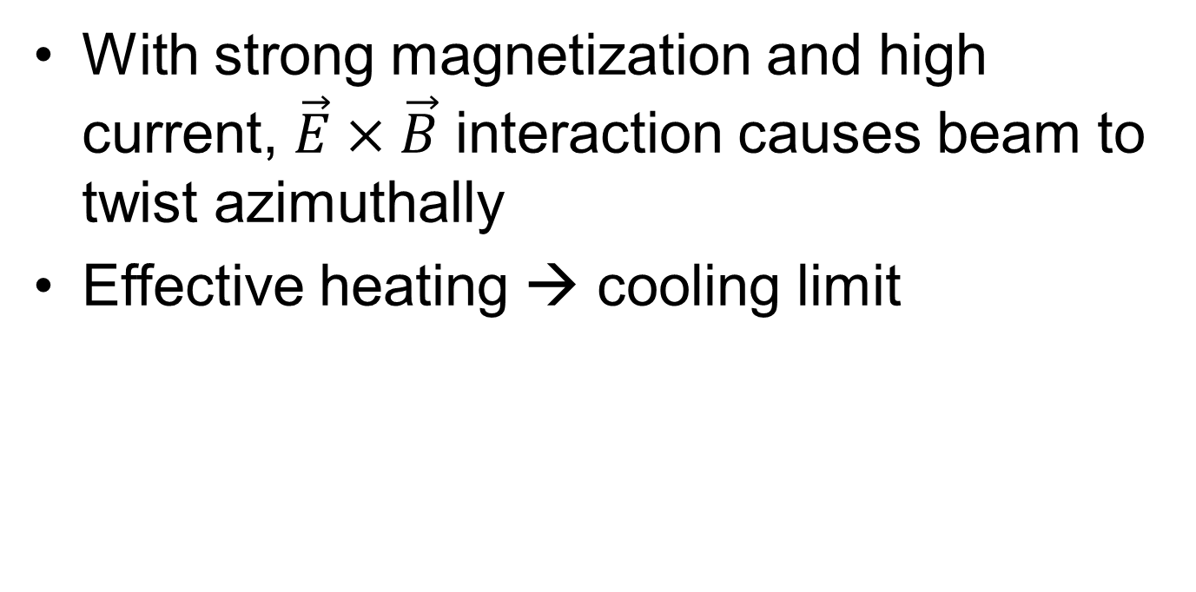
Space charge drift limit
With strong magnetization and high current, $\vec{E}×\vec{B}$ interaction causes beam to twist azimuthally
Effective heating → cooling limit

Slide 11
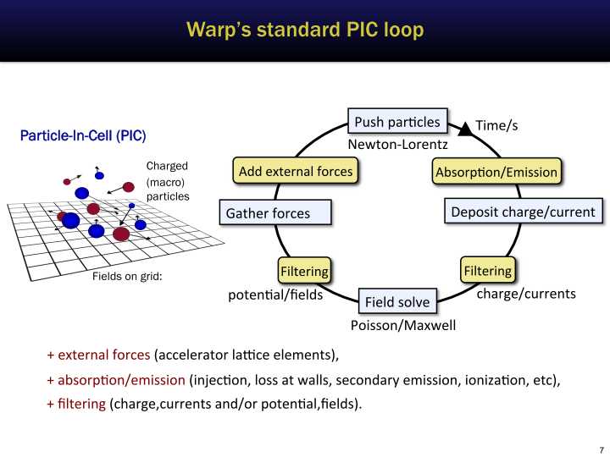
Slide courtesy of J.L. Vay from https://people.nscl.msu.edu/~lund/uspas/scs_2016/

Slide 12
Misc. development
Tools for working with Warp:
Extracting particle data from HDF5 files, converting velocities to angles, etc.
Ionization class extension, allowing arbitrary emission energies
Diagnostic output of fields/particles according to OpenPMD specification for offline analysis

Slide 13
Simulation parameters
116 keV electron beam, 10 mA
1 meter drift as domain
Background H₂ gas with realistic ionization cross-section
In this work, density chosen to observe compensation reasonably quickly
Available on GitHub
https://github.com/radiasoft/rscooler/

Slide 14
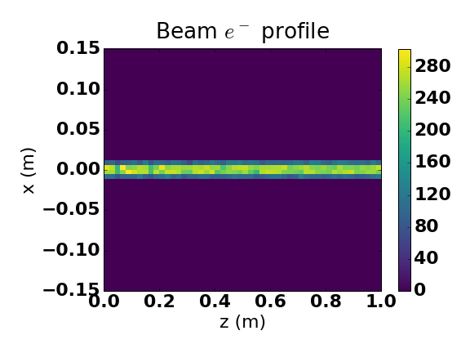

Slide 15
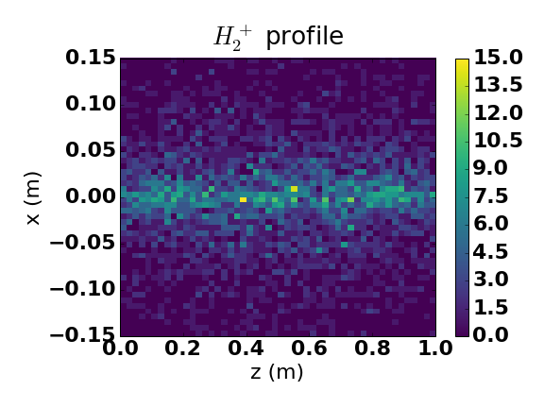

Slide 16
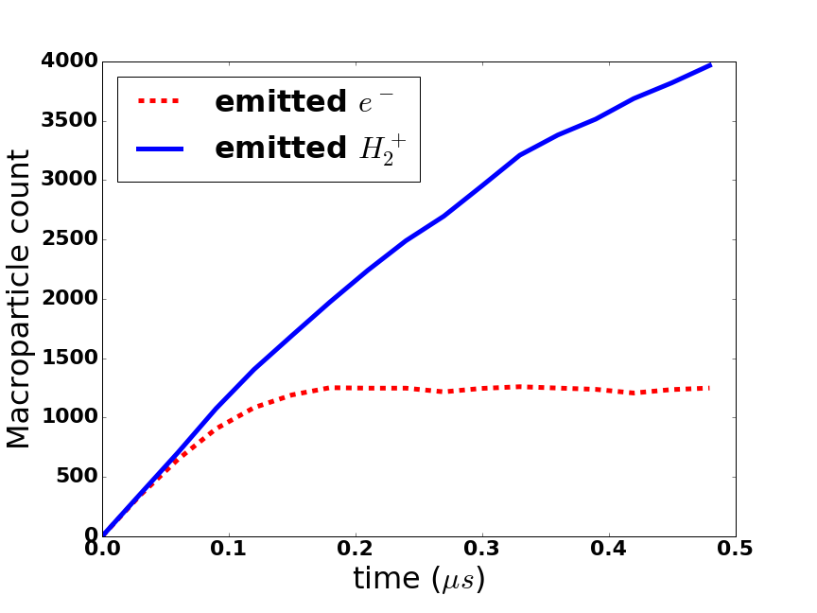

Slide 17
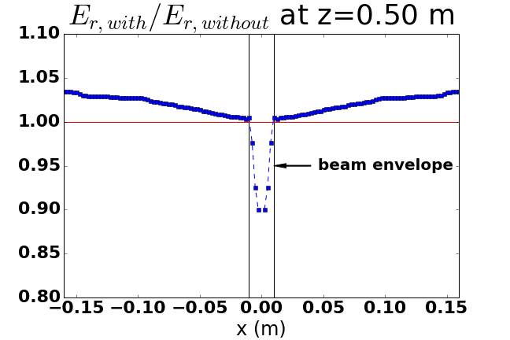
Field suppression at center of beam

Slide 18
Further work
Scale up current, aiming for ~ Ampere
Use of NERSC likely
Replicate Fermilab beam properties
Quantify dynamic friction for use in long-term study
Study effects of solenoid alignment error

Slide 19
Thank you!

Slide 20
Backup Slides

