Slide 1

Plotting in Python
James Gerity
September 28, 2016
Slides available at http://www.github.com/jgerity/talks

Slide 2
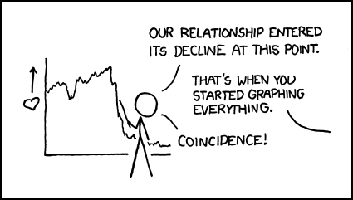
Scope of this talk
matplotlib, seaborn, Bokeh, ggplot
Image from https://xkcd.com/523/ under CC BY-NC 2.5

Slide 3
A brief rant on colormaps
Colormap matters! A poor choice can…
…create perceptual artifacts in data
…be a nightmare to print (→ grayscale conv!)
…screw with colorblind readers
…most importantly, be ugly

Slide 4
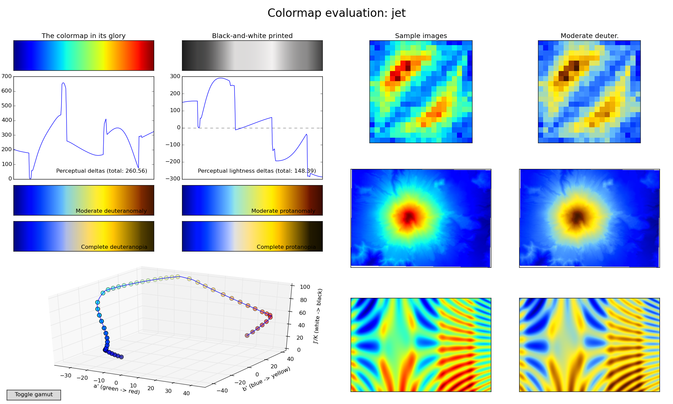
A “bad” choice: Jet
Figure from https://bids.github.io/colormap/

Slide 5
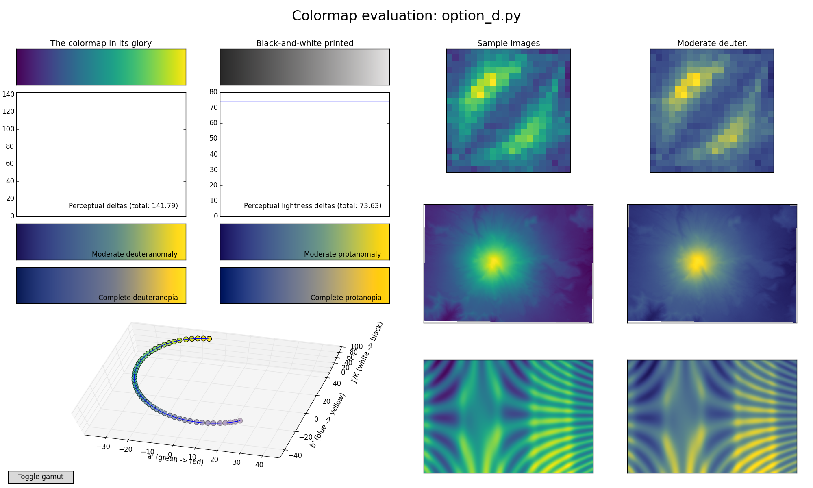
A “good” choice: Viridis
Figure from https://bids.github.io/colormap/

Slide 6
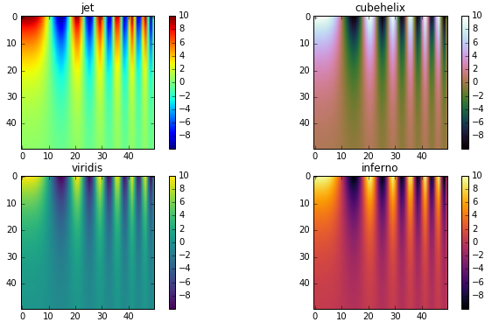
Also “good”: cubehelix, inferno
Figure adapted from http://jakevdp.github.io/blog/2014/10/16/how-bad-is-your-colormap/

Slide 7
matplotlib
Module structure:
matplotlib top-level: graphics backend control, default parameters
pyplot: MATLAB-like plotting framework and probably already your BFF
cm: predefined colormaps and tools for making your own
…and lots of minutiae

Slide 8
matplotlib
Imperative vs declarative graphics
Inline magic for IPython
Gridspec trickery: http://matplotlib.org/users/gridspec.html

Slide 9
Anatomy of a matplotlib figure
…in the form of a matplotlib figure!
https://github.com/rougier/figure-anatomy

Slide 10
matplotlib examples
Line/scatter
histogram
imshow/contour
XKCD style
Swag examples, including annotation (LaTeX callout)

Slide 11
seaborn
At minimum: nicer styling than matplotlib defaults…
At best: save yourself from reinventing the same wheel over and over and over…
Heatmap, joint plot

Slide 12
bokeh
Interactive graphs for the web
With server backend, can produce very sophisticated interactions
But even without, can provide nice dataset exploration tools

Slide 13
Other libraries of interest
ggplot, mpld3, datashader

Slide 14
Thank you!

Slide 15
Backup Slides

