Slide 1

Regular Expressions
James Gerity
Jan 26, 2017
Slides available at http://www.github.com/jgerity/talks

Slide 2
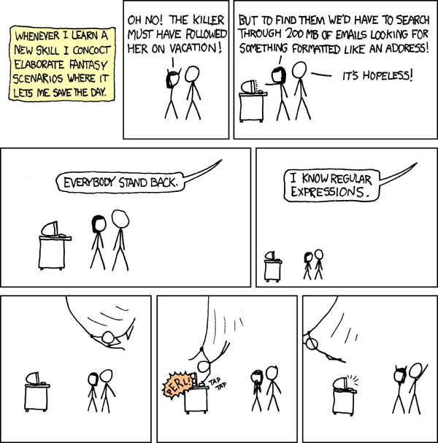
Scope of this talk
Learn to do this…
Image from https://xkcd.com/208/ under CC BY-NC 2.5

Slide 3
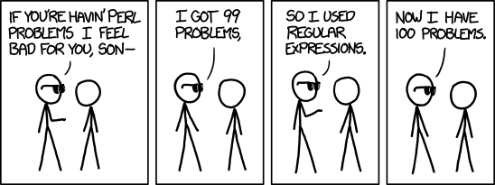
Scope of this talk
…without falling prey to this
Image from https://xkcd.com/1171/ under CC BY-NC 2.5

Slide 4
Scope of this talk
What are regular expressions?
What are regular expressions used for?
How are regular expressions used with some common tools?
Hands on!

Slide 5
What are regular expressions (regex)?
Many operations boil down to searching for strings and then Doing Something™ (printing, replacing, etc.) with that string
Wikipedia: “A regular expression…is an expression used to specify a set of strings”

Slide 6
What are regular expressions?
Simplest way is to list each member of the set:
/grey|gray/ defines the set containing the strings “grey” and “gray”
Metacharacters let us be more concise:
/gr[ea]y/ and /gr(e|a)y/ define the same set of strings!

Slide 7
What are regular expressions?
Metacharacters let us describe large sets of strings based on their structure
/Galile./ matches “Galileo,” “Galilei”, but also “Galilea,” “Galile%”, and so on using the ‘.’ metacharacter, which stands for any single character.

Slide 8
What are regular expressions?
Metacharacters let us describe large sets of strings based on their structure
/Galile.*/ matches “Galile, Galileo, Galilei, Galileo Galileo, Galileo Galilei,” etc. using the ‘*’ character, which matches any number of repeats

Slide 9
Metacharacters
. | Any character | ( ) | A group for nesting expressions
[ ] | Group of chars to match: [xXy] matches ‘x,’ ‘X’ or ‘y’ | \1, \2, etc. | A reference to the nth group
[^ ] | Group of chars not to match | * | Match the preceding element 0 or more times
^ | Matches the start of the string | {m, n} | Match the preceding element at least m times, at most n
$ | Matches the end of the string | ? | Match the preceding 0 or 1 time
| | Boolean OR | + | Match the preceding 1 or more times
Any of these can be matched literally by escaping them, e.g. \*

Slide 10
What are regular expressions useful for?
Searching for a vague target
If you know the structure of a string, you can encode this information into your search
Search-and-replace
Many command-line tools let you use them!
Can be extremely useful when refactoring code!

Slide 11
Hands-on examples
Browse to http://regexr.com/3f5dh (or pair up with someone) if you’d like to try a few hands-on challenges.
Try to match:
Phone number
Email
All numbers in the example data section
Any corpus you’d like to match against?

Slide 12
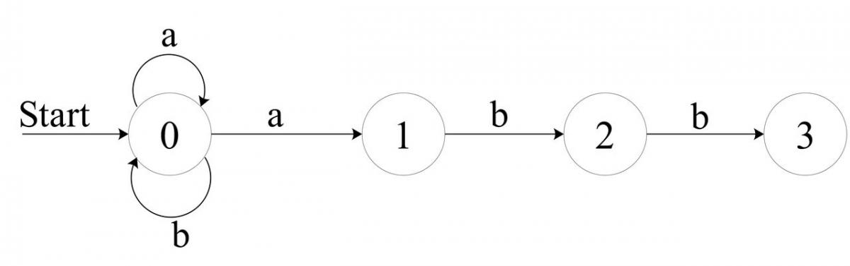
A word on regex implementation
Below is a state machine describing the regular expression /(a|b)*abb/. At any step, we can take an arrow if we match its target
Image from gamedev.net

Slide 13
A word on regex implementation
This regex matches aaabb and abaabb, but not baab, because we get ‘stuck’ in state 2.
Image from gamedev.net

Slide 14
sed
Usage: sed [OPTION]... {script-only-if-no-other-script} [input-file]...
Very powerful for one-liners, but somewhat esoteric commands
Common commands/flags:
s/match/replace/gi
g/match/p
Very powerful when combined with pipes

Slide 15
grep
$ grep --help | head -4
Usage: /usr/bin/grep [OPTION]... PATTERN [FILE]...
Search for PATTERN in each FILE or standard input.
PATTERN is, by default, a basic regular expression (BRE).
Example: /usr/bin/grep -i 'hello world' menu.h main.c
Named for sed mnemonic g/re/p
Useful flags: -A, -B, -C, -i, -I, -r, --include

Slide 16
vim
/match and ?match allow searching forwards/backwards for match (way better than hjkl navigation!)
:g/match/{Ex-cmd} will perform the specified operation (e.g. ‘d’ for delete, ‘y’ for yank) to matching lines
:s/match/replace/[gi] allows search and replace

Slide 17
Regex in Python
`re` module
Match objects are the return value
Replacement (there’s also `str.replace()`)
Pre-compiled regex if you use one frequently
Django use case: https://git.io/vMhVV

Slide 18
awk
gawk [ POSIX or GNU style options ] -f program-file [ -- ] file ...
Like sed, but less focused on stream edits
Allows lots of flow control, perform novel operations like arithmetic
Personally wrote my way around awful database at old employer, script still running!
Peter can tell us more!

Slide 19
What are regular expressions not useful for?
Prime number regex
Neat/gross abuse of lookaround, but not efficient
Parsing HTML*
* https://stackoverflow.com/questions/1732348/regex-match-open-tags-except-xhtml-self-contained-tags/1732454#1732454

Slide 20
Things I didn’t mention…
A couple different flavors with differences
i.e. POSIX has [:alpha:] and [:blank:], vim uses \a and \s for the same
Different implementations (e.g. \1 vs $1 for backreferences)

Slide 21
Things I didn’t mention…
Extensions give additional tools like lookaround, but these generally discard the regularity of the grammar
As a result, relying heavily on these can result in a much slower expression evaluation
An example: /q(?!u)/ will match any ‘q’ not followed by a ‘u’ (a feature called lookahead)

Slide 22
Useful resources
http://regexr.com/
https://github.com/aloisdg/awesome-regex
http://www.regular-expressions.info/
http://www.zytrax.com/tech/web/regex.htm
https://www.gnu.org/software/gawk/manual/
https://docs.python.org/3/library/re.html

Slide 23
Slightly less useful resources
https://swtch.com/~rsc/regexp/regexp1.html
https://www.gamedev.net/resources/_/technical/general-programming/finite-state-machines-and-regular-expressions-r3176

Slide 24
Thank you!

Slide 25
Feedback?

Slide 26
Backup Slides

