Slide 1

Computationally useful Python libraries: Numpy, SciPy, et al.
James Gerity
September 14, 2016
Slides available at http://www.github.com/jgerity/talks

Slide 2
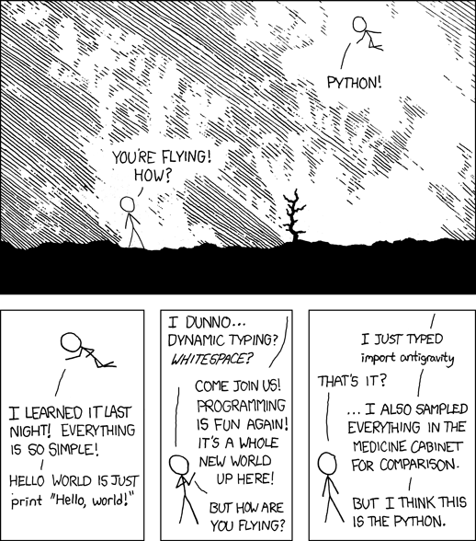
The power of Python modules
Image from http://xkcd.com/353 under CC BY-NC 2.5

Slide 3
Scope of this talk
We will not discuss plot/vis libraries here
matplotlib, bokeh, seaborn, plotly, ggplot, VTK
We will discuss libraries that make computational tasks easier.
There’s a lot more to cover than we have time for, so see the accompanying notes on GitHub

Slide 4
Built-ins
Some fairly self-explanatory ones:
random, math, time, argparse
Data wrangling:
csv, xml, json, re
Quality of life:
itertools, os, sys, glob, pickle, collections

Slide 5
Scipy
SciPy stack vs SciPy library
The stack is a collection of modules
The library is a set of numerical routines
The stack makes up a well-rounded target for basic scientific Python literacy

Slide 6
SciPy stack
http://www.scipy.org/stackspec.html
Python, Numpy, SciPy (library), Matplotlib, IPython, pandas, Sympy, nose

Slide 7
IPython/Jupyter (again)
IPython – more sophisticated interactivity
Jupyter – a “notebook” interface on top
You can try it: http://try.jupyter.org/
This is becoming a scientific Python norm, so it’s well worth learning now!
Demo notebook

Slide 8
Numpy
N-D arrays are the basic type in numpy
A little bit like MATLAB vectors
Every array has a static datatype, so it can map to fast-executing code elsewhere.
Often, a “different” version of an array (e.g. a slice) is actually a view of the same data.

Slide 9
Numpy
Crash-course intro to numpy, see numpy/numpy_intro.ipynb
Lots more info in official docs

Slide 10
Misc. Numpy tips
ndarray.shape - one-stop shop for info on what an array looks like
Arithmetic operations default to elementwise. I.e. A*B does not mean inner product! Use numpy.dot() instead.
Useful functions: arange, linspace, eye, ones, zeros

Slide 11
Misc. Numpy tips
Division by zero, inf, NaN…
Array slicing using numpy.where etc.
Saving/loading arrays to/from files

Slide 12
Misc. Numpy tips
Broadcasting allows for operations using arrays of different shape, if they are the same size along one axis.
Try: np.arange(0,5) * np.eye(10).reshape(20,5)
Good write-up of broadcasting: http://scipy.github.io/old-wiki/pages/EricsBroadcastingDoc

Slide 13
SciPy library
Where numpy is all about shuffling arrays…
“SciPy is a collection of mathematical algorithms and convenience functions built on the Numpy extension of Python.”

Slide 14
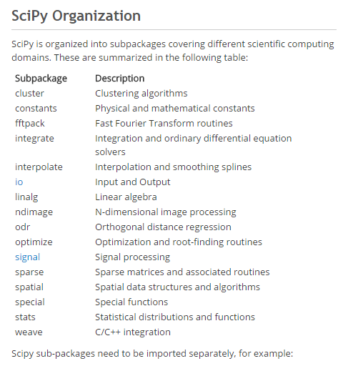
SciPy subpackages
tl;dr – there are a ton of them!
These are the ones we’ll talk about.

Slide 15
scipy.integrate
The integrate package has useful tools for simple numerical integration
See scipy/numerical_integration.ipynb

Slide 16
scipy.optimize
Multiple minimization algorithms
Fitting example from cookbook: see scipy/fitting_data.ipynb
Optimization is a very tricky subject, so be careful!
…but for common problems, this will do well
Non-linear solvers

Slide 17
scipy.signal
A variety of tools for splining and filtering of 1D/2D data
Chirp generation
Low/high/bandpass filters, see scipy/FIR_filter.ipynb
Also of interest is scipy.fftpack, which has (potentially slow!) FFT / DCT / DST transform implementations.

Slide 18
scipy.stats
Large number of available distributions for sampling random variables
Some statistical tests, methods
http://www.scipy-lectures.org/packages/statistics

Slide 19
SciPy library
Tons of examples in the cookbook:
http://scipy-cookbook.readthedocs.io/
Full documentation:
http://docs.scipy.org/doc/scipy-0.18.0/reference/

Slide 20

Pandas
PANDAS
Basic structure: data frame
Like R, but in Python!
Tutorial given at SciPy 2015
Some examples: pandas/*.ipynb
10 minutes to pandas: http://pandas.pydata.org/pandas-docs/version/0.18.1/10min.html

Slide 21
Astropy
!
I’M NOT AN ASTRONOMER
¯\_(ツ)_/¯
Astropy consists of a core package with common functionality:
units and constants
Juggling coordinate systems with multiple frames, units, etc. Seems to be mostly done with SkyCoord
Working with FITS files (astropy.io.fits)
Fitting/modeling routines (looks WIP)

Slide 22
Astropy
!
I’M NOT AN ASTRONOMER
¯\_(ツ)_/¯
There are also “affiliated” packages that provide additional functionality:
astroquery: convenience library for accessing online databases, e.g. Simbad, SDSS,…
ccdproc: for reducing raw CCD data
spectral_cube
halotools: tools for study/simulation of halos
…

Slide 23
Thank you!

Slide 24
Backup Slides

Slide 25
Stuff I haven’t gotten to…
h5py
SymPy / Sage
Nose
Profiling with cProfile etc.
Numba, Cython, writing ‘traditional’ languages using numpy/scipy

Slide 26
Numba
Going fast, but not a cure-all
JIT compilation
Numpy support
Vectorizing functions

