Slide 1

A whirlwind tour of

Slide 2
“big ideas”
Goal is to give you a roadmap, not a comprehensive understanding
setuptools User Guide is fantastic (if not thrilling) reading: https://setuptools.pypa.io/en/latest/userguide/index.html
setuptools is a tool for building distributable packages for Python software
Including metadata about dependencies, etc.
Can be used in imperative or declarative styles
Capable of building components written in not-Python

Slide 3
“small ideas”
setuptools is a tool that ‘eats’ metadata and spits out an installable package .whl or .tar.gz
setuptools is one tool among many

Slide 4
setuptools - overview
The setuptools user fills in two distinct types of information:
Project metadata
Build-time executable code

Slide 5
setuptools - overview
Two types of information:
Project metadata
setup() function in setup.py, OR static data in setup.cfg, pyproject.toml
The name of the distribution (what you pip install), version number, dependencies, license, etc.
Build-time executable code

Slide 6
setuptools - overview
Two types of information:
Project metadata
Build-time executable code
Does any number of things at (only) build time
Truly arbitrary! Powerful, but easy to write obscure things
Exclusively in setup.py or things run by it

Slide 7
setuptools - overview
Important note: once upon a time, users ran setup.py directly, e.g.
python3 setup.py install
python3 setup.py develop
New software SHOULD NOT do this!

Slide 8
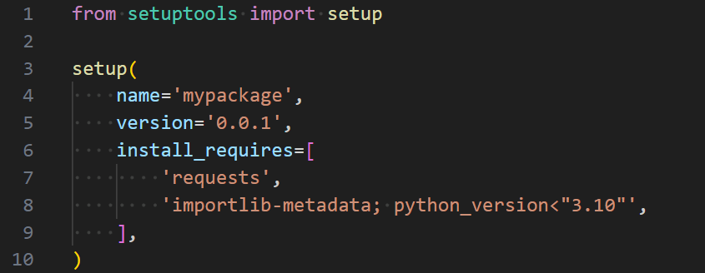
Anatomy of a setup.py

Slide 9
Anatomy of a setup.py
Fundamentally, this is a function call

Slide 10
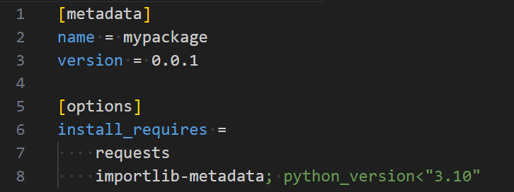
Anatomy of a setup.cfg

Slide 11
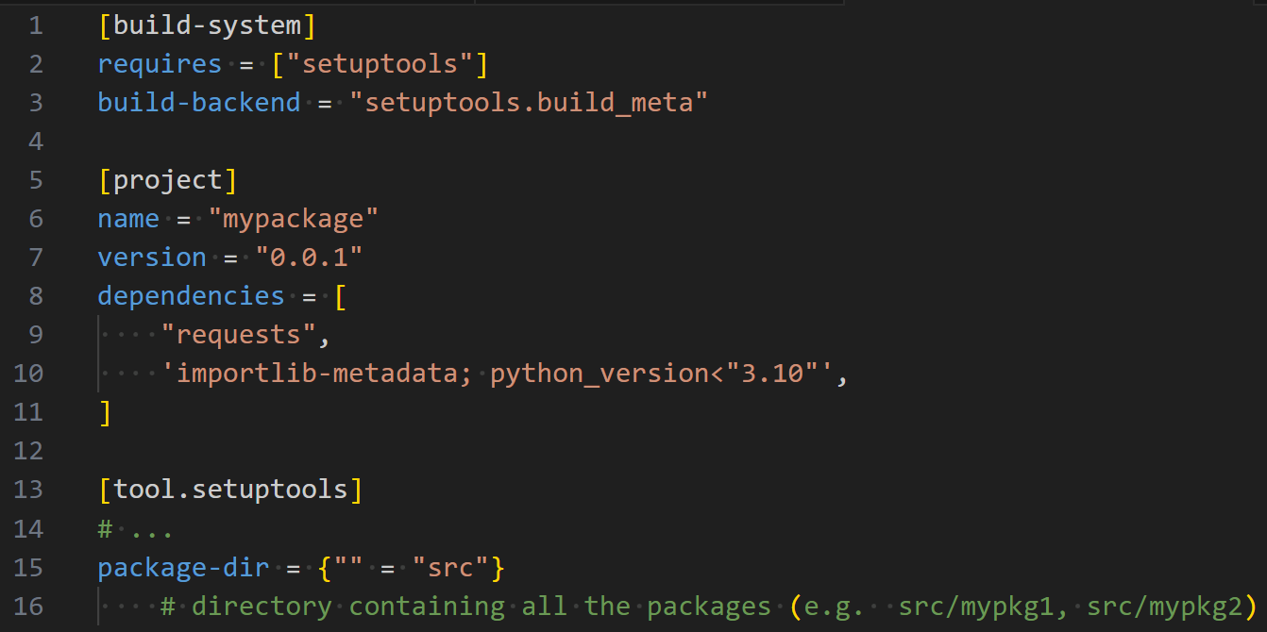
Anatomy of a pyproject.toml

Slide 12
Anatomy of a pyproject.toml
“This PEP 517 project uses setuptools”

Slide 13
Anatomy of a pyproject.toml
PEP 517 metadata (build system independent)

Slide 14
Anatomy of a pyproject.toml
setuptools-specific metadata

Slide 15
Anatomy of a pyproject.toml
Note: not plural!

Slide 16
setuptools metadata fields
The gimmes:
name, version, author, description, install_requires
Package discovery:
packages, package_dir, package_data
The weirdos:
cmdclass, ext_modules
https://setuptools.pypa.io/en/latest/references/keywords.html

Slide 17
Intermezzo:
why so many ways to do it?!

Slide 18
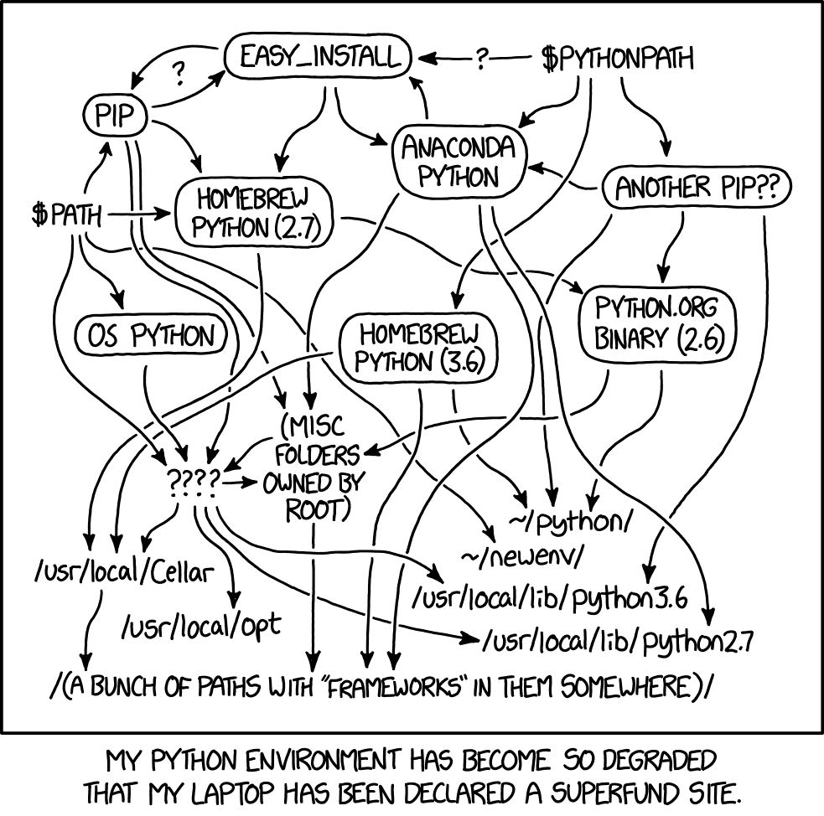
Comic by xkcd, used under the terms of CC-BY-NC 2.5
https://xkcd.com/1987/

Slide 19
A brief history of Python packaging
Ancient pre-history:
No formal concept of packaging!
A bunch of .py goes from [HERE] to [THERE]
What if we could formalize that 🤔

Slide 20
A brief history of Python packaging
distutils is born, quickly added to the stdlib
setup.py, setup.cfg come into existence here
The concept of a “distribution” formalizes “a bunch of .py”
But some problems are left unsolved, many of them about package metadata

Slide 21
A brief history of Python packaging
setuptools is born
Based on distutils, but substantially more capable
Package metadata!
Extension modules! (i.e. written in not-Python)
Not part of stdlib, but this allows it to move quickly
Eventually, it even absorbed distutils

Slide 22
A brief history of Python packaging
Concurrently, tools for ‘installing’ and otherwise juggling distributions also come into existence
easy_install
wheel
pip
These influence and are influenced by setuptools

Slide 23
A brief history of Python packaging
For a ‘long’ time, setuptools is the way things get done
Desire for some more flexibility leads to PEP 517/518
Formal division between building distributions (“build backend”) and installing them (“integration frontend”)
setuptools is compatible with the modern way, it is not obsolete as is often claimed
“Reports of my death are greatly exaggerated” - setuptools

Slide 24
A taste of advanced setuptools

Slide 25
Advanced setuptools
Loading requirements from a file
https://github.com/nedbat/scriv/blob/603f8e760ca4a2ab6011c02f3b5cc6dcaaf8c7dc/setup.py#L72

Slide 26
Advanced setuptools
Building an extension module
https://git.snoopj.dev/SnoopJ/unicodedata2/src/commit/a7ef92c6dbffb5a3bfe198156e5a924d476880eb/setup.py#L21-L25

Slide 27
Advanced setuptools
Custom cmdclass
https://github.com/numpy/numpy/blob/4adc87dff15a247e417d50f10cc4def8e1c17a03/setup.py#L389

Slide 28
Thank you!
Questions?

