Slide 1


A cooling storage ring for an electron-ion collider
James Gerity, Peter McIntyre
Texas APS Section Meeting, October 30, 2015
Slides available at http://www.github.com/jgerity/talks

Slide 2
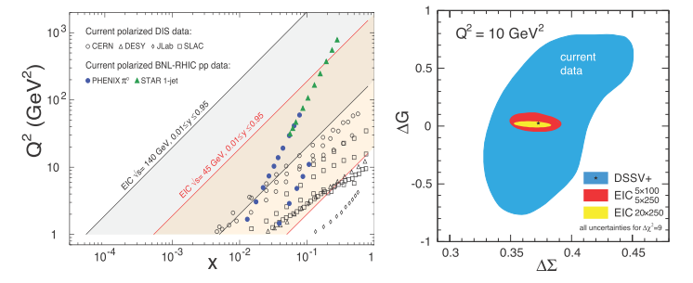
Why an EIC?
An EIC would provide a powerful probe of unexplored regions of nuclear parameters
Accessible $Q^{2}$ with different parameter regimes
Uncertainties on gluon and quark helicity contributions to the proton spin
Figure from 2014 community whitepaper “Electron Ion Collider: The Next QCD Frontier” (arXiv:1212.1701)

Slide 3
Questions to be answered
How are the sea quarks and gluons, and their spins, distributed in space and momentum inside the nucleon?
Where does the saturation of gluon densities set in?
How does the nuclear environment aﬀect the distribution of quarks and gluons and their interactions in nuclei?
See 2014 community whitepaper “Electron Ion Collider: The Next QCD Frontier” (arXiv:1212.1701)

Slide 4
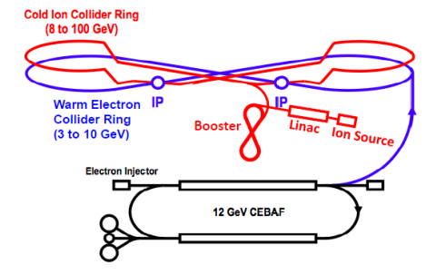
What is MEIC?
The Medium-energy Electron-Ion Collider is Jefferson Lab’s EIC design
Fig. 8 geometry preserves spin polarization naturally
Figure from 2014 community whitepaper “Electron Ion Collider: The Next QCD Frontier” (arXiv:1212.1701)

Slide 5
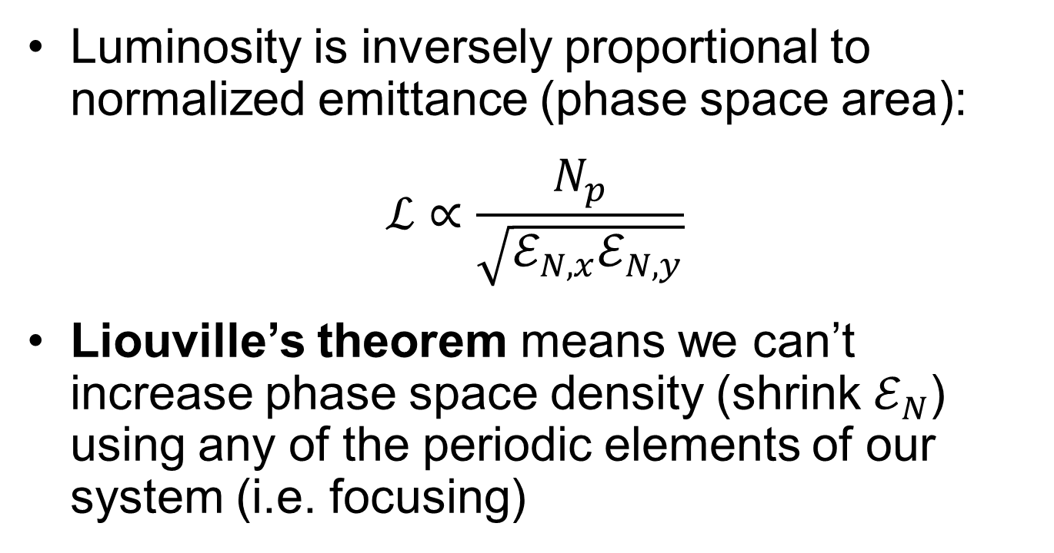
Electron cooling
Luminosity is inversely proportional to normalized emittance (phase space area):
$$ℒ∝\frac{N_{p}}{\sqrt{ℰ_{N,x}ℰ_{N,y}}}$$
Liouville’s theorem means we can’t increase phase space density (shrink $ℰ_{N}$) using any of the periodic elements of our system (i.e. focusing)

Slide 6
Electron cooling
In any accelerator, our beam of particles has a finite velocity spread.
Ion beam seen from stationary (lab) frame

Slide 7
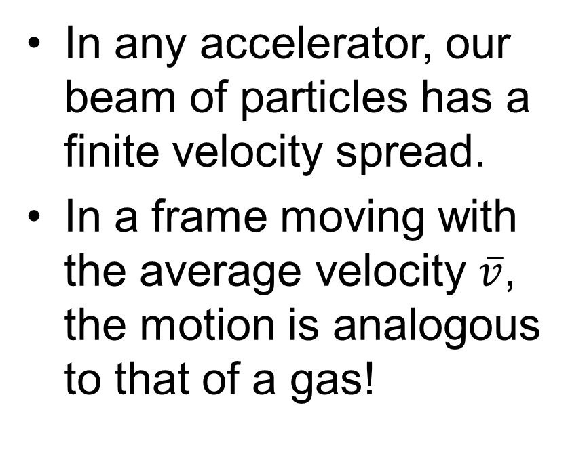
Electron cooling
In any accelerator, our beam of particles has a finite velocity spread.
In a frame moving with the average velocity $\overline{v}$, the motion is analogous to that of a gas!
Ion beam seen from moving frame

Slide 8
Electron cooling
How to cool a gas? Mix with a colder one!
Coulomb collision with ‘cold’ electrons drives velocity profiles to equilibrium
Ion beam seen from stationary (lab) frame
Ion beam seen from moving frame, with electrons

Slide 9
Cooling ring motivation
Existing EIC concepts rely on cooling for performance, but…
The cooling strategies employed are heavy R&D subjects!
Energy recovery & circulator @ MEIC
Coherent cooling @ eRHIC
Can more conventional cooling help offset the technical risk?

Slide 10
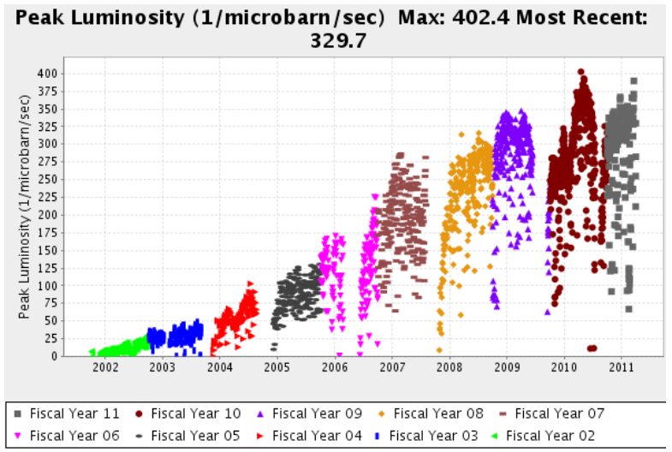
Cooling ring motivation
From FY’02 to FY’11, Tevatron peak luminosity was increased by an order of magnitude
Cooling and stacking of beam in the Recycler was essential to this success

Slide 11
Motivation for a dedicated cooling ring
Marginal cost can be achieved with low-field magnets, use of existing space
Low risk in terms of R&D; extends current technology directly
Augments existing approach, works together with ERL

Slide 12
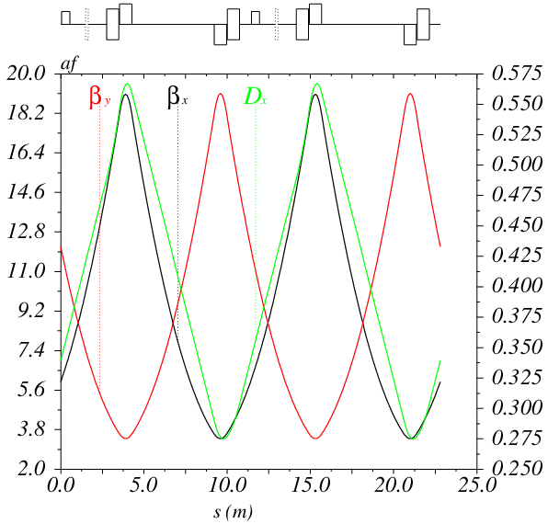
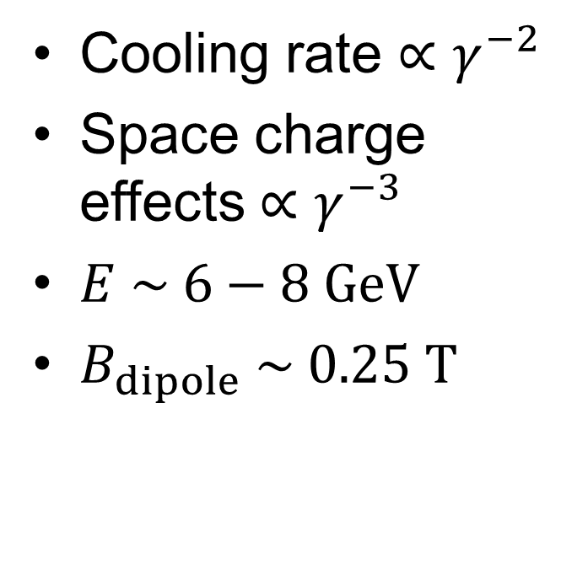


Cooling ring parameters and optics
Cooling rate $∝γ^{−2}$
Space charge effects $∝γ^{−3}$
$E \sim 6−8 GeV$
$B_{dipole} \sim 0.25 T$
$$β_{x,y} (m)$$
$$D (m)$$

Slide 13
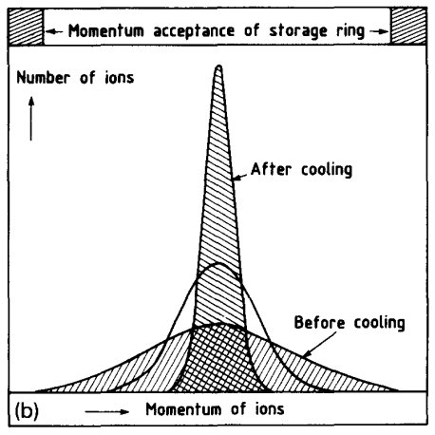
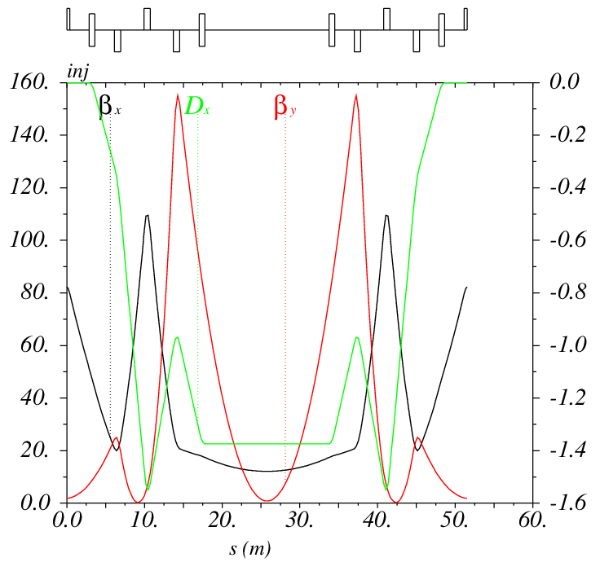


Stacking and injection optics
$$β_{x,y} (m)$$
$$D (m)$$
Figure from H. Poth, Electron cooling: Theory, experiment, application, Physics Reports, 196 (1990) 135-297.
Dispersive insertion, allowing side-by-side injection of new beam

Slide 14
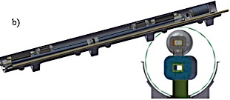
Cooling ring
There is unallocated space in the existing cryostat layout for this additional ring
Cooling ring
Common cryostat
Collision ring

Slide 15
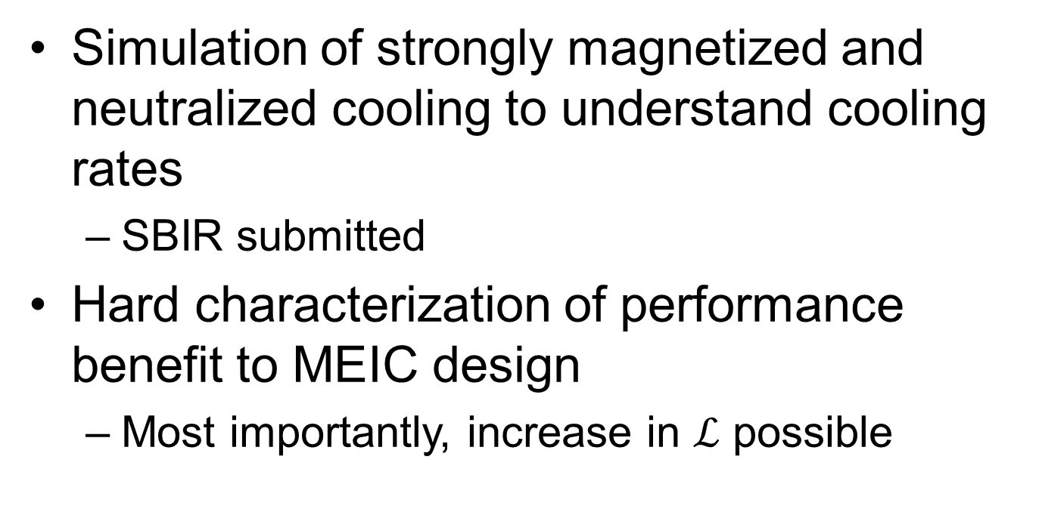
Future Work
Simulation of strongly magnetized and neutralized cooling to understand cooling rates
SBIR submitted
Hard characterization of performance benefit to MEIC design
Most importantly, increase in $ℒ$ possible

Slide 16

Thank you!

Slide 17
Backup slides

Slide 18
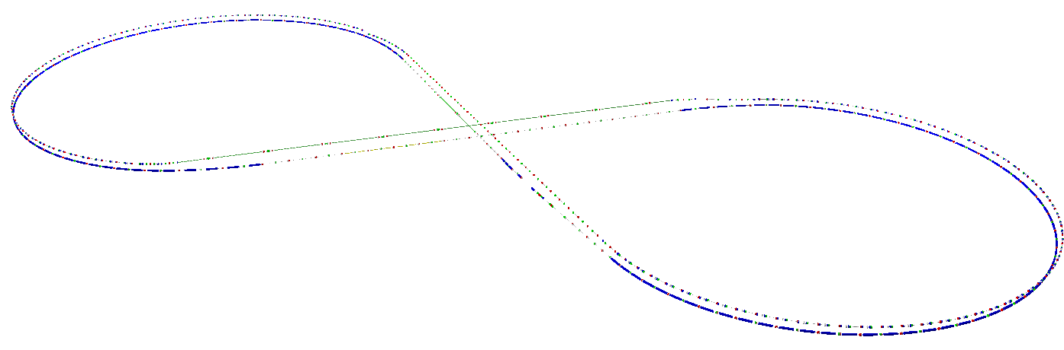
Cooling ring
Collision ring

Slide 19
Ion source
Booster ring
Storage ring
Collision ring
Physics
Electron cooling
Accumulation
Dump old beam

Slide 20
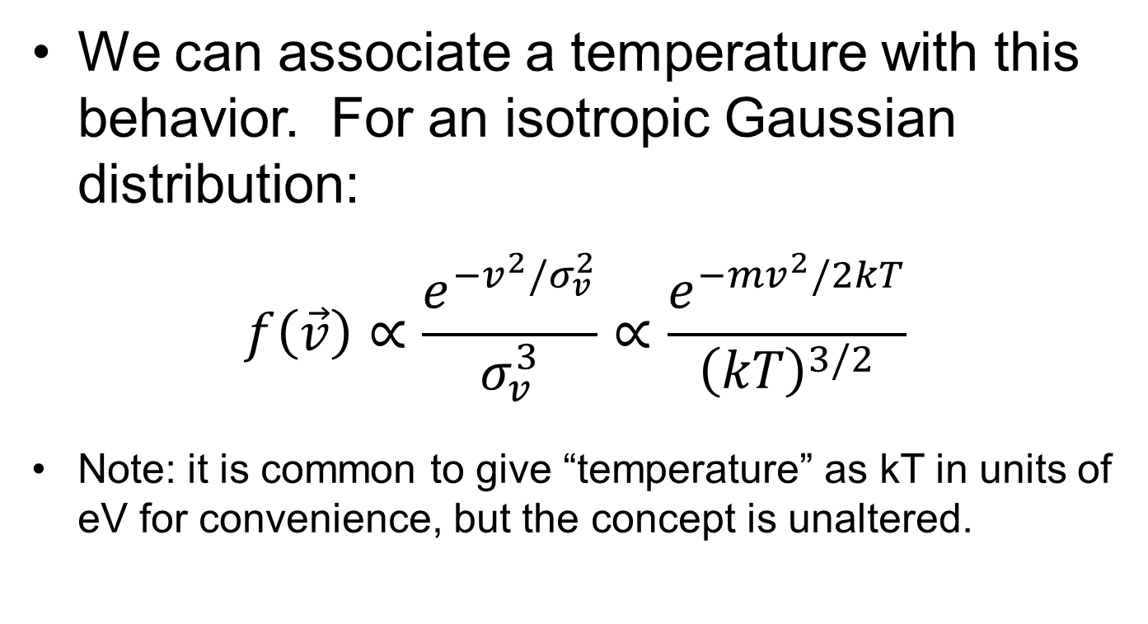
Electron cooling
We can associate a temperature with this behavior. For an isotropic Gaussian distribution:
$$f\left(\vec{v}\right)∝\frac{e^{−v^{2}/σ_{v}^{2}}}{σ_{v}^{3}}∝\frac{e^{−mv^{2}/2kT}}{{\left(kT\right)}^{3/2}}$$
Note: it is common to give “temperature” as kT in units of eV for convenience, but the concept is unaltered.

Slide 21
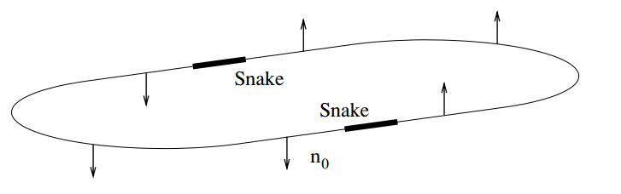
Figure from “Siberian Snakes in high-energy accelerators” Mane et. al (2005) http://dx.doi.org/10.1088/0954-3899/31/9/R01

