Slide 1

High Performance Computing: Concepts and Best Practices
James Gerity
August 12, 2016
Slides available at http://www.github.com/jgerity/talks

Slide 2
What is HPC?
High performance computing (HPC) is a catch-all term for computing at greater scales than what is realized by a typical workstation.
Some problems would require tens of thousands of hours (or years!) on a single machine
With more computing power and memory, perhaps we can do better.

Slide 3
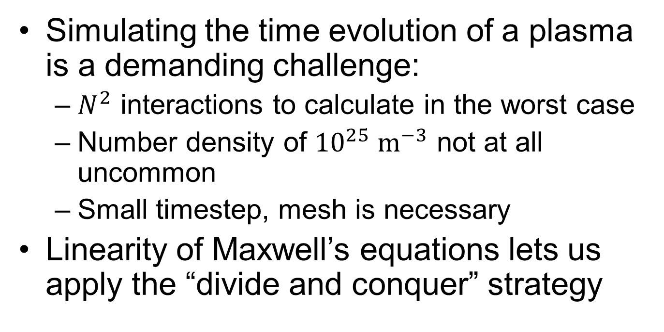
Example problem: Particle-in-cell
Simulating the time evolution of a plasma is a demanding challenge:
$N^{2}$ interactions to calculate in the worst case
Number density of ${10}^{25} {\text{m}}^{−3}$ not at all uncommon
Small timestep, mesh is necessary
Linearity of Maxwell’s equations lets us apply the “divide and conquer” strategy

Slide 4
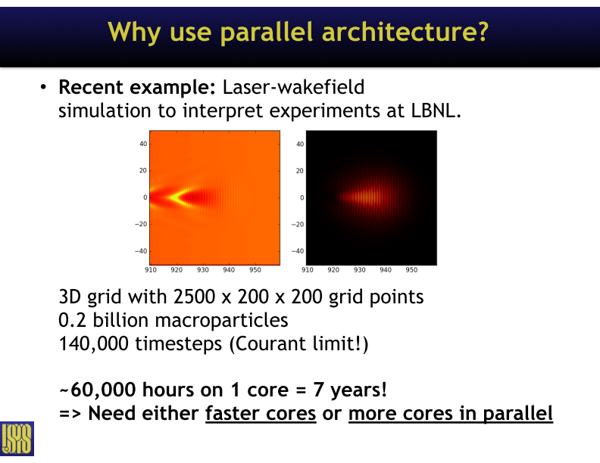
Slide courtesy of Remi Lehe

Slide 5
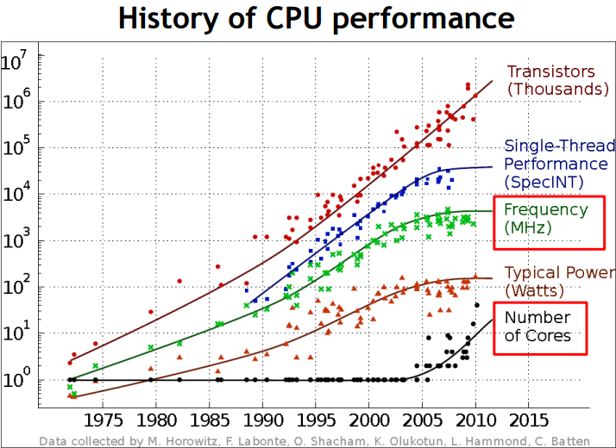
Can we just wait on faster processors?

Slide 6
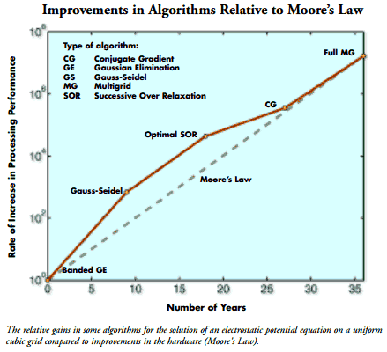
What problems does HPC not solve?
If the problem requires sharing information between CPUs, we have to communicate, which is slow!
Better algorithms yield more gain than Moore’s Law does
From 2005 report “Computational Science: Ensuring America's Competitiveness”

Slide 7
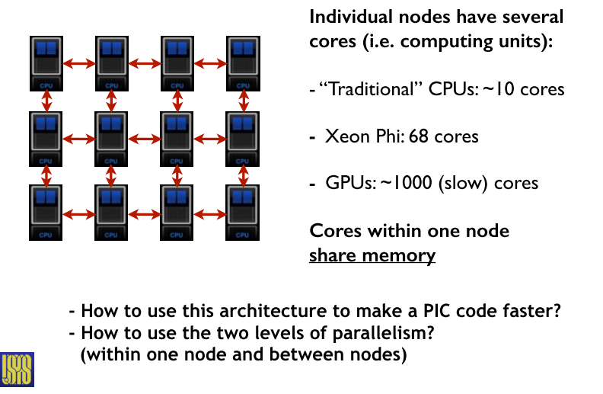
What is a cluster?
Slide courtesy of Remi Lehe

Slide 8
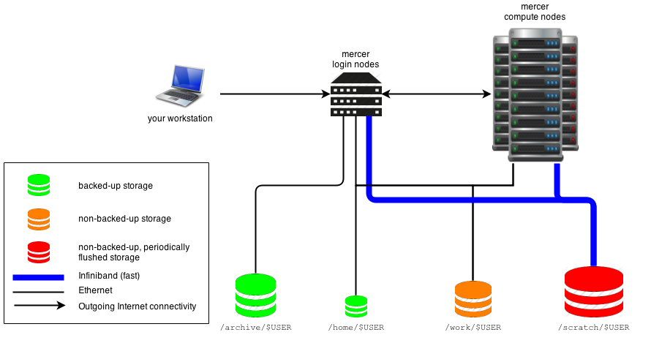
What is a cluster?
Image modified from https://wikis.nyu.edu/display/NYUHPC/High+Performance+Computing+at+NYU

Slide 9
Cluster layout
Login nodes
Main form of user interaction with the system
Allows some development, as well as submitting jobs
Compute/worker nodes
Computational work done here, generally less aware of the broad view of how a job is split up.

Slide 10
Cluster layout
Storage
At large machines, usually have separate facilities that can be accessed from many places
Networked file systems like AFS, NFS
Important to understand what is available to compute nodes and how fast it is
If you bottleneck at filesystem I/O, potentially several orders of magnitude slower!

Slide 11
Schedulers
From the login node, jobs are submitted to a scheduler, software that handles the logistics of balancing many jobs from different users across nodes.
Knowing the ins and outs of the scheduler you’re using is an absolute must!
Examples of schedulers: SLURM, TORQUE, HTCondor

Slide 12
How not to be “that jerk” on a shared system
It is your responsibility to know the local machine’s policy. Read the MOTD and the documentation!
Make sensible resource requests – does your job actually benefit from tying up several nodes? Benchmark it first!

Slide 13
How not to be “that jerk” on a shared system
Don’t use the login node for heavy computational work!
Best case scenario, you waste your own time
Worst case scenario, you crash the login node and waste everybody’s time
Ideally, develop locally and understand how things scale, so there aren’t surprises when you go to bigger jobs.

Slide 14
How not to be “that jerk” on a shared system
Some remarks c/o Alexx Perloff:
World-wide LHC Computing Grid (WLCG): This is a complicated beast, but we make use of it through a system called CRAB (CMS Remote Analysis Builder).
There is an assumption that you will be submitting a certain type of job (I.e. Single core not requiring memory over 1.9 GB, and a job that won’t last more than 48 hours). Beyond that there is a priority that takes things into account similar to the LPC computing cluster, but it also takes into account where your requested data is, where the stage-in and stage-out are coming from, how many jobs are running on a particular cluster and how many open slots it has.
Basically it is a world-wide balancing act across >100 computing clusters of various locations, sizes, throughput, and architecture.
The value of understanding the “right” way to submit jobs on a system like this cannot be overstated!

Slide 15
MPI
Message Passing Interface (MPI) is a standardized and portable message-passing system
Run MPI-aware program with “mpiexec” command and –np flag for number of processes to use
Tasks can be divided among processes of different “rank,” with a communication framework for exchanging information.

Slide 16
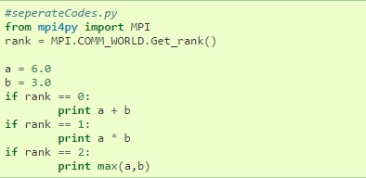
A simple MPI example in Python

Slide 17
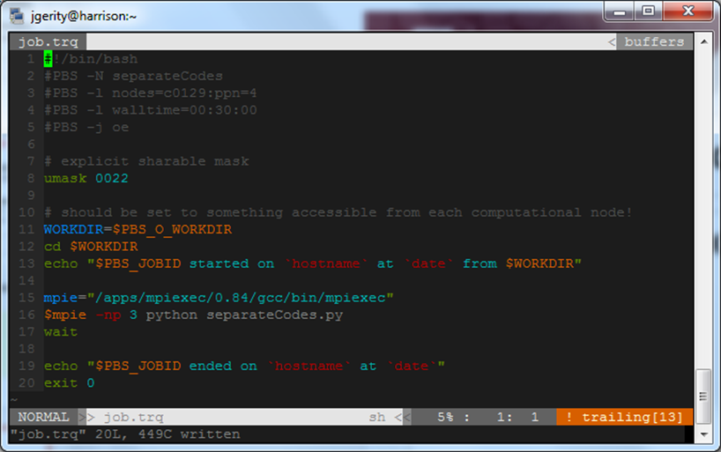
A simple MPI example in Python

Slide 18
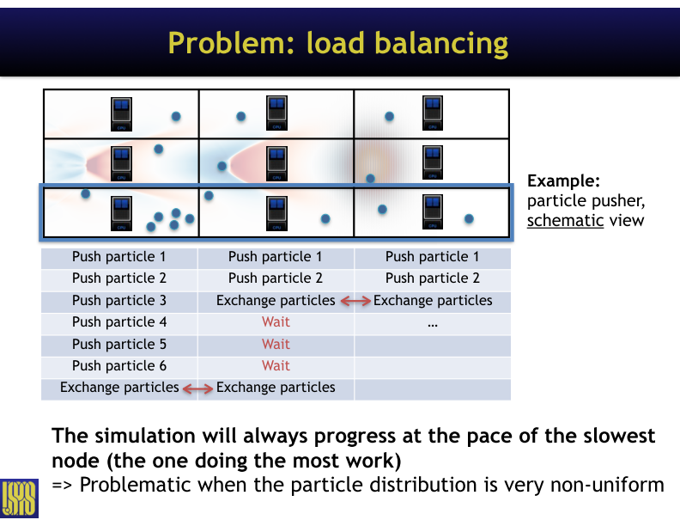
MPI
Slide courtesy of Remi Lehe

Slide 19
OpenMP
“OpenMP Application Program Interface (API) is a portable, scalable model that gives parallel programmers a simple and flexible interface for developing portable parallel applications. OpenMP supports multi-platform shared-memory parallel programming in C/C++ and Fortran on all architectures”

Slide 20
OpenMP
OpenMP allows separate threads to operate as fast as they can…
…BUT introduces the possibility of a race condition in some cases

Slide 21
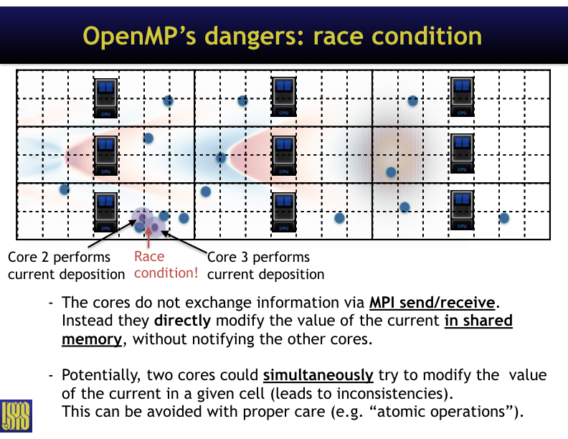
Slide courtesy of Remi Lehe

Slide 22
GPGPU
A video card, more generally known as a graphics processing unit (GPU), is a collection of many processors that share memory.
Designed with computer graphics in mind, but there is substantial overlap with non-graphics computation!
Increasingly common to utilize this hardware for computation (future topic, maybe…)

Slide 23
We have a small computational cluster!
The 20 iMac workstations in MPHY 330 are networked in an HTCondor cluster, giving you access to 20 i5 quad-cores and 80 GB of RAM!
Some more information available from https://csg.physics.tamu.edu/docs/condor/

Slide 24
Interactive Condor computing session
Let’s log into the Condor cluster.
Use your ssh client to log into metis.physics.tamu.edu with your department credentials
On Mac/Linux:
ssh username@metis.physics.tamu.edu
On Windows:
Use a terminal emulator like PuTTY

Slide 25
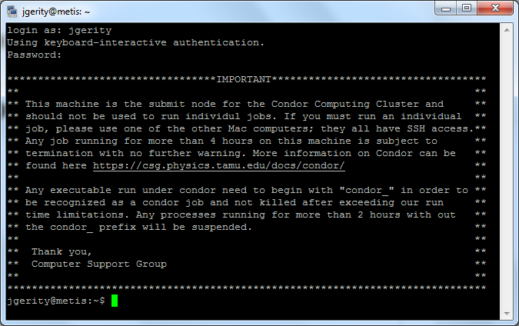
Interactive Condor computing session

Slide 26
Submitting Condor jobs
To run a job on metis, follow the CSG instructions:
Create a working directory called Condor in your home directory
Create a job file describing your task. See fourier.job for an example
Submit the job using the condor_submit command

Slide 27
Thank you!

