Slide 1

Introduction to Python
James Gerity
August 25, 2016
Slides available at http://www.github.com/jgerity/talks

Slide 2
What is Python
Interpreter vs compiler
Speed difference!
Strong vs weak typing
Object oriented
What it’s for
What it’s not for

Slide 3
Misc talking points
Rich ecosystem
Scientifically important: numpy/scipy, astropy, matplotlib, pandas, hdf5
Generally, there’s an existing library for any task that is “common enough”
Anaconda, pip, and containers for environment management
REPL (ROOT analogy)
Ipython/Jupyter
Specifically mention Markdown (and pandoc), draw analogy to Mathematica

Slide 4
Three Short Python Programs
Hello World
`python –c ‘print(“Hello world!”)’`
Counting to 100 or somesuch
For loop, arithmetic operations, maybe even lists
Something with a defined method and keyword arguments

Slide 5
Three Longer Python Programs
Determining last Friday’s date
https://git.io/v6bXt
Parsing and plotting data from a CSV
https://git.io/v6bXf
Brownian motion
http://scipy-cookbook.readthedocs.io/items/BrownianMotion.html

Slide 6
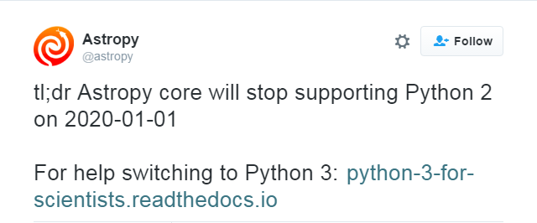
Python 2 vs Python 3
Integer division
Print function
Importing from __future__

Slide 7
Useful resources
Learn Python the Hard Way - https://learnpythonthehardway.org/book/
Think Python – a free textbook on Python http://greenteapress.com/wp/think-python/
Scipy lectures https://scipy-lectures.github.io/

Slide 8
Thank you!

Slide 9
Backup Slides

