Slide 1

Plotting in Python
James Gerity
September 29, 2016
Slides available at http://www.github.com/jgerity/talks

Slide 2
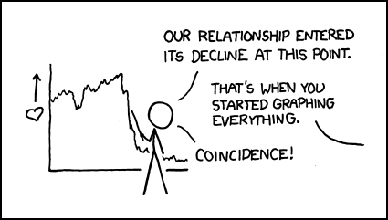
Scope of this talk
matplotlib, seaborn, Bokeh, ggplot
Image from https://xkcd.com/523/ under CC BY-NC 2.5

Slide 3
A brief rant on colormaps
Colormap matters! A poor choice can…
…create perceptual artifacts in data
…be a nightmare to print (→ grayscale conv!)
…screw with colorblind readers
…most importantly, be ugly

Slide 4
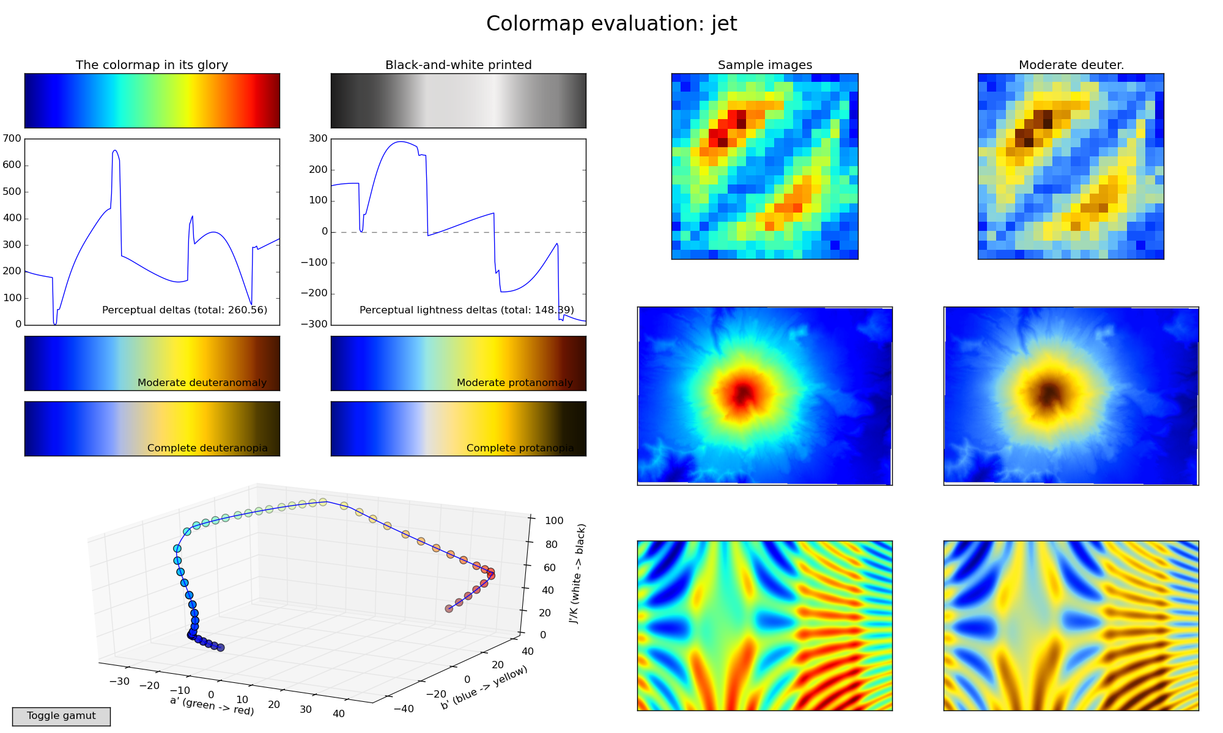
A “bad” choice: Jet
Figure from https://bids.github.io/colormap/

Slide 5
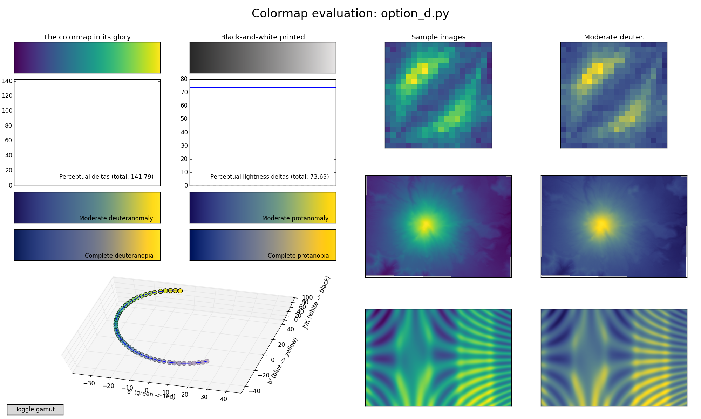
A “good” choice: Viridis
Figure from https://bids.github.io/colormap/

Slide 6
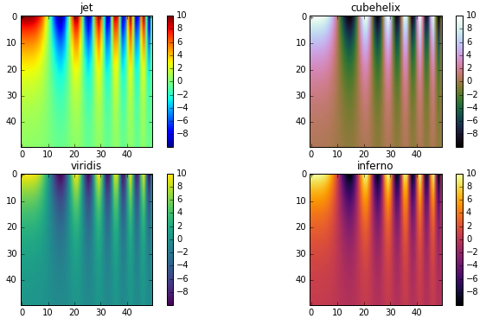
Also “good”: cubehelix, inferno
Figure adapted from http://jakevdp.github.io/blog/2014/10/16/how-bad-is-your-colormap/

Slide 7
matplotlib
Module structure:
matplotlib top-level: graphics backend control, default parameters
pyplot: MATLAB-like plotting framework and probably already your BFF
cm: predefined colormaps and tools for making your own
…and lots of minutiae

Slide 8
matplotlib
Imperative vs declarative graphics
Inline magic for IPython
Gridspec trickery: http://matplotlib.org/users/gridspec.html

Slide 9
Anatomy of a matplotlib figure
…in the form of a matplotlib figure!
See anatomy_of_matplotlib_figure.ipynb

Slide 10
matplotlib examples
histogram
imshow/contour
Swag examples, including annotation (LaTeX callout)
Strings support LaTeX with $, and Python’s string formatting is a powerful tool

Slide 11
A very pretty example…
Apparently, SciPy has a plotting contest each year! I highly recommend a look!
One example from 2014
http://gregj.net/JHEPC/

Slide 12
seaborn
At minimum: nicer styling than matplotlib defaults…
At best: save yourself from reinventing the same wheel over and over and over…
Heatmap, joint plot
See seaborn.ipynb for a whirlwind tour

Slide 13
bokeh
Interactive graphs for the web
With server backend, can produce very sophisticated interactions
But even without, can provide nice dataset exploration tools

Slide 14
Other libraries of interest
ggplot, mpld3, datashader

Slide 15
Thank you!

Slide 16
Backup Slides

