Slide 1

Computing Skills for Grad School
James Gerity
August 17, 2017
Slides available at http://www.github.com/jgerity/talks

Slide 2
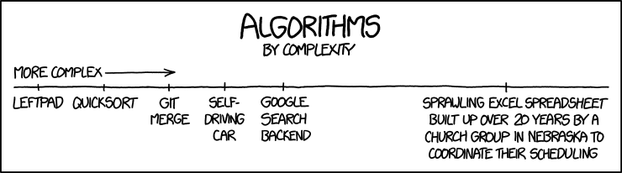

Slide 3
Scope of this talk
More things to say than will fit in this talk, see the list of notes and reading material online.
And ask questions!
Programming is most rewarding as an auto-didactic process!

Slide 4
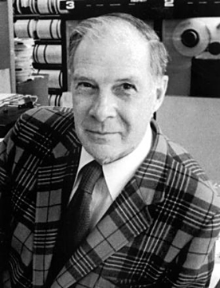
Computing’s purpose in science
“The purpose of computation is insight, not numbers” – Richard Hamming
By the way, intellectual property matters!
Image from Bell Labs courtesy Wikipedia under fair use
https://en.wikipedia.org/w/index.php?curid=40177109

Slide 5
Computing’s purpose in science
“Reproducibility and replication of studies are essential for the progress of science…The truth is computational science and engineering lacks an accepted standard of evidence.”
O. Mesnard and L. Barba, 2016 (arXiv:1605.04339)
The onus falls on you, the researcher!

Slide 6
The “fluffy” stuff
At the very least: keep an orderly house
Version control software like git
(https://git-scm.com)
Remember Murphy’s Law and make backups (and test your recovery strategy)
Documentation matters: the poor sot who has to read your code in 6 months? It’s you.

Slide 7
The other stuff
Most useful skills are agnostic of any specific programming language.
Flow control
Conditional statements (if-then-else), loops (for, while)
Data types
Floating point numbers, how to know when precision is an issue (spoiler: always)

Slide 8
The other stuff
Asymptotic complexity, how to profile code
I have seen so many hours wasted (many my own) optimizing code that wasn’t slow.

Slide 9
Computing workgroup
Blah blah come learn and teach
Things we’ve discussed
Python, plotting
Regex
HPC
CLI skills

Slide 10
Useful resources
Scipy lectures https://scipy-lectures.github.io/
A long list of other resources available on GitHub, along with this presentation: https://github.com/jgerity/talks

Slide 11
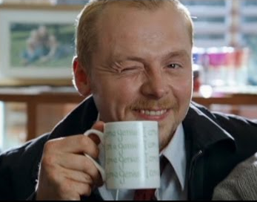
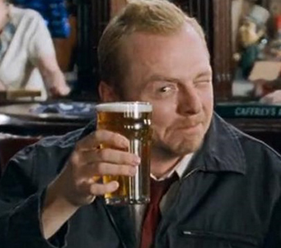
Liquid Physics
M | Tu | W | Th | F
Each Friday at 5:30 PM, look for the email!

Slide 12
Thank you!

Slide 13
Backup Slides

